Slide 1
FUND Uzerzoom Testing Wireframe – Applying for Green Jobs
Feb 15th 2021
Martin Kerr

Slide 2
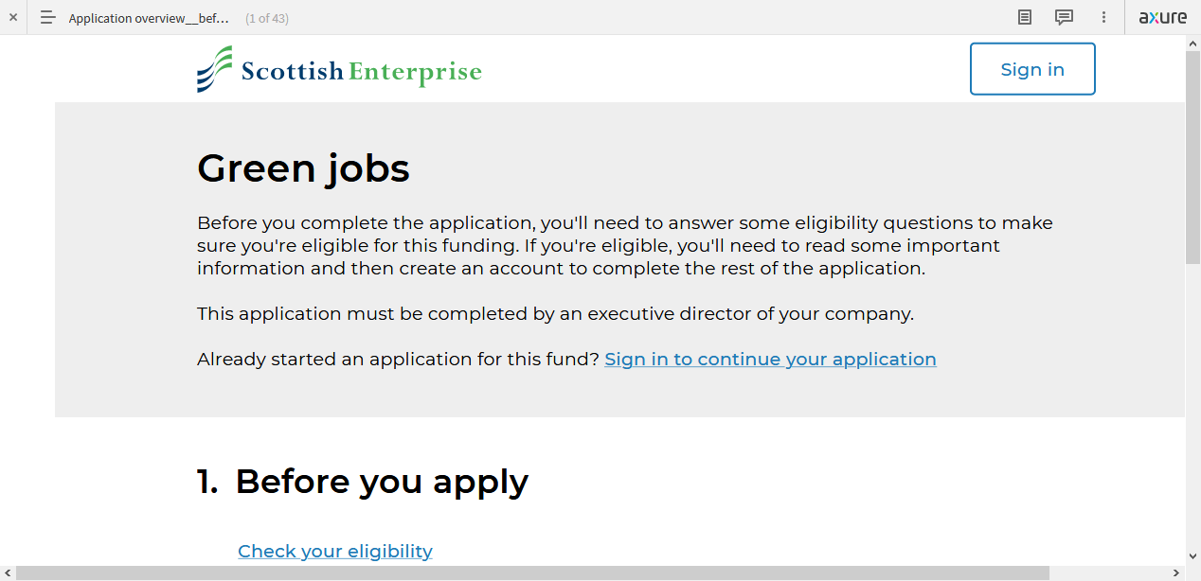
What we tested
We tested the latest FUND wireframe https://4jd442.axshare.com/

Slide 3
Who we tested with
We tested:
20 members of the UserZoom panel
Screened for
Business Owners
Business Decisions Makers
Accountants
Financial Advisors
Online Unmoderated Online Testing

Slide 4
Results Summary
De-Minimis is still an obscure term to most
Driving License & Passport were accepted as Personal Photo ID BUT There were concerns around data security and also implied personal liability
Evidence Requirements could still be clearer

Slide 5
Q1: Personal ID
We gave a long list of popular personal ID documents The preferred options for use in online applications was
Driving License, Photo (14 of 20)
Utility Bill (11 of 20)
Passport, Photo (10 of 20)
Bank Statement (9 of 20)

Slide 6
Q2: De-minimis
Nobody knows what this is.
The description on the site did not help

Slide 7
Q3: Help text
Most people did not notice the help text
Most that did see it, thought it was fine.
A couple of people wanted more detail

Slide 8
Q4: Evidence requirements
On people thinking Evidence Requirements were obvious and clear, it was about:
no: 40%
yes: 60%

Slide 9
Q5: Eligibility Requirements
Eligibility requirements clarity rated:
71% positive

Slide 10
Q6: De-minimis
Even after using the wireframe, people do not know what De-Minimis is in a business context.
Googling it will give you a Latin translation “about minimal things”

Slide 11
Q7: Passport or Driving License scan
People are 40/60 (66% positive) on this being OK.
Most people are used to using these documents for personal uses and have no problem with that.
The unease crept in from two areas:
“This links me Personally to the business. Does this mean liability” etc…
Is my data secure

Slide 12
fin

