Slide 1
FUND Application Wireframe Testing
Feb 16^{th &} 18st 2021
Martin Kerr
Anubhav Mittal
Lorna Hayton
Katie Dickerson

Slide 2
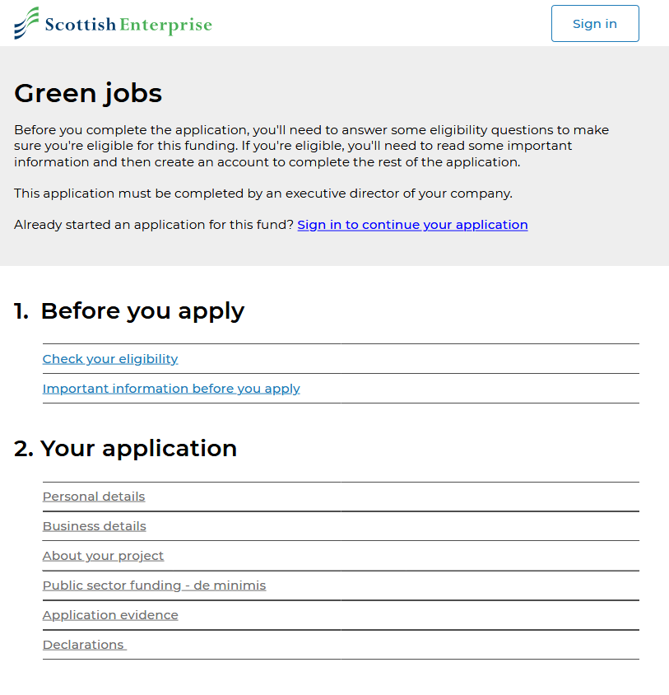
What we tested
We tested the latest wireframe prototype of: applying for Green Jobs Funding
https://4jd442.axshare.com

Slide 3
Who we tested with
We tested:
6 potential customers
SME’s
Using Video calls (Microsoft Teams)

Slide 4
Results Summary
De Minimis is still an unhelpful term
De Minimis is not mentioned in the eligibility section, even though it is an “absolute requirement”
Customers needs to be told in advance, what information documents & evidence will be “needed to successfully complete the application”, to avoid unpleasant surprises
Private documents make people nervous about security and liability
Business Plan’s are referenced confusingly (Repeatedly and with/without a template).

Slide 5
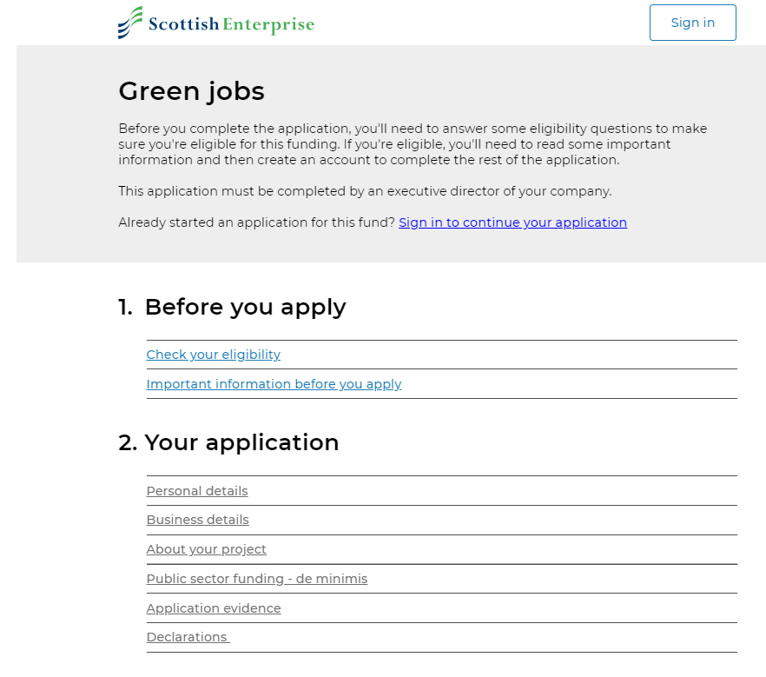
Starting the application
Makes sense
Clean and Clear
BUT
COMPLETED was not understood as SAVED
De-Minimis should be earlier as it is a potential show stopper. Should it be in Eligibility.
And nobody knows what De-Minimis is

Slide 6
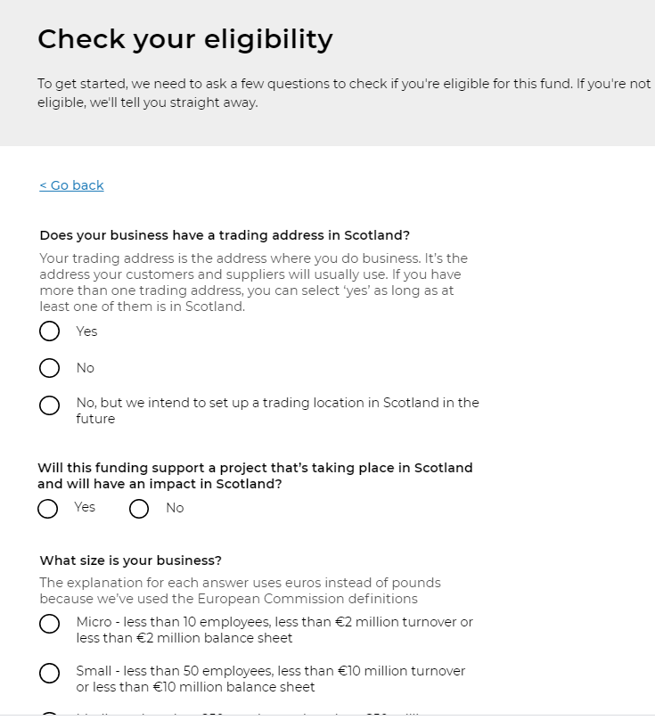
Eligibility
Nice and Clear
Questions make sense
BUT
The term Tax Haven surprised one Finance Director, who said he “would not expect to see such an emotive term on a Government Website”. It made him suspect the site.
De-Minimis is not mentioned here

Slide 7
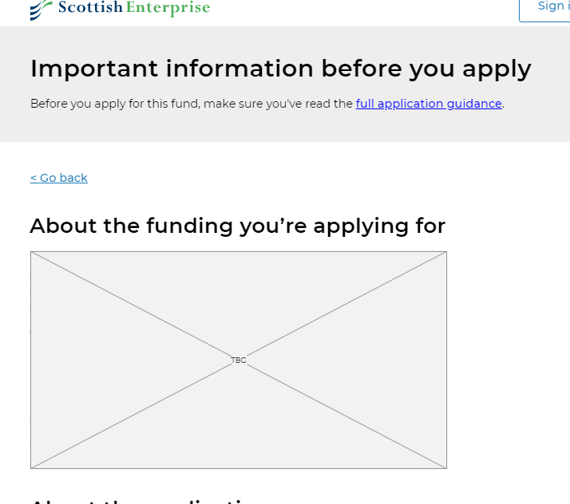
Before you apply
Some customers wanted the linked “Full application Guidance”, to be part of the page content

Slide 8
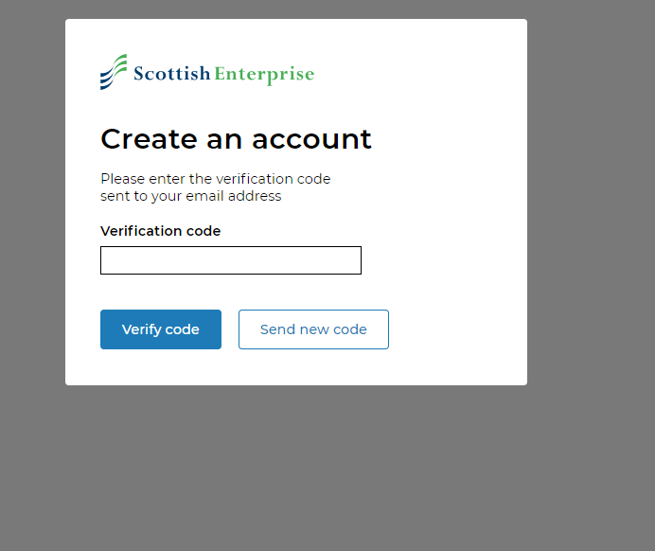
Create an Account
Fairly low friction ☺
Some people would expect this code via Mobile Phone

Slide 9
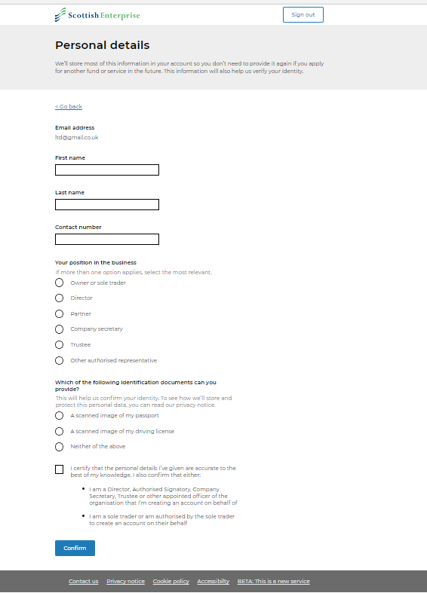
Personal Details
“Scanned passport & driving license” were understood and supported as Personal Photo ID
Driving License was the more popular choice.
BUT
People expressed concerns of data privacy/security
They were also concerned about any perceived Personal Liability that using Personal Documents suggests

Slide 10
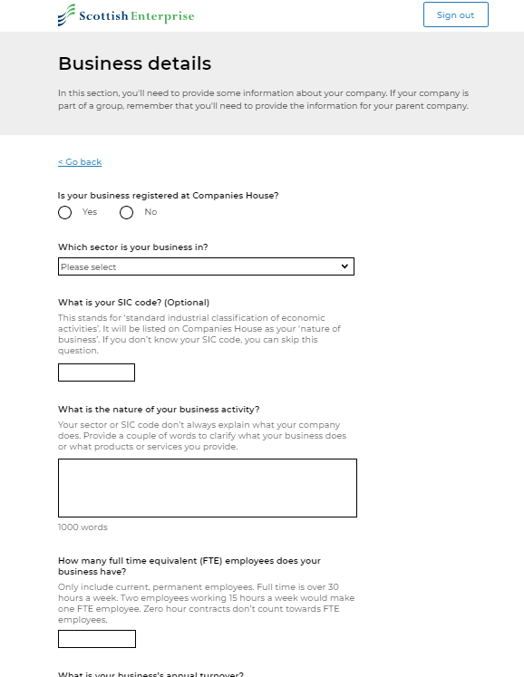
Business Details
It would be handy to know that having SIC code would be helpful (Evidence Requirements)
1000 Word limit on Text Box’s also suggests that you have to write “A Lot”

Slide 11
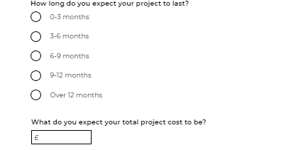
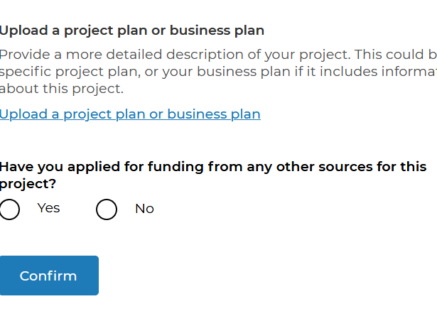
About your Project
“Project Cost” was viewed as a vague term
Users were surprised that they needed to provide a business/project plan at short notice (Evidence Requirements)
1000 words…

Slide 12
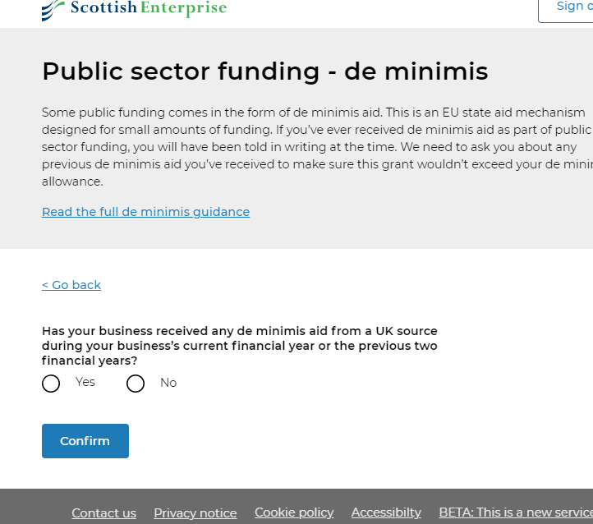
De Minimis
Nobody knows what this is
It is not mentioned in the Eligibility Requirements (i.e. don’t proceed if you are at your limit)
The descriptive text is not in user friendly language
The term itself might not be the best way into this section (Have you reached your State Aid Limits…)

Slide 13
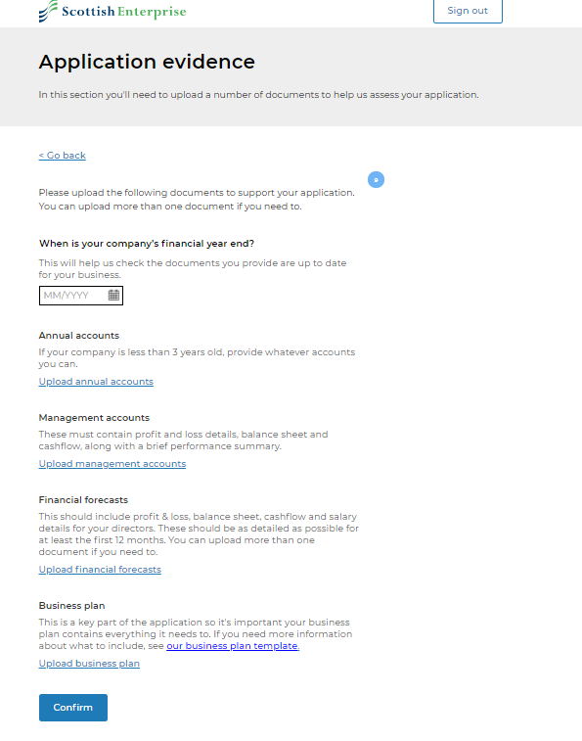
Evidence
Security concerns were expressed around this sensitive information. “If I am not a Public Company then I don’t might not want my information to be Public”.
Lots of Evidence that I could have been warned about before starting.
I already uploaded a Business Plan and ”NOW” you are giving me a template? Confusing.

Slide 14
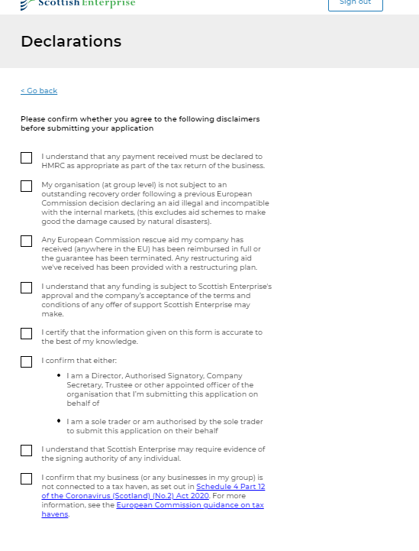
Declarations
People like TickBox’s

Slide 15
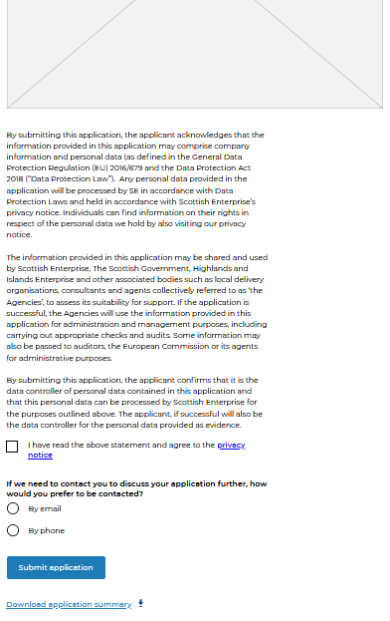
Review
People asked for the option to download the summary BEFORE Submitting.
“What if I want Email AND Phone”

Slide 16
Results Summary
De Minimis is still an unhelpful term
De Minimis is not mentioned in the eligibility section, even though it is an “absolute requirement”
Customers needs to be told in advance, what information documents & evidence will be “needed to successfully complete the application”, to avoid unpleasant surprises
Private documents make people nervous about security and liability
Business Plan’s are referenced confusingly (Repeatedly and with/without a template).

Slide 17
fin

