Slide 1
Find Business Support (FBS)
User Research
Closed Card Sort – New Filters
&
Open Card Sort – New Filters
Aug 2021
Anubhav Mittal

Slide 2
Closed Card Sort – New Filters

Slide 3
Who we tested with
15 Online closed card sort sessions, with UserTesting panel
Male – 10 / Female – 5
UK wide

Slide 4
What we were trying to find out
Test new filter types and categories with the users and understand if these will work for them.
The Closed Card Sort gives people categories and asks them to place items into them
We explored the following things:
If the 5 filter category's make sense?
If the items listed under each of the 5 filter category's make sense?
If users want an "All Scotland“ as an option under the "I am located in" category?
Thoughts on the language used for categories
If there was anything missing from the filter categories or the items under the categories.

Slide 5
Results summary
-All users were able to successfully complete the card sort exercise with ease.
-They categorized the items in the same way as the proposed solution (mostly, but with some overlap)
-“I am looking for” category is a bit confusing and overlapping with other groups
-Filter categories and the items within them made sense to all the users
-14 out of the 15 users would like an “All Scotland” option under the “I am located in” category
-Overall, users found the language used for this exercise easy and straightforward:
It is very straightforward to me. I understand what it is saying, and I have a good grasp of what each category and term is saying.
Simple and easy to understand, could clearly identify and put them in categories.
-However, there were some dislikes mainly around items being categorized under more than one category:
There's a lot of things that could go under both "looking for support with" and "I operate in" but other than that it all makes sense.
The titles are a bit too ambiguous and there is more context needed for both the titles and many of the options, e.g., transport and storage could apply to three of the categories.
-Few suggestions included:
Brexit is missing if businesses are still wanting support with Brexit.
I think "OTHER" could go in all categories and some have cards that could go in other categories too such as "digital" for example or "finance" which are industries and services
Where items can be placed in to two categories: Education, training as an example, give the option for them to sit within both.

Slide 6
New filters
I operate in | I am looking for support with | I am located in | I am a | I am looking for
Agriculture, forestry and fishing | Coronavirus | Aberdeen City | Charity | Consultancy and advice
Animal services | Digital | Aberdeenshire | Community organisation | Funding
Chemical and life sciences | Innovation/R&D | Angus | Co-operative | Programmes
Construction | International trade | Argyll and Bute | Limited company | Research and information
Creative industries | Net zero | Clackmannanshire | Partnership | Self-help guides
Domestic services | Skills | Comhairle nan Eilean Siar | Social organisation | Training
Education, training and HR | Starting a business | Dumfries and Galloway | Sole trader
Energy and environment | Working practices | Dundee City | Other
Financial and business services | Finance | East Ayrshire
Food and drink |  | East Dunbartonshire
Hair and beauty services |  | East Lothian
Horticulture |  | East Renfrewshire
Hospitality, catering and event management |  | Edinburgh
Human health and social work |  | Falkirk
Industrial manufacturing |  | Fife
Information and communication services |  | Glasgow
Leisure and sport |  | Highlands
Real estate and property services |  | Inverclyde
Retail and wholesale |  | Midlothian
Technology and engineering |  | Moray
Tourism |  | North Ayrshire
Transport and storage |  | North Lanarkshire
All sectors |  | Orkney Islands
Other |  | Perth and Kinross
 |  | Renfrewshire
 |  | Scottish Borders
 |  | Shetland Islands
 |  | South Ayrshire
 |  | South Lanarkshire
 |  | Stirling
 |  | West Dunbartonshire
 |  | West Lothian
 |  | Outwith Scotland

Slide 7
Closed card sort results (15 users)
 | I operate in | I am located in | I am looking for support with | I am a | I am looking for
Chemical and life sciences | 100 %
Construction | 100 %
Leisure and sport | 100 %
Industrial manufacturing | 100 %
Agriculture, forestry and fishing | 94 %
Hospitality, catering and event management | 94 %
Creative industries | 94 %
Technology and engineering | 94 %
Tourism | 94 %
Horticulture | 94 %
Energy and environment | 88 % |  | 13 %
Human health and social work | 88 %
Food and drink | 81 % |  |  |  | 13 %
Hair and beauty services | 81 % |  |  |  | 13 %
Retail and wholesale | 81 %
Real estate and property services | 81 % |  |  |  | 13 %
Transport and storage | 75 % |  |  |  | 19 %
Animal services | 75 % |  |  |  | 19 %
All sectors | 63 % |  | 25 % |  | 13 %
Information and communication services | 63 % |  |  |  | 31 %
Financial and business services | 63 % |  |  |  | 31 %
Digital | 50 % |  | 50 %
Domestic services | 50 % |  | 19 % |  | 31 %
Finance | 50 % |  | 31 % |  | 19 %
Education, training and HR | 50 % |  | 31 % |  | 19 %
Research and information | 38 % |  | 25 % |  | 38 %
Other | 31 % | 13 % | 19 % | 19 % | 13 %
Glasgow |  | 100 %
Highlands |  | 100 %
Inverclyde |  | 100 %
Midlothian |  | 100 %
Moray |  | 100 %
North Ayrshire |  | 100 %
North Lanarkshire |  | 100 %
Perth and Kinross |  | 100 %
Orkney Islands |  | 100 %
Renfrewshire |  | 100 %
Falkirk |  | 100 %
Shetland Islands |  | 100 %
South Ayrshire |  | 100 %
South Lanarkshire |  | 100 %
Stirling |  | 100 %
West Dunbartonshire |  | 100 %
West Lothian |  | 100 %
Fife |  | 100 %
Dumfries and Galloway |  | 100 %
Edinburgh |  | 100 %
East Renfrewshire |  | 100 %
East Lothian |  | 100 %
East Dunbartonshire |  | 100 %
East Ayrshire |  | 100 %
Dundee City |  | 100 %
Comhairle nan Eilean Siar |  | 100 %
Clackmannanshire |  | 100 %
Argyll and Bute |  | 100 %
Angus |  | 100 %
Aberdeenshire |  | 100 %
Aberdeen City |  | 100 %
Scottish Borders |  | 88 % | 13 %
Outwith Scotland |  | 81 % | 13 %
Starting a business |  |  | 106 %
Coronavirus |  |  | 100 %
Net zero |  |  | 75 % |  | 13 %
International trade | 31 % |  | 69 %
Innovation/R&D | 25 % |  | 69 %
Working practices |  |  | 63 % |  | 38 %
Limited company |  |  |  | 100 %
Sole trader |  |  |  | 100 %
Charity | 13 % |  |  | 81 %
Co-operative |  |  |  | 75 % | 19 %
Community organisation | 19 % |  |  | 63 % | 13 %
Partnership |  |  | 13 % | 63 % | 19 %
Social organisation | 13 % |  | 19 % | 56 %
Consultancy and advice |  |  | 19 % |  | 75 %
Self-help guides |  |  | 25 % |  | 75 %
Programmes |  |  | 31 % |  | 69 %
Funding |  |  | 38 % |  | 63 %
Training |  |  | 31 % |  | 63 %
Skills |  |  | 44 % |  | 56 %
Users categorised the items in the same way as the proposed solution
“I am looking for” category is a bit confusing and overlapping with other groups
Recommendation:
Merge
I am looking for and
I am looking for support with
Raw data link: https://scotent.sharepoint.com/sites/Marketing-and-Service-Transformation/User%20Research/1_Research/SEP/Analysis/2020%20Testing/Filters-CardSort-Aug2021

Slide 8
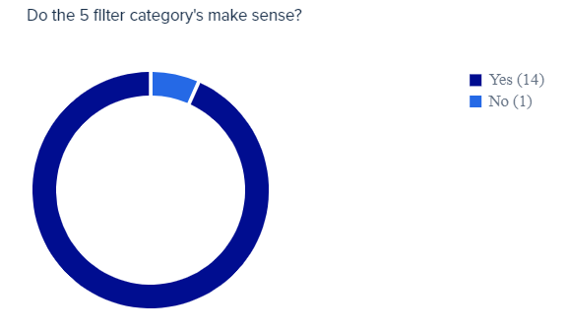
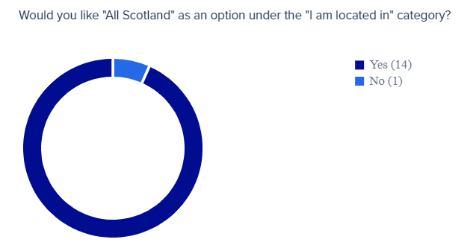
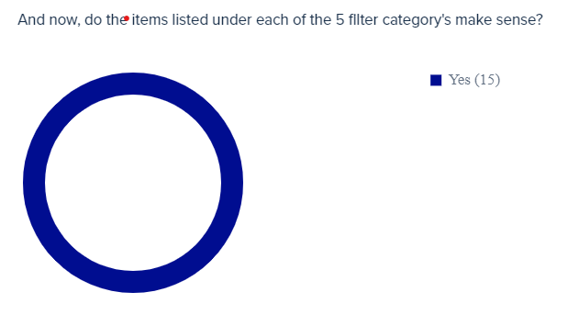
FBS New filters

Slide 9
FBS New filters – language
Things users mentioned when asked about the language used during the card sort exercise:
Likes
It is very straightforward to me. I understand what it is saying, and I have a good grasp of what each category and term is saying.
The exercise was very easy to understand, I found that the categories made sense straight away and I liked the naming of the categories. It helped me to visualize the process of filtering/searching on the website. The language was relevant in the context of the business support sector, and I thought it made the necessary steps towards narrowing down a search.
I am located in makes perfect sense. - I am a makes sense. - I operate in could be confusing and may need a more info tab or example. - I am looking for seems straight forward. - I am looking for support with could have a cross over with I am looking for on some topics maybe.
simple and easy to understand, could clearly identify and put them in categories.

Slide 10
FBS New filters – language
Things users mentioned when asked about the language used during the card sort exercise:
Dislikes
The titles are a bit too ambiguous and there is more context needed for both the titles and many of the options, e.g., transport and storage could apply to three of the categories.
I would have to say that some of these were a bit vague but overall, It wasn't that difficult for me to sort them in groups once I started working on this task
There's a lot of things that could go under both "looking for support with" and "I operate in" but other than that it all makes sense.
Some cards are ambiguous for people with limited English skills, e.g., the "I am looking for" is very similar to "I am looking for support with" and if it's presented as that it could confuse people (I don't know how it's going to be displayed). Overall, the language is straightforward, otherwise - I think most people would understand everything on the cards.
Everything was clear but I was unsure about the ‘Outwith Scotland' card
The titles are a bit too ambiguous and there is more context needed for both the titles and many of the options, e.g., transport and storage could apply to three of the categories.
Suggestions
Brexit is missing if businesses are still wanting support with Brexit.
I think "OTHER" could go in all categories and some have cards that could go in other categories too such as "digital" for example or "finance" which are industries and services
Where items can be placed in to two categories: Education, training as an example, give the option for them to sit within both.

Slide 11
Open Card Sort – New Filters

Slide 12
Who we tested with
15 Online open card sort sessions, with UserTesting panel
Male – 10 / Female – 5
UK wide

Slide 13
What we were trying to find out
Validate (or invalidate), groupings suggested by the Closed Card Sort
The Open Card Sort gives people freedom to create their own categories and then place items into them.
We explored the following things:
What Categories people would create?
How these merge into main Categories
If there was anything that just does not really fit the main categories suggested

Slide 14
Open card sort results (15 users)
 | Region | Support | Sector & Business Type | Using the site | Other
Aberdeen City | 84%
Dundee City | 84%
Edinburgh | 84%
Falkirk | 84%
Glasgow | 84%
Shetland Islands | 84%
Aberdeenshire | 79%
Angus | 79%
East Lothian | 79%
North Ayrshire | 79%
Orkney Islands | 79%
Perth and Kinross | 79%
South Ayrshire | 79%
South Lanarkshire | 79%
Argyll and Bute | 74%
Clackmannanshire | 74%
Dumfries and Galloway | 74%
East Ayrshire | 74%
East Dunbartonshire | 74%
Inverclyde | 74%
Midlothian | 74%
Moray | 74%
North Lanarkshire | 74%
Scottish Borders | 74%
West Dunbartonshire | 74%
West Lothian | 74%
East Renfrewshire | 68%
Fife | 68%
Highlands | 68%
Renfrewshire | 68%
Stirling | 68%
I am located in | 53%
Comhairle nan Eilean Siar | 47%
Outwith Scotland | 47%
I am looking for support with |  | 63%
Skills |  | 63%
Working practices |  | 63%
I am looking for |  | 63%
Programmes |  | 63%
Self-help guides |  | 63%
Coronavirus |  | 53%
Starting a business |  | 53%
Funding |  | 53%
Training |  | 53%
International trade |  | 47% | 26%
Net zero |  | 47%
Financial and business services |  | 37% | 42%
Digital |  | 37% | 42%
Domestic services |  | 37% | 37%
Consultancy and advice |  | 37% | 37%
Research and information |  | 37% | 37%
Finance |  | 32% | 42%
Real estate and property services |  | 26% | 53%
Animal services |  | 26% | 47%
Education, training and HR |  | 26% | 47%
Innovation/R&D |  | 26% | 47%
Co-operative |  | 26% | 47%
Partnership |  | 26% | 47%
Hair and beauty services |  | 26% | 42%
Creative industries |  |  | 68%
Technology and engineering |  |  | 68%
Agriculture, forestry and fishing |  |  | 63%
Construction |  |  | 63%
Energy and environment |  |  | 63%
Leisure and sport |  |  | 63%
All sectors |  |  | 63%
Chemical and life sciences |  |  | 58%
Food and drink |  |  | 58%
Horticulture |  |  | 58%
Human health and social work |  |  | 58%
Industrial manufacturing |  |  | 58%
Retail and wholesale |  |  | 58%
Tourism |  |  | 58%
Transport and storage |  |  | 58%
Charity |  |  | 58%
Community organisation |  |  | 58%
Sole trader |  |  | 58%
Hospitality, catering and event management |  |  | 53%
Information and communication services |  |  | 53%
Limited company |  |  | 53%
Social organisation |  |  | 53%
I operate in |  |  | 47%
I am a |  |  | 42%
Other |  |  | 32%
All users were able to successfully complete the card sort exercise with ease.
3 main categories emerged
Region
Support
Sector or Business Type
This confirms the confusion in the closed sort exercise above – users prefer 3 categories
Raw data link: https://scotent.sharepoint.com/sites/Marketing-and-Service-Transformation/User%20Research/1_Research/SEP/Analysis/2020%20Testing/Filters-CardSort-Aug2021

Slide 15
Thank you!

