Slide 1
Find Business Support (FBS)
User Research
Open Card Sort – New Filters (v2)
Aug 2021
Anubhav Mittal

Slide 2
Closed Card Sort – New Filters (v2)

Slide 3
Who we tested with
15 Online closed card sort sessions, with UserTesting panel
Male – 9 / Female – 6
UK wide

Slide 4
What we were trying to find out
Test new filter types and categories with the users and understand if these will work for them.
The Closed Card Sort gives people categories and asks them to place items into them
We explored the following things:
If the filter category's make sense?
If the items listed under each of the filter category's make sense?
If users want an "All Scotland“ as an option under the "I am located in" category?
Thoughts on the language used for categories
If there was anything missing from the filter categories or the items under the categories.

Slide 5
Results summary
-All users were able to successfully complete the card sort exercises with ease.
-They categorized the items in the same way as the proposed solution (mostly, but with some overlap)
-Filter categories and the items within them made sense to all the users
-Majority users would like an “All Scotland” option under the “I am located in” category
-Overall, users found the language used for this exercise easy and straightforward

Slide 6
New filters v2
I operate in | I am looking for support with | I am located in | I am a
Agriculture, forestry and fishing | Consultancy and advice | Aberdeen City | Charity
Animal services | Coronavirus | Aberdeenshire | Community organisation
Chemical and life sciences | Digital | Angus | Co-operative
Construction | Finance | Argyll and Bute | Limited company
Creative industries | Funding | Clackmannanshire | Partnership
Domestic services | Innovation/R&D | Comhairle nan Eilean Siar | Social organisation
Education, training and HR | International trade | Dumfries and Galloway | Sole trader
Energy and environment | Net zero | Dundee City | Other
Financial and business services | Programmes | East Ayrshire
Food and drink | Research and information | East Dunbartonshire
Hair and beauty services | Self-help guides | East Lothian
Horticulture | Skills | East Renfrewshire
Hospitality, catering and event management | Starting a business | Edinburgh
Human health and social work | Training | Falkirk
Industrial manufacturing | Working practices | Fife
Information and communication services |  | Glasgow
Leisure and sport |  | Highlands
Real estate and property services |  | Inverclyde
Retail and wholesale |  | Midlothian
Technology and engineering |  | Moray
Tourism |  | North Ayrshire
Transport and storage |  | North Lanarkshire
All sectors |  | Orkney Islands
Other |  | Perth and Kinross
 |  | Renfrewshire
 |  | Scottish Borders
 |  | Shetland Islands
 |  | South Ayrshire
 |  | South Lanarkshire
 |  | Stirling
 |  | West Dunbartonshire
 |  | West Lothian
 |  | Outside Scotland

Slide 7
Closed card sort results v2 (15 users)
Users categorised the items in the same way as the proposed solution
“I am looking for support with” category is mildly ambiguous with some overlap with “I operate in”
“There was an ambiguity when matching certain cards to certain filter. Namely between the "i operate in" and "i am looking for support with" sections where for example you could operate in training but also be looking for support in training. Or you operate in international trade and looking for support there”
Raw data link:
\\scotent.sharepoint.com@SSL\DavWWWRoot\sites\Marketing-and-Service-Transformation\User Research\1_Research\SEP\FBS Research 2021\Filters-CardSort-Aug2021-V2

Slide 8
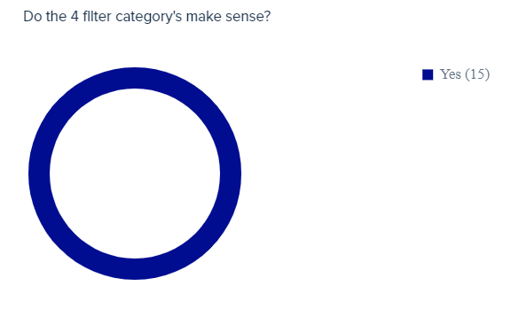
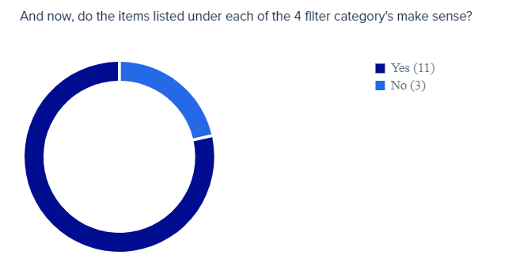
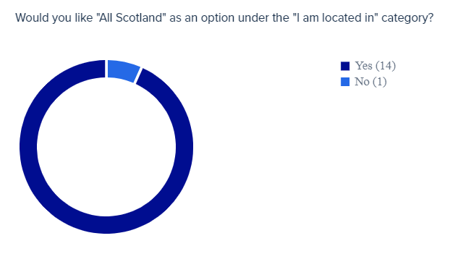
FBS New filters v2

Slide 9
Closed Card Sort – New Filters (v2.1)

Slide 10
Who we tested with
15 Online open card sort sessions, with UserTesting panel
Male – 9 / Female – 6
UK wide

Slide 11
New filters v2.1
Industry/Sector | Topic | Location | Type of business | Type of support
Agriculture, forestry and fishing | Coronavirus | Aberdeen City | Charity | Consultancy and advice
Animal services | Digital | Aberdeenshire | Community organisation | Funding
Chemical and life sciences | Innovation/R&D | Angus | Co-operative | Programmes
Construction | International trade | Argyll and Bute | Limited company | Research and information
Creative industries | Net zero | Clackmannanshire | Partnership | Self-help guides
Domestic services | Skills | Comhairle nan Eilean Siar | Social organisation | Training
Education, training and HR | Starting a business | Dumfries and Galloway | Sole trader
Energy and environment | Working practices | Dundee City | Other
Financial and business services | Finance | East Ayrshire
Food and drink |  | East Dunbartonshire
Hair and beauty services |  | East Lothian
Horticulture |  | East Renfrewshire
Hospitality, catering and event management |  | Edinburgh
Human health and social work |  | Falkirk
Industrial manufacturing |  | Fife
Information and communication services |  | Glasgow
Leisure and sport |  | Highlands
Real estate and property services |  | Inverclyde
Retail and wholesale |  | Midlothian
Technology and engineering |  | Moray
Tourism |  | North Ayrshire
Transport and storage |  | North Lanarkshire
All sectors |  | Orkney Islands
Other |  | Perth and Kinross
 |  | Renfrewshire
 |  | Scottish Borders
 |  | Shetland Islands
 |  | South Ayrshire
 |  | South Lanarkshire
 |  | Stirling
 |  | West Dunbartonshire
 |  | West Lothian
 |  | Outside Scotland

Slide 12
Closed card sort V2.1 results (15 users)
All users were able to successfully complete the card sort exercise with ease.
The areas that overlap are “Topics” and “Type of support”
“Topic and type of support are a bit vague to me. I did not understand the real difference between the two”
Raw data link:
\\scotent.sharepoint.com@SSL\DavWWWRoot\sites\Marketing-and-Service-Transformation\User Research\1_Research\SEP\FBS Research 2021\Filters-CardSort-Aug2021-V2

Slide 13
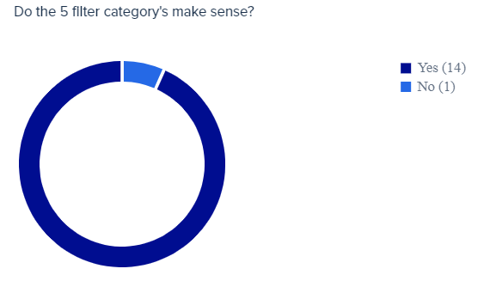
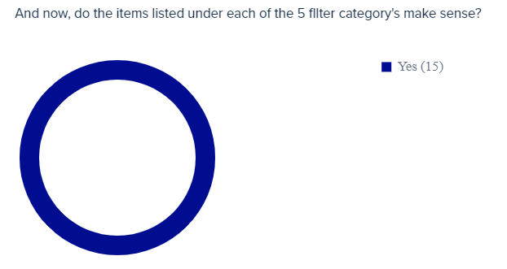
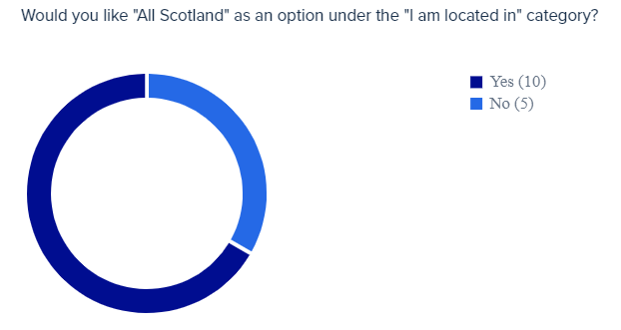
FBS New filters v2.1

Slide 14
Thank you!

