Slide 1
Find Business Support (FBS)
User Research
Open Card Sort – New Filters (v3)
Aug 2021
Anubhav Mittal

Slide 2
Closed Card Sort – New Filters (v3)

Slide 3
Who we tested with
15 Online closed card sort sessions, with UserTesting panel
Male – 9 / Female – 6
UK wide

Slide 4
What we were trying to find out
Test new filter types and categories with the users and understand if these will work for them.
The Closed Card Sort gives people categories and asks them to place items into them
We explored the following things:
What information would the users provide about their company in order to find support
If the filter category's make sense?
If the items listed under each of the filter category's make sense?
Thoughts on the language used for categories
If there was anything missing from the filter categories or the items under the categories.
The order of the filter categories that users would like to see when filtering

Slide 5
Results summary
-All users were able to successfully complete the card sort exercises with ease.
-They categorized the items in the same way as the proposed solution (mostly, but with some overlap)
-Filter categories and the items within them made sense to all the users
-”How would you like your support delivered?” category was less clear to the users
-” What are you looking for support with?” filter category was the most important filter in terms of order of preference
-Overall, users found the language used for this exercise easy and straightforward
-When asked about the information the users would provide public sector to receive support following things were shared: their company details such as name, vat no, size, turnover, company description to issues that they were facing and the help that they wanted such as loan.

Slide 6
New filters v3
What industry are you in? | Where is your organisation based? | What type of organisation are you? | What are you looking for support with? | How would you like your support delivered?
Agriculture, forestry and fishing | Aberdeen City | Charity | Coronavirus | Consultancy and advice
Animal services | Aberdeenshire | Community organisation | Digital | Funding
Chemical and life sciences | Angus | Co-operative | Innovation/R&D | Programmes
Construction | Argyll and Bute | Limited company | International trade | Research and information
Creative industries | Clackmannanshire | Partnership | Net zero | Self-help guides
Domestic services | Comhairle nan Eilean Siar | Social organisation | Skills | Training
Education, training and HR | Dumfries and Galloway | Sole trader | Starting a business
Energy and environment | Dundee City | Other | Working practices
Financial and business services | East Ayrshire |  | Finance
Food and drink | East Dunbartonshire
Hair and beauty services | East Lothian
Horticulture | East Renfrewshire
Hospitality, catering and event management | Edinburgh
Human health and social work | Falkirk
Industrial manufacturing | Fife
Information and communication services | Glasgow
Leisure and sport | Highlands
Real estate and property services | Inverclyde
Retail and wholesale | Midlothian
Technology and engineering | Moray
Tourism | North Ayrshire
Transport and storage | North Lanarkshire
All sectors | Orkney Islands
Other | Perth and Kinross
 | Renfrewshire
 | Scottish Borders
 | Shetland Islands
 | South Ayrshire
 | South Lanarkshire
 | Stirling
 | West Dunbartonshire
 | West Lothian
 | All Scotland
 | Outside Scotland

Slide 7
Closed card sort results v3 (15 users)
Users categorised the items in the same way as the proposed solution
First 4 categories made good sense but the last one was ambiguous
“How would you like your support delivered?” was less clear to the users
Raw data link:
https://scotent.sharepoint.com/sites/Marketing-and-Service-Transformation/User%20Research/1_Research/SEP/FBS%20Research%202021/Filters-CardSort-Aug2021-V3

Slide 8
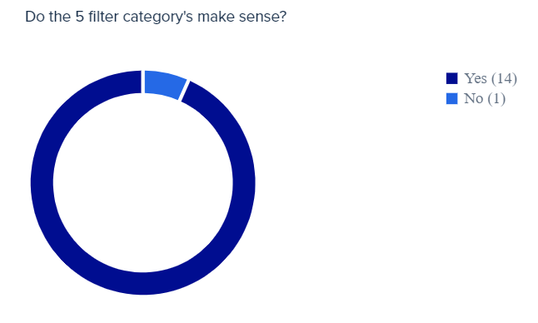
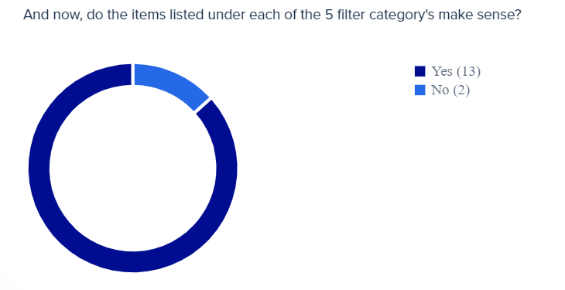
FBS New filters v3

Slide 9
FBS New filters v3
If you were looking for support from the Public Sector, what information would you provide about your company, to find the relevant support:
I'd provide my sector, my revenue, my costs and my profits. Along with the age and size (number of employees) I have.
I will provide name of my company, what it does, bit of information about it size, so this kind of information. Without giving any secret or confidential information, just general information.
I would give my company name, a short description of what the company does, the location, the problem with company
Business area Pain points summary Location of the business Size of the business
I would give the size of the company, i.e.. no, of employees. What the company does, what sector it's in. Who our customers are. Any information relevant to financials that would help them determine what we needed, e.g., business loan
Industry, type of help I was looking for and why I was looking for help.
Probably a brief overview of what the company does and what information I am looking for.
company name, vat number , turnover and accounts . products information, staff numbers
Type of company, target customer, location, if its digital or physical products/services, our revenue, how many staff & emp; profits

Slide 10
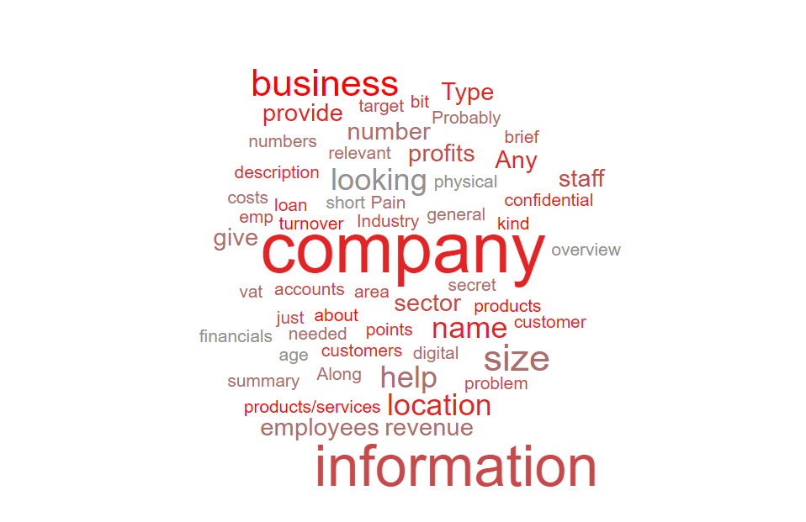
FBS New filters v3
FBS New filters v3

Slide 11
FBS New filters v3
Please share your thoughts on the language used in this exercise:
It is quite nice and clear, the easiest section was organization based, type of industry was also quite easy. Overall, I did not find any difficulty in locating each item in the category.
simple and straightforward regarding intended purpose of finding a support option which is viable and relating to your business needs.
I would say the language is simple but also confusing. For example, there is 'finance' and 'funding', both are simple terms on their own but yet when they are together it's hard to work out the differences between.
The language is basic, so it should make sense to most people. The only thing I would say is that some of the categories could be phrased better, particularly the one that says, 'what are you looking for support with'. I would expect to see something phrased like 'what support are you looking for' as it is more concise.
In general, the language seems clear I just could not find a label that would fit into "How would you like your support to be delivered?"

Slide 12
FBS New filters v3
When asked if anything was missing from the filter categories or the items under the category, following were mentioned:
Age of Business
Size of Business
Brexit
Covid

Slide 13
FBS New filters v3
What do you think would be the most important filter category, rank them in order of preference:
1.What are you looking for support with?
2.What type of organization are you? 3.Where is your organization based? 4.What industry are you in? 5.How would you like your support delivered?

Slide 14
Thank you!

