Slide 1
Activity Plan: staff user research
19/05/2021
Katie Dickerson
Martin Kerr

Slide 2
What we tested
The Word document version of the Activity Plan that was used for the OM pilot project

Slide 3
Who we tested with
6 staff members
4 who were part of the pilot
2 who weren't part of the original pilot group

Slide 4
What we wanted to learn
What were they trying to achieve with the activity plan?
What was their experience of using the activity plan?
What worked well for them?
What didn't work so well for them?
How did they share the activity plan and any updates with customers?
Did they have to adapt the plan to meet the needs of their project?
Are there changes that could be made to the plan to make their jobs easier?

Slide 5
Results summary
The outcomes and actions section is useful
The activity plan works better for some types of projects than others
There is duplication from the EOI
Businesses are reluctant to sign off on the plans because it's too much like a contract
The plan and the wording could be simplified to be more customer-friendly

Slide 6
What were they trying to achieve with the activity plan?
Show us what resources we need and what the customer needs to deliver
A draft of the initial chat with the client
Initially it was a simple plan that could be agreed between us and the customer, but now it has more detailed measures and feels more like a contract
It's a way of capturing a plan (for me), and helping the company understand what we're doing to help them
It's capturing our commitment to the business - what we can do to add value to the opportunity

Slide 7
What was their experience of using the activity plan?
Mixed experiences – it depends on the company/project
Well suited for innovation projects or projects where funding support is involved
Doesn't work as well for:
Inward investment
Long-term projects
Enabling opportunities
Some companies seem to really value the activity plan – others less so
What happens if you have an opportunity that grows – at what point do you need a new plan?

Slide 8
What worked well?
Outcomes and actions
It helps us be transparent about what we want the company to do and what we're doing for them
The activity plan could be useful if we're dealing with a company we haven't worked with before and it's a one-off

Slide 9
What didn't work so well?
Duplication from the EOI
Agreed by section is unnecessary – this can just be done via email
No version control (one plan is on its 6th version)
Businesses feel like it's a contract and are reluctant to sign off on measures – what are the consequences if I don't deliver?
Engagement with the company section – this will have to be updated constantly
Some of the language is too SE-focused and vague
For example, 'Company deemed appropriate for Opportunity Management support'
It's trying to meet the needs of both SE and the client at the same time
Businesses don't care about benefits to SE or the Scottish economy

Slide 10
How did they share the activity plan and any updates with customers?
Only shared the outcomes/actions with the company
Would prefer if there was an internal section and a section we share with customers
Put a meeting in the diary and then shared the draft activity plan 2-3 days before
Shared new versions of the plan at biweekly meetings, then via email for approval
The company is responsible for tracking agreed actions – it's their plan

Slide 11
Did they have to adapt the plan to meet the needs of their project?
Most didn't make any changes to the template, but there are things they would do to improve it
One staff member added 'Last updated' dates to the first and second pages

Slide 12
Are there changes that could be made to the plan to make their jobs easier?
Remove duplication from EOI
Simplify the plan - make it less about what the company can do for us and more about what we can do for them
Work through the plan with the company so they're more invested in it
Guidance on what's required for some of the sections
Version control
Have a digital version

Slide 13
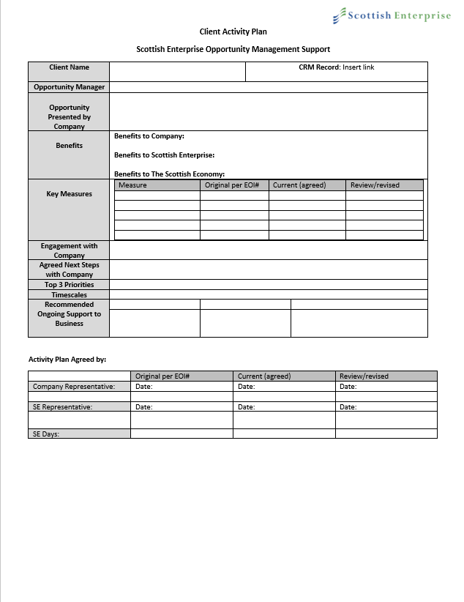
Companies aren't that interested in benefits to SE/economy
Feels too formal
Hard to keep this up to date
Timescales are estimated and may change
People felt this wasn't needed

Slide 14
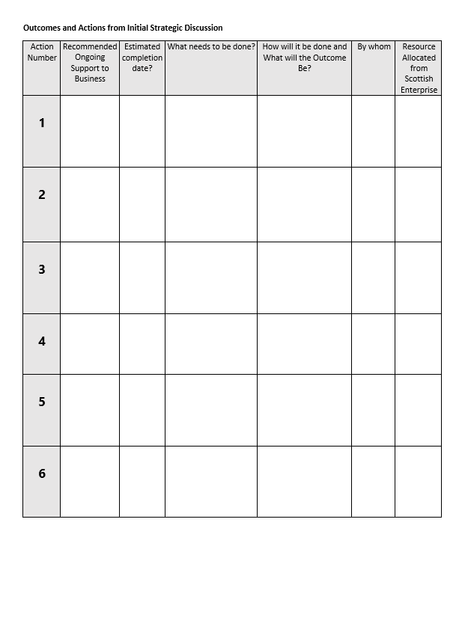
It isn't just based on the initial strategic discussion
This is where the real value is

Slide 15
Quotes
"It's more about what they can do for us rather than the other way around."
"It's hard to get customers to sign it off because there's no money involved."
"Clients are reluctant to sign off on economic measures because it's of no benefit to them."
"If we're dealing with someone and it's a one-off I can see the benefit – but when will we be doing one-offs?"
"The current process doesn't take our history with the company into account."

Slide 16
User needs
Record progress against activities – this is challenging with the current activity plan

Slide 17
How might we...
Make the plan simpler?
Make the plan more user-friendly?
Get companies to be more invested in - and less intimidated by - the plan?
Make it easier for staff manage complex or longer-term projects?
Make it easier for staff to keep track of changes to the plan?

Slide 18
Fin

