Slide 1
Expression of Interest
Initial testing of EOI form
Dec 1st 2020
Martin Kerr
Anubhav Mittal

Slide 2
Summary
We put the form on UserZoom for online unmoderated testing with their panel
We added a screener for Scottish Business Owners or Decision Makers

Slide 3
Hypotheses
To structure testing, we applied 2 Hypotheses to the research:
Hypothesis 1
People will welcome the Expression of Interest approach
Hypothesis 2
The form will make sense and be easy to use
The test notes allow retrospective application of new Hypotheses up to a point

Slide 4
Hypothesis 1: Partially supported
Hypothesis: People will welcome the Expression of Interest approach
Findings:
People understand the benefits of the approach
They think it will save them time in the long run
Expect to not have to resubmit the same information again
BUT
Would rather have a quick online solution that gives an immediate answer
Have a solution that can be left and returned to with their data still saved
Recommendations:
Clarify language around EOI vs Pre-qualification, and the exact purpose of this form

Slide 5
Hypothesis 2: XXX
Hypothesis: The form will make sense and be easy to use
Findings:
ooo
Recommendations:
ooo

Slide 6
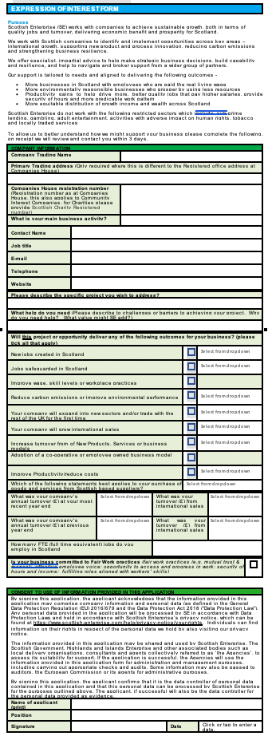
The form
Has 5 main sections
Purpose
Company Information
Project Info
Outcomes
Consent

Slide 7
Pre-test questions
We asked the following question before showing the form:
When applying to the government for business support, which approach would you prefer?
What do you understand by Expression of Interest?
What are the Pros of Expression of Interest?
What are the Cons of Expression of Interest?

Slide 8
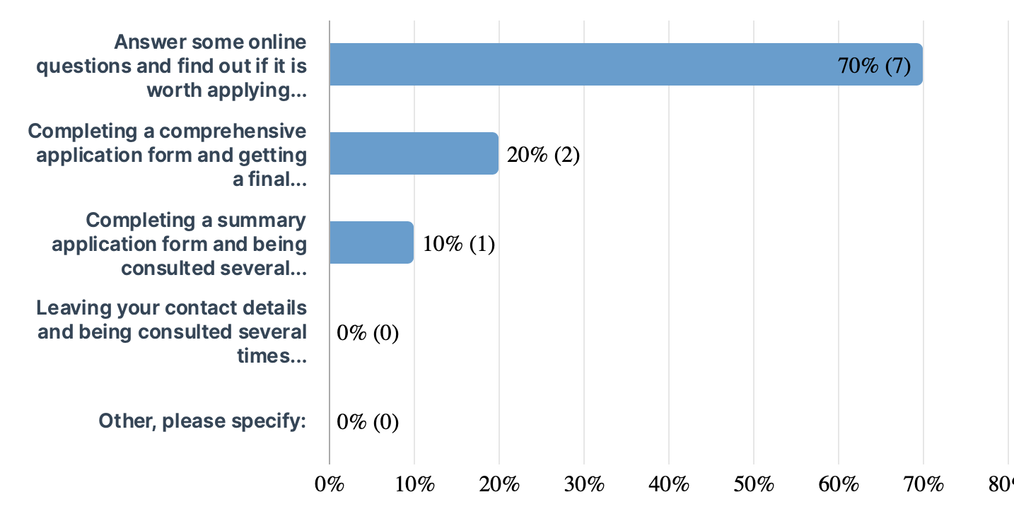
Pre-test (1)
When applying to the government for business support, which approach would you prefer?
Notes: This section raises the question of “Pre-qualifaction” vs “Expression of Interest”

Slide 9
Pre-test (2)
To register your interest in something, whether you take it up or not can be decided later.
An expression of interest in my understanding is a person business or other has orated a desire to find out more about my business or willingness to consider furthering that relationship
Confirming that you are keen to be involved and would undertake an exercise to evidence this if necessary such as an application or due diligence checks
Expression of intrest is a gathering information tool to allow the perspective client decide if thery are looking to go ahead with the service
Give details about my business and a short paragraph on why I want to submit an application
I believe that an Expression of Interest is essentially the first step in understanding or applying for a position. It is an opportunity for you to put forward anything you deem to be key about yourself in relation to the particular role and what your skills, strengths and aims are based on the requirements/asks listed within the job description.
Registering interest in a service / product etc - potential
I think it means a formal/legal way of letting an organisation know you are interested in a service. Like when you buy a house
Giving an initial note to be interested in something before actually applying through a set procedure.
Expression of interest is a template that expresses a company’s interest in buying another company
What do you understand by Expression of Interest?

Slide 10
Pre-test (2)
What do you understand by Expression of Interest?
These suggest:
Showing that you are interested
Collecting Data
Formal/Legal
First Step
Collecting Evidence
An initial decision to proceed (or not)

Slide 11
Pre-test (3)
You should be notified of any change
it gives options it provides feedback on prototypes
Not having to go through the full application process and perhaps being shortlisted in some way. Not wasting a lot of time being considered only to be let down ultimately in some way
information packs etc allow buisness owners make a clear desicion based on factual information
You don’t need to submit a full application until you know that you qualify for it
It is an opportunity to present yourself in the best light possible and to do it in a succinct and clear way. It does not have to take a lot of time to prepare and is usually fairly easy to tailor based on the different role descriptions. It is non-committal and does not take away from other potential opportunities - you are just registering your awareness of the role and your availability.
not confirmed / flexibility / not tied in
I think it means that you need to be engaged in teh process and so those competing for the same service won’t get an advantage as you need to be provided with the same information as them
taken the initiative to show interest in something rather than knowingly applying with many others.
you can se the initial reaction from the company you are trying to buy and the reaction from the general public
What are the Pros of Expression of Interest?

Slide 12
Pre-test (3)
What are the Pros of Expression of Interest?
These suggest
More communication & feedback
Shorter process before being shortlisted
Less wasted time
Clear decisions
An opportunity
Flexible
Fair

Slide 13
Pre-test (4)
You have not reached a decision there and then
they can be self serving and costly
It may not work out and any time spend even completing initial checks may be wasted.
sometimes the information packs are one sided and arent telling the truth
waiting time before you get to receive the money
It is one way communication, there is no onus on the other party to respond which is not helpful if there are questions or you would like further information. Other cons would be that it is just a summary of you and your skills when you may feel there is much more you would like to discuss about what you can bring to the table and your skills - you have to be selective.
a little general / not guaranteed / just in principle
You may want to show interest in confidence and formally doing it might remove this.
It can sometimes feel like a double procedure for an application
it might expose your companies strategy and the expression of interest may lead to other parties blocking the move.
What are the Cons of Expression of Interest?

Slide 14
Pre-test (4)
What are the Cons of Expression of Interest?
These suggest
Possible waste of time & money
Possibly not that realistic
A bit generic
Quite one way (Communication)
Possibly extra effort required (Doubling up)
Intellectual Property / Business Strategy leakage

Slide 15
Initial response to EOI form
We asked the following question about the EOI form:
Now that you have had a look at the "Expression of Interest form (EOI form)", what does it mean to you?
What do you expect as a result of completing this EOI form?
If you were using this EOI form, how do you feel about this way of accessing our products and services?
Is this what you were expecting to see when we mentioned "Expression of Interest form" (EOI form)?

Slide 16
Initial Thoughts (1)
We as a company registering and expressing our interest in receiving help from Scotttish Enterprise
it means a specific application to get sponsored mentored for a particular objective/ goal
Outlines criteria for qualification. A short overview as to whether you will qualify depending on the business type and outcomes delivered. Once completed you will receive a quick response as to whether your business is eligible based on the criteria achieved and this will probably prompt a further more detailed application process.
the same as before however this one seems as though it tailors it to each and every client
As I said before, I let the agency know that I am interested in applying for the service/grant
It is a description of what services / finances are on offer in a very broad sense and allows you to respond in kind, in a summarised format, what you would expect or need from these services and what your current position is in relation to the aforementioned business areas; costs, FTE etc
it seems to be the first part in the administrative process of getting support form SE
It’s a way of SCottish Enterprise assessing my business for suitability for support from them. The benefit to me is the help Scottish Enterprise can provide in supporting my involvement in the project I’m interested in. It makes clear that there are social and environmental elements as well as commercial ones that are important to Scottish Enterprise and the likelihood of them working with my company
It means you can show an interest to apply for S.E. funding to support my business by filling out this form.
it is a form that will give your company information to Scottish Enterprise and they will help your company to grow and reach new opportunities
Now that you have had a look at the "Expression of Interest form (EOI form)", what does it mean to you?

Slide 17
Initial Thoughts (1)
Now that you have had a look at the "Expression of Interest form (EOI form)", what does it mean to you?
These suggest:
Registering
Specific
Applying
Lists services / grants
Summarise my needs & commitments
Registering
Asking for Help

Slide 18
Initial Thoughts (2)
We as a company registering and expressing our interest in receiving helpTo be contacted after three days for further discussions and whether we would receive assistance
an acknowledgement email stating what to expect next. I would expect a time frame to receive an answer and potentially a point should i wish to update the information submitted
A quick turnaround and decision as to whether you can proceed with the funding application and to enter a second stage of the process
an information pack and tailord plan on how they can help
Have a response of whether I am eligible for the grant/service. If it is the case I will be sent a full application form to ouline my project, business case, risk assessment, etc.
Further communication would surely come whether by letter, email or telephone to discuss the eligibility for the scheme or not and, if so, what in particular the business could benefit from most. Down the line I would expect either managerial assistance/advice or financial assistance from the scheme.
Contact from SE and guidance
For SCottish Enterprise to contact me within 3 days of receiving this application to discuss my company’s suitablility and, if suitable, what they can do to support me
To be contacted by S.E. to allow me to apply for funding, or to be told that I cannot apply for funding, or perhaps to ask further questions to see if I can meet their demands by giving more detailed information.
I would expect assistance in growth and with new productsyour company to grow and reach new opportunities
What do you expect as a result of completing this EOI form?

Slide 19
Initial Thoughts (2)
What do you expect as a result of completing this EOI form?
These suggest
Contact within 3 days
Comms
Quick Decision
How SE can help / Tailored plan of help
How to proceed
Help

Slide 20
Initial Thoughts (3)
A very good way, short and simple
I feel this is quite a standard way to access products
Fine. It suggests qualifying criteria and this allows a business to decide whether to proceed with the EOI ’application’ at this point. If you fail to meet the criteria at this early stage you can almost self declare that you will/wont qualify and proceed accordingly.
fine, this is very clear information
I don’t mind it, it is a documented process which is helpful for both the agency and me
I would feel very positive, there is nothing restrictive or ’scary’ in the form in the sense that it is very clear that it is informative only i.e. information gathering so as to be as much help and to provide the best assistance possible. I would feel as though we are both laying our cards out on the table and that we are there to help each other.
clear and fine - no issues - it would be an expected 1st part of the journey
Form is clear. If my company doesn’t fit the social/environmental criteria then there’s little point in me spending time looking for their support. I like the form
I would feel comfortable with it. It appears thorough and fair as well as informative.
I would prefer that the questionnaire was an online survey and not a downloadable word document. It feels more professional if it is done all online.
If you were using this EOI form, how do you feel about this way of accessing our products and services?

Slide 21
Initial Thoughts (3)
If you were using this EOI form, how do you feel about this way of accessing our products and services?
These suggest
Good, short, simple, standard
Suggests a nice quick fair decision
Positive, clear, sensible
As expected
Obvious if it is worth me continuing
Thorough, fair, informative
BUT
Would be better online

Slide 22
Initial Thoughts (4)
50% said it was as expected
the rest said:
Is this what you were expecting to see when we mentioned "Expression of Interest form" (EOI form)?
The form could be in a better format than word (although I’m not sure if this is how it would be presented in reality) - there are so many other interactive formats available .pdf or online interactive forms that may be really useful for people slightly more tech savvy or who don’t want to have things in paper format to complete.
I thought EOI form would be simply a legal thing to benefit me rather than a way of Scottish Enterprise assessing my suitability. That could just be my ignorance of what EOI is rather than anything unusual about this form
I think my definition of an EOI form was wrong..

Slide 23
Purpose Section
We asked the following question about the Purpose section:
1. Understanding the the "Purpose" was:
2. The "Purpose" paragraph was:
3. Is this what you were expecting to see when we mentioned "Expression of Interest form" (EOI form)?
4. Please suggest any changes that you would like to see in the "Purpose" paragraphs? (please put n/a if no comment)

Slide 24
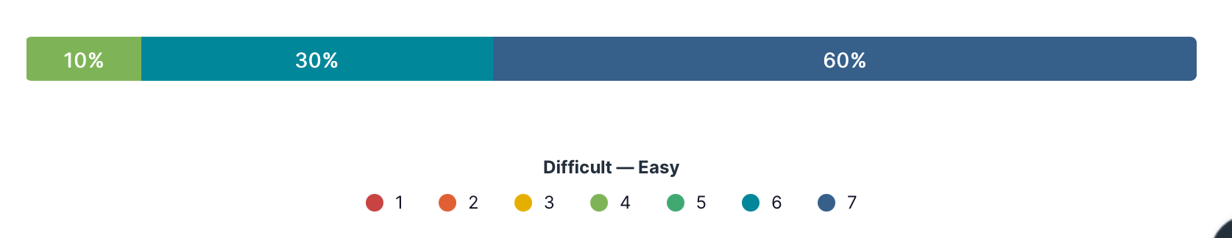
Purpose section
Understanding this section:

Slide 25
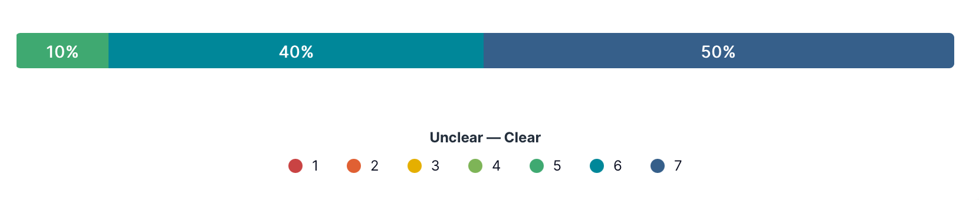
Purpose section
The purpose was:

Slide 26
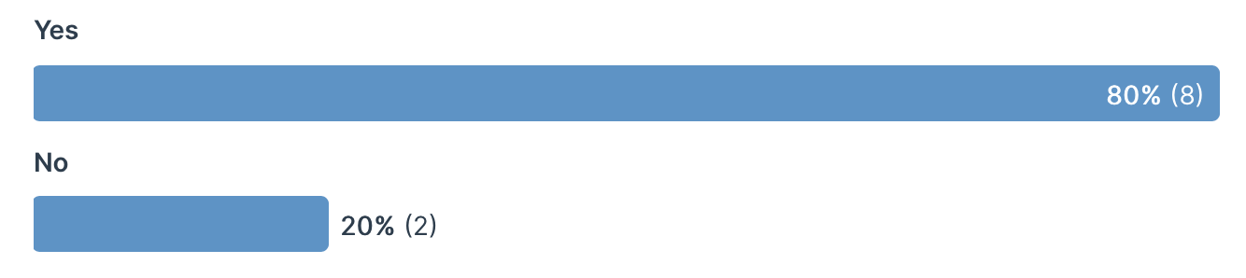
Purpose section
As Expected?:

Slide 27
Purpose section
Suggestions:
I feel there is adequate information in this and I cannot think of any suggestions at this time
Maybe add levels of funding/support available and what different aspects a business can apply for. Case studies would be useful as well. Not necessarily on the form but on the website so a business can see what types of thing are available and they can see how they might also benefit or draw suitable comparisons
Other than the format I don’t see anything much at all that could change. You could list the sectors that you do not work with by bullet point instead of within the sentence itself, which may be clearer
I think the use of word document is not very professional and it should all be online.

Slide 28
Company Information
We asked the following question about this section:
1. Understanding the "Company information" section was:
2. The questions were:
3. Were the questions what you would expect from an EOI form?
4. Are there any questions that you would not be able to answer?

Slide 29
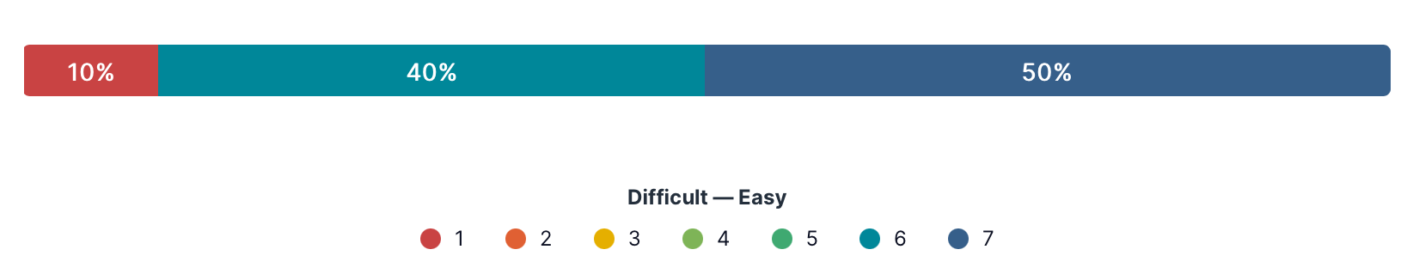
Company Information
Understanding this section was:

Slide 30
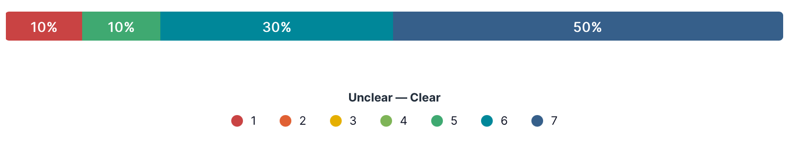
Company Information
The questions were:

Slide 31
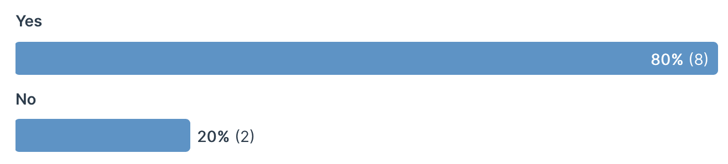
Company Information
As Expected?:

Slide 32
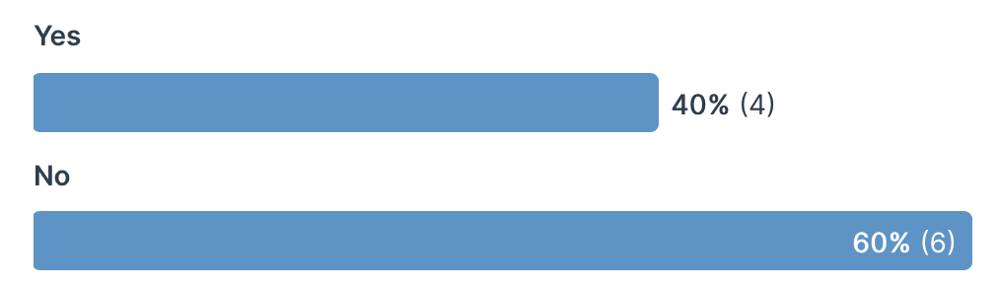
Company Information
Are there questions that could not be answered:

Slide 33
Project Information
We asked the following question about the Project Information section:
1. Understanding the questions were:
2. The questions asked were:
3. Were the questions what you would expect from an EOI form?
4. Are there any questions that you would not be able to answer?

Slide 34
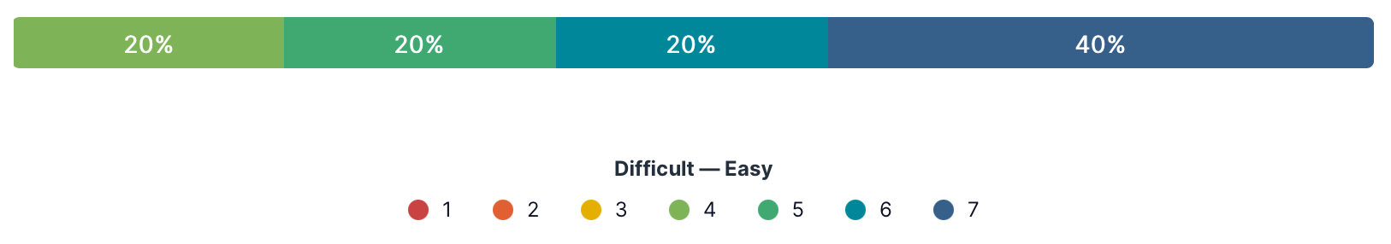
Project Information
Understanding the questions were:

Slide 35
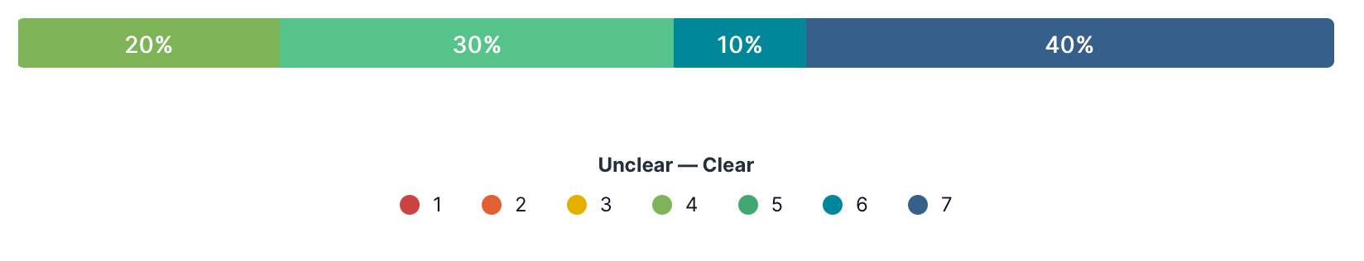
Project Information
The questions were:

Slide 36
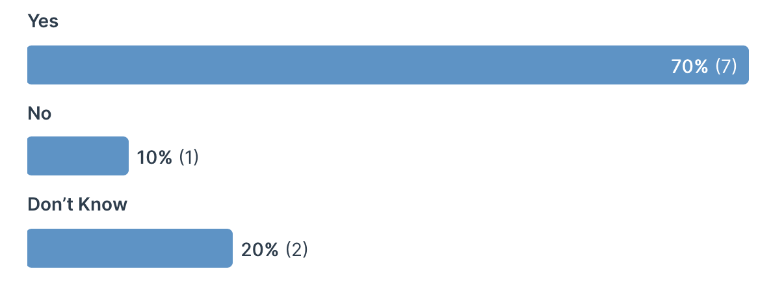
Project Information
As Expected?:

Slide 37
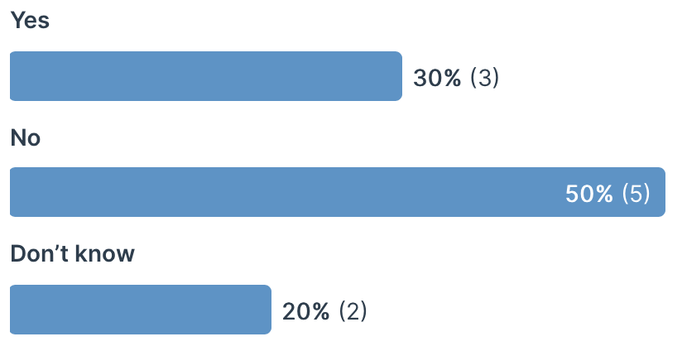
Project Information
Are there questions that could not be answered:

Slide 38
Outcomes
We asked the following question about the Outcomes section:
1. Understanding the questions were:
2. The questions asked were:
3. Were the questions what you would expect from an EOI form?
4. Are there any questions that you would not be able to answer?

Slide 39
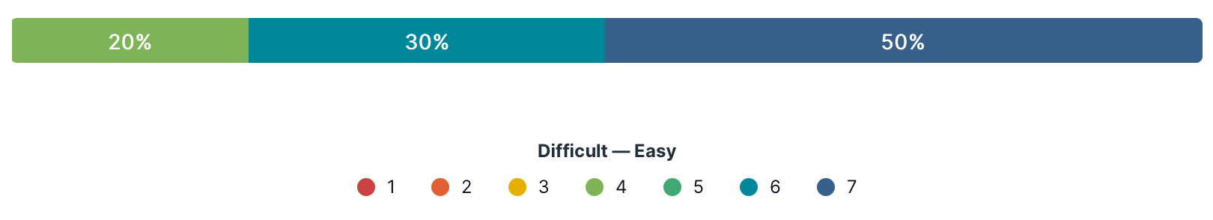
Outcomes
Understanding the questions were:

Slide 40
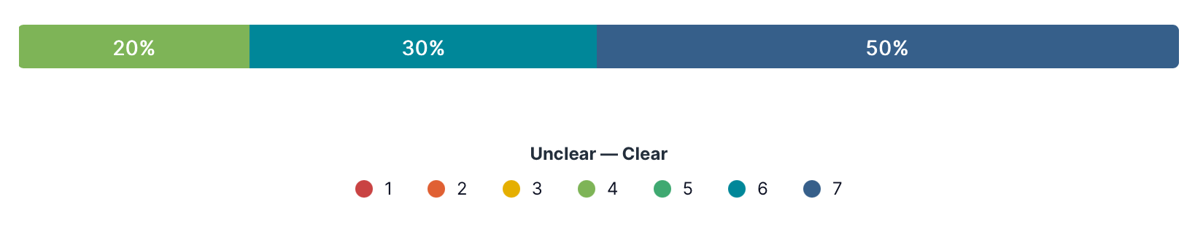
Outcomes
The questions were:

Slide 41
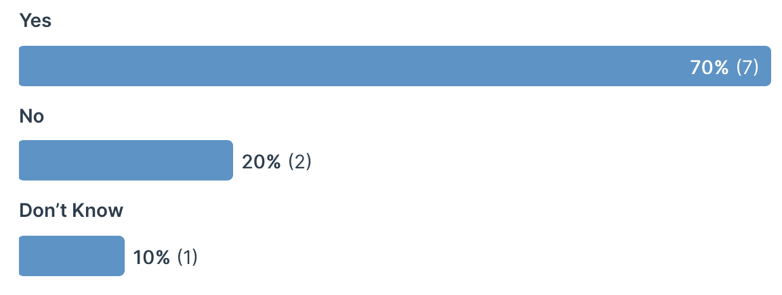
Outcomes
As Expected?:

Slide 42
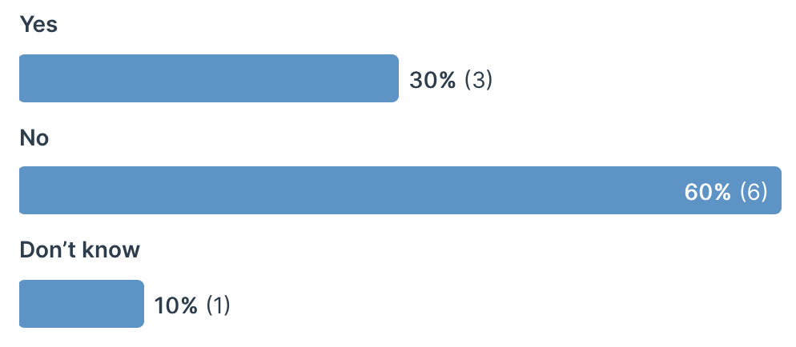
Outcomes
Are there questions that could not be answered:

Slide 43
Consent
We asked the following question about the Consent section:
1. Understanding the "Consent" paragraph was:
2. The "Consent " paragraph was:
3. Is this what you expect the "Consent" paragraph to look like in the "Expression of Interest form" (EOI form)?
4. Please suggest any changes that you would like to see in the "Consent" paragraphs? (please put n/a if no comment)

Slide 44
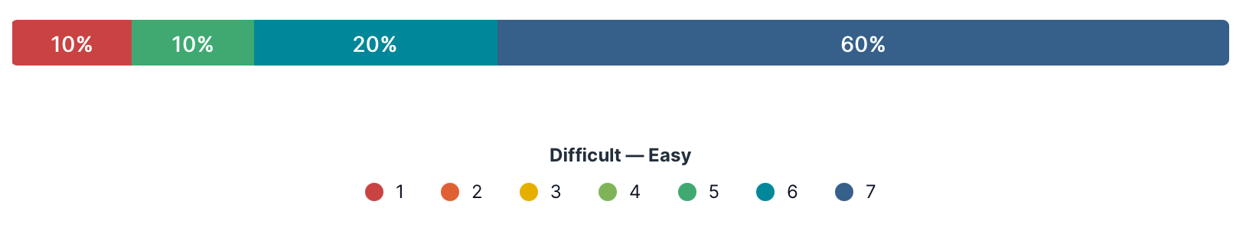
Consent
Understanding the "Consent" paragraph was:

Slide 45
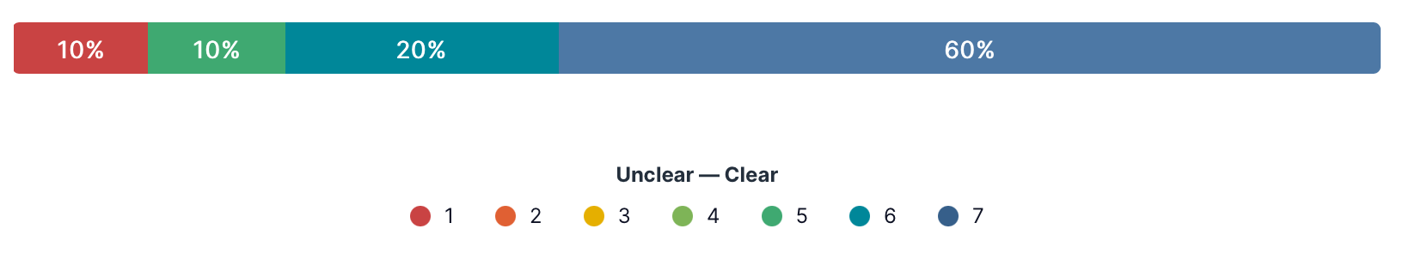
Consent
The "Consent " paragraph was:

Slide 46
Consent
Is this what you expect the "Consent" paragraph to look like in the "Expression of Interest form" (EOI form)?

Slide 47
Outcomes
Please suggest any changes that you would like to see in the "Consent" paragraphs? (please put n/a if no comment)
I think it should all be online and not in a word document. If it’s online it will be much more user friendly.

Slide 48
Follow Up Questions
We asked these follow up questions:
1. What do you expect to happen as a result of completing this EOI form and submitting in?
2. Do you feel that the EOI form will get you the support required by you/your business?
3. At any point while filling in the form did you notice the lack of any of these?
4. Overall, how easy or difficult are the questions to understand?
5. If you were filling in this form for your company how would you find it?
6. Overall, the questions were:
7. Please list top 3 benefits of this EOI form approach. (use n/a if no comment)
8. Please list top 3 drawbacks of this EOI form approach. (use n/a if no comment)

Slide 49
Follow up (1)
We would be contacted for further information
I would expect a reply informing me that have received my application what time frame i could expect a reply in and who i can use as a point of contact for any further help i required
A decision as to whether you qualify or a request for further clarification on some areas perhaps and then to initiate a full checking process with application that is more detailed or maybe interview process
someone gets back in touch to discuss further
receiving a reply within 3 working days
To receive a response / confirmation of success (or not) in a respective period of time. Following this, further communication with SE regarding the most suitable assistance they can offer.
journey started - I would be contacted by SE
for Scottish Enterprise to contact me to discuss within 3 days
receiving a reply from SE seeking more information, or to ask to apply for funding or perhaps hear we wouldn’t be eligible to apply on this ocasion.
I would expect to be contacted by Scottish Enterprise within a few days
What do you expect to happen as a result of completing this EOI form and submitting in?

Slide 50
Follow up (1)
What do you expect to happen as a result of completing this EOI form and submitting in?
These suggests:
Reply (3 working days)
Contact
Decision
Success or Not
Supply more information

Slide 51
Follow up (2)
70% think it will get them the needed support
Do you feel that the EOI form will get you the support required by you/your business?
Comments
We never get any support
its far too specific and frankly daunting
It depends on other applications I imagine, funding available for projects overall. It is probably a first step along a longer process however may take a long time to process
It is a first stage in explaining why I need support
If you have read the Purpose section of the form correctly and still felt as though it is correct to complete it and push for the assistance from SE then I believe there is a good case for believing you/your business would get the support. SE wants to help out businesses that meet their goals/aims and therefore there is a shared interest for both parties. The form made me feel very positive.
It seemed to have a founding principle of social responsibility - so providing I met the criteria for assistance and was requesting something which matched the ethos I don’t see any problems provided I meet the social/envvironmental/economic criteria
It feels fair, open and honest.

Slide 52
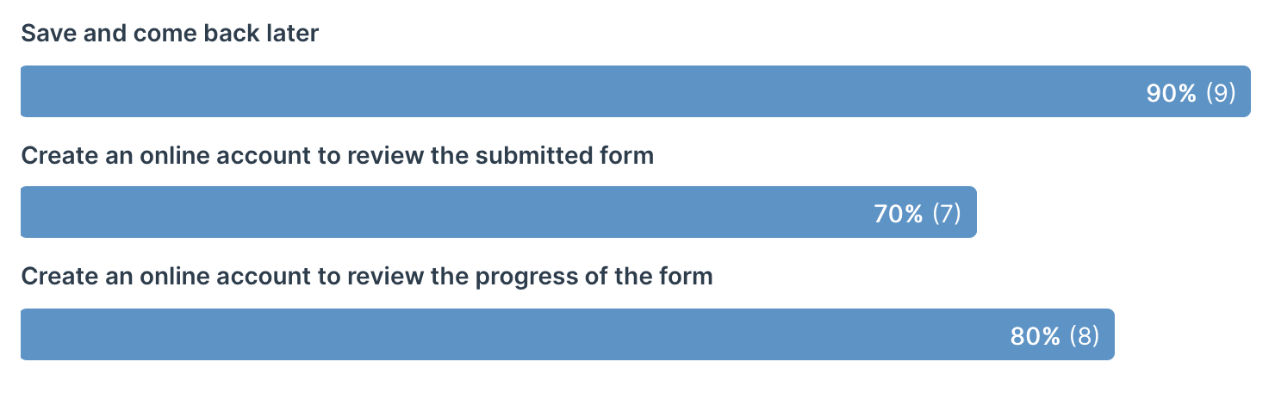
Follow up (3)
At any point while filling in the form did you notice the lack of any of these?

Slide 53
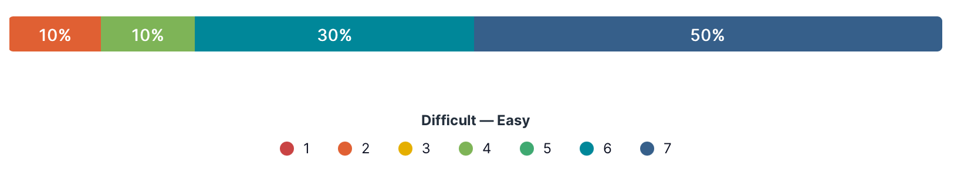
Follow up (4)
Overall, how easy or difficult are the questions to understand?

Slide 54
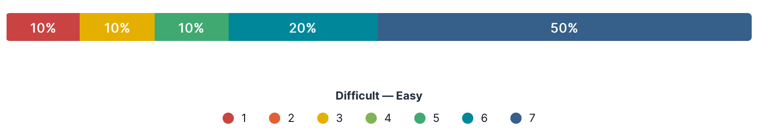
Follow up (5)
If you were filling in this form for your company how would you find it?

Slide 55
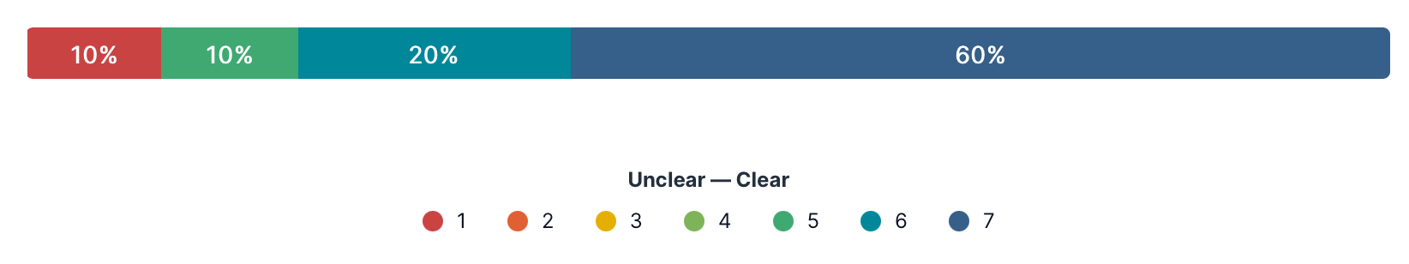
Follow up (6)
Overall the questions were?

Slide 56
Follow up (7)
Simple
it weeds out people who are not committed it will make you do your research it might challenge you to think bigger for your business idea
Brief. To the point. Get a quick decision (in theory)
easy, userfriendly and fast approach
Quick to complete. Clear to understand questions Clean layout
clear easy to understand functional
Clear at the outset what Scottish Enterprise are looking for before they would support a company Quick to complete if you have the information. Once you know you will need this information then process nice and quick each time you apply as info will be the same Clearly laid out
Clear. Well laid out. Open, fair, honest.
Clear questions, easy to understand, not too much information
Please list top 3 benefits of this EOI form approach. (use n/a if no comment)

Slide 57
Follow up (8)
Is it worth doing, we never get support, so why bother
the language is very daunting, its incredibly condescending and they really have too high expectations
Cannot give a lot of detail and show off my project
Not the best format to complete online (without printing it out and completing manually) Not a better description of ’project’ and some terminology may be lost on some Would be nicer to have an expected response time on the form for when you would likely hear back about success/no success
time consuming formulaic can’t think of 3rd
Would be better as an online form that could be saved and reused no other drawbacks
Not being able to start and save for later, but equally the form can be used as a guide to prepare details to then fill it in all together,
use of word document instead of online, lack of save feature, lack of help section, easy to understand, not too much information
Please list top 3 drawbacks of this EOI form approach. (use n/a if no comment)

Slide 58
Recomendations
ooo

Slide 59
ooo
ooo

Slide 60
fin

