Slide 1
Expression of Interest v2
Version 2 testing of EOI form
Dec 8th 2020
Martin Kerr
Anubhav Mittal

Slide 2
Test Summary
We put the Expression of Interest form VERSION 2 on UserZoom, for online unmoderated testing with their panel. This included a WORD document version, as well as an Online (WEB) version.
We added a screener for Scottish Business Owners or Decision Makers
We asked questions to find opinions on:
The EOI approach
The EOI form
We tested with 10 participants

Slide 3
Hypotheses
To structure testing, we applied 2 Hypotheses to the research:
Hypothesis 1
People will welcome the Expression of Interest approach
Hypothesis 2
The form will make sense and be easy to use
The test notes allow retrospective application of new Hypotheses up to a point

Slide 4
Hypothesis 1: Partially supported
Hypothesis: People will welcome the Expression of Interest approach
Findings:
People understand the benefits of the approach
They think it will save them time in the long run
Expect to not have to resubmit the same information again
The online solution scores better than the word document
BUT
Have a solution that can be left and returned to with their data still save
Recommendations:
Clarify language around EOI vs Pre-qualification, and the exact purpose of this form

Slide 5
Hypothesis 2: Supported
Hypothesis: The form will make sense and be easy to use
Findings:
The form makes overall sense
People conflate EOI and Pre-qualification
The ability to save progress is valued
Recommendations:
Look at iterating on the Purpose Paragraph
Consider an online option even if it is just SurveyMonkey or similar

Slide 6
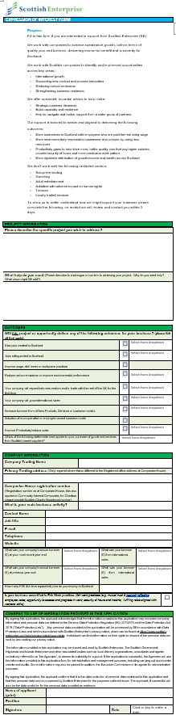
The form (Word Document)
Has 5 main sections
Purpose
Project Info
Outcomes
Company Information
Consent

Slide 7
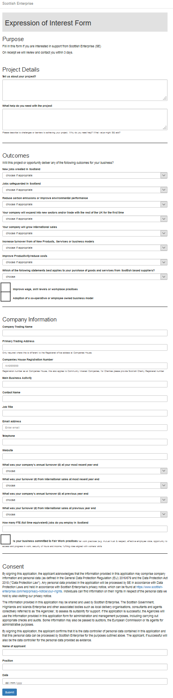
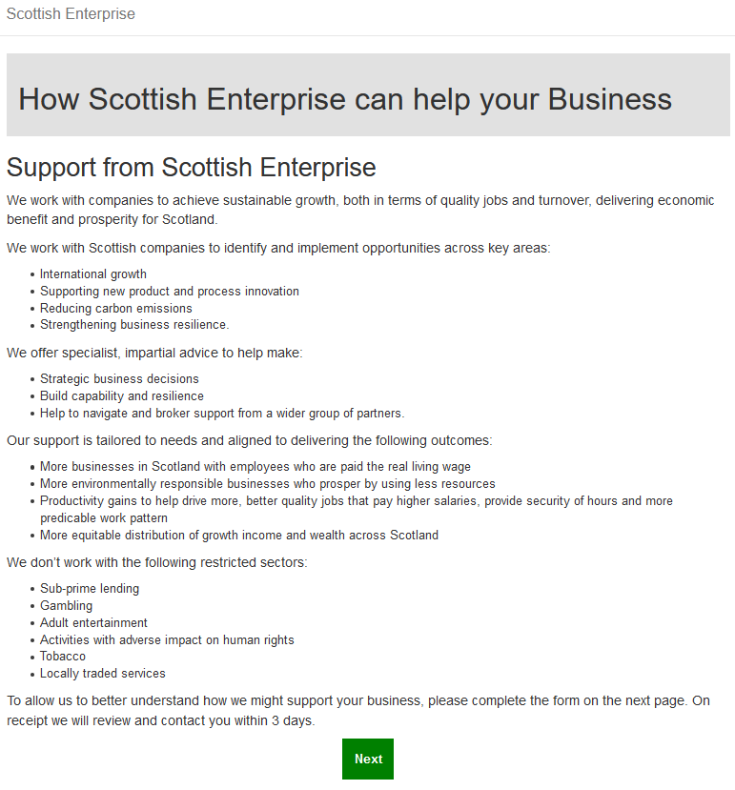
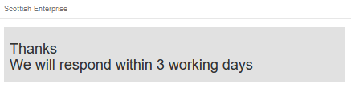
The form (Web)
https://scotentsd.github.io/testing/test_om/

Slide 8
Contents (TOC)
Keep reading for in depth findings
or
Skip to Summary & Recommendations
Or
Jump to any of these sections
Pre-test questions
Word Doc Version
Web Version
Summary
Recommendations

Slide 9
Pre-test questions
We asked the following question before showing the form:
When applying to the government for business support, which approach would you prefer?
What do you understand by Expression of Interest?
What are the Pros of Expression of Interest?
What are the Cons of Expression of Interest?

Slide 10
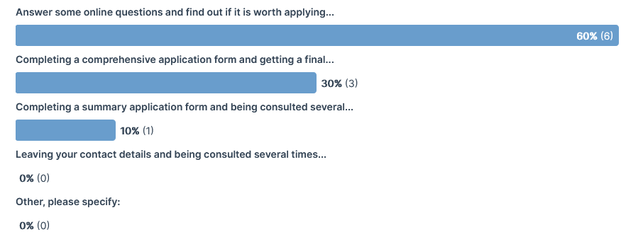
Pre-test (1)
When applying to the government for business support, which approach would you prefer?
Notes: This is similar to last week

Slide 11
Pre-test (2)
Showing interest in applying for something for when it becomes available
that mean for me , what we are looking for
is what is shown as interesting fro people
The chance to present myself in a clear professional document
a transaction document between two bodies
An indication of interest to undertake a project or to determine if you qualify for something before the main applacation
This means that you are interested in something but not necessarily committed. You just want to know more.
this is when you advise that you are interested in a certain purchase or scheme
To notify someone that you are interested in the service/offering but not ready to commit
To contact someone officially involved in a scheme/project and submit an interest in talking part
What do you understand by Expression of Interest?

Slide 12
Pre-test (2)
What do you understand by Expression of Interest?
These suggest:
Showing that you are interested
Applying
Waiting for availability
Interested
Not necessarily committed

Slide 13
Pre-test (3)
I would hope to be notified when the service becomes available
something we will have after we closed our interested
the qualification for
It is a written document therefor anyone required has the chance to read the same material as someone else in the decision making process
structured, well known and systematic
It saves time, It clarifies points, it streamlines the process
It means that you can express an interest with no commitment. If that choice isn’t yours alone you can give your fellow decision-makers the information they will need to see if they want to make an expression of interest and actual commitment to applying.
it allows the person providing the service to tailor their services to the needs that you have expressed
You can either reserve a place/position without having to commit to an expense or into an agreement
officially noted as interested with a date and time stamp. gives a general idea of numbers who are interested quick and easy to apply
What are the Pros of Expression of Interest?

Slide 14
Pre-test (3)
What are the Pros of Expression of Interest?
These suggest
Availability
Fair
Structured
Saves time
Interest without commitment
Tailored solution
Reserving a place

Slide 15
Pre-test (4)
None that I can think of
is about conclusion
something is not totally interest
You don’t get the chance to give a personal presentation where you are able to build a raport with those in the decision making process.
open for interpretation, subjectivity and difficulty in composition
It may leave people out
You may get your hopes up that this will be of use to your company or you may spend the time you don’t have looking into it.
it can limit your options has the person providing the service may not offer you a service that you later decide you needed
You may not be the only one and this may not guarantee you the item/service
can be oversubscribed how is it communicated - people may not apply as don’t understand terminology
What are the Cons of Expression of Interest?

Slide 16
Pre-test (4)
What are the Cons of Expression of Interest?
These suggest
None ☺
No in-person rapor building
Open to interpretation…Subjective
Opportunity cost and Hope fatigue
No guarantee of a service
Comms may deter submissions

Slide 17
Response to the Word Document
We asked the following question about the Word Doc EOI form:
What do you expect as a result of completing this EOI form?What do you expect as a result of completing this EOI form?
Is this what you were expecting to see when we mentioned "Expression of Interest form" (EOI form)?
Can you rate the form sections and identify any particular questions that caused you problems

Slide 18
EOI Word(1)
To be put on a register by which I could be given help or support with the project in question
will be dilling whit my problem and solution
I hope to get support for my business according to whit the new strategy of the country
either a notification of a successful or rejected application
Support with regards to business and strategy / consulting
I get feedback to see if I qualify for the next stage
That I will be contacted by Scottish Enterprise with details of how they might be able to help. This contact will be within 3 working days of them receiving the EOI.
i might expect someone from Scottish Enterprise to contact me for more information about my project
I was expecting some more questions around our aim and goals for the business maybe where we see it growing to in 5 years time. It would also be helpful to ask what skills you feel the business is missing when thinking about these future ambitions. The reason for this is that the proposed funding or help should be specific to the gaps in the applicants business model.
to be contacted in 3 days to go over my application
What do you expect as a result of completing this EOI form?

Slide 19
EOI Word(1)
These suggest:
A register
Support for my business
Decision
Communication
Qualify Y/N
3 Days
A bit light on questions about my business goals etc…
What do you expect as a result of completing this EOI form?

Slide 20
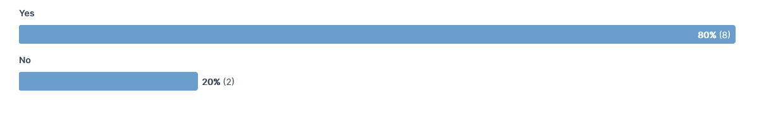
EOI Word (2)
Is this what you were expecting to see when we mentioned "Expression of Interest form" (EOI form)?
Last version? 50% said it was what they expected to see

Slide 21
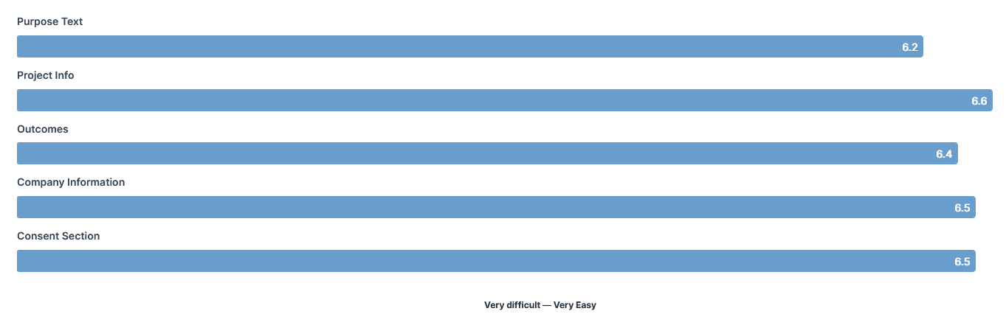

EOI Word (3)
Can you rate the form sections and identify any particular questions that caused you problems
Last version?

Slide 22
Response to the Web Form
We asked the following question about the WEB form:
What do you expect as a result of completing this EOI form?What do you expect as a result of completing this EOI form?
Is this what you were expecting to see when we mentioned "Expression of Interest form" (EOI form)?
Can you rate the form sections and identify any particular questions that caused you problems

Slide 23
EOI Web Form(1)
To be put a register to be informed about support opportunities
I will get the support for developed business and quality control
i like this idea achieve sustainable growth
Yes and more
business / strategy support once again
To get feedback within 3 days
To be contacted within 3 wd by SE detailing how they might be able to help a business.
i would expect a confirmation email and a follow up phone call to discuss further details about the project.
Already completed when selected next it opened the task again
again to be contacted in 3 days to discuss my application
What do you expect as a result of completing this EOI form?

Slide 24
EOI Web Form(1)
These suggest:
A Register
Get Support
Be informed
Sustainable Growth
Feedback in 3 days
How you might help
Confirmation (email / phone …)
What do you expect as a result of completing this EOI form?

Slide 25
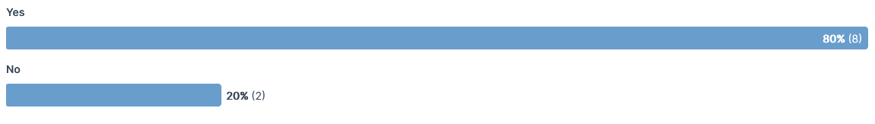
EOI Web Form(2)
Is this what you were expecting to see when we mentioned "Expression of Interest form" (EOI form)?

Slide 26
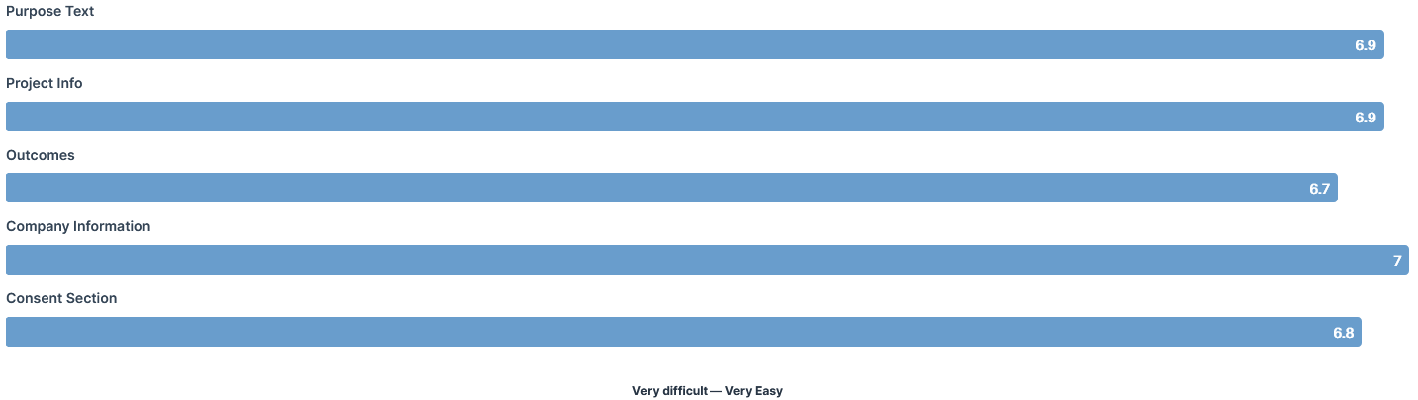
EOI Web Form(3)
Can you rate the form sections and identify any particular questions that caused you problems
Last version?

Slide 27
Follow Up Questions
We asked these follow up questions:
1. What do you expect to happen as a result of completing this EOI form and submitting in?
2. Do you feel that the EOI form will get you the support required by you/your business?
3. At any point while filling in the form did you notice the lack of any of these?
4. Overall, how easy or difficult are the questions to understand?
5. If you were filling in this form for your company how would you find it?
6. Overall, the questions were:
7. Please list top 3 benefits of this EOI form approach. (use n/a if no comment)
8. Please list top 3 drawbacks of this EOI form approach. (use n/a if no comment)

Slide 28
Follow up (1)
ToTo be put on a register expressing interest in being offered project support
I will get complete ideas to improve my bussines
I will support to grow up my business
A result of my application successful or rejected
receive a response and offer of support for business or strategical support
To get feedback if I qualify or not for support within 3 days
That you will be contacted within 3 days with details of financial and other help you may get.
i would expect, to be contacted either by phone or my way of an additional form through the post to provide more detailed information.
There will be someone who gets in contact with some offers of help and support to help grow the business
a meeting or call will be arranged with SE to go over my application to iron out any missing info/understanding.
What do you expect to happen as a result of completing this EOI form and submitting in?

Slide 29
Follow up (1)
What do you expect to happen as a result of completing this EOI form and submitting in?
These suggests:
A Register
Support & Ideas
Success or Rejection
Within 3 days
Supplemental communication
Probably Phone or Email

Slide 30
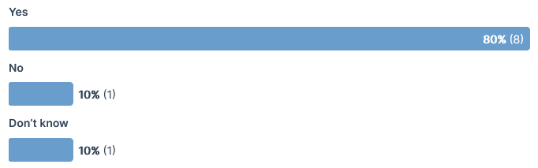
Follow up (2)
Do you feel that the EOI form will get you the support required by you/your business?
Last version? 70% said yes

Slide 31
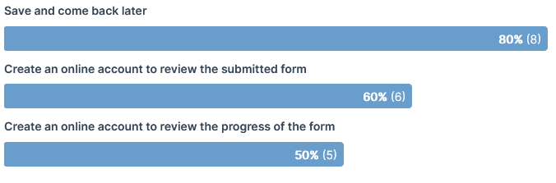
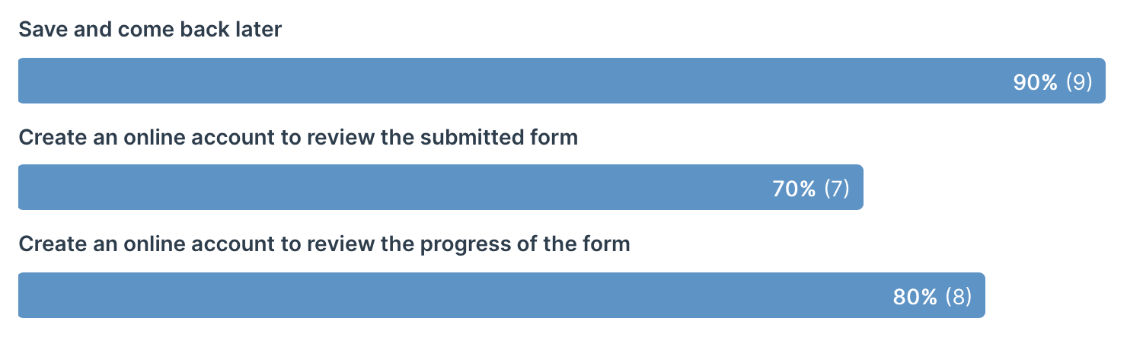
Follow up (3)
At any point while filling in the form did you notice the lack of any of these?
Last version?

Slide 32
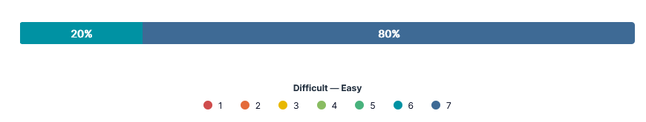
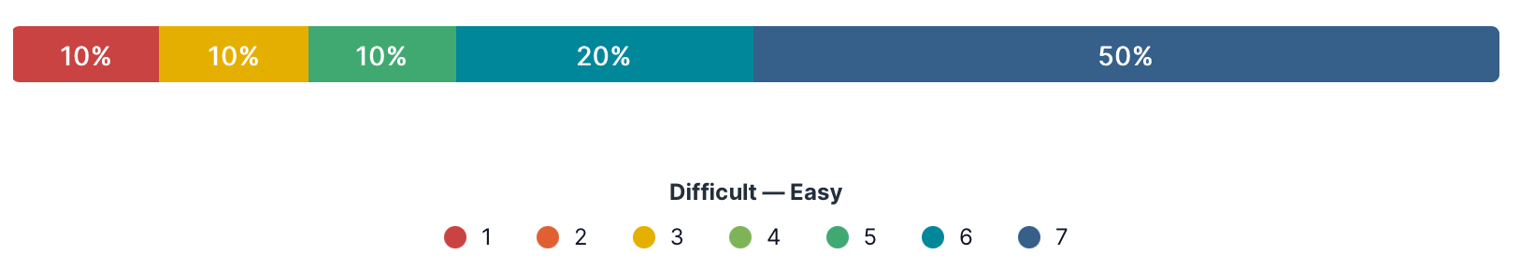
Follow up (4)
Overall, how easy or difficult are the questions to understand?
Last version?

Slide 33
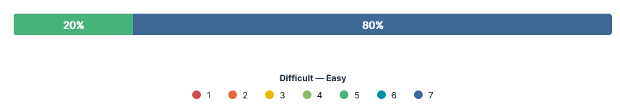
Follow up (5)
If you were filling in this form for your company how would you find it?
Last version?

Slide 34
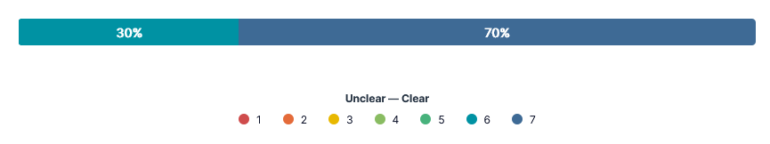
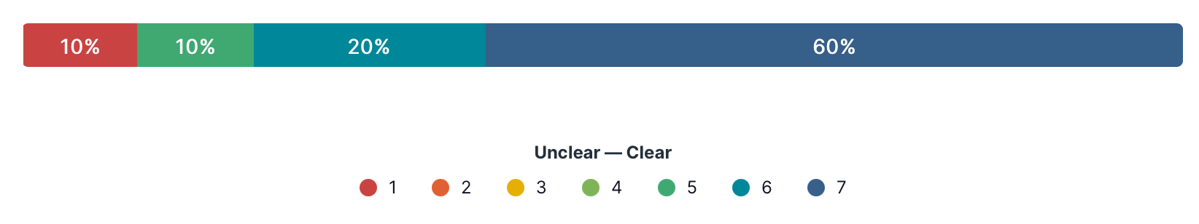
Follow up (6)
Overall the questions were?
Last version?

Slide 35
Follow up (7)
It allows me to provide plenty of information about the business and project It explains to me what the form is for and will do
Service, efficient and control
Ability to leave the document then return at a later time. Ability to share the document before submitting to others in the company
Simple, Fast, Structured
It is easy to get feedback on qualification
Form was very short and easy to complete. Where questions needed any kind of explaining this was done i.e when it asked about fair working practices. You were told what help you could expect in short i.e financial and impartial advice.
Top benefits are to direct you to get the support you need.
1. Clear sections 2. Drop downs to help categorise your answers 3. Not too overwhelming
Easy to complete easy to understand what projects will be supported expectations of reply are set out - i.e. 3 days
Please list top 3 benefits of this EOI form approach. (use n/a if no comment)

Slide 36
Follow up (8)
Lending, Opportunities, Productivity
Having multiple copies if sharing with colleagues
Not allowed to give a whole lot of information. Unable to send a copy of the form filled in to yourself within the format i.e a button to click to send the copy to yourself. Not being able to save your progress.
The form is limited in information asked and may cause delays whilst further information is gathered.
1. Not enough context on some of the fair working questions 2. No progress indicator 3. No preview to what can be offered
Please list top 3 drawbacks of this EOI form approach. (use n/a if no comment)

Slide 37
Summary
Table of Contents
The scores improved, with Project Info and Company Info faring the best. This is great as these were identified as the biggest issues in the last version.
The web version scores better than the word version
Making the headings more discreet, highlighting the project section and unifying the Company Info section all seem to have worked well.
The purpose section is still weak….but it was me that rewrote it, and that shows why Professional Content developers are worth it. ☺ (mk)

Slide 38
Recommendations
Table of Contents
Adopt the discreet section headings shown here
Keep the company info unified if possible (Registration requirements may cause this to be tricky)
Iterate the Purpose section
Consider other online submission options (question list and Survey monkey etc..)

Slide 39
fin

