Slide 1
Expression of Interest v3
Version 3 testing of EOI form
Dec 17th 2020
Martin Kerr
Anubhav Mittal

Slide 2
Test Summary
We put the Expression of Interest form VERSION 3 on UserZoom, for online unmoderated testing with their panel. This included a SURVEY MONKEY version, with a web page intro.
We added a screener for Scottish Business Owners or Decision Makers
We asked questions to find opinions on:
Does having the form as a SurveyMonkey survey improve it’s usability and Ease of Use.
We tested with 10 participants

Slide 3
Hypotheses
To structure testing, we applied 2 Hypotheses to the research:
Hypothesis 1
Presenting the EOI form as a SurveyMonkey will improve it’s Ease of Use

Slide 4
Hypothesis 1: Not Supported
Hypothesis: Presenting the EOI form as a SurveyMonkey will improve it’s Ease of Use
Findings:
People were jarred by moving from a web page off to a SurveyMonkey without being explicitly informed what was about to happen
BUT
The general usability was not impared.
Recommendations:
Clarify language the transition to a Survey platform and retest.
Test with a simplified form.

Slide 5
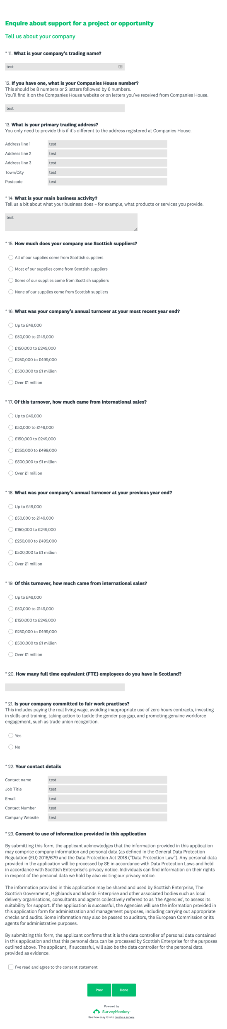
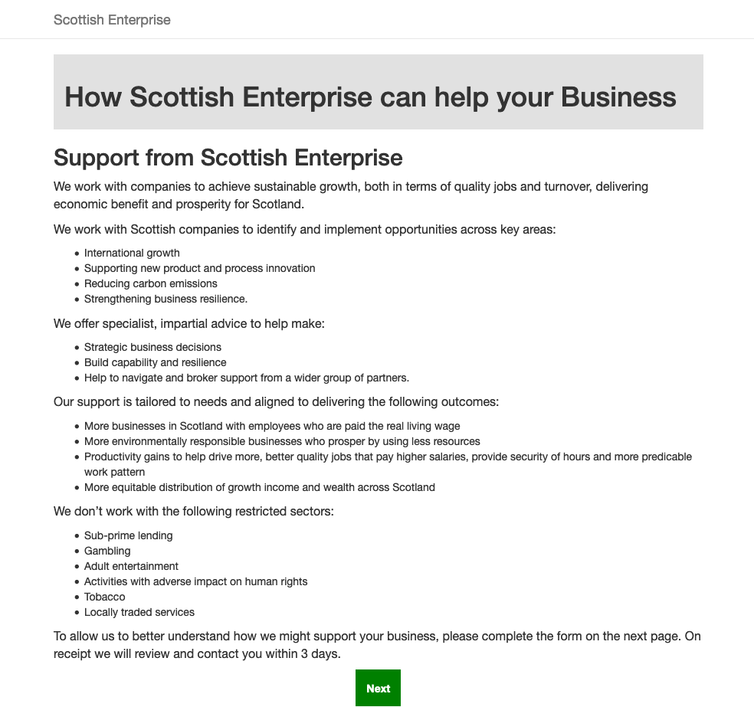
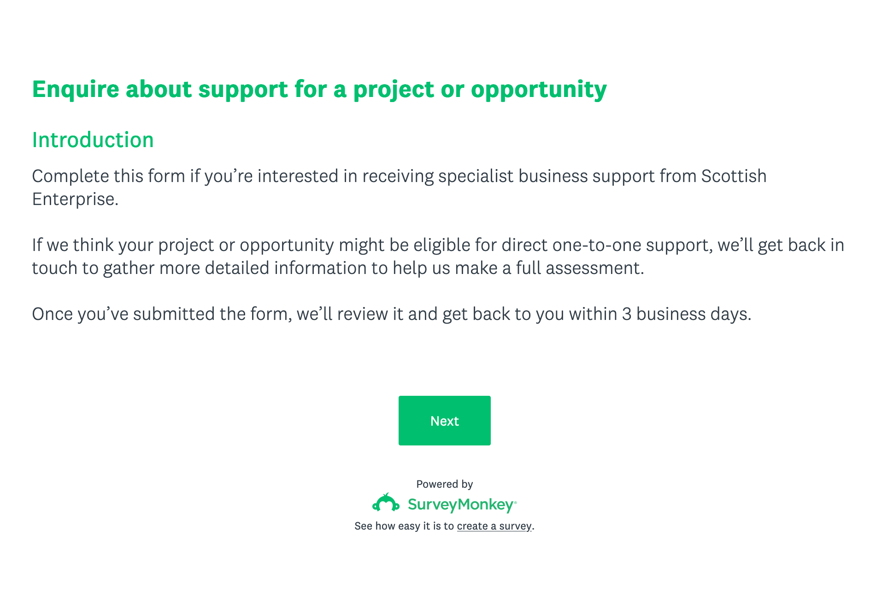
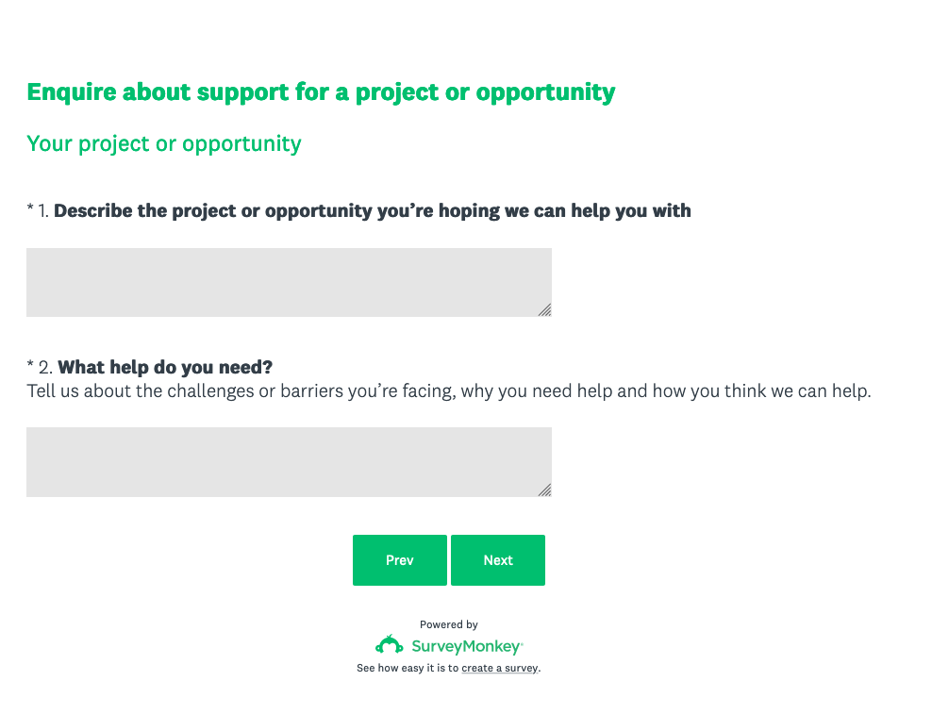
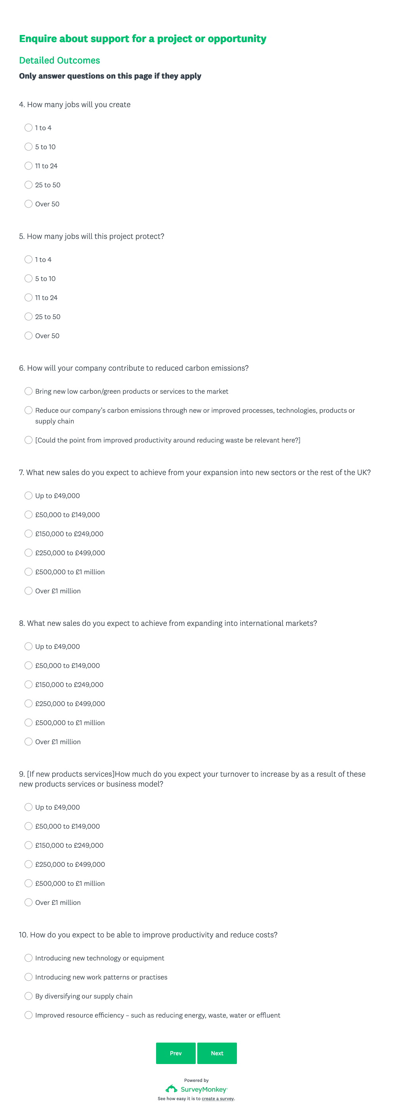
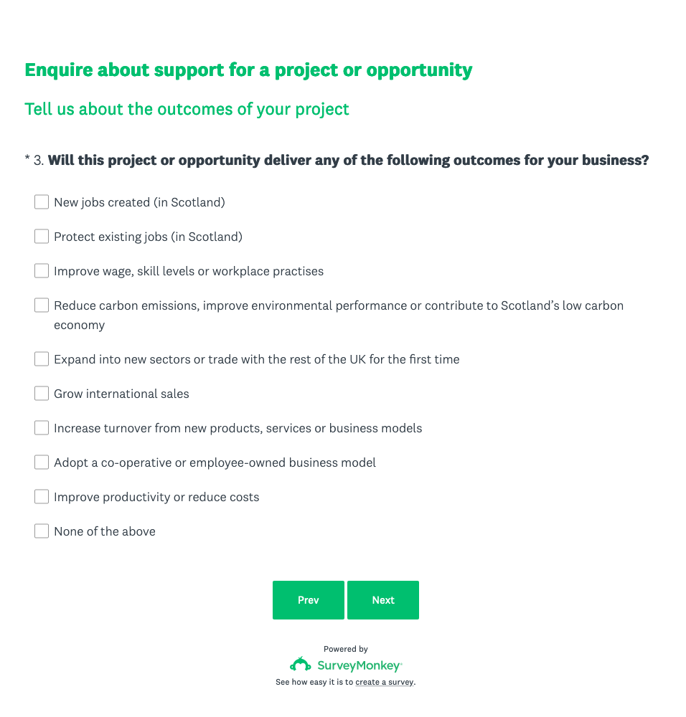
The form (SurveyMonkey)

Slide 6
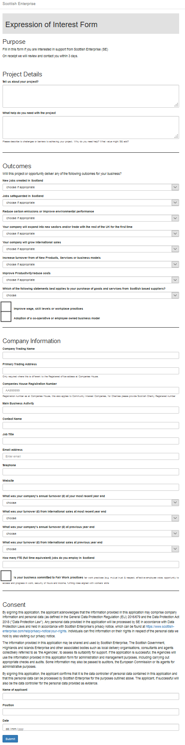
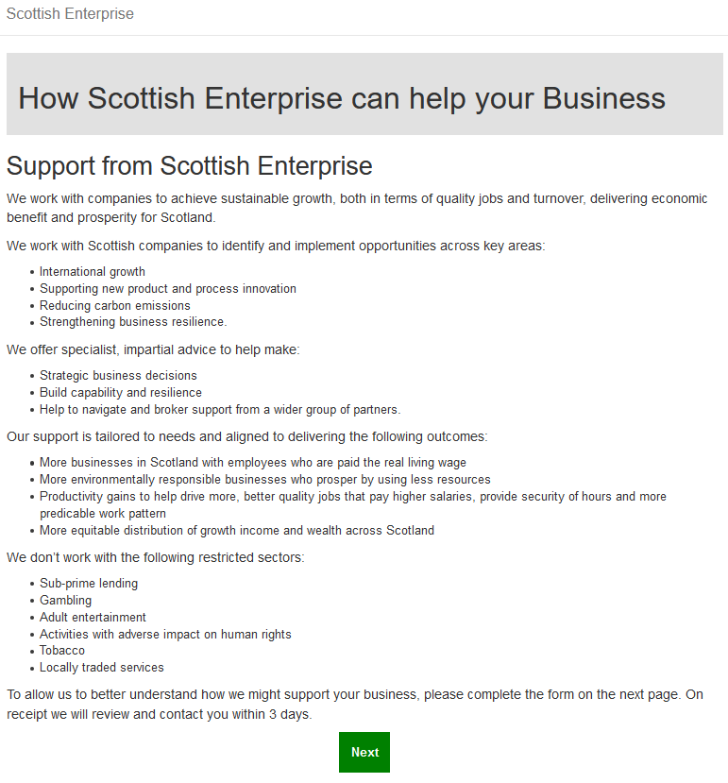
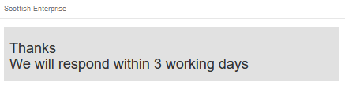
Previous version (Web)
https://scotentsd.github.io/testing/test_om/

Slide 7
Summary
Table of Contents
Presenting the form as a SurveyMonkey survey did NOT make it easier to use.
It didn’t reduce the usability by as much.
Most people were surprised when they were sent to s SurveyMonkey
There are a few factors that were changed at the same time. This means that it is still worth further testing. This will disprove/prove the validity of this approach.

Slide 8
Recommendations
Table of Contents
Retest with a more “Managed” transition to the SurveyMonkey
Retest with All Questions on one Page.
Retest with a smaller form (no Outcomes)

Slide 9
fin

