Slide 1
Expression of Interest v4 & V5
Version 4 & 5 testing of EOI form
Jan 7th 2021
Martin Kerr
Anubhav Mittal

Slide 2
Test Summary
We put the Expression of Interest form VERSION 4 on UserZoom, for online unmoderated testing with their panel. This included a SURVEY MONKEY version, with a web page intro.
We added a screener for Scottish Business Owners or Decision Makers
We asked questions to find opinions on:
Does having the form as a SurveyMonkey survey improve it’s usability and Ease of Use.
We tested with 10 participants

Slide 3
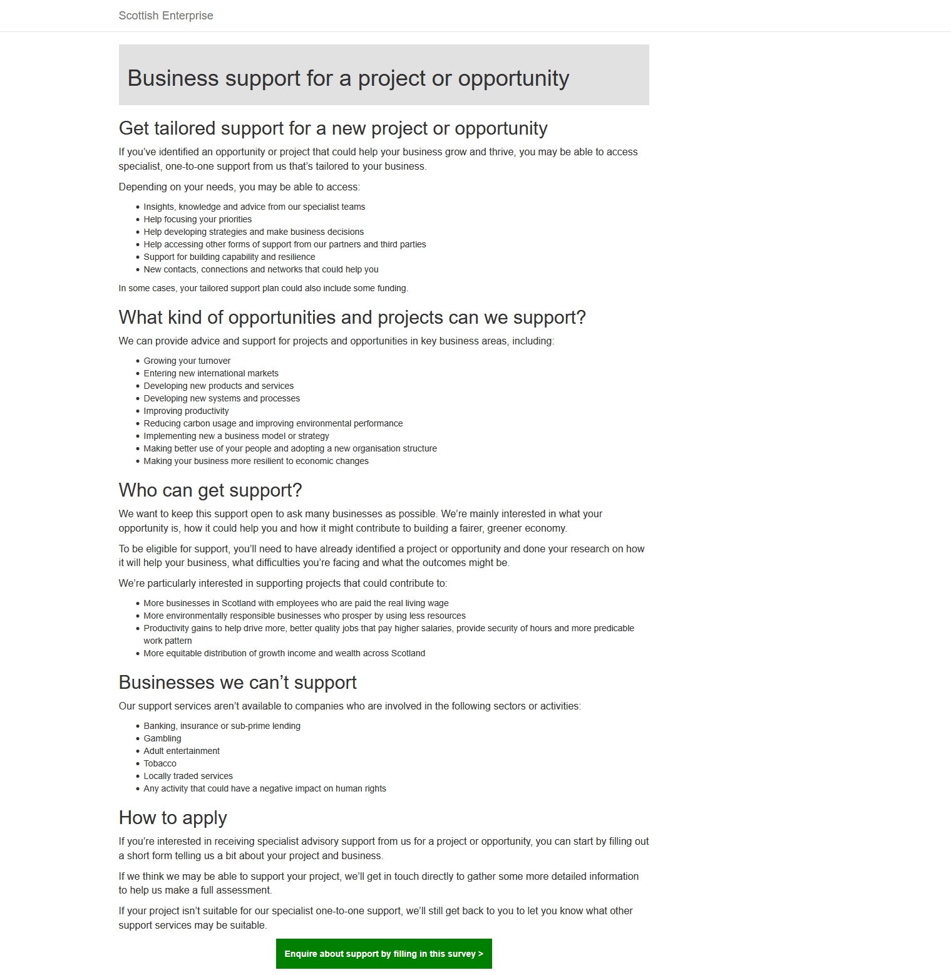
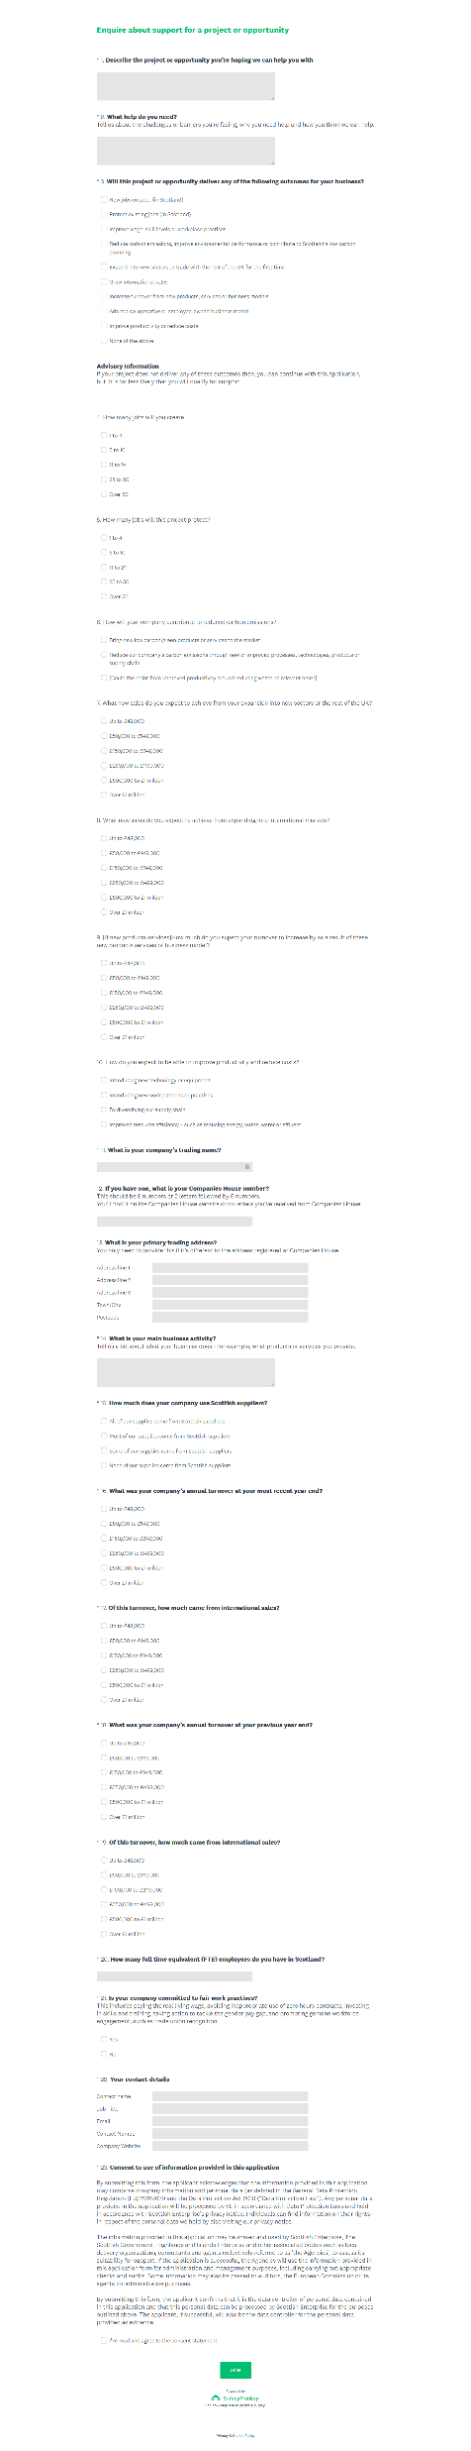
V4 https://scotentsd.github.io/testing/test_om/v4.html

Slide 4
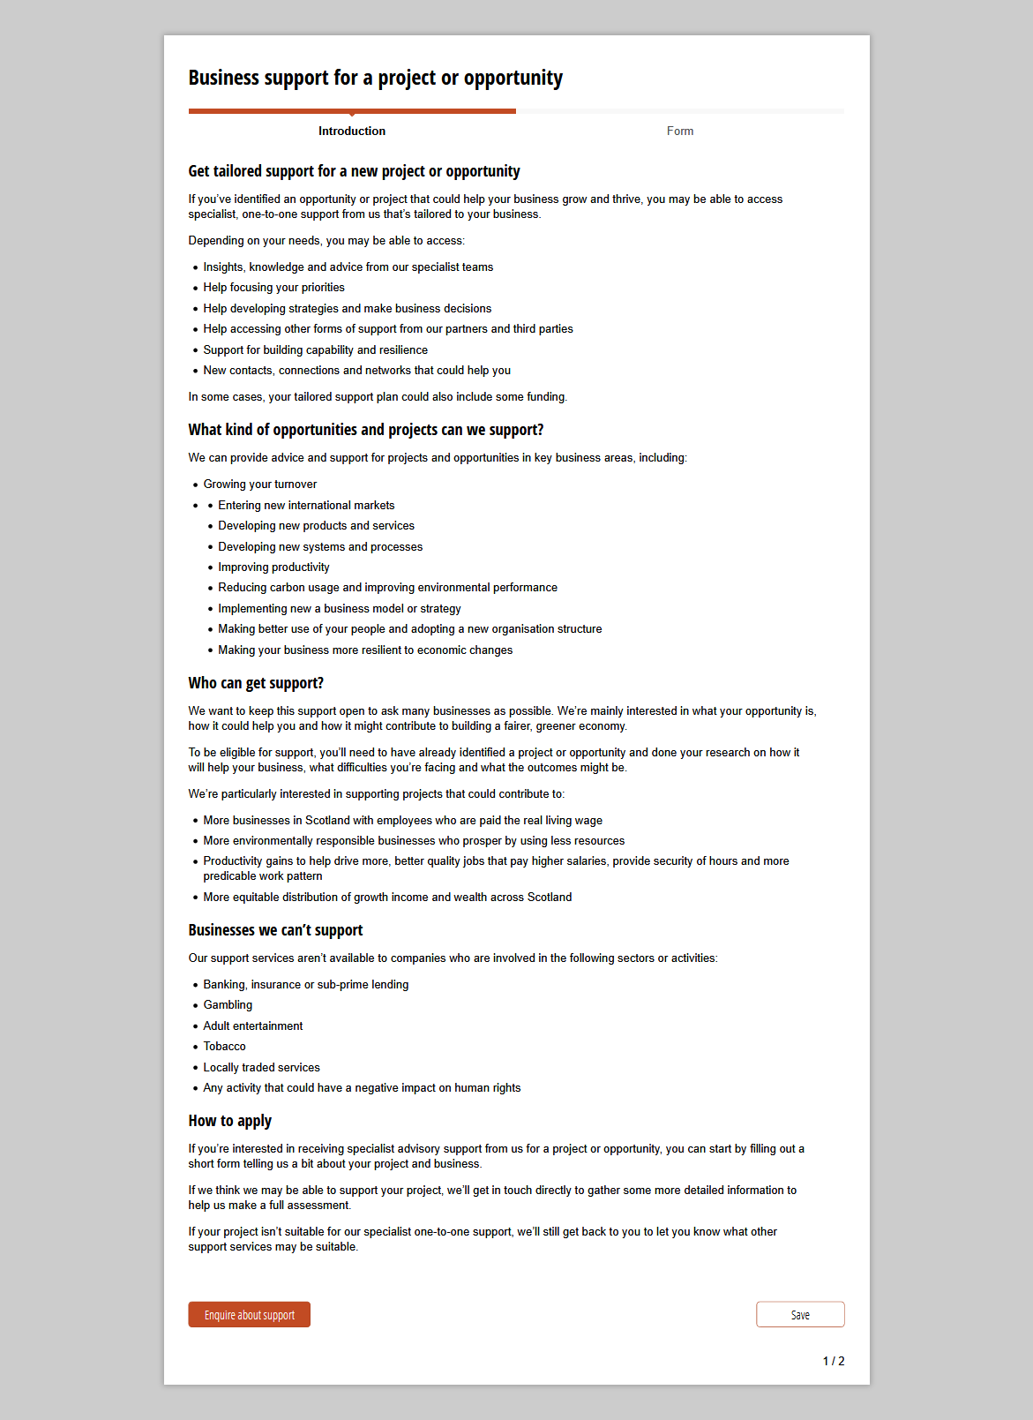
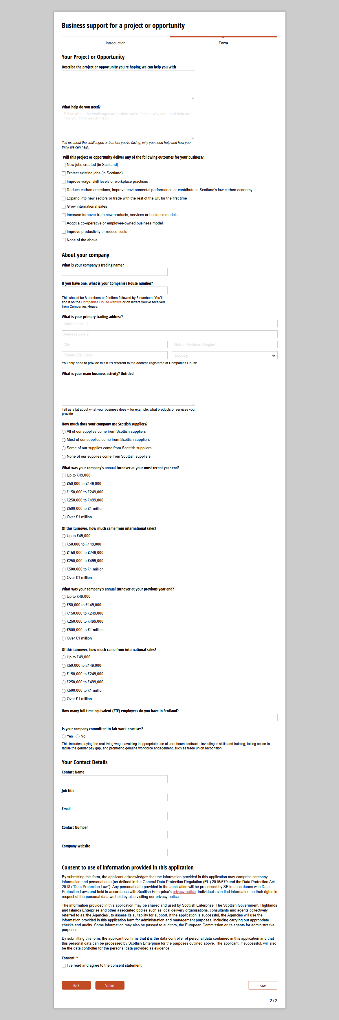
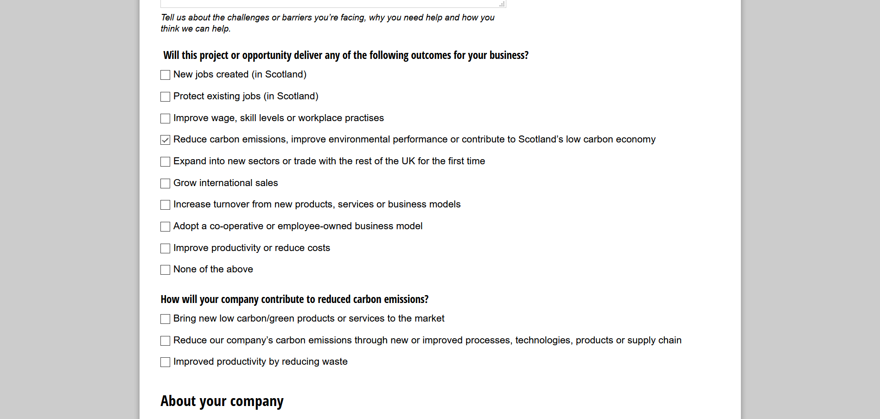
V5 https://www.cognitoforms.com/CognitoForms79/BusinessSupportForAProjectOrOpportunity

Slide 5
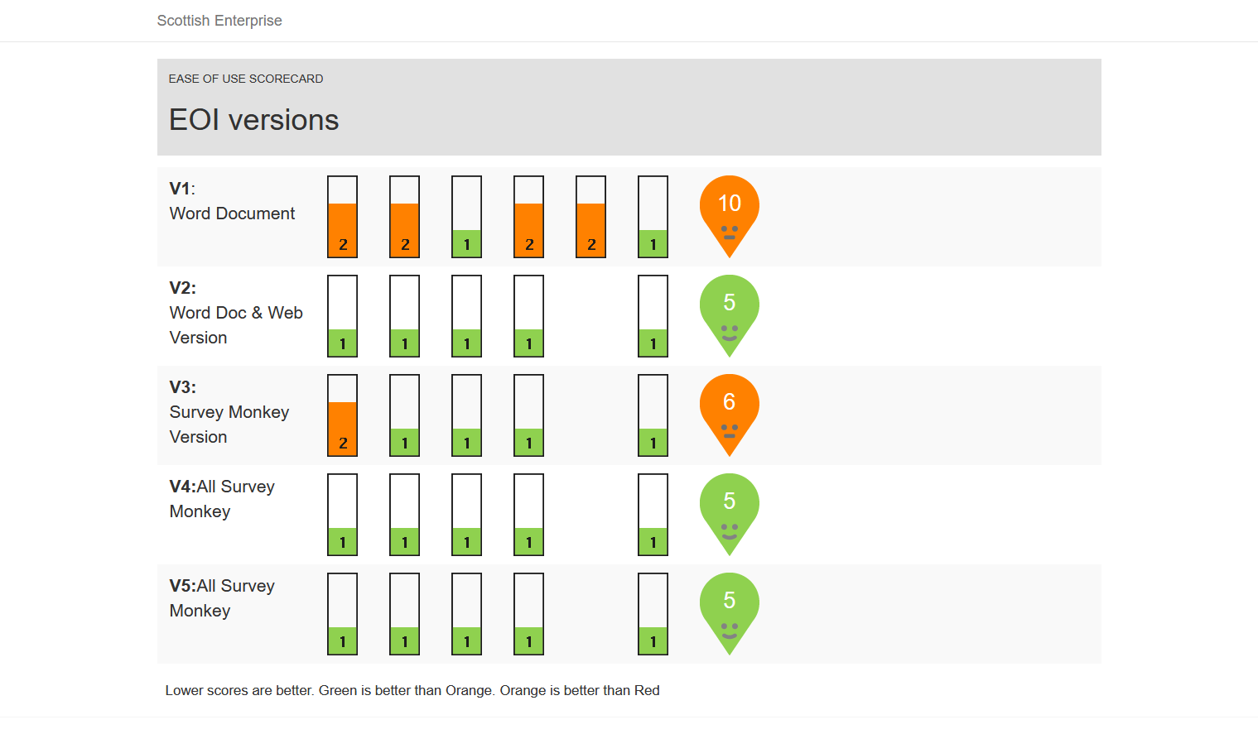
Table of Contents

Slide 6
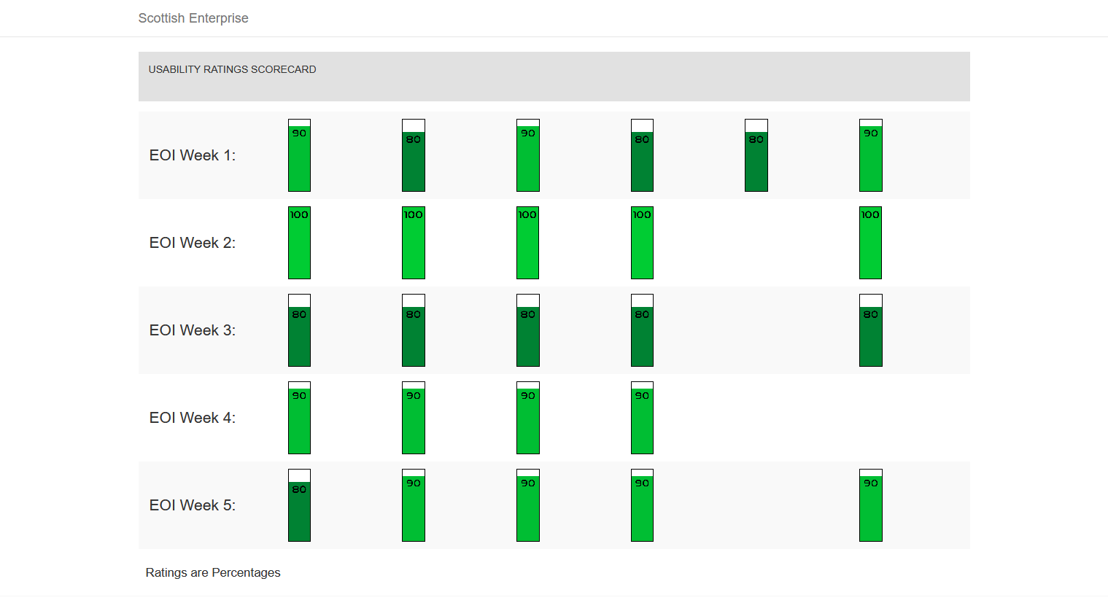
Table of Contents

Slide 7
Older versions
V3: https://scotentsd.github.io/testing/test_om/v3.html
V2: https://scotentsd.github.io/testing/index.html
V1: https://scotentsd.github.io/testing/index.html

Slide 8
fin

