Slide 1
Design critique
Design crit
GDS
Notes:
Who has heard of it before?
Who has participated in a design critique?
Who has had their work critiqued?

Slide 2
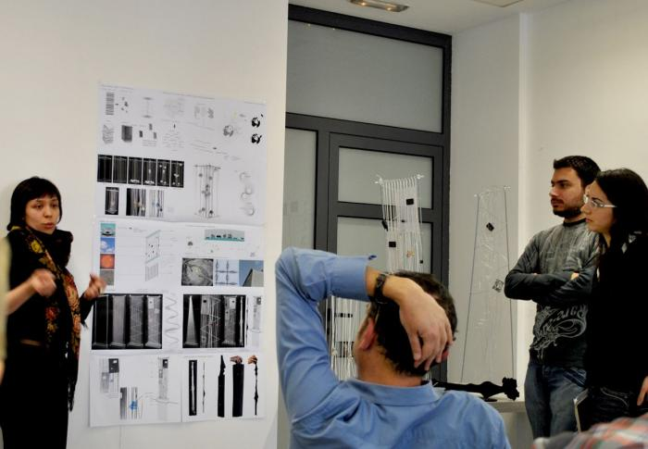
Notes:
it often looks something like this
can anyone talk about their experience of design crit?
Is this mans head falling off?

Slide 3
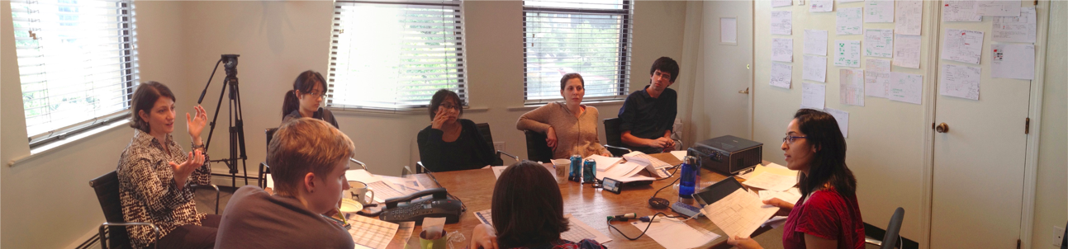
What should you critique?
Anything and everything
Notes:
How do you think this woman might be feeling?
Photo from Flickr by @juhansonin

Slide 4
Critique, not criticism

Slide 5
Critique
A detailed analysis of something

Slide 6
What are they for?

Slide 7
What are they for?
To improve the thing

Slide 8
Who with?

Slide 9
Who with?
Anyone who isn’t a user

Slide 10
What should you critique?

Slide 11
What should you critique?
Anything and everything

Slide 12
What are the benefits?

Slide 13
What are the benefits?
a second (etc) opinion
or an outsider's view
de-risk your design
to mitigate bias
to stress-test your design
test ideas
to share your work

Slide 14
Running a
design crit
GDS

Slide 15
If it’s your work being reviewed...

Slide 16
1. Set the context
who are the users?
what do they need?
what stage is the project at?
what are our current assumptions?

Slide 17
2. Say what kind of feedback you want
graphic design
interaction design
service design
content design

Slide 18
3. Let the team review the work
don’t give a demo
don’t talk too much
don’t get defensive
do take notes
do listen

Slide 19
When showing your work - if you’re talking, you’re not listening
Notes:
The point of this is to get feedback
Resist the urge to explain or defend
If you are asked a question, deflect the answer back -

Slide 20
“What does this do?”
“What would you like it to do?”
Notes:
If you answer the question, you squash the idea behind it

Slide 21
Have a note taker

Slide 22
If you’re reviewing someone’s work...

Slide 23
1. Listen to the context
ask questions if you need to

Slide 24
2. Give the right kind of feedback
avoid personal opinions
avoid absolute statements
ask open questions
be kind
explore ideas and suggest alternatives

Slide 25
“I don’t like X”
“Y never works”
“What happens if…”
“Have you tried…”

Slide 26
In your groups
take it in turns to show your work
chose someone to take notes
do a design crit
take your time

Slide 27
Getting feedback
1. Set the context
who are the users?
what do they need?
what stage is the project at?
what are our current assumptions?
2. Say what kind of feedback you want
graphic design
interaction design
service design
content design
3. Let the team review the work
don’t give a demo
don’t talk too much
don’t get defensive
do take notes
do listen
Giving feedback
1. Listen to the context
ask questions if you need to
2. Give the right kind of feedback
avoid personal opinions
avoid absolute statements
ask open questions
be kind
explore ideas and suggest alternatives
“I don’t like X”
“Y never works”
“What happens if…”
“Have you tried…”

Slide 28
Dealing with subjective comments and specific solutions
Notes:
ask for a specific example
ask why why why
take it offline

Slide 29
How was it?

Slide 30
Any questions?

