Slide 1
Task Based Approach
Marketing Communications Formal team meeting
July 1st 2008
Martin Kerr & David O’Brien
Web Team, Information Services

Slide 2
Agenda
Task-Based Approach – What is it
Customer Roles
Customer Tasks
How does it actually work
How will it evolve
When will it evolve
Task Management Framework
Questions

Slide 3
Task-Based Approach – What is it
An approach that concentrates on Customer Tasks that match with SE Deliverables
Puts Customers at the centre of everything
Measurable
Scientific

Slide 4
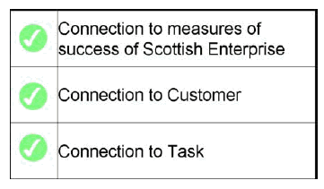
Task-Based Approach – What is it(2)
“It means changing the rules on how you get anything published onto a site from “it’s part of my project to publish this on the web” to “I need to publish this because it makes it easier for customers to achieve their tasks” (Gerry McGovern, SE workshop, Apr 2007)
The business case test for getting anything published on SE.com:
E.g. help 2,000 Scottish businesses during 08/09
Customer = Scottish growing businesses
Task = “I want to know how SE can help my business grow”

Slide 5
Customer Roles (x12)
  Scottish Growing Businesses
  Scottish Start-ups
  Scottish Businesses
  Banks, Investors & Venture Capitalists
  Foreign Investors
  Individuals
  Industry Groups
  Academics & Researchers
  Media
  SE Stakeholders & Partners
  Scottish Government
  Intermediaries & Business Advisers

Slide 6
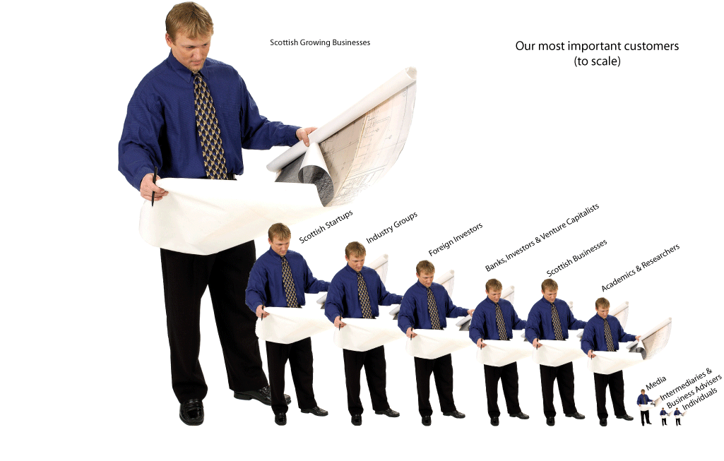
Customer Roles

Slide 7
Customer Tasks (201)
About Us – 18 tasks
Start your Business – 1 task
Grow Your Business – 17 tasks
Your Sector – 156 tasks*
Investment – 8 tasks
News and events – 1 task
* Note that the 13 priority industries each have the same 12 tasks associated with them (13 * 12 = 156)

Slide 8
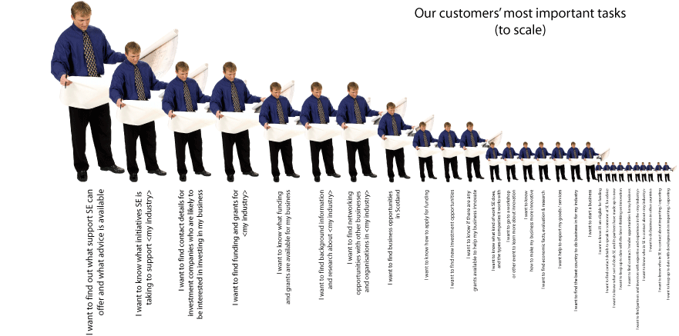
Customer Tasks

Slide 9
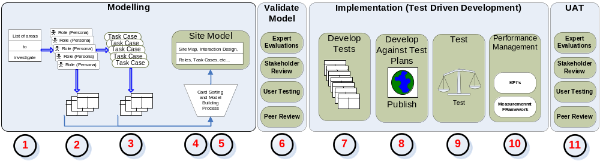
How does it actually work

Slide 10
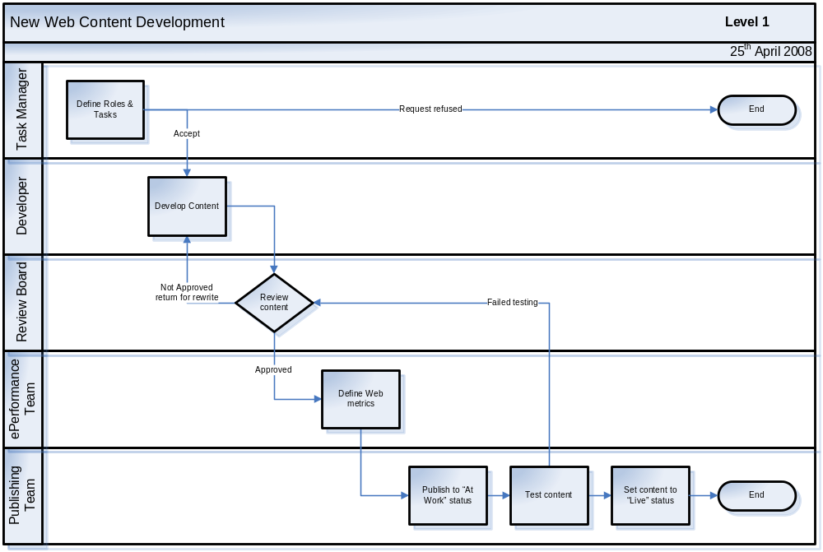
How does it actually work

Slide 11

How will it Evolve
Phase 1
  Roles and Tasks
  Scottish-Enterprise.com
  Reporting
Phase 2
  Personas and Customer Intelligence
  Web Analytics
  Tighter focus on Business Cases
  Task management & Task Reviews
Phase 3
  Economic Impact
  Financial Benefit
  …

Slide 12
When will it Evolve
 | 2008
 | Q1 |  |  | Q2 |  |  | Q3 |  |  | Q4
Description | Jan | Feb | Mar | Apr | May | Jun | Jul | Aug | Sept | Oct | Nov | Dec
Phase 1
SE.COM Relaunch
Phase 2
Personas and Customer Intelligence
Web Analytics
Tighter focus on business case
Task Management

Slide 13
Task Management Framework
Key activities:
meet quarterly
set task strategy
task targets
task performance / reporting
ensure web team have authority
Task Management
Steering Group
Connection to measures
of success for SE
Web Team
Connection to
customer
Task
Owner
Connection to
task
Task
Owner
Task
Owner
Task
Owner

Slide 14
Any questions?

Slide 15
Industry Tasks (12)
  I want to find funding and grants for <my sector> businesses
  I want to find partners and investors with expertise and experience in <my sector>
  I want to know what initiatives SE is taking to support <my sector>
  I want to find background information and research about the <my sector>
  I want to know what SE's strategy is for <my sector>
  I want to find networking opportunities with other businesses and organisations in <my sector>
  I want to know who in SE to contact about the <my sector>
  I want to keep up to date with developments in the <my sector>
  I want to find details of Scottish companies operating in <my sector>
  I want to know what laws and regulation are particularly important for <my sector> companies
  I want to influence SE's policy for the <my sector>
  I want to work in <my sector>

Slide 16
“About Us” Tasks (18)
I want to know what kind of work SE does, and the types of companies it works with
I want to find economic facts, evaluation & research
I want to find contract / tender opportunities for my business
I want to find out more about Scottish Enterprise's role
I want to know more about Scottish Enterprise
I want to find research material to help me prepare a briefing
I want to tell SE what I think about them
I want to know how to make this website easier to use
I want to know how SE will treat my personal information
I want to know the terms and conditions of use for this site
I want to know if I can re-use some of the content on this website
I want to know if the information I'm looking for has already been published or if I need to submit a Freedom of Information request to get it
I want to know what SE's policy is on equality
I want to know what standards SE has for its dealings with its customers
I want to know what projects SE has approved and how much money they are spending on them
I want to know what State Aid Notified Schemes are happening
I want to work for SE
I want to know what decisions have been made by SE's Board

Slide 17
“Grow Your Business” Tasks (17)
I want to find out what support SE can offer and what advice is available
I want to find business opportunities in Scotland
I want to know if there are any grants available to help my business innovate
I want to go to a workshop or other event to learn more about innovation
I want to know how to make my business more innovative
I want help to export my goods / services
I want to find the best country to do business in for my industry
I want to keep up to date with the latest thinking on innovation
I want to do business in other countries
I want to know who in SE to contact about importing / exporting
I want to keep up to date with developments in importing / exporting
I want to find potential partners and investors to help my business innovate
I want to know how to apply for innovation grants to increase my chances of success
I want to have my say about the innovation support SE offers and shape how they work in the future
I want help to import goods / services into Scotland
I want to find out more about my industry in a specific country
I want to find business opportunities in other countries

Slide 18
Investment Opportunities Tasks (8)
I want to find contact details for investment companies who are likely to be interested in investing in my business
I want to know what funding and grants are available for my business
I want to know how to apply for funding
I want to find new investment opportunities
I want to know if I am eligible for funding
I want to find contact details to speak to someone at SE for advice
I want to know what sort of deals SE and its partners have made up to now
I want to keep up to date with new investment opportunities for my business

Slide 19
“News and Events” Task (1)
I want to keep up-to-date with what SE is doing
“Start a Business” Task (1)
I want to start a business

