Slide 1
SE – Export Sector Opportunties
Design test
02/12/20

Slide 2
What are we testing?
As part of the export section redesign, research on user needs highlighted that the SE site is lacking information on opportunties in international markets, despite our TS team having lots of information related to this. As a result, we're developing a new section to meet these needs. We want to test two designs to understand which one users prefer.
(More detail on the user needs can be viewed on the LK board for this project user need 1 and user need 2)
Sample
Number: 10 people
Region: UK
Device: Desktop & mobile
Method: Online unmoderated basic usability test
Screener target: businesses owners/senior decision makers

Slide 3
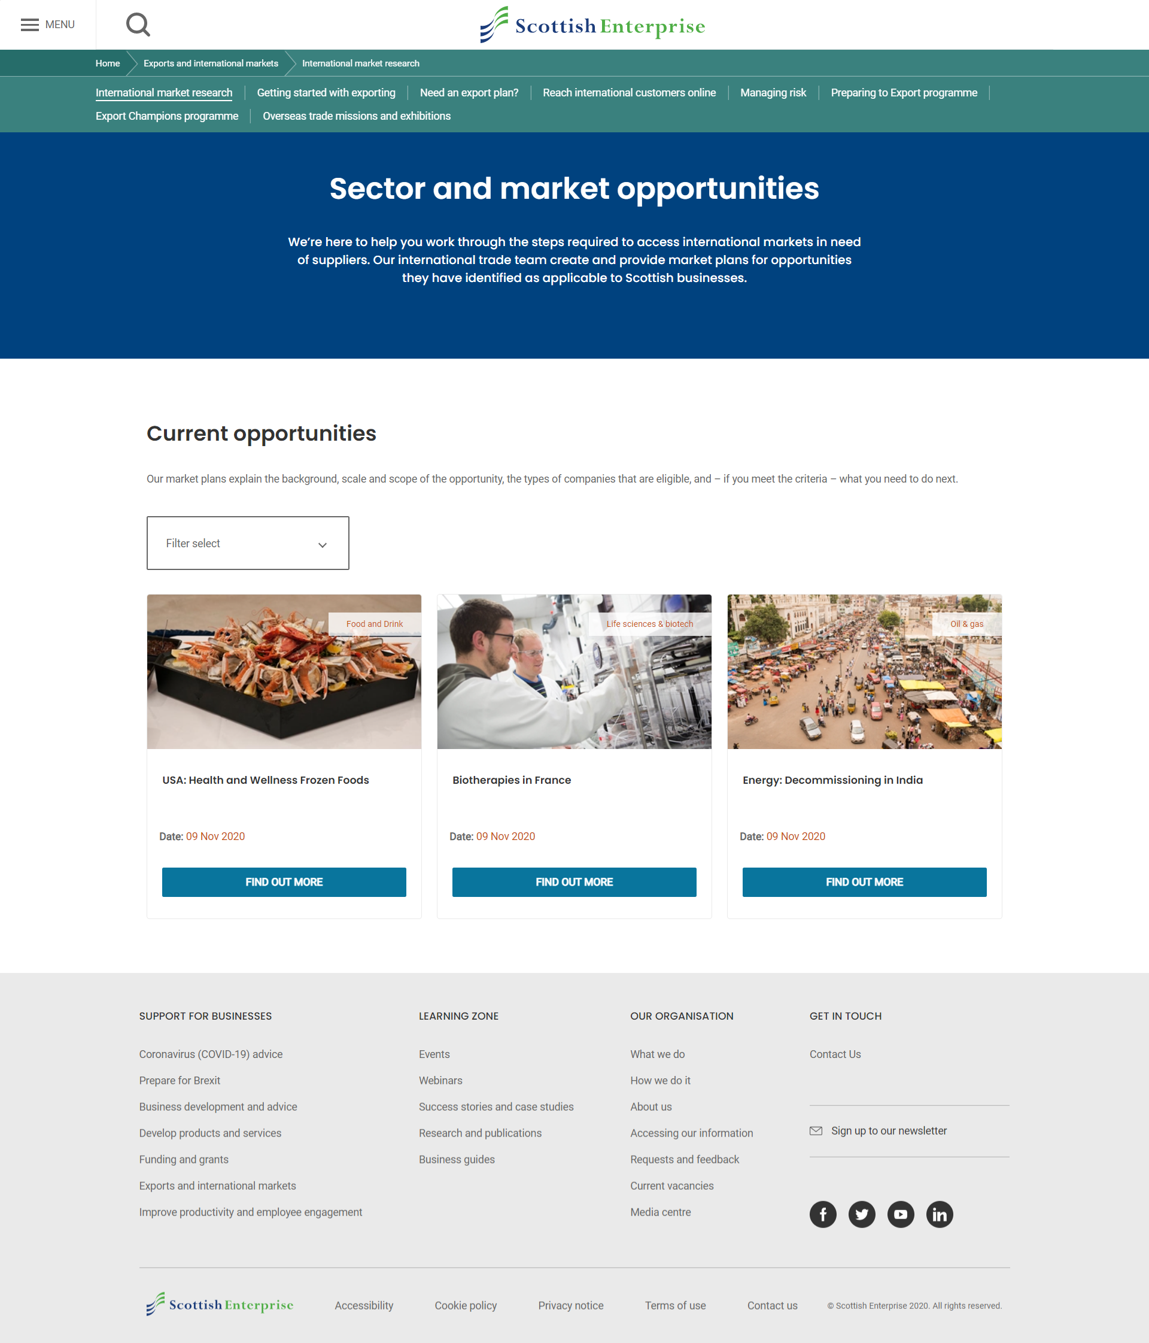
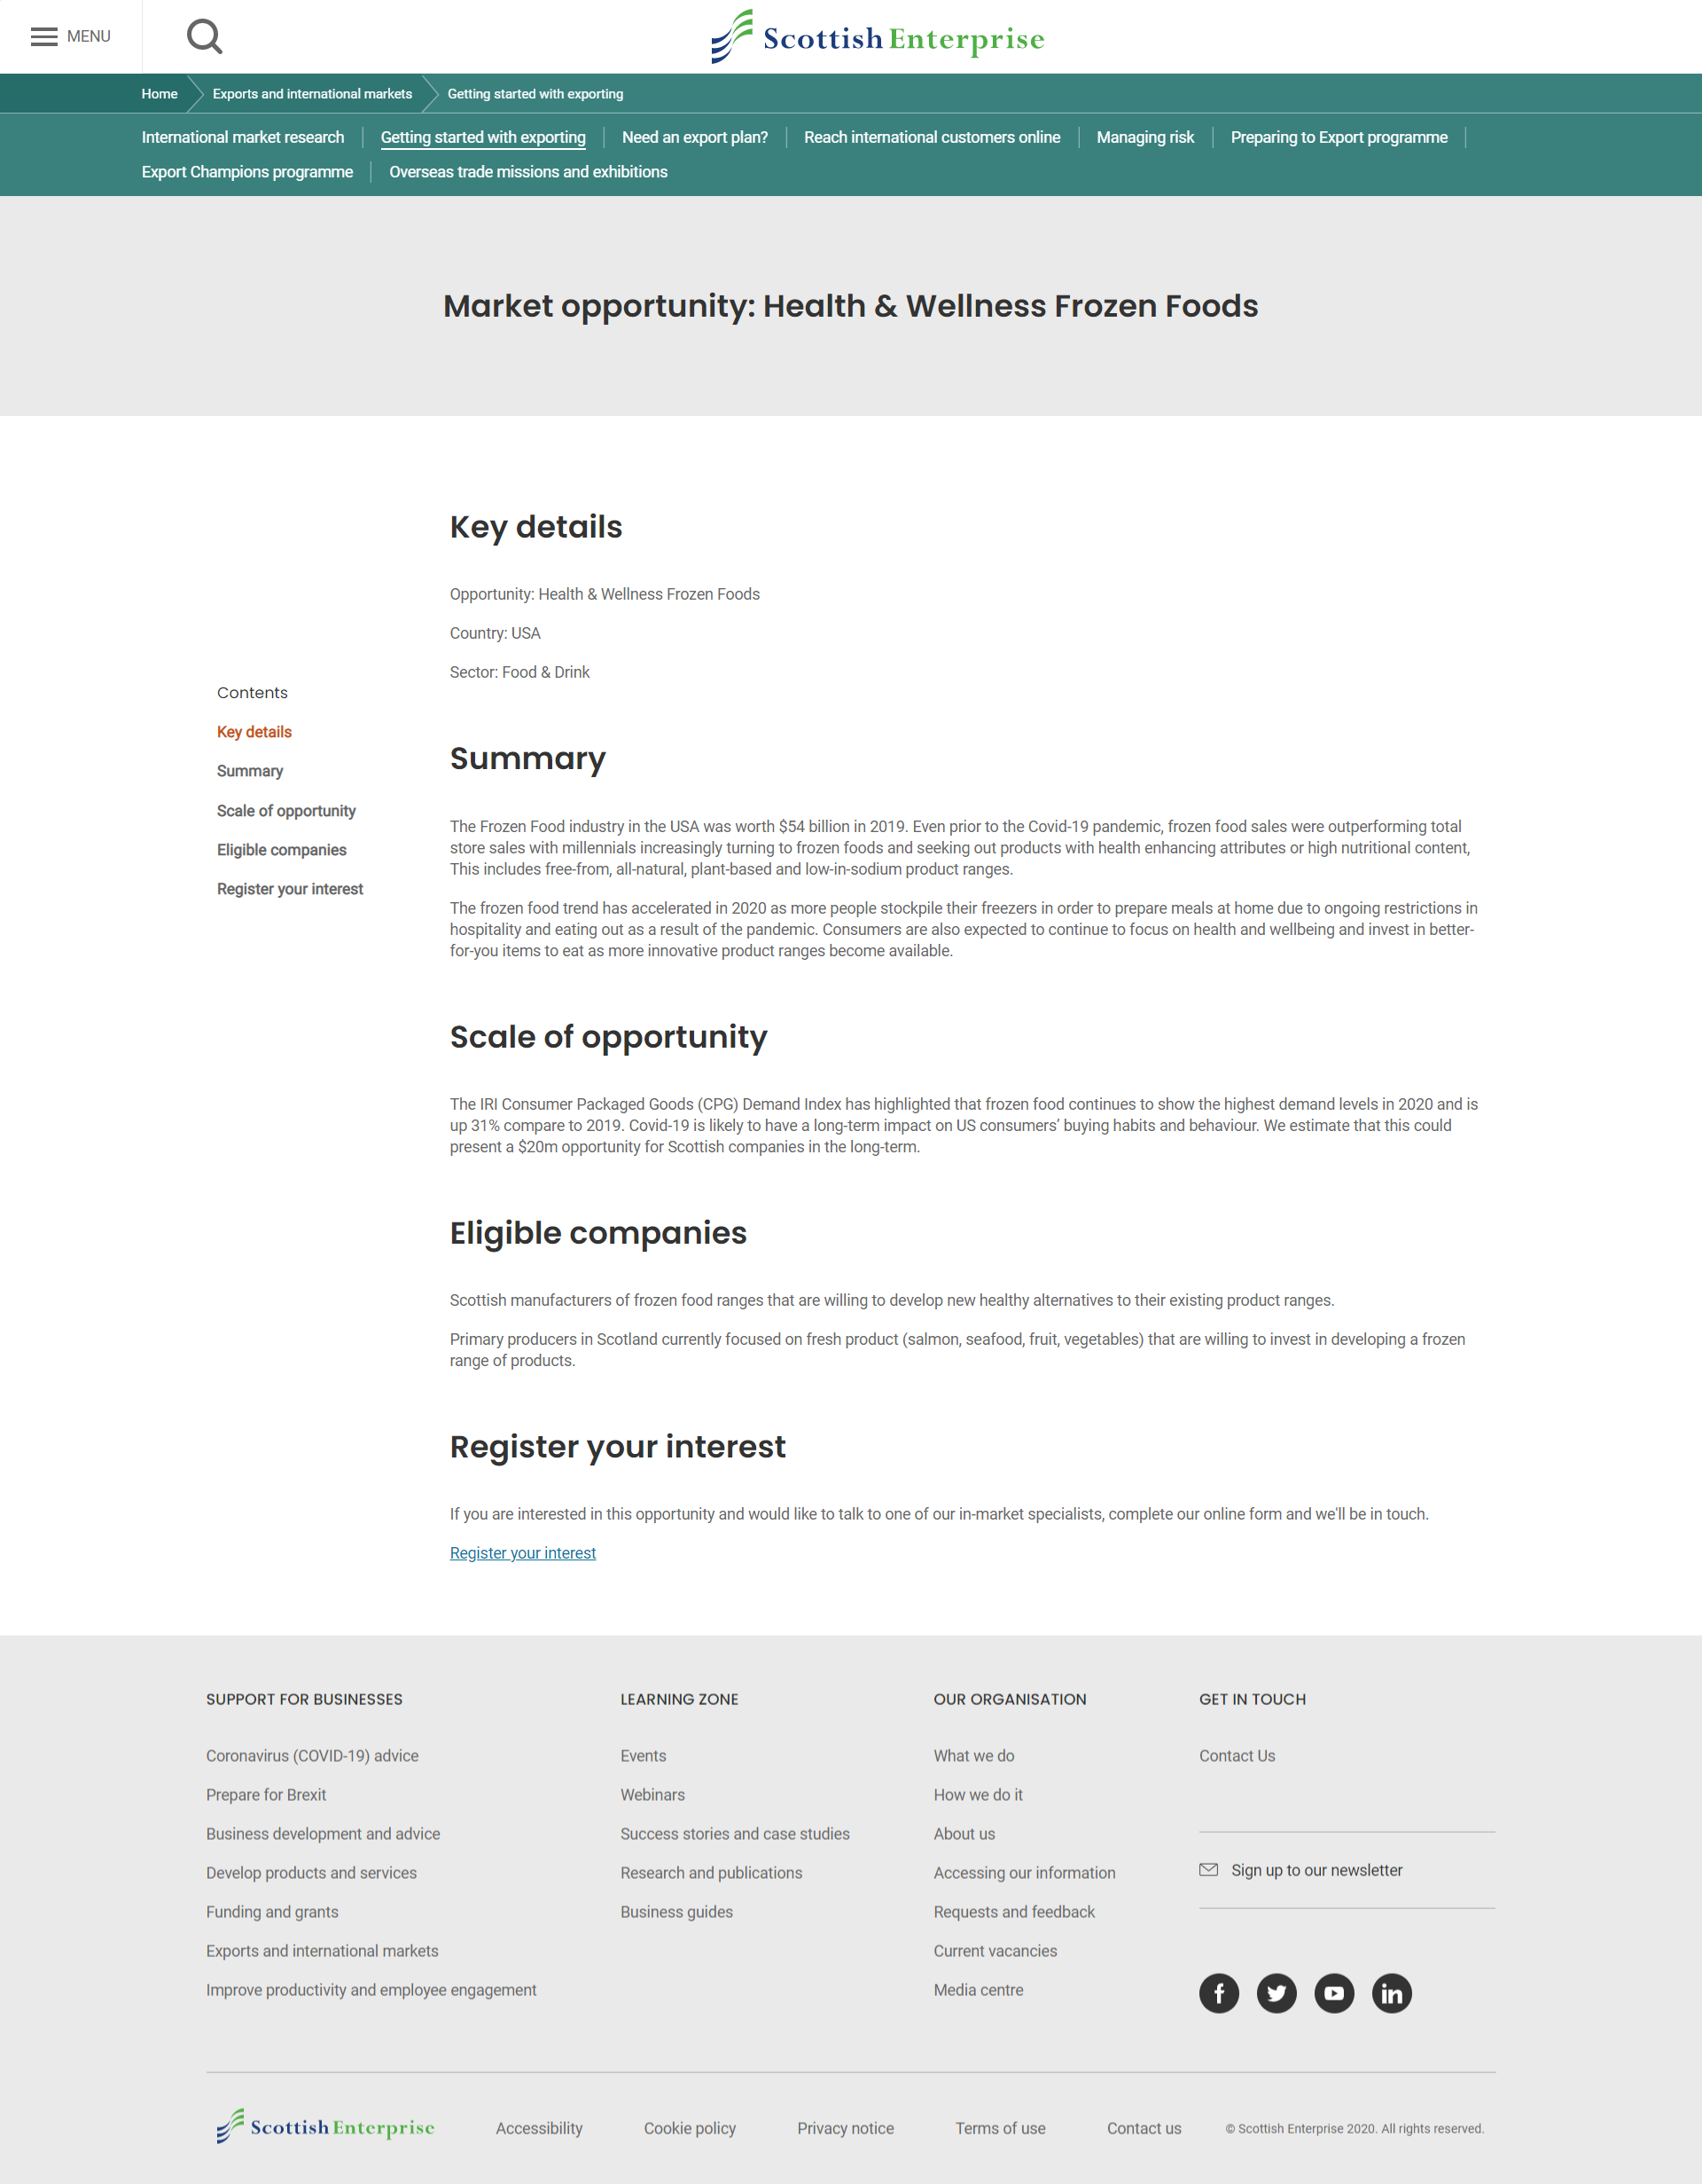
Design 1
Page 1
Page 2

Slide 4
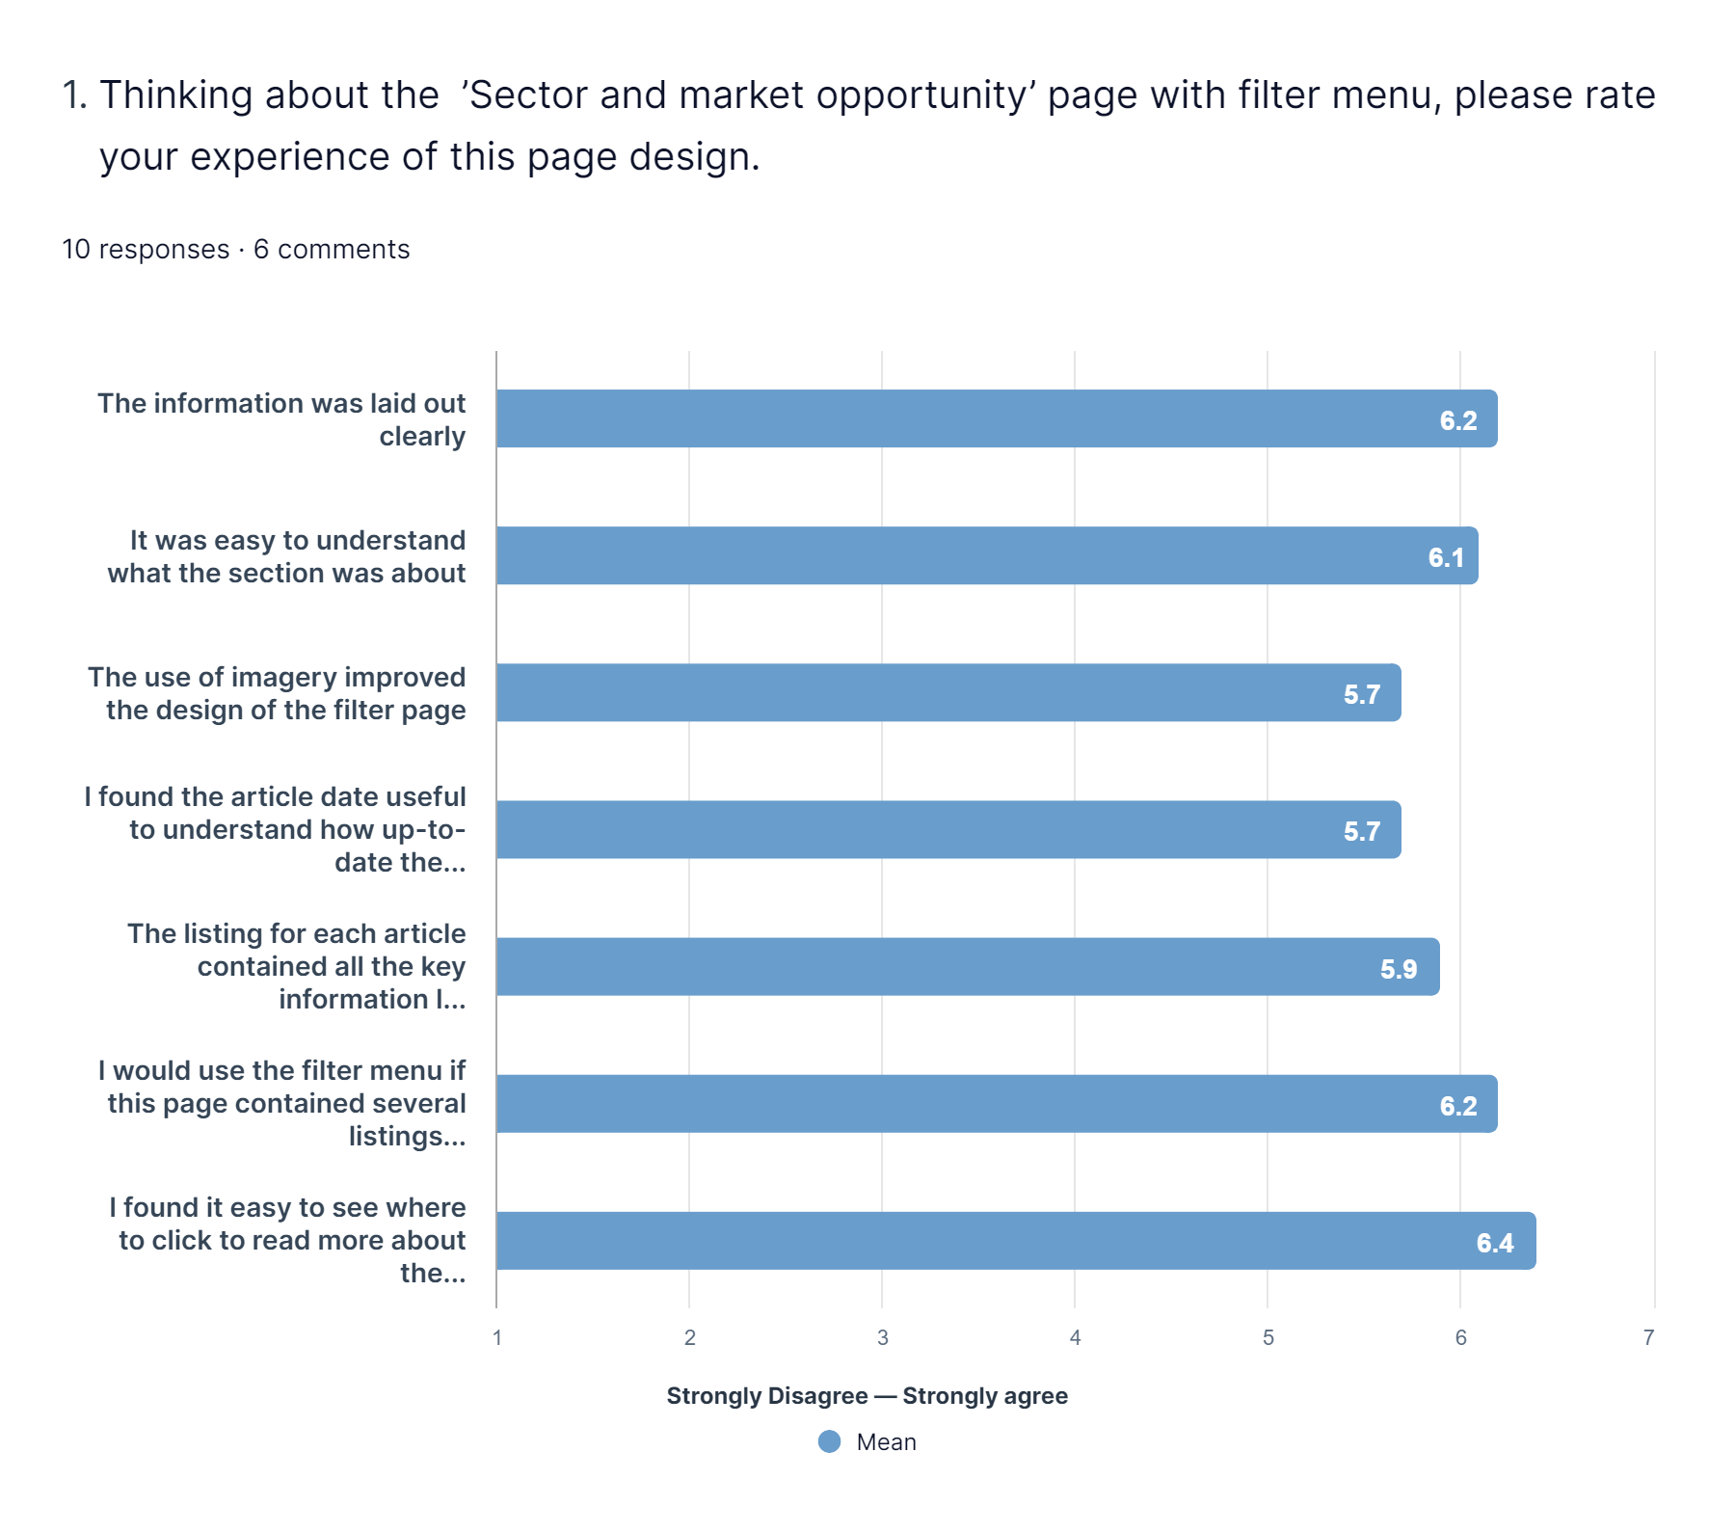
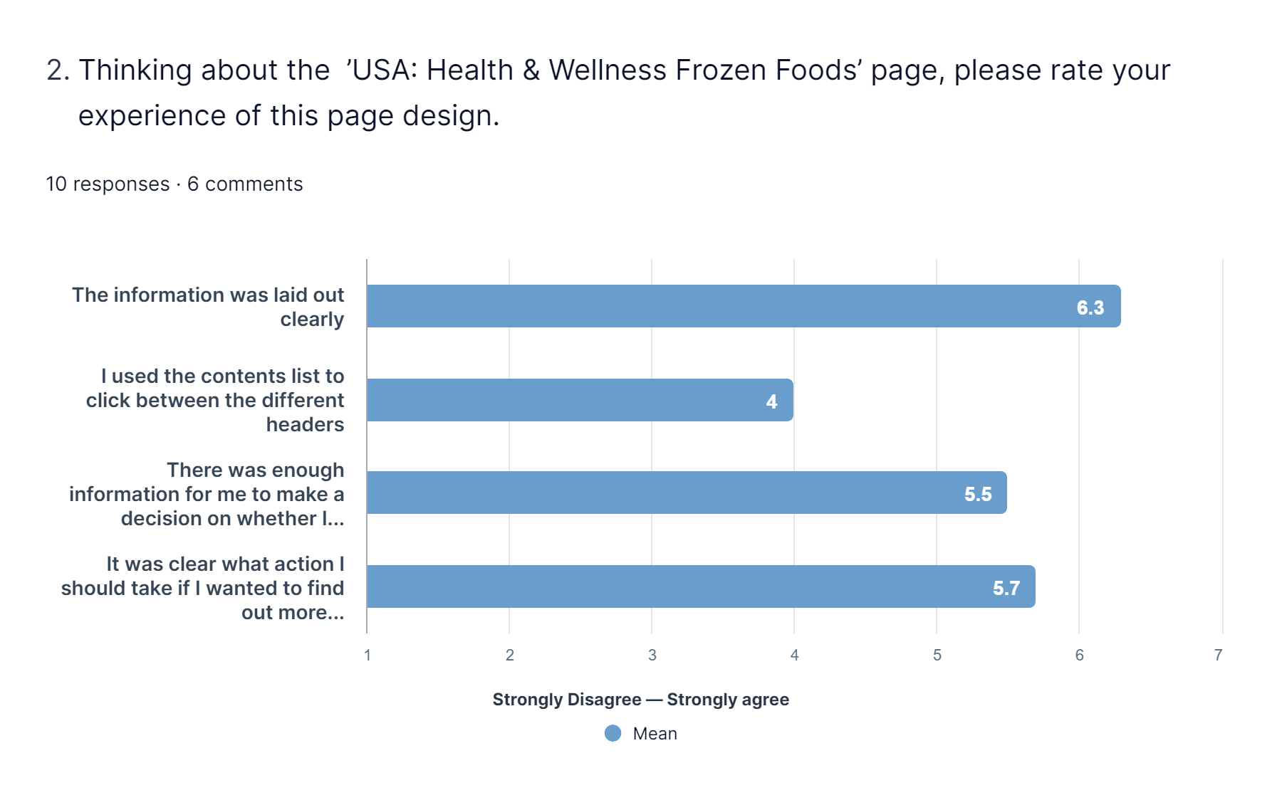
Design 1 – questionnaire

Slide 5
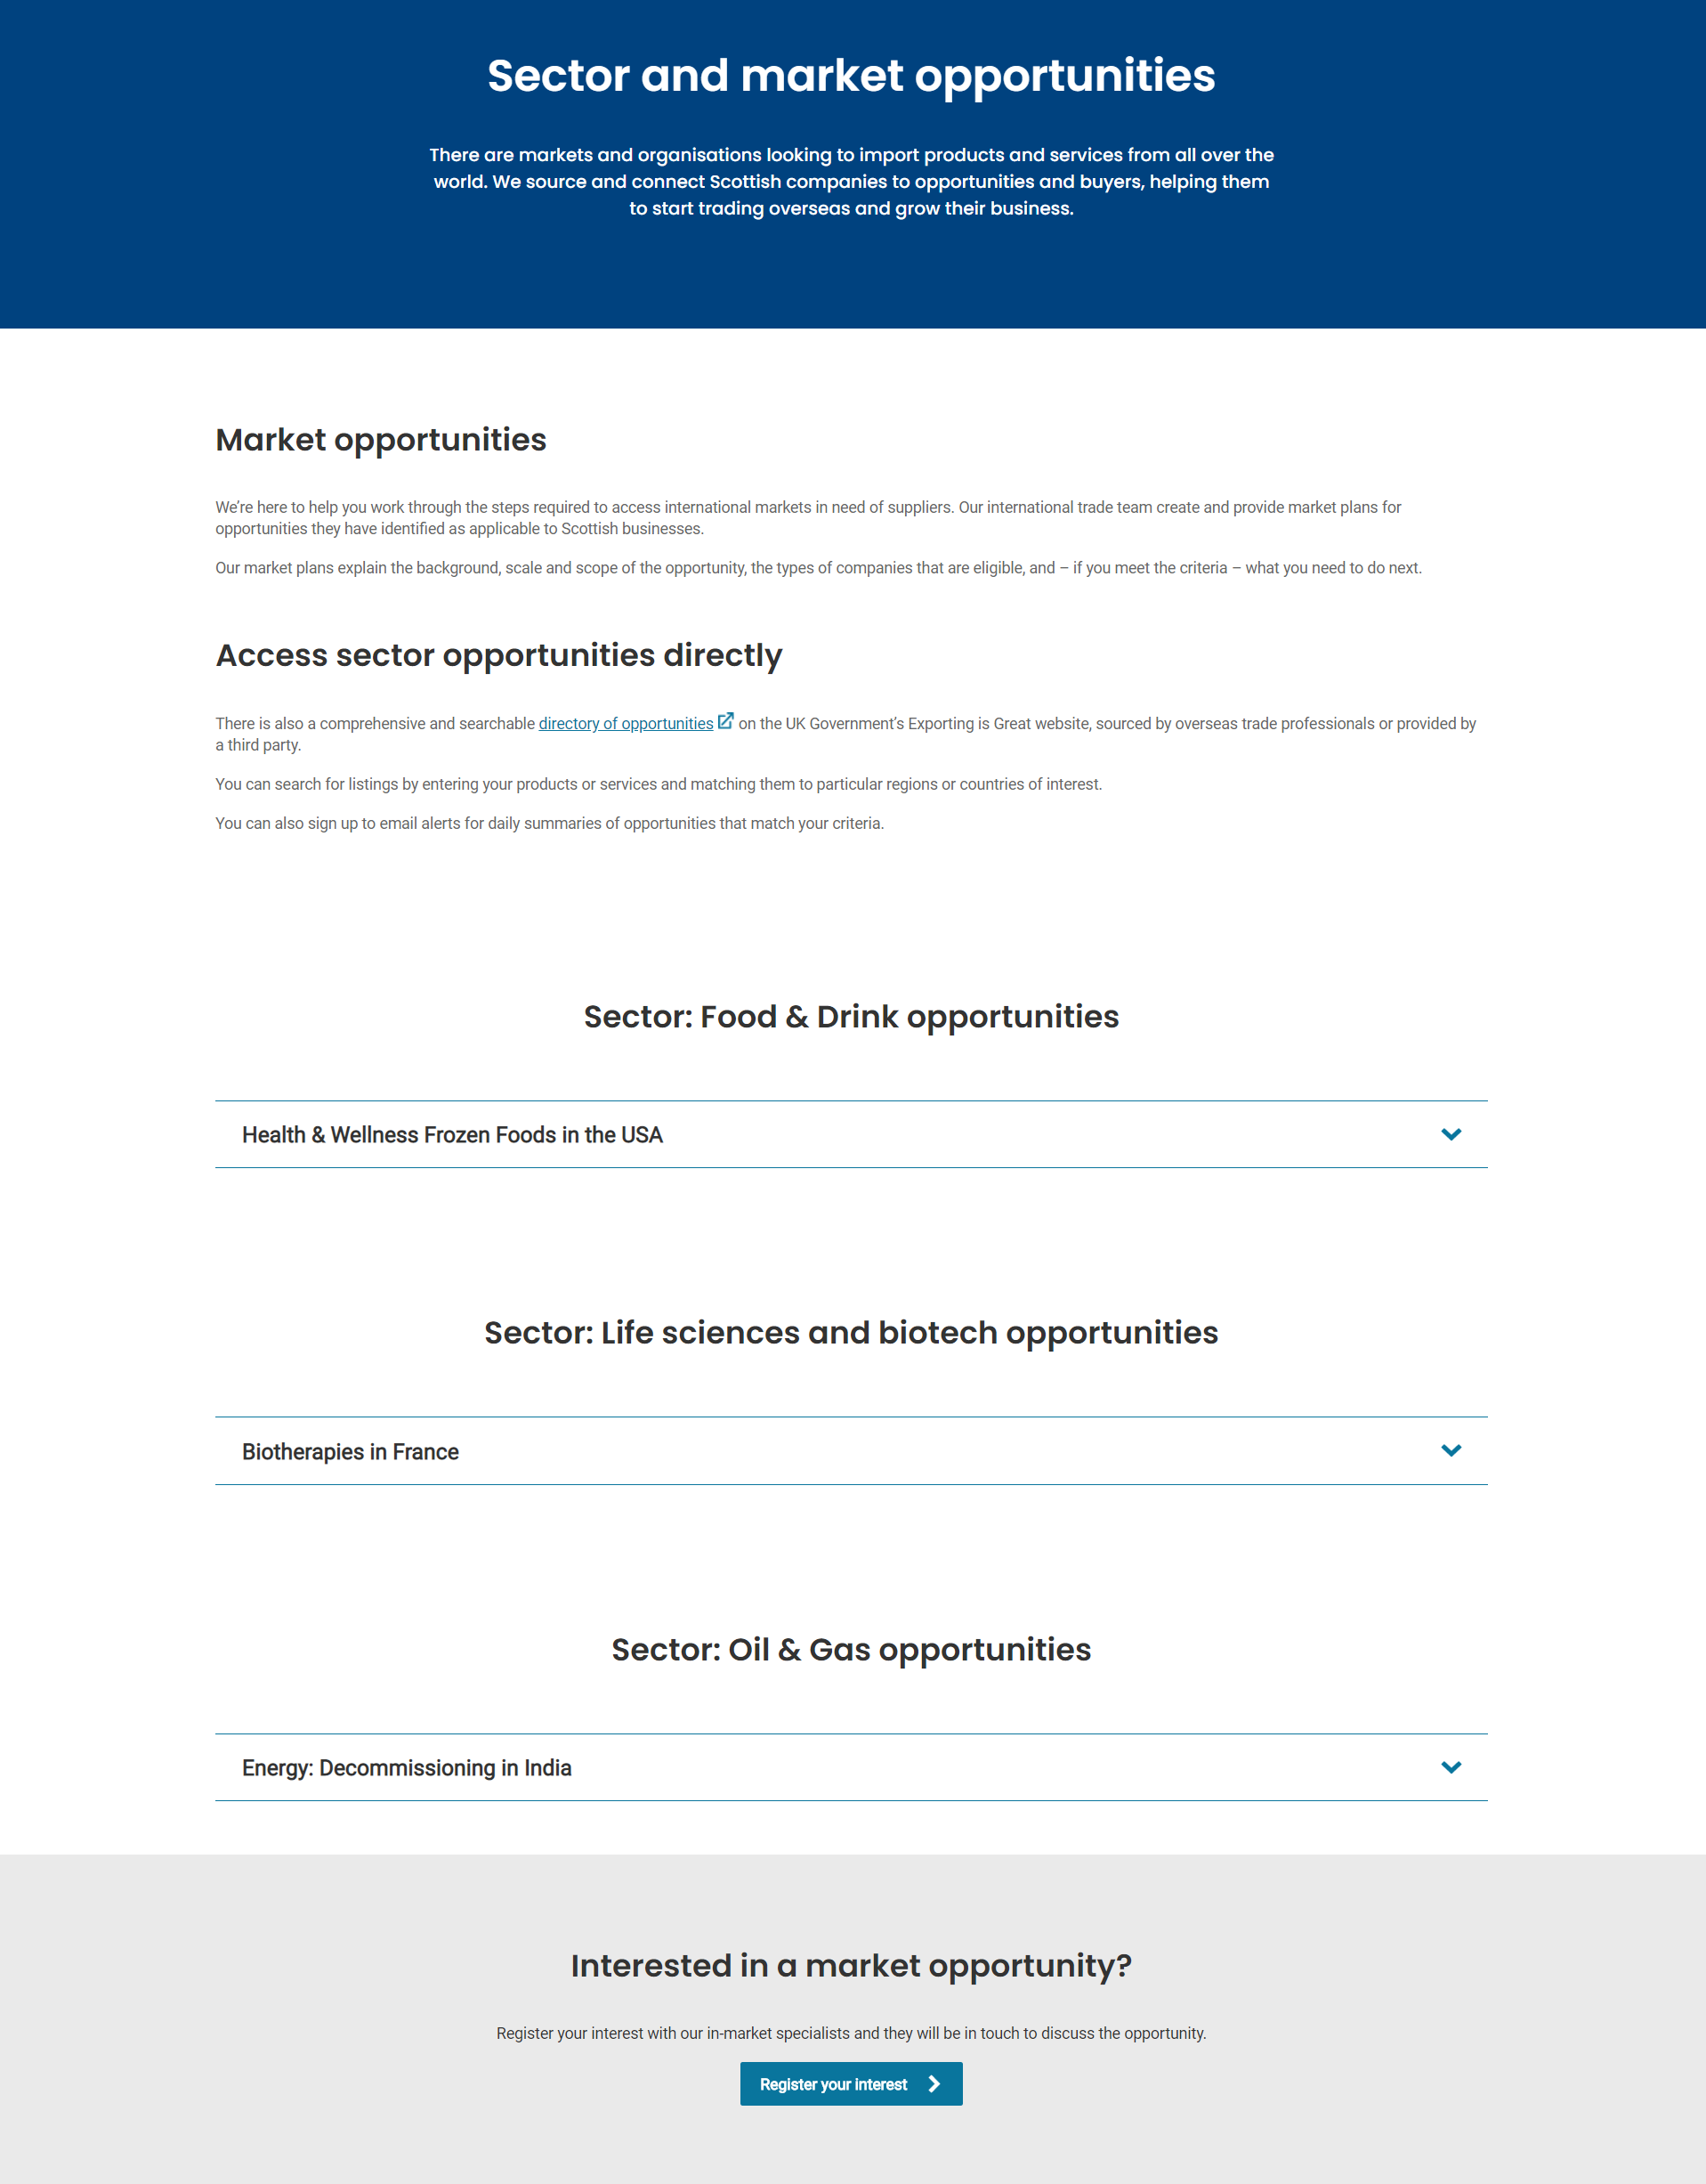
Design 2

Slide 6
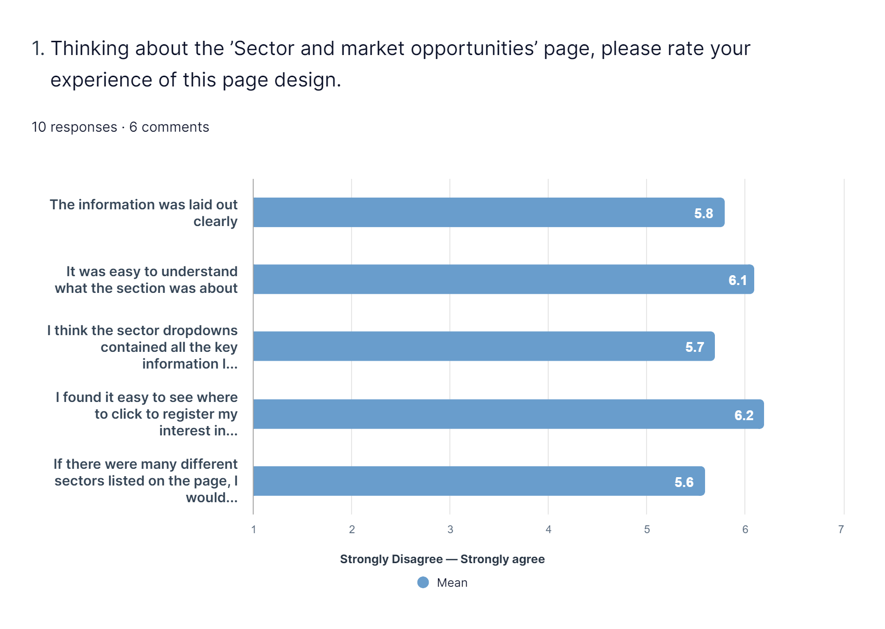
Design 2 – questionnaire

Slide 7
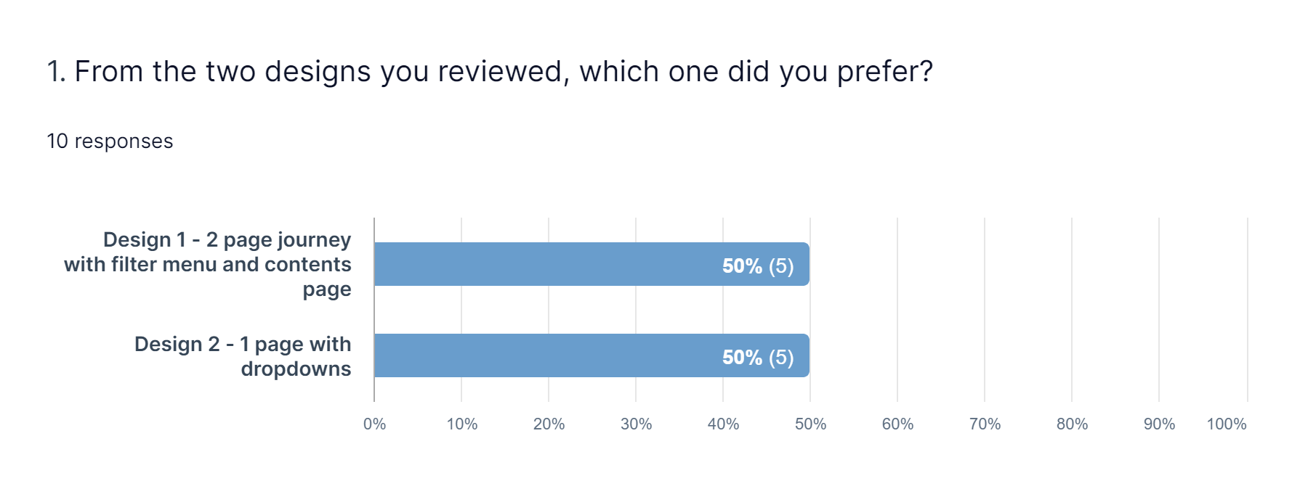
Results - Final questionnaire

Slide 8
Results - Please detail the main reason you chose this option
Design 1 – participant comments | Design 2 – participant comments
felt design 2 put too much information on one page and design 1 was therefore laid out better, more clearly, had a picture, and was easier to just take in that information and then make a decision from what you have seen. | I like both of them...but the second one seems to flow together better. The drop down menus work well because you can scroll between them, instead of having to look at different pages for the different sections. I just wish those nice photos were used in the second design as well, then it would be perfect.
Design 1 is easier to navigate but the dropdowns of design 2 are fundamental in attracting more and more business to the site. | tbh I liked both. I liked Design 1 as it contained images but I do prefer to have all information on the same page as in the Design 2. It would be great if Design 2 could have some images.
The more options there are, the more complicated Design 2 would be, and the more difficult it would be to find the one I wanted. | Found the main headings to be clearer in design 2.
Didn’t seem quite so clutterd. Easy to navigate through | More compact and direct.
More interactive. | Not quite sure If I was on the page I was supposed to be

Slide 9
Results – comparing the questionnaire answers
Looking at the questions that were asked in both questionnaires, design 1 edges it.
Question | Design 1 score | Design 2 score
The information was laid out clearly | 6.2 | 5.8
It was easy to understand what the section was about | 6.1 | 6.1
I found it easy to see where to click to read more about the opportunity/register my interest | 6.4 | 6.2

Slide 10
Conclusions and recommendations
While the vote was equally split amongst the 10 participants, 2 users who selected design 2 as their preference actually said they liked both so this swings the vote in favour of design 1 (filter page)
Given the potential size of this section when all the market plans are added, design 1 will better future proof in terms of usability. The lack of a filter component to use with design 2 for the accordions would see this design quickly become unwieldy from a user point of view as more sectors are added, as one participant commented "The more options there are, the more complicated Design 2 would be, and the more difficult it would be to find the one I wanted."
Recommendations
The new section should be built using design 1
The sourcing of images for each sector opportunity on the filter page could prove challenging, we'll need to agree with TS where these images will come from

