Slide 1
Global Accessibility Awareness Day
Thursday 21 May 2020 – For all staff in Scottish Enterprise

Slide 2
We will tell you about…
Accessibility - intro
Invisible disabilities
What the digital team is doing – FindBusinessSupport.gov.scot
What HR and Health and Safety are doing
Make your social media posts accessible
Assisted digital users
Simple things you can do and apply at work
We will share these slides and more resources

Slide 3
What is Accessibility?

Slide 4
The World Health Organization defines disability as:
“A mismatch in interaction between the features of a person’s body and the features of the environment in which they live.”

Slide 5
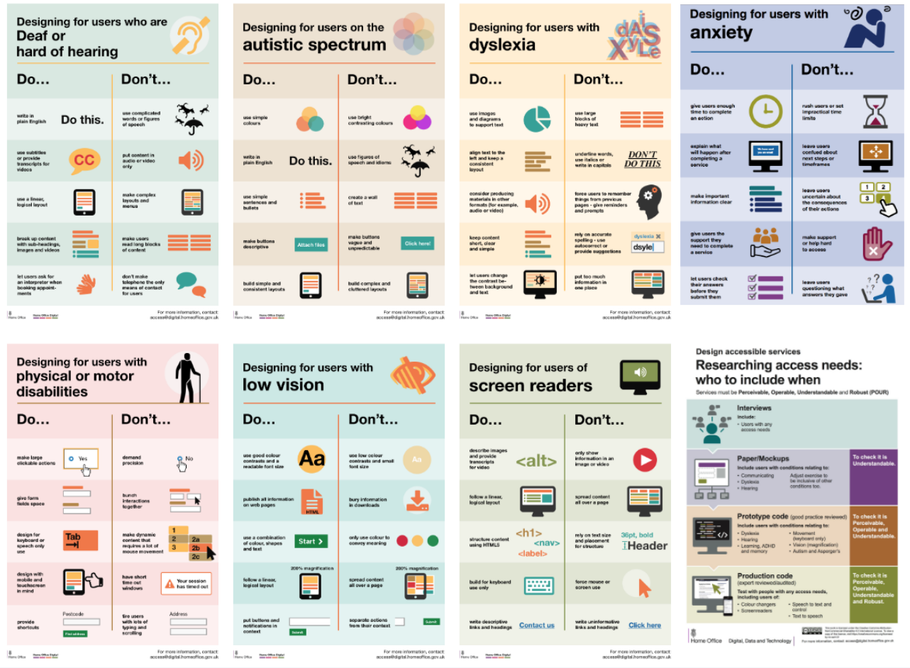
Do and Don’t posters from the Home Office

Slide 6
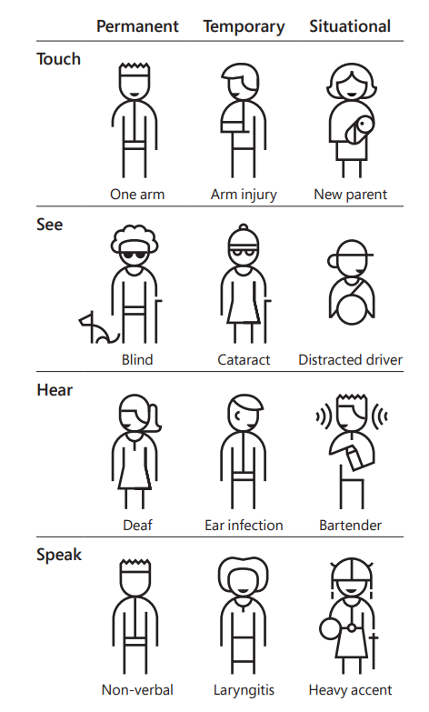
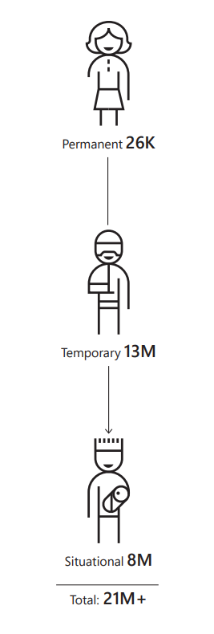
From the Microsoft Inclusive Design toolkit.
Figures are for the US.

Slide 7

Temporary accessibility
LOCKDOWN

Slide 8
Invisible disabilities

Slide 9
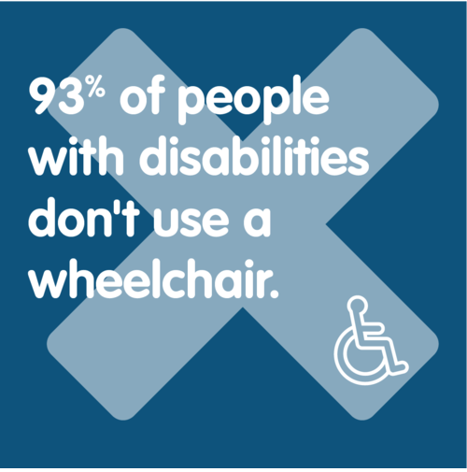
Invisible disabilities
“An invisible disability is a physical, mental or neurological condition that is not visible from the outside, yet can limit or challenge a person’s movements, senses, or activities.” - Invisible Disabilities Association
Examples: Multiple Sclerosis (M.S.), Chronic Fatigue Syndrome, Lupus, Autism, Crohn’s disease, Dyslexia, Anxiety and many more.

Slide 10
Public places: Priority seats in transports, accessible toilets and disabled parking spaces
“I have been verbally abused on public transport because I have a white cane & use my phone. I have residual vision like 94% of registered blind people. I use accessible tech to magnify the screen.” — Dr Amy Kavanagh

Slide 11
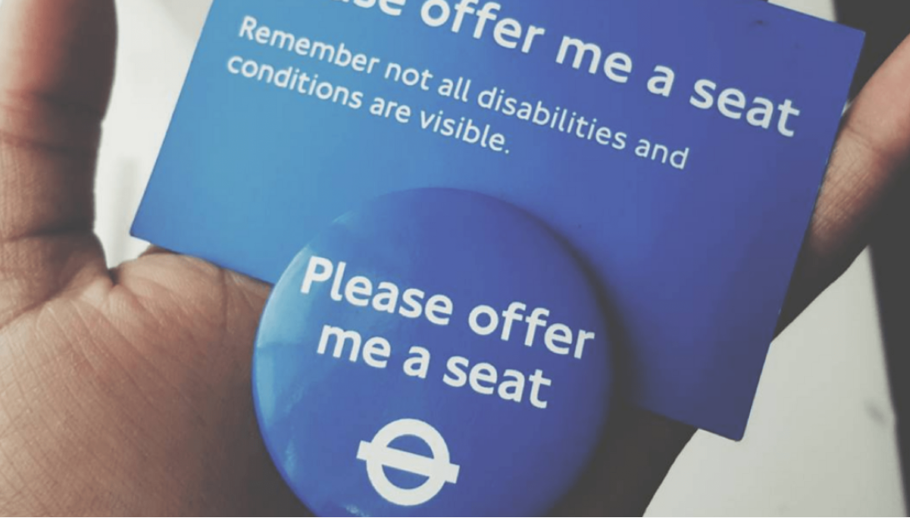

Initiatives to help

Slide 12
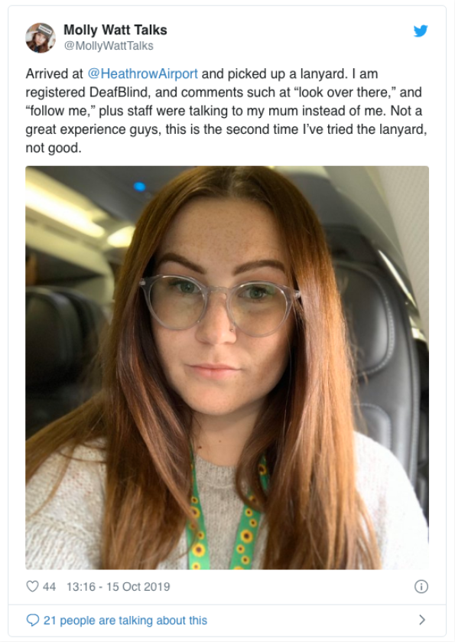
Not always well understood …

Slide 13
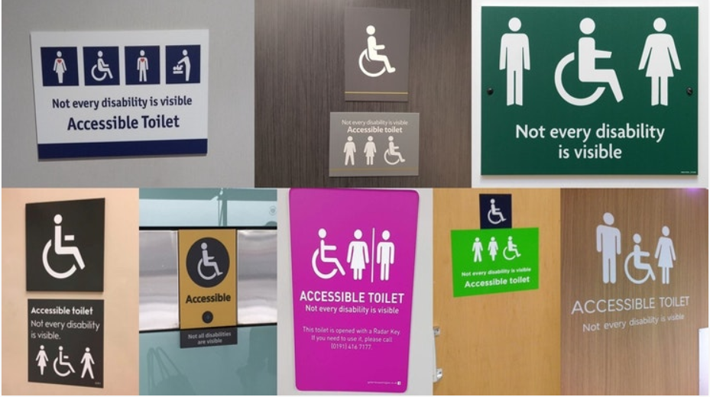
Toilets access
Crohn’s & Colitis UK has launched Not Every Disability is Visible.
They ask UK’s major supermarkets, restaurants, pubs and travel hubs to change their accessible toilet signs to highlight that Not Every Disability is Visible.

Slide 14
At work
Not everyone feels ok to disclose that they have a disability
Hard to get people internally when we want to do some user research
Initiative for people to get fit, or lose weight
Meeting where everyone is supposed to stand or move things around

Slide 15
At work
“I’d rather be thought rude than detail to a colleague why I’m not folding chairs and stacking them against the wall at the end of the meeting.”
We should always be mindful that we’re all different and offer an alternative or a way out.

Slide 16
Why people often do not want to disclose they have an invisible disability?
“Knowing someone has a disability more often than not changes the way you perceive them. Whether the reaction is discriminatory or empathetic, this unwanted attention can make life feel suffocating. In being open about our disability, we unfortunately have to accept the reality that people will treat us differently.”

Slide 17
Invisible disabilities
More on this:
https://scotentsd.github.io/Invisible-disabilities/

Slide 18
What the Digital team is doing - FBS

Slide 19
What the Digital team is doing - FBS
- Accessibility work done on Find Business Support
- How different teams can help
- User Testing
- QA Testing
- Design Systems can help
Lessons
- Design it in up front. It costs less
- The longer you wait, the harder it is to fix (costly)

Slide 20
What HR and Health and Safety are doing

Slide 21
What SE can do for you (HR)
Wellbeing Approach
Our Wellbeing Hub is a 'one stop shop' which incorporates 6 different wellbeing pillars for support and guidance to help our SE employees.
Future Wellbeing policy in progress.
Don't forget our Mental Health Advisers.

Slide 22
Covid-19 Response
Working from home
Removal of core hours
Family First/caring responsibilities
Wellbeing Resources
Mental and Physical Health
Increased use of Yammer for social purposes
Increased communications throughout the business

Slide 23
Health & Safety
SE seeks disability information as part of Equality Act compliance.
The H&S Team provide guidance on the provision of equipment, furniture and other items required to support and assist individuals.
They carry out and provide guidance and information on:
Workstation assessments
Return to work assessments
Expectant mother assessments
Fire risk assessment and personal evacuation plans
Equality Act assessment audits for all offices
Suitability of external venues to host events managed by SE

Slide 24
Health & Safety
Items are provided following a one to one meeting/assessment at the staff member’s base office or carried out by telephone during closure of offices with a member of the Health & Safety Team. Meetings can be arranged by an individual contacting the team directly or the team being notified by HR following sick leave or as recommended by an Occupational Health Assessment.
For some this involves assessing evacuation arrangements to ensure that these individuals can evacuate the building safely - use of evacuation chairs being one example. All offices with passenger lifts have an evacuation chair and a team of trained operators.
All offices as standard provide height adjustable desks. The desks allow working from a seated and standing position and can be used on a first come basis (this is in addition to Vari-desks or height adjustable desks allocated to individuals). Offices also have hearing induction loops to assist individuals with hearing impairment. Office meeting room booking forms ask about accessibility requirement for attendees.
All venues used to host events arranged, managed and promoted by SE must provide appropriate arrangements for attendees with disabilities
Prior to lockdown, where it was possible individuals' specialist equipment (chairs, keyboards, mice etc) were delivered to the home address

Slide 25
Health & Safety
Working from home
Following the closure of all offices and everyone working from home, a number of measures have been taken to support staff.
These include a dedicated intranet page providing advice and information on the workstation set up and general health and wellbeing.
During the lockdown items have been issued to individuals for homeworking.

Slide 26
Make your social media posts accessible

Slide 27
Make your social media posts accessible
Alt text
All pictures should have an alternative text. Will be read by a screen reader for users who can’t see them.
Capitalise Hashtags
#ThisIsHowtoFormatAnAccessibleHashtag

Slide 28
Make your social media posts accessible
Emoji
Try not to use them too much. They are read aloud by screen readers. For example: 😃 would become “smiley face emoji”.
Avoid Caps letters
Harder for everyone to read.
The ‘shape’ of a word help readers to identify it.

Slide 29
Make your social media posts accessible
Make sure you add subtitles on your video, and even better if you can: a transcript!
More on this:
https://scotentsd.github.io/Making-our-social-media-comms-accessible/

Slide 30
Assisted digital users

Slide 31
Assisted digital users
This time is not strictly speaking an accessibility issue.
We are talking about users who can’t use online services for various reasons.
If you don’t think about potential accessibility issues when you design your online service, then you might prevent some people from using it.

Slide 32
Assisted digital users
But most of the time the reasons can be:
Lack of trust in your service or the internet
Lack of confidence to use an online service themselves
No access to the internet, data, to a suitable device or assistive technology
Lack of digital skills

Slide 33
Assisted digital users
Just like for accessibility, users will have different needs at different times and in different circumstances
For example:
might be ok for online shopping but struggle to upload a document or posting on social media
visiting an area where there is no signal or on a train without WiFi
hardly any data left on your account, no or slow internet access
Might be under a lot of stress: applying online to get support because of an assault, or have just lost someone, or about to lose their home

Slide 34
Assisted digital users
1 in 7 people in Scotland can’t go online
(that’s about 800,000 people)
We need to make sure they can still access our services and offer alternative:
Phone – face to face – someone acting on their behalf (EFRS)

Slide 35
Digital exclusion
2 in 10 adults in Scotland lack basic digital skills
1 in 10 have no digital skills (find info, order shopping online or fill in a form)
13% of households have no internet access at home (17% for the lowest income households)
1 in 8 adults do not use the internet at all

Slide 36
Assisted digital users
More on this:
https://scotentsd.github.io/A11Y-assisted-inclusion/

Slide 37
Simple things you can do and apply at work

Slide 38
Publishing accessible documents
Think about format
Whenever possible, publish a web page – NOT a PDF
PDFs make your content harder to find, use and maintain
PDFs often don’t work well with screen readers
If you do need to publish a document, it should be IN ADDITION TO a web page
Keep language simple
Use Plain English – don’t use a long word when a short one will do
If you need to use technical terms or abbreviations, explain them the first time you use them

Slide 39
Publishing accessible documents
Give the document structure
Break up your document to make it more readable using headings, numbered steps and bullet points
Don’t use bold to mark up subheadings
Keep the document simple
Give it a meaningful title
Keep paragraphs and sentences short
Don't rely on things like colour or shape to get meaning across
Avoid images with text, as you can't resize the text in an image
Make sure any link text clearly describes where the link is going to go and is understandable even out of context

Slide 40
Problems with PDFs
They don't change size to fit the browser – Users must zoom in and out and scroll - this is especially an issue on mobile phones
They’re not designed for reading on screens – PDFs are designed for offline use, not online
It’s hard to track their use – It’s hard to get analytics about how people use PDFs – we can’t see how long they have viewed it or what links they followed
They cause difficulties with navigation and orientation – Users are taken away from the website when the download a PDF, so they lose the context of the website and its navigation
They can be hard for some users to access – Some users need to change browser settings, like colours or text size, to make content easier to read – it’s difficult to do this with a PDF
They’re harder to keep up to date – A web page is easier to update when things change

Slide 41
Checking documents for accessibility
Checking a PDF for accessibility
Use Adobe Reader or Adobe Acrobat Pro, as well as a screen reader
Non-Visual Desktop Access (NVDA) is a free open source screen reader for windows – or ask the digital team
Adobe Reader - go to Edit -> Accessibility -> Quick check
To fix any issues, you need to edit the original document in Word or Adobe Acrobat Pro
Check a Word document for accessibility
Use the Office accessibility checker
For all documents
Use this accessibility checklist by 18F (the US government’s digital agency) to help you test manually
GOV.UK has more guidance on publishing accessible documents

Slide 42
More general advice
Don’t assume, don’t judge, you don’t know what someone might be going through
Focus on the person, not the disability
Ask if they need help, don’t just help assuming it’s good for them, it might not
Keep your meeting short (under 1hour) - don’t assume everyone can stand for more than 15 min, plan for chairs
Describe any photo or diagram you have in a presentation
Make sure you have a good mic when you speak so everyone can hear you clearly
Notes:
Kathy, happy to do that slide if you prefer.

Slide 43
What next?

Slide 44
Links to various resources
You can find more information and links to resources in this blog post:
https://scotentsd.github.io/GAAD2020/
We will add to it in the next days so do come back and check it.

Slide 45
Get in touch!
The digital team and all the people who presented today will be happy to tell you more!

Slide 46
Quiz answers
- 360,000 registered blind or partially sighted
- 11 million have hearing loss
- 900,000 have severe or profound hearing loss
- 390,000 are deafblind
- 6.4 million have dyslexia
-700,000 are on the Autism spectrum
- 16 million people experience poor mental health every year in the UK

Slide 47
Thank you!

