Slide 1


CS 146: Data Structures and Algorithms June 2 Class Meeting
Department of Computer Science San Jose State University Summer 2015 Instructor: Ron Mak
www.cs.sjsu.edu/~mak

Slide 2
Basic Info
Office hours
TuTh 2:00 – 3:00 PM
MH 413
Class website
http://www.cs.sjsu.edu/~mak/
Green sheet
Assignments
Lecture notes

Slide 3
Course Objectives
Ensure that students are familiar with ways to implement elementary data structures and their associated algorithms.
Introduce students to the implementation of more complex data structures and their associated algorithms.
Acquaint students with advanced sorting techniques (radix sort, heap sort, merge sort, quicksort).

Slide 4
Course Objectives, cont’d
Teach students how to determine the time complexity of algorithms.
Introduce students to algorithm design techniques.

Slide 5
Student Learning Outcomes
Implement lists, stacks, queues, search trees, heaps, union-find ADT, and graphs and use these data structures in programs they design.
Prove basic properties of trees and graphs.
Perform breadth-first search and depth-first search on directed as well as undirected graphs.
Use advanced sorting techniques (radix sort, heap sort, merge sort, quicksort).
Determine the running time of an algorithm in terms of asymptotic notation.

Slide 6
Student Learning Outcomes
Solve recurrence relations representing the running time of an algorithm designed using a divide-and-conquer strategy
Comprehend algorithms designed using greedy, divide-and-conquer, and dynamic programming techniques
Comprehend the basic concept of NP-completeness and realize that they may not be able to efficiently solve all problems they encounter in their careers

Slide 7
Take Roll!

Slide 8
Introduction to Algorithm Analysis
To analyze an algorithm, we are measuring it.
A convenient measure must be:
Measuring a resource we care about (elapsed time, memory usage, etc.).
Quantitative, to make comparisons possible.
Easy to compute.
A good predictor of the “goodness” of the algorithm.
Mostly in this class, we will be concerned with elapsed time.

Slide 9
Example: Reading Books
Algorithm: Read a book.
Measure: Length of time to read a book.
Given a set of books to read, can we predict how long it will take to read each one, without actually reading it?
Possible ways to compute reading time:
weight of the book
physical size (width, height, thickness) of the book
total number of words
total number of pages

Slide 10
Introduction to Algorithm Analysis, cont’d
Our concern generally is not how long a particular run of an algorithm will take, but how well the algorithm scales.
How does the run time increase as the amount of input increases.
Example: How does the reading time of a book increase as the number of pages increases?
Example: How does the run time of a particular sort algorithm increase as the number of items to be sorted increases?

Slide 11
Introduction to Algorithm Analysis, cont’d
When we compare two algorithms, we want to compare how well they scale.
Can we do this comparison without actually running the algorithms?

Slide 12
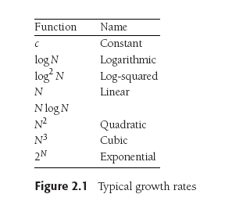
How Well Does an Algorithm Scale?
Data Structures and Algorithms in Java, 3rd ed.
by Mark Allen Weiss
Pearson Education, Inc., 2012
ISBN 978-0-13-257627-7

Slide 13
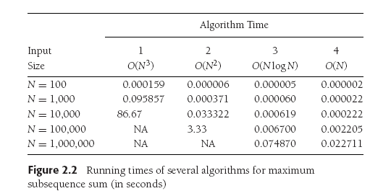
How Well Does an Algorithm Scale? cont’d
Data Structures and Algorithms in Java, 3rd ed.
by Mark Allen Weiss
Pearson Education, Inc., 2012
ISBN 978-0-13-257627-7

Slide 14
How Well Does an Algorithm Scale? cont’d
Data Structures and Algorithms in Java, 3rd ed.
by Mark Allen Weiss
Pearson Education, Inc., 2012
ISBN 978-0-13-257627-7

Slide 15
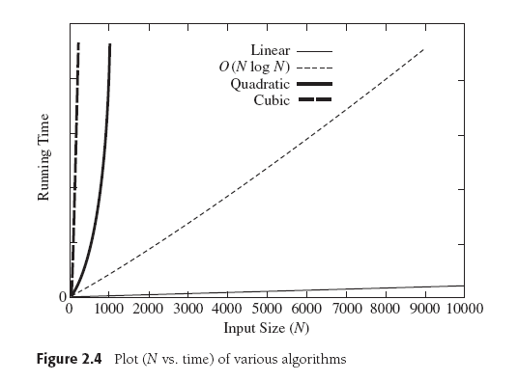
How Well Does an Algorithm Scale? cont’d
Data Structures and Algorithms in Java, 3rd ed.
by Mark Allen Weiss
Pearson Education, Inc., 2012
ISBN 978-0-13-257627-7

Slide 16
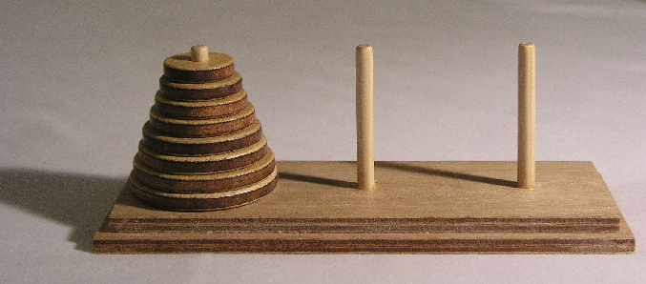
Towers of Hanoi
Goal: Move the stack of disks from the source pin to the destination pin.
You can move only one disk at a time.
You cannot put a larger disk on top of a smaller disk.
Use the third pin for temporary disk storage.

Slide 17
Towers of Hanoi: Solve Recursively!
Label the pins A, B, and C.
A: source
B: temporary
C: destination
Solve one disk (source ➔ destination)
Move disk from A to C (source ➔ destination)
Solve two disks (source ➔ destination)
Move disk from A to B (source ➔ temp)
Move disk from A to C (source ➔ destination)
Move disk from B to C (temp ➔ destination)

Slide 18
Towers of Hanoi: Solve Recursively! cont’d
Solve three disks (source ➔ destination)
Solve for two disks (source ➔ temp)
Move disk from A to C (source ➔ destination)
Solve for two disks (temp ➔ destination)

Slide 19
Towers of Hanoi: Solve Recursively! cont’d
We can solve the puzzle for n disks if we already know how to solve it for n-1 disks.
Solve n disks (source = A, destination = C)
Solve for n-1 disks (source ➔ temp)
Move disk from A to C (source ➔ destination)
Solve for n-1 disks (temp ➔ destination)

Slide 20
Towers of Hanoi: Recursive Solution
private static final char A = 'A'; // initial source
private static final char B = 'B'; // initial temp
private static final char C = 'C'; // initial destination
private static int count = 0;
private static void move(char from, char to)
{
System.out.printf("%2d: Move disk from %c to %c.\n",
++count, from, to);
}
public static void main(String args[])
{
int n = 6;
System.out.printf("Solve for %d disks:\n\n", n);
solve(n, A, C, B);
}
Hanoi1.java

Slide 21
Towers of Hanoi: Solve Recursively!
Solve n disks (source = A, destination = C)
Solve for n-1 disks (source ➔ temp)
Move disk from A to C (source ➔ destination)
Solve for n-1 disks (temp ➔ destination)
private static void solve(int n, char source,
char destination, char temp)
{
if (n > 0) {
solve(n-1, source, temp, destination);
move(source, destination);
solve(n-1, temp, destination, source);
}
}
Hanoi1.java
Demo

Slide 22
Towers of Hanoi: Analysis
How can we measure how long it will take to solve the puzzle for n disks?
What’s a good predictor?
The number times we move a disk from one pin to another.
Therefore, let’s count the number of moves.

Slide 23
Towers of Hanoi: Analysis, cont’d
Solve n disks (source = A, destination = C)
Solve for n-1 disks (source ➔ temp)
Move disk from A to C (source ➔ destination)
Solve for n-1 disks (temp ➔ destination)
What is the pattern in the number of moves as n increases?
Let f(n) be the number of moves for n disks.
{
1 n = 1
2f(n-1) + 1 n > 1
f(n) =

Slide 24
Towers of Hanoi: Analysis
{
1 n = 1
2f(n-1) + 1 n > 1
f(n) =
This is a recurrence relation.
f shows up in its own definition: f(n) = 2f(n-1) + 1
The mathematical analogy of recursion.
Can we find the definition of function f ?
Observation: Since f(n) = 2f(n-1) + 1, we know that f(n) > 2f(n-1).
Therefore, if we increase the number of disks from n to n+1, the number of moves will at least double.

Slide 25
Towers of Hanoi: Count Moves
private static void move(char from, char to)
{
++count;
}
public static void main(String args[])
{
System.out.println("Disks Moves");
for (int n = 1; n <= 10; n++) {
count = 0;
solve(n, A, C, B);
System.out.printf("%5d %5d\n", n, count);
}
}
Don’t print. Just count moves.
Hanoi2.java
Demo

Slide 26
Towers of Hanoi: Analysis
Disks Moves
1 1
2 3
3 7
4 15
5 31
6 63
7 127
8 255
9 511
10 1023
What’s the pattern?
Can we prove this?
Just because this formula holds for the first 10 values of n, does it hold for all values of n ≥ 1?
f(n) = 2^{n} - 1

Slide 27
Proof by Induction: Base Case
Prove that if:
then:
{
1 n = 1
2f(n-1) + 1 n > 1
f(n) = 2^{n} - 1
for all n ≥ 1
f(n) =
Let n = 1.
Then f(1) = 2¹ - 1 = 1 is true.

Slide 28
Proof by Induction: Inductive Step
Prove that if:
then:
{
1 n = 1
2f(n-1) + 1 n > 1
f(n) = 2^{n} - 1
for all n ≥ 1
f(n) =
Let n > 1.
Inductive hypothesis: Assume that f(k) = 2^{k} - 1 is true for all k < n, where n > 1
Since n-1 < n, then by our hypothesis: f(n-1) = 2^{n-1} – 1.
From the recurrence relation: f(n) = 2f(n-1) + 1 = 2(2^{n-1} - 1) + 1 = 2^{n} -1.
So if f(k) = 2^{k} - 1 is true for all k < n, it must also be true for n as well.
Therefore, f(n) = 2^{n} -1 for all n > 1.

Slide 29
Break

Slide 30
Algorithm Analysis
An algorithm is a set of operations to perform in order to solve a problem.
We want to know how an algorithm scales as its input size grows.
If T(N) is the running time of an algorithm with N input values, then how does T(N) change as N increases?

Slide 31
Big-Oh and its Cousins
Let T(N) be the running time of an algorithm with N input values.
Big-Oh
T(N) = O(f(N)) if there are positive constants c and n₀ such that T(N) ≤ cf(N) when N ≥ n₀.
In other words, when N is sufficiently large, function f(N) is an upper bound for time function T(N).
We don’t care about small values of N.
T(N) will grow no faster than f(N) as N increases.

Slide 32
Big-Oh and its Cousins
Let T(N) be the running time of an algorithm with N input values.
Omega
T(N) = Ω(g(N)) if there are positive constants c and n₀ such that T(N) ≥ cg(N) when N ≥ n₀.
In other words, when N is sufficiently large, function g(N) is lower bound for time function T(N).
We don’t care about small values of N.
T(N) will grow at least as fast as g(N) as N increases.

Slide 33
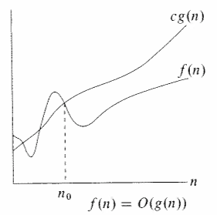
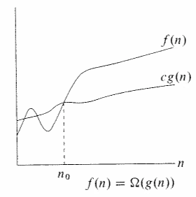
Big-Oh and its Cousins
cf(N)
T(N)
T(N)
cg(N)
N
N
T(N) = O(f(N))
T(N) = Ω(g(N))
Upper bound
Lower bound

Slide 34
Big-Oh and its Cousins
Let T(N) be the running time of an algorithm with N input values.
Theta
T(N) = Θ(h(N)) if and only if:
T(N) = O(h(N)) and
T(N) = Ω(h(N))
In other words, the rate of growth of T(N) equals the rate of growth of h(N).

Slide 35
Big-Oh and its Cousins
Let T(N) be the running time of an algorithm with N input values.
Little-Oh
T(N) = o(p(N)) if there are positive constants c and n₀ such that T(N) < cp(N) when N ≥ n₀.
p(N) is similar to the upper bound function f(N) but instead of T(N) ≤ cf(N) we have T(N) < cp(N).

Slide 36
Big-Oh and its Cousins
If T₁(N) = O(f₁(N)) and T₂(N) = O(f₂(N)) then
T₁(N) + T₂(N) = O(f₁(N) + f₂(N)) or O(max(f₁(N), f₂(N)))
T₁(N) x T₂(N) = O(f₁(N) x f₂(N))
If T(N) is a polynomial of degree k, then
T(N) = Θ(N^{k})
If T(N) = log^{k} N for any constant k, then
T(N) = O(N)
Logarithms grow slowly!

Slide 37
Towers of Hanoi: Rate of Growth
We decided that a good predictor of T(n) for solving the Towers of Hanoi problem was f(n).
n is the number of disks
f(n) = 2^{n}-1 is the number of disk moves
Therefore,
T(n) = Θ(2^{n})

Slide 38
Compare Growth Rates
If we want to compare the growth rates of two functions f(N) and g(N), compute
The limit is 0: f(N) = o(g(N)) g(N) is an upper bound for f(N).
The limit is a constant c ≠ 0: f(N) = Θ(g(N)) f(N) and g(N) have the same growth rate.
The limit is ∞: g(N) = o(f(N)) f(N) is an upper bound for g(N).
lim f(N) / g(N) N→∞

Slide 39
General Rules for Computing Running Time
Consecutive statements
Add the running times of the statements.
Generally, only consider the statement with the maximum running time.
Branching statement
The running time of the entire statement is at most the maximum running time of its branches.

Slide 40
Computing Running Time, cont’d
Loop
The running time of a loop is at most the number of iterations times the running time of the statements in the loop.
Nested loops
Compute the running time of the statements in the innermost loop, then multiply by the product of the numbers of iterations of all the loops.

Slide 41
Scalability of Different Algorithms
Problem: Given an array of positive and negative integers, find the maximum sum of a contiguous subsequence of the array.
Four algorithms to solve this problem:
LinearRuntimeGrowth: T(N) = O(N)
LogarithmicRuntimeGrowth: T(N) = O(N log N)
QuadraticRuntimeGrowth: T(N) = O(N²)
CubicRuntimeGrowth: T(N) = O(N³)
Demo

Slide 42
Scalability of Different Algorithms, cont’d
One set of results for the maximum sum problem.
Times in milliseconds.
MaxSubseq2.java
n Linear Logarithmic Quadratic Cubic
1000 1 0 4 120
2000 1 2 1 890
3000 0 0 2 1467
4000 0 0 5 3436
5000 1 0 6 6698
6000 0 0 9 11392
7000 0 0 12 18344
8000 0 0 16 27235
9000 0 0 20 39085
10000 0 0 24 53218

Slide 43
Scalability of Different Algorithms, cont’d
Problem: Compute the n^{th} Fibonacci number.
Two algorithms to solve this problem:
Start with 1, 1, and repeatedly add the previous two values.
LinearGrowthRate: T(N) = O(N)
Use recursion: fib(n) = fib(n-2) + fib(n-1)
ExponentialGrowthRate: T(N) = Ω(1.5^{N})
Why is the growth
rate exponential?
Demo

Slide 44
Scalability of Different Algorithms, cont’d
One set of results for the Fibonacci problem.
Times in milliseconds.
Fibonacci2.java
n Linear Exponential
5 0 0
10 0 1
15 0 0
20 0 2
25 0 3
30 0 4
35 0 45
40 0 504
45 0 5358
50 0 59267

Slide 45
Assignment #1: Text Search
Download the complete text of War and Peace as an ASCII file from http://www.cs.sjsu.edu/~mak/CS146/assignments/1/WarAndPeace.txt
Over 65,000 lines.
Over a half million words.

Slide 46
Assignment #1: Text Search
Write a Java program to search for the following names in the text:
Makar Alexeevich
Joseph Bazdeev
Boris Drubetskoy

Slide 47
Assignment #1: Text Search, cont’d
For each occurrence of each name, print
the starting line number (first line is 1)
the starting character position (first position is 1)
the name
Example output:
LINE POSITION NAME
1 Boris Drubetskoy
21953 2 Makar Alexeevich
9 Boris Drubetskoy
46612 19 Joseph Bazdeev

Slide 48
Assignment #1: Text Search, cont’d
Notes
A name can be split across two consecutive lines.
More than one name can be on a line.
You must print the names in the order that they appear in the text.
Print how long your program runs:
Run your program several times and pick the median time.
long start = System.currentTimeMillis();
/* do everything here */
long elapsed = System.currentTimeMillis() - start;

Slide 49
Assignment #1: Text Search, cont’d
You may work individually as a team of one, or you can partner with another student as a team of two.
You can be on only one team at a time.
If you partner with someone, both of you will receive the same score for this assignment.
You’ll be able to choose a different partner or work alone for subsequent assignments.

Slide 50
Assignment #1: Text Search, cont’d
Create a zip file containing:
Your Java source files.
A sample output file.
Use output redirection, or cut-and-paste into a text file.
A short report (at most 3 pages) describing your algorithm and how well it will scale with respect to the length of the text and the number and lengths of the names to search.
Name the zip file after yourself or yourselves. Examples: smith.zip, smith-jones.zip

Slide 51
Assignment #1: Text Search, cont’d
Email the zip file to ron.mak@sjsu.edu
The subject line must be:
Example:
Due: Monday, June 8 at 11:59 PM
CS 146 Assignment #1 Your name(s)
CS 146 Assignment #1 Mary Smith & John Jones

