Slide 1


CS 146: Data Structures and Algorithms July 21 Class Meeting
Department of Computer Science San Jose State University Summer 2015 Instructor: Ron Mak
www.cs.sjsu.edu/~mak

Slide 2
Graph Representation
Represent a directed graph with an adjacency list.
For each vertex, keep a list of all adjacent vertices.
Data Structures and Algorithms in Java, 3rd ed.
by Mark Allen Weiss
Pearson Education, Inc., 2012
ISBN 0-13-257627-9

Slide 3
Topological Sort
We can use a graph to represent the prerequisites in a course of study.
A directed edge from Course A to Course B means that Course A is a prerequisite for Course B.
Data Structures and Algorithms in Java, 3rd ed.
by Mark Allen Weiss
Pearson Education, Inc., 2012
ISBN 0-13-257627-9

Slide 4
Topological Sort, cont’d
A topological sort of a directed graph is an ordering of the vertices such that if there is a path from v_{i} to v_{j}, then v_{i} comes before v_{j} in the ordering.
The order is not necessarily unique.
Data Structures and Algorithms in Java, 3rd ed.
by Mark Allen Weiss
Pearson Education, Inc., 2012
ISBN 0-13-257627-9

Slide 5
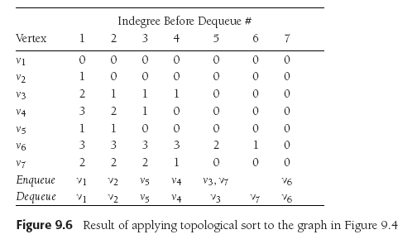
Topological Sort
Topological sort example using a queue.
Start with vertex v₁.
On each pass, remove the vertices with indegree = 0.
Subtract 1 from the indegree of the adjacent vertices.
Data Structures and Algorithms in Java, 3rd ed.
by Mark Allen Weiss
Pearson Education, Inc., 2012
ISBN 0-13-257627-9

Slide 6
Topological Sort
Pseudocode to perform a topological sort.
O(|E| + |V |) time

Slide 7
Shortest Path Algorithms
Assume there is a cost associated with each edge.
The cost of a path is the sum of the cost of each edge on the path.
Find the least-cost path from a “distinguished” vertex s to every other vertex in the graph.
Data Structures and Algorithms in Java, 3rd ed.
by Mark Allen Weiss
Pearson Education, Inc., 2012
ISBN 0-13-257627-9

Slide 8
Shortest Path Algorithms, cont’d
A negative cost results in a negative-cost cycle.
Make a path’s cost arbitrarily small by looping.
Data Structures and Algorithms in Java, 3rd ed.
by Mark Allen Weiss
Pearson Education, Inc., 2012
ISBN 0-13-257627-9

Slide 9
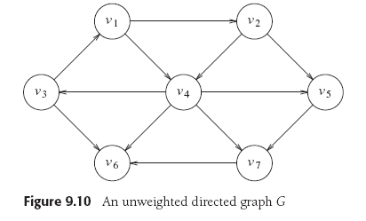
Unweighted Shortest Path
Minimize the lengths of paths.
Assign a weight of 1 to each edge.
In this example, let the distinguished vertex s be v₃.
Data Structures and Algorithms in Java, 3rd ed.
by Mark Allen Weiss
Pearson Education, Inc., 2012
ISBN 0-13-257627-9

Slide 10
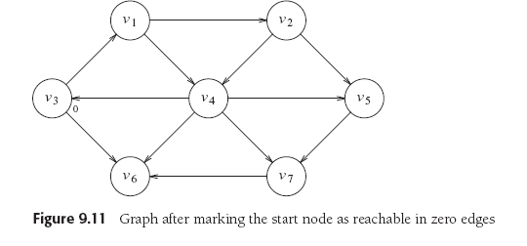
Unweighted Shortest Path, cont’d
The path from s to itself has length (cost) 0.
Data Structures and Algorithms in Java, 3rd ed.
by Mark Allen Weiss
Pearson Education, Inc., 2012
ISBN 0-13-257627-9

Slide 11
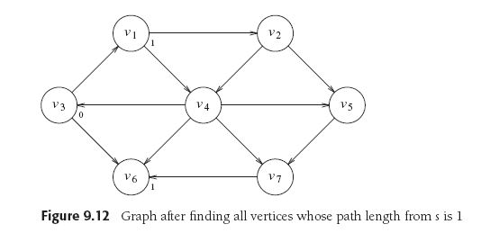
Unweighted Shortest Path, cont’d
Find vertices v₁ and v₆ that are distance 1 from v₃:
Data Structures and Algorithms in Java, 3rd ed.
by Mark Allen Weiss
Pearson Education, Inc., 2012
ISBN 0-13-257627-9

Slide 12
Unweighted Shortest Path, cont’d
Find all vertices that are distance 2 from v₃.
Begin with the vertices adjacent to v₁ and v₆.
Data Structures and Algorithms in Java, 3rd ed.
by Mark Allen Weiss
Pearson Education, Inc., 2012
ISBN 0-13-257627-9

Slide 13
Unweighted Shortest Path, cont’d
Find all vertices that are distance 3 from v₃.
Begin with the vertices adjacent to v₂ and v₄.
Now we have the shortest paths from v₃ to every other vertex.
Data Structures and Algorithms in Java, 3rd ed.
by Mark Allen Weiss
Pearson Education, Inc., 2012
ISBN 0-13-257627-9

Slide 14
Unweighted Shortest Path, cont’d
Keep the tentative distance from vertex v₃ to another vertex in the d_{v} column.
Keep track of the path in the p_{v} column.
A vertex becomes known after it has been processed.
Don’t reprocess a known vertex.
No cheaper path can be found.
Set all d_{v} = ∞.
Enqueue the distinquished vertex s and set d_{s} = 0.
During each iteration, dequeue a vertex v.
Mark v as known.
For each vertex w adjacent to v whose d_{w} = ∞
Set its distance d_{w} to d_{v} + 1
Set its path p_{w} to v.
Enqueue w.

Slide 15
Unweighted Shortest Path, cont’d

Slide 16
Unweighted Shortest Path, cont’d

Slide 17
Break

Slide 18
Weighted Least Cost Path
Dijkstra’s Algorithm
Example of a greedy algorithm.
Greedy algorithm
At each stage, do what appears to be the best at that stage.
May not always work.
Keep the same information for each vertex:
Either known or unknown
Tentative distance d_{v}
Path information p_{v}

Slide 19
Dijkstra’s Algorithm
At each stage:
Select an unknown vertex v that has the smallest d_{v}.
Declare that the shortest path from s to v is known.
For each vertex w adjacent to v:
Set its distance d_{w} to the d_{v} + cost_{v,w}
Set its path p_{w} to v.
Data Structures and Algorithms in Java, 3rd ed.
by Mark Allen Weiss
Pearson Education, Inc., 2012
ISBN 0-13-257627-9

Slide 20
Dijkstra’s Algorithm, cont’d
Start with s = v₁
Data Structures and Algorithms in Java, 3rd ed.
by Mark Allen Weiss
Pearson Education, Inc., 2012
ISBN 0-13-257627-9

Slide 21
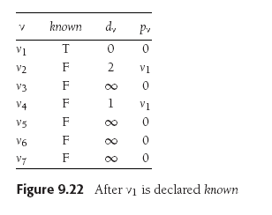
Dijkstra’s Algorithm, cont’d
Set v₁ to known.
v₂ and v₄ are unknown and adjacent to v₁:
Set d₂ and d₄ to their costs + cost of v₁
Set p₂ and p₄ to v₁.
Data Structures and Algorithms in Java, 3rd ed.
by Mark Allen Weiss
Pearson Education, Inc., 2012
ISBN 0-13-257627-9

Slide 22
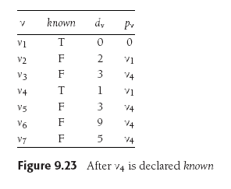
Dijkstra’s Algorithm, cont’d
Set v₄ to known.
v₃, v₅, v₆, and v₇ are unknown and adjacent to v₄:
Set their d_{w} to their costs + cost of v₄
Set their p_{w} to v₄.
Data Structures and Algorithms in Java, 3rd ed.
by Mark Allen Weiss
Pearson Education, Inc., 2012
ISBN 0-13-257627-9

Slide 23
Dijkstra’s Algorithm, cont’d
Set v₂ to known. v₅ is unknown and adjacent:
d₅ is already 3 which is less than 2+10=12, so v₅ is not changed
Data Structures and Algorithms in Java, 3rd ed.
by Mark Allen Weiss
Pearson Education, Inc., 2012
ISBN 0-13-257627-9

Slide 24
Dijkstra’s Algorithm, cont’d
Set v₅ to known. v₇ is unknown and adjacent.
Do not adjust since 5 < 3+6.
Set v₃ to known. v₆ is unknown and adjacent.
Set d₆ to 3+5=8 which is less than its previous value of 9.
Set p₆ to v₃.
Data Structures and Algorithms in Java, 3rd ed.
by Mark Allen Weiss
Pearson Education, Inc., 2012
ISBN 0-13-257627-9

Slide 25
Dijkstra’s Algorithm, cont’d
Set v₇ to known. v₆ is unknown and adjacent.
Set d₆ to 5+1=6 which is less than its previous value of 8.
Set p₆ to v₇.
Data Structures and Algorithms in Java, 3rd ed.
by Mark Allen Weiss
Pearson Education, Inc., 2012
ISBN 0-13-257627-9

Slide 26
Dijkstra’s Algorithm, cont’d
Set v₆ to known.
The algorithm terminates.
Data Structures and Algorithms in Java, 3rd ed.
by Mark Allen Weiss
Pearson Education, Inc., 2012
ISBN 0-13-257627-9

Slide 27
Assignment #6
In this assignment, you will write programs to:
Perform a topological sort
Find the shortest unweighted path
Find the shortest weighted path

Slide 28
Assignment #6, cont’d
Write a Java program to perform a topological sort using a queue.
Use Figure 9.81 (p. 417 and on the next slide) in the textbook as input.
Print the sorting table, similar to Figure 9.6 (p. 364), except that instead of generating a new column after each dequeue operation, you can print the column as a row instead.
Print the nodes in sorted order, starting with vertex s.

Slide 29
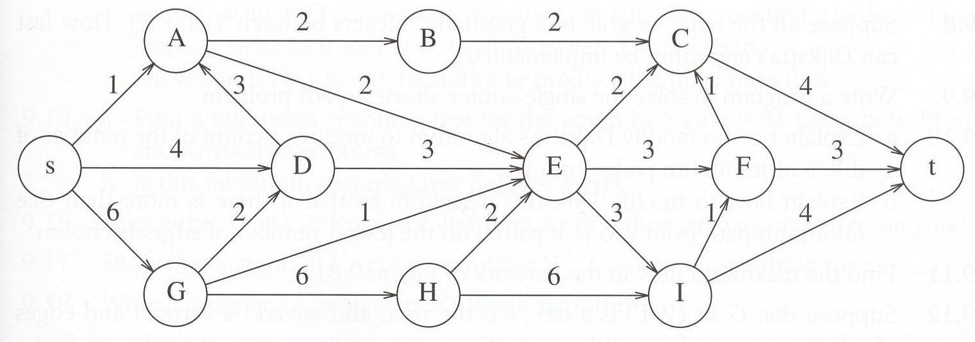
Assignment #6, cont’d
Figure 9.81 for the topological sort program.
Data Structures and Algorithms in Java, 3rd ed.
by Mark Allen Weiss
Pearson Education, Inc., 2012
ISBN 0-13-257627-9

Slide 30
Assignment #6, cont’d
Write a Java program to find the unweighted shortest path from a given vertex to all other vertices.
Use Figure 9.82 (page 418 and the next slide) as input.
Vertex A is distinguished.
Print the intermediate tables (such as Figure 9.19).
Print the final path.

Slide 31
Assignment #6, cont’d
Write a Java program to find the weighted shortest path from a given vertex to all other vertices.
Use Figure 9.82 (page 418 and the next slide) as input.
Vertex A is distinguished.
Print the intermediate tables (such as Figures 9.21-9.25).
Print the final path.

Slide 32
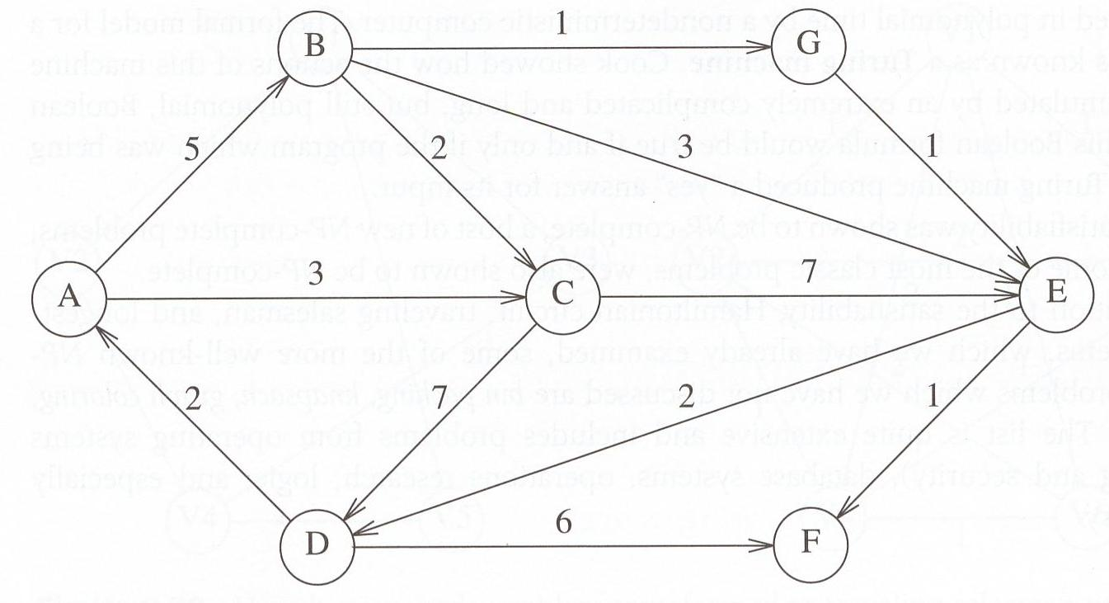
Assignment #6, cont’d
Figure 9.82 for the shortest path programs. Vertex A is distinguished.
Data Structures and Algorithms in Java, 3rd ed.
by Mark Allen Weiss
Pearson Education, Inc., 2012
ISBN 0-13-257627-9

Slide 33
Assignment #6, cont’d
You may choose a partner to work with you on this assignment.
Both of you will receive the same score.
Email your answers to ron.mak@sjsu.edu
Subject line: CS 146 Assignment #6: Your Name(s)
CC your partner’s email address so I can “reply all”.
Due Friday, July 30 at 11:59 PM.

Slide 34
Minimum Spanning Tree (MST)
Suppose you’re wiring a new house.
What’s the minimum length of wire you need to purchase?
Represent the house as an undirected graph.
Each electrical outlet is a vertex.
The wires between the outlets are the edges.
The cost of each edge is the length of the wire.

Slide 35
Minimum Spanning Tree (MST), cont’d
Create a tree formed from the edges of an undirected graph that connects all the vertices at the lowest total cost.

Slide 36
Minimum Spanning Tree (MST), cont’d
The MST
Is an acyclic tree.
Spans (includes) every vertex.
Has |V |-1 edges.
Has minimum total cost.
Data Structures and Algorithms in Java, 3rd ed.
by Mark Allen Weiss
Pearson Education, Inc., 2012
ISBN 0-13-257627-9

Slide 37
Minimum Spanning Tree (MST), cont’d
Add each edge to an MST in such a way that:
It does not create a cycle.
Is the least cost addition.
A greedy algorithm!
Data Structures and Algorithms in Java, 3rd ed.
by Mark Allen Weiss
Pearson Education, Inc., 2012
ISBN 0-13-257627-9

