Slide 1


CS 146: Data Structures and Algorithms July 21 Class Meeting
Department of Computer Science San Jose State University Summer 2015 Instructor: Ron Mak
www.cs.sjsu.edu/~mak

Slide 2
Minimum Spanning Tree (MST)
Suppose you’re wiring a new house.
What’s the minimum length of wire you need to purchase?
Represent the house as an undirected graph.
Each electrical outlet is a vertex.
The wires between the outlets are the edges.
The cost of each edge is the length of the wire.

Slide 3
Minimum Spanning Tree (MST), cont’d
Create a tree formed from the edges of an undirected graph that connects all the vertices at the lowest total cost.

Slide 4
Minimum Spanning Tree (MST), cont’d
The MST
Is an acyclic tree.
Spans (includes) every vertex.
Has |V |-1 edges.
Has minimum total cost.
Data Structures and Algorithms in Java, 3rd ed.
by Mark Allen Weiss
Pearson Education, Inc., 2012
ISBN 0-13-257627-9

Slide 5
Minimum Spanning Tree (MST), cont’d
Add each edge to an MST in such a way that:
It does not create a cycle.
Is the least cost addition.
A greedy algorithm!
Data Structures and Algorithms in Java, 3rd ed.
by Mark Allen Weiss
Pearson Education, Inc., 2012
ISBN 0-13-257627-9

Slide 6
Prim’s Algorithm for MST
Rediscovered by Robert C. Prim in 1957 to solve connection network problems.
First discovered in 1930 by Czech mathematician Vojtěch Jarník.
At any point during the algorithm, some vertices are in the MST and others are not.
Choose one vertex to start.

Slide 7
Prim’s Algorithm for MST, cont’d
At each stage, add another vertex to the tree.
Choose a vertex such that:
The edge (u, v) has the lowest cost among all the edges.
u is already in the tree and v is not.
Similar to Dijkstra’s algorithm for shortest paths.
Maintain whether or not a vertex is known, and its d_{v} and p_{v} values.

Slide 8
Prim’s Algorithm for MST, cont’d
Data Structures and Algorithms in Java, 3rd ed.
by Mark Allen Weiss
Pearson Education, Inc., 2012
ISBN 0-13-257627-9

Slide 9
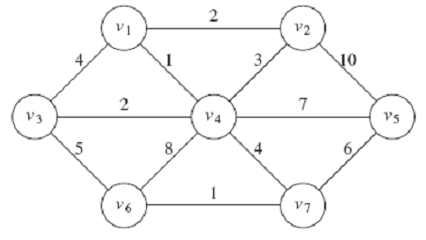
Prim’s Algorithm for MST, cont’d
Data Structures and Algorithms in Java, 3rd ed.
by Mark Allen Weiss
Pearson Education, Inc., 2012
ISBN 0-13-257627-9

Slide 10
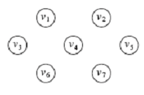
Prim’s Algorithm for MST, cont’d
Choose v₁ to start. Declare it known.
Set the d_{v} and p_{v} of v₁’s neighbors.
Data Structures and Algorithms in Java, 3rd ed.
by Mark Allen Weiss
Pearson Education, Inc., 2012
ISBN 0-13-257627-9

Slide 11
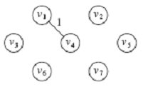
Prim’s Algorithm for MST, cont’d
Choose v₄ and declare it known.
Set the d_{v} and p_{v} of v₄’s neighbors
that are still unknown: v₃, v₅, v₆, and v₇.
Don’t do v₂ because d₂ = 2 < 3.
Data Structures and Algorithms in Java, 3rd ed.
by Mark Allen Weiss
Pearson Education, Inc., 2012
ISBN 0-13-257627-9

Slide 12
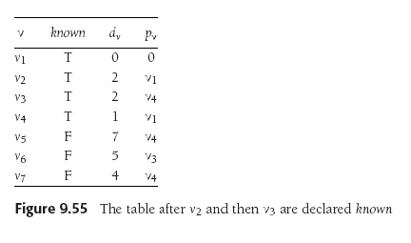
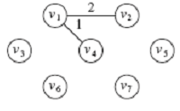
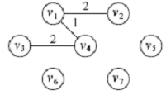
Prim’s Algorithm for MST, cont’d
Choose v₂ and declare it known.
No changes to the table.
Choose v₃ and declare it known.
Set the d_{v} and p_{v} of v₃’s neighbors
that still unknown: v₆.
Set d₆ = 5 < its previous value 8.
Data Structures and Algorithms in Java, 3rd ed.
by Mark Allen Weiss
Pearson Education, Inc., 2012
ISBN 0-13-257627-9

Slide 13
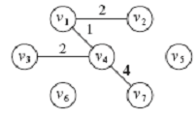
Prim’s Algorithm for MST, cont’d
Choose v₇ and declare it known.
Set the d_{v} and p_{v} of v₄’s neighbors
that still unknown: v₅ and v₆.
Set d₅ = 5 < its previous value 7.
Set d₆ = 1 < its previous value 5.
Data Structures and Algorithms in Java, 3rd ed.
by Mark Allen Weiss
Pearson Education, Inc., 2012
ISBN 0-13-257627-9

Slide 14
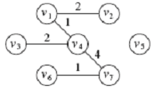
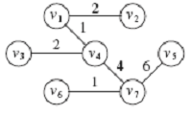
Prim’s Algorithm for MST, cont’d
Choose v₆ and declare it known.
No changes to the table.
Choose v₅ and declare it known.
No changes to the table.
Data Structures and Algorithms in Java, 3rd ed.
by Mark Allen Weiss
Pearson Education, Inc., 2012
ISBN 0-13-257627-9

Slide 15
Kruskal’s Algorithm for MST
Published by Joseph Kruskal in 1956.
A greedy algorithm using equivalence classes.
First partition the vertices into |V | equivalence classes.
Process the edges in order of weight.
Add an edge to the MST and combine two equivalence classes if the edge connects two vertices in different equivalence classes.

Slide 16
Kruskal’s Algorithm for MST, cont’d
Use previously studied data structures!
A min heap (priority queue) to process the edges in order.
Disjoint sets to represent equivalence classes.
Union/find algorithm to combine equivalence classes.

Slide 17
Kruskal’s Algorithm for MST, cont’d
Data Structures and Algorithms in Java, 3rd ed.
by Mark Allen Weiss
Pearson Education, Inc., 2012
ISBN 0-13-257627-9

Slide 18
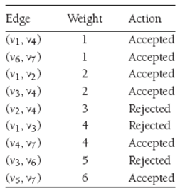
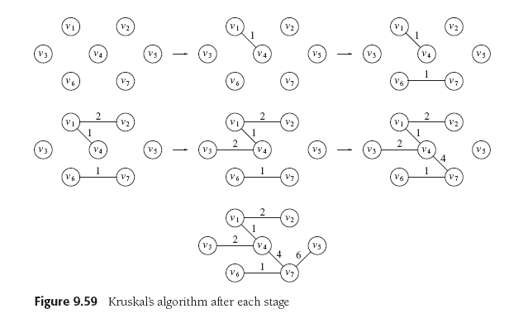
Kruskal’s Algorithm for MST, cont’d
Data Structures and Algorithms in Java, 3rd ed.
by Mark Allen Weiss
Pearson Education, Inc., 2012
ISBN 0-13-257627-9

Slide 19
Kruskal’s Algorithm for MST, cont’d
ArrayList<Edge> kruskal(List<Edge> edges, int numVertices)
{
DisjointSets ds = new DisjointSets(numVertices);
PriorityQueue<Edge> = new PriorityQueue<>(edges); // min heap
List<Edge> mst = new ArrayList<>();
while (mst.size() != numVertices) {
Edge e = pq.deleteMin(); // Edge e = (u, v)
SetType uset = ds.find(e.getu());
SetType vset = ds.find(e.getv());
// If in different equivalence classes,
// then accept the edge.
if (uset != vset) {
mst.add(e);
ds.union(uset, vset);
}
}
return mst;
}

Slide 20
Graph Traversal Algorithms
Graph traversal is similar to tree traversal.
Visit each vertex of a graph in a particular order.
Special problems for graphs:
It may not be possible to reach all vertices from the start vertex.
The graph may contain cycles.
Don’t go into an infinite loop.
“Mark” each vertex after a visit.
Don’t revisit marked vertices.

Slide 21
You’re Lost in a Maze
You have a bag of bread crumbs.
As you go down each path, you drop bread crumbs to mark your path.
Whenever you come to a dead end, you retrace your path by following your bread crumbs.
You continue retracing your path (“backtracking”) until you come to an intersection with an unmarked path.
You (recursively) go down the unmarked path.

Slide 22
Depth-First Search
Represent the maze as a graph.
Each path is an edge.
Each intersection is a vertex.
You are doing a depth-first search of the graph.

Slide 23
Depth-First Search
void dfs(Vertex v)
{
v.visited = true; // mark
for each Vertex w adjacent to v {
if (!w.visited) {
dfs(w); // recursively visit w
}
}
}
Implicitly uses a stack for the recursive calls.
Visits each vertex once.
Processes each edge once in a directed graph.
Processes each edge from both directions in an undirected graph.
Therefore, Θ(|V | + |E |).

Slide 24
Depth-First Search
3
2
B
F
H
4
C
5
1
A
D
G
I
8
6
7
E
9

Slide 25
Depth-First Search and Games
Depth-first search is used by game-playing programs.
Example: IBM’s “Deep Blue” chess playing program.
Use a graph to represent the possible moves from the present situation into the future.
Each vertex is a decision point for either you or your opponent.

Slide 26
Depth-First Search and Games, cont’d
Perform a depth-first search to look at possible move outcomes of both you and your opponent.
Each edge would have the cost of going down that path.
Backtrack if a path is a dead end or its cost is not beneficial.
How deeply your program can search depends on the computer’s memory and the allowed search time.

Slide 27
Find a Lost Child in a Large Building
Start in the room where the child was last seen.
Search each room adjacent to the first room.
Put a tag on the door to mark a room you’ve already searched.
Then search each room adjacent to the rooms you’ve already searched.
Repeatedly search all the rooms adjacent to rooms you’ve already searched before moving farther out from the first room.

Slide 28
Breadth-First Search
Represent the building as a graph.
Each room is a vertex.
Each hallway between rooms is an edge.
You are doing a breadth-first search of the graph.

Slide 29
Breadth-First Search
void bfs(Vertex s)
{
Queue<Vertex> q = new Queue<>();
q.enqueue(s);
s.visited = true;
while (!q.empty()) {
Vertex v = q.dequeue();
for each Vertex w adjacent to v {
if (!w.visited) {
w.visited = true;
q.enqueue(w);
}
}
}
}

Slide 30
Breadth-First Search
2
6
B
F
H
8
C
3
1
A
4
D
G
I
9
7
E
5

Slide 31
Assignment #6
In this assignment, you will write programs to:
Perform a topological sort
Find the shortest unweighted path
Find the shortest weighted path
Compute a minimum spanning tree (two algorithms)

Slide 32
Assignment #6, cont’d
Write a Java program to perform a topological sort using a queue.
Use Figure 9.81 (p. 417 and on the next slide) in the textbook as input.
Print the sorting table, similar to Figure 9.6 (p. 364), except that instead of generating a new column after each dequeue operation, you can print the column as a row instead.
Print the nodes in sorted order, starting with vertex s.

Slide 33
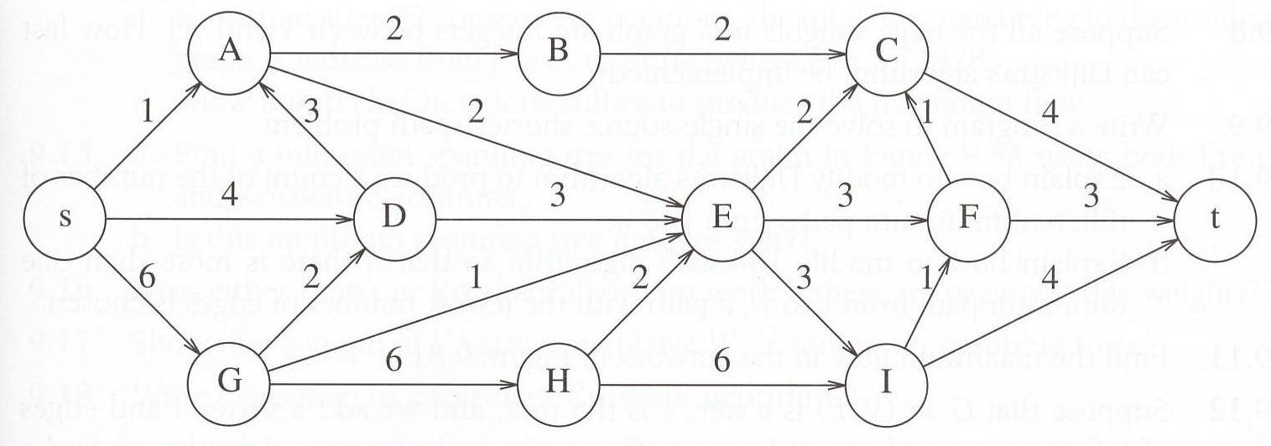
Assignment #6, cont’d
Figure 9.81 for the topological sort program.
Data Structures and Algorithms in Java, 3rd ed.
by Mark Allen Weiss
Pearson Education, Inc., 2012
ISBN 0-13-257627-9

Slide 34
Assignment #6, cont’d
Write a Java program to find the unweighted shortest path from a given vertex to all other vertices.
Use Figure 9.82 (page 418 and the next slide) as input.
Vertex A is distinguished.
Print the intermediate tables (such as Figure 9.19).
Print the final path.

Slide 35
Assignment #6, cont’d
Write a Java program to find the weighted shortest path from a given vertex to all other vertices.
Use Figure 9.82 (page 418 and the next slide) as input.
Vertex A is distinguished.
Print the intermediate tables (such as Figures 9.21-9.25).
Print the final path.

Slide 36
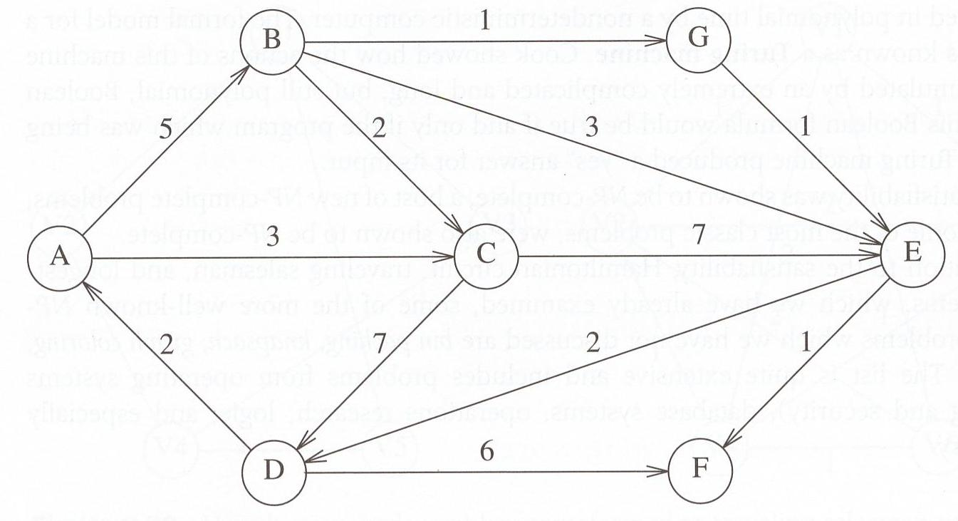
Assignment #6, cont’d
Figure 9.82 for the shortest path programs. Vertex A is distinguished.
Data Structures and Algorithms in Java, 3rd ed.
by Mark Allen Weiss
Pearson Education, Inc., 2012
ISBN 0-13-257627-9

Slide 37
Assignment #6, cont’d
Write a Java program that implements Prim’s algorithm to compute the minimum spanning tree as shown on the next slide.
Print tables similar to Figures 9.52 – 9.57
Write a Java program that implements Kruskal’s algorithm to compute the minimum spanning tree as shown on the next slide.
Print a table similar to Figure 9.58

Slide 38
Assignment #6, cont’d
Data Structures and Algorithms in Java, 3rd ed.
by Mark Allen Weiss
Pearson Education, Inc., 2012
ISBN 0-13-257627-9

Slide 39
Assignment #6, cont’d
You may choose a partner to work with you on this assignment.
Both of you will receive the same score.
Email your answers to ron.mak@sjsu.edu
Subject line: CS 146 Assignment #6: Your Name(s)
CC your partner’s email address so I can “reply all”.
Due Friday, July 30 at 11:59 PM.

Slide 40
Hash Tables
Consider an array or an array list.
To access a value, you use an integer index.
The array “maps” the index to a data value stored in the array.
The mapping function is very efficient.
As long as the index value is within range, there is a strict one-to-one correspondence between an index value and a stored data value.
We can consider the index value to be the “key” to obtaining the corresponding data value.

Slide 41
Hash Tables
A hash table also stores data values.
Use a key to obtain the corresponding data value.
The key does not have to be an integer value.
For example, the key could be a string.
There might not be a one-to-one correspondence between keys and data values.
The mapping function may not be trivial.

Slide 42
Hash Tables
We can implement a hash table as an array of cells.
Refer to its size as TableSize.
If the hash table’s mapping function maps a key value into an integer value in the range 0 to TableSize – 1, then we can use this integer value as the index into the underlying array.

Slide 43
Hash Tables
Suppose we’re storing employee data records into a hash table.
We use an employee’s name as the key.

Slide 44
Hash Tables
Suppose that the name
john hashes (maps) to 3
phil hashes to 4
dave hashes to 6
mary hashes to 7
This is an ideal situation because each employee record ended up in a different table cell.
Data Structures and Algorithms in Java, 3rd ed.
by Mark Allen Weiss
Pearson Education, Inc., 2012
ISBN 0-13-257627-9

Slide 45
Hash Function
We need an ideal hash function to map each data record into a distinct table cell.
It can be very difficult to find such a hash function.
The more data we put into a hash table, the more “collisions” occur.
A collision is when two or more data records are mapped to the same table cell.
How can a hash table handle collisions?

Slide 46
Keys for Successful Hashing
Good hash function
Good collision resolution
Size of the underlying array a prime number

Slide 47
Collision Resolution
Separate chaining
Linear probing

Slide 48
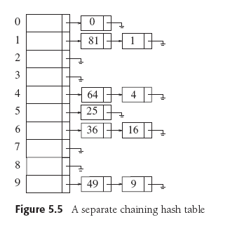
Collision Resolution: Separate Chaining
Each cell in a hash table is a pointer to a linked list of all the data records that hash to that entry.
To retrieve a data record, we first hash to the cell.
Data Structures and Algorithms in Java, 3rd ed.
by Mark Allen Weiss
Pearson Education, Inc., 2012
ISBN 0-13-257627-9

Slide 49
Collision Resolution: Separate Chaining, cont’d
Then we search the associated linked list for the data record.
We can sort the linked lists to improve search performance.
Data Structures and Algorithms in Java, 3rd ed.
by Mark Allen Weiss
Pearson Education, Inc., 2012
ISBN 0-13-257627-9

Slide 50
Collision Resolution: Linear Probing
Does not use linked lists.
When a collision occurs, try a different table cell.
Try in succession h₀(x), h₁(x), h₂(x), …
h_{i}(x) = (hash(x) + f(i)) mod TableSize, with f(0) = 0
hash(x) produces the home cell.
Function f is the collision resolution strategy.
With linear probing, f is a linear function of i, typically, f(i) = i

Slide 51
Collision Resolution: Linear Probing, cont’d
Insertion
If a cell is filled, look for the next empty cell.
Search
Start searching at the home cell, keep looking at the next cell until you find the matching key is found.
If you encounter an empty cell, there is no key match.
Deletion
Empty cells will prematurely terminate a search.
Leave deleted items in the hash table but mark them as deleted.

Slide 52
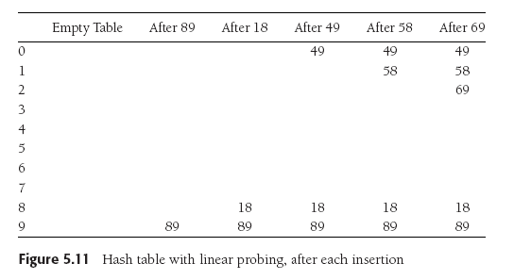
Collision Resolution: Linear Probing, cont’d
Suppose TableSize is 10, the keys are integer values, and the hash function is the key value modulo 10.
We want to insert keys 89, 18, 49, 58, and 69.
Data Structures and Algorithms in Java, 3rd ed.
by Mark Allen Weiss
Pearson Education, Inc., 2012
ISBN 0-13-257627-9

Slide 53
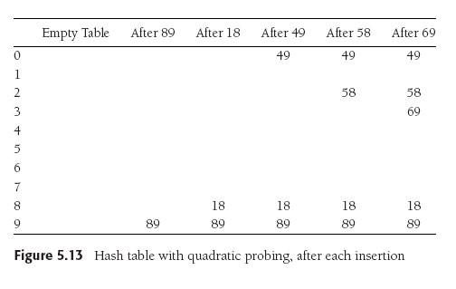
Collision Resolution: Quadratic Probing
Linear probing causes primary clustering.
Try quadratic probing instead: f(i) = i².
49 collides with 89: the next empty cell
is 1 away.
58 collides with 18: the next cell is filled.
Try 2² = 4 cells away
from the home cell.
Same for 69.
Data Structures and Algorithms in Java, 3rd ed.
by Mark Allen Weiss
Pearson Education, Inc., 2012
ISBN 0-13-257627-9

Slide 54
Load Factor
The load factor λ of a hash table is the ratio of the number of elements in the table to the table size.
λ is much more important than table size.
For probing collision resolution strategies, it is important to keep λ under 0.5.
Don’t let the table become more than half full.
If quadratic probing is used and the table size is a prime number, then a new element can always be inserted if the table is at most half full.

Slide 55
Collision Resolution: Double Hashing
Apply a second hash function.
Use the resolution strategy function f(i) = i•hash₂(x)
Probe away from the home cell at distances hash₂(x), 2•hash₂(x), 3•hash₂(x), ...
The second hash function should be easy to calculate.
Example: R-(x mod R) where R is a prime number < TableSize
The second hash function must never evaluate to 0.
Data Structures and Algorithms in Java, 3rd ed.
by Mark Allen Weiss
Pearson Education, Inc., 2012
ISBN 0-13-257627-9

Slide 56
Collision Resolution: Double Hashing
hash₂(x) = R-(x mod R)
R = 7
hash₂(49) = 7-0 = 7 hash₂(58) = 7-2 = 5 hash₂(69) = 7-6 = 1
Data Structures and Algorithms in Java, 3rd ed.
by Mark Allen Weiss
Pearson Education, Inc., 2012
ISBN 0-13-257627-9

Slide 57
Rehashing
Do a rehash if the table gets too full: λ > 0.5
Make the table larger (2X)
Use a new hash function.
Each existing element in the hash table must be rehashed and moved to its new location.
An expensive operation.
Shouldn’t happen very often.

Slide 58
Rehashing
Data Structures and Algorithms in Java, 3rd ed.
by Mark Allen Weiss
Pearson Education, Inc., 2012
ISBN 0-13-257627-9

Slide 59
Built-in Java Support for Hashing
Java’s built-in HashSet and HashMap use separate chaining hashing.
Each Java object has a built-in hash code defined by the Object class (the base class of all Java classes)
public int hashCode()
public boolean equals()

Slide 60
Built-in Java Support for Hashing, cont’d
Equal objects must produce the same hash code.
Unequal objects need not produce distinct hash codes.
A hash function can use an object’s hash code to product a key suitable for a particular hash table.

