Slide 1


CS 146: Data Structures and Algorithms July 28 Class Meeting
Department of Computer Science San Jose State University Summer 2015 Instructor: Ron Mak
www.cs.sjsu.edu/~mak

Slide 2
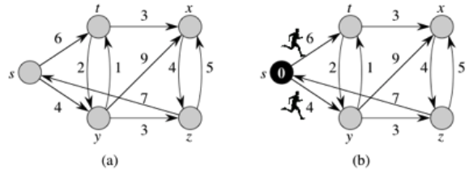
Dijkstra’s Algorithm Revisited
Think of a graph as a kind of race track.
Runners are waiting to be tagged at each vertex.
Edge weights are running times.
At time 0, runners take off from vertex s.
http://www.cs.dartmouth.edu/~thc/cs10/lectures/0509/0509.html

Slide 3
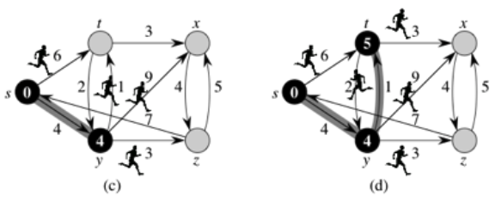
Dijkstra’s Algorithm Revisited, cont’d
At time 4, the runner reaches vertex y and tags.
Runners take off from vertex y.
One of the runners from vertex y reaches vertex t before the runner from vertex s.
The runner from vertex s loses and leaves the race.
http://www.cs.dartmouth.edu/~thc/cs10/lectures/0509/0509.html

Slide 4
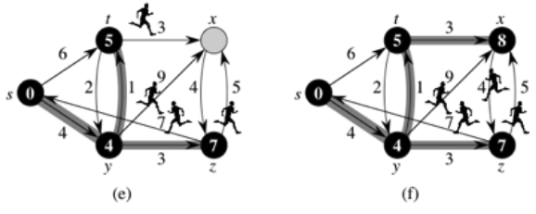
Dijkstra’s Algorithm Revisited, cont’d
The runner from vertex y reaches vertex z.
The runner from vertex t reaches vertex x first.
Now we have the shortest (fastest) path from vertex s to each of the other vertices.
http://www.cs.dartmouth.edu/~thc/cs10/lectures/0509/0509.html

Slide 5
Greedy Algorithms
Proceed in stages.
At each stage, choose a local optimum.
Attempt to do what is best based on current information.
“Take what you can get now.”
Hope this process leads to the global optimum.
Doesn’t always work.

Slide 6
Example Greedy Algorithms
Dijkstra’s algorithm for shortest weighted path.
Prim’s algorithm for minimum spanning tree.
Kruskal’s algorithm for minimum spanning tree.

Slide 7
Job Scheduling Algorithms
An operating system’s job scheduler picks jobs to run that are waiting in the job queue.
Each job has an expected run time.
Once a job starts to run, let it run to completion (non-preemptive scheduling).
Goal: Minimize average turnaround time for all the jobs.
Turnaround time = time spent in queue + time spent running

Slide 8
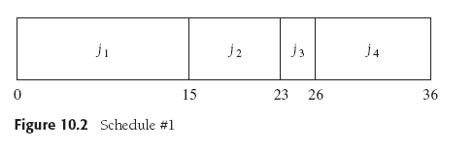
FCFS: A Non-Greedy Scheduling Algorithm
First-Come First-Served (FCFS) algorithm
Turnaround times:
j1: 15
j2: 15 + 8 = 23
j3: 15 + 8 + 3 = 26
j4: 15 + 8 + 3 + 10 = 36
Average turnaround time: (15 + 23 + 26 + 36)/4 = 25.00
Data Structures and Algorithms in Java, 3rd ed.
by Mark Allen Weiss
Pearson Education, Inc., 2012
ISBN 0-13-257627-9

Slide 9
SJF: A Greedy Scheduling Algorithm
Shortest Job First (SJF) algorithm
Always pick the job with the shortest expected run time.
Turnaround times:
j3: 3
j2: 3 + 8 = 11
j4: 3 + 8 + 10 = 21
j1: 3 + 8 + 10 + 15 = 36
Average turnaround time: (3 + 11 + 21 + 26)/4 = 17.75
Data Structures and Algorithms in Java, 3rd ed.
by Mark Allen Weiss
Pearson Education, Inc., 2012
ISBN 0-13-257627-9

Slide 10
Huffman’s Greedy Algorithm
Goal: Reduce the number of bits to transmit a message.
Invented by David A. Huffman in 1952.
Idea: Use fewer bits to encode message characters that appear more frequently.
Normally, each message character is encoded by a fixed number of bits.
Examples: 7-bit ASCII code 8-bit UTF-8 code

Slide 11
Huffman’s Greedy Algorithm, cont’d
Use a full binary tree to determine character encodings.
Each node is either a leaf or has two children.
Each character is a leaf node.
In the path from the root to a character:
Each left link is a 0 bit
Each right link is a 1 bit
No character code is a prefix of another character.

Slide 12
Huffman’s Greedy Algorithm, cont’d
Use frequency
as the weight.
Always merge the two trees
with the lowest weights.
Data Structures and Algorithms in Java, 3rd ed.
by Mark Allen Weiss
Pearson Education, Inc., 2012
ISBN 0-13-257627-9

Slide 13
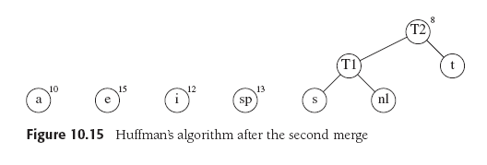
Huffman’s Greedy Algorithm, cont’d
Always merge the two trees
with the lowest weights.
Data Structures and Algorithms in Java, 3rd ed.
by Mark Allen Weiss
Pearson Education, Inc., 2012
ISBN 0-13-257627-9

Slide 14
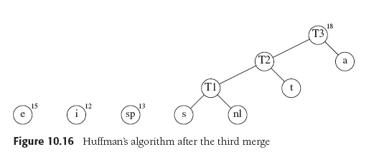
Huffman’s Greedy Algorithm, cont’d
Always merge the two trees
with the lowest weights.
Data Structures and Algorithms in Java, 3rd ed.
by Mark Allen Weiss
Pearson Education, Inc., 2012
ISBN 0-13-257627-9

Slide 15
Huffman’s Greedy Algorithm, cont’d
Always merge the two trees
with the lowest weights.
Data Structures and Algorithms in Java, 3rd ed.
by Mark Allen Weiss
Pearson Education, Inc., 2012
ISBN 0-13-257627-9

Slide 16
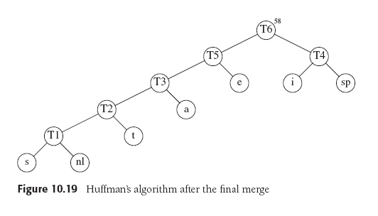
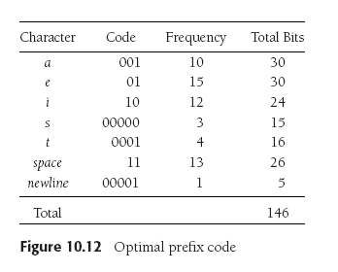
Huffman’s Greedy Algorithm, cont’d
Always merge the two trees
with the lowest weights.
Data Structures and Algorithms in Java, 3rd ed.
by Mark Allen Weiss
Pearson Education, Inc., 2012
ISBN 0-13-257627-9
Decode: 000000010001100010001011110000100001
000000010001100010001011110000100001
s a t i a t e☐ i t \n

Slide 17
Divide and Conquer Algorithms
Divide a problem into at least two smaller problems.
The subproblems can (but not necessarily) be solved recursively.
Conquer by forming the solution to the original problem from the solutions to the smaller problems.

Slide 18
Example Divide and Conquer Algorithms
Solution to the Towers of Hanoi puzzle.
Mergesort
Quicksort

Slide 19
Multiplying Two Large Integers
We want to multiply two large N-digit integers X and Y.
Done the usual way, it’s Θ(N²).

Slide 20
Multiplying Two Large Integers
Let X = 61,438,521 and Y = 94,736,407.
Divide and conquer: Break each number into two parts.
X_{L} = 6,143 and X_{R} = 8,521
Y_{L} = 9,473 and Y_{R} = 6,407
Therefore:
X = X_{L}10⁴ + X_{R}
Y = Y_{L}10⁴ + Y_{R}

Slide 21
Multiplying Two Large Integers
Replace the multiplier of 10⁴ with:
Since we’re already computing X_{L}Y_{L} and X_{R}Y_{R}, we’ve reduced the number of multiplications by one.
With these algebraic manipulations, computing XY is O(N^{log 3}) = O(N^{1.59}).

Slide 22
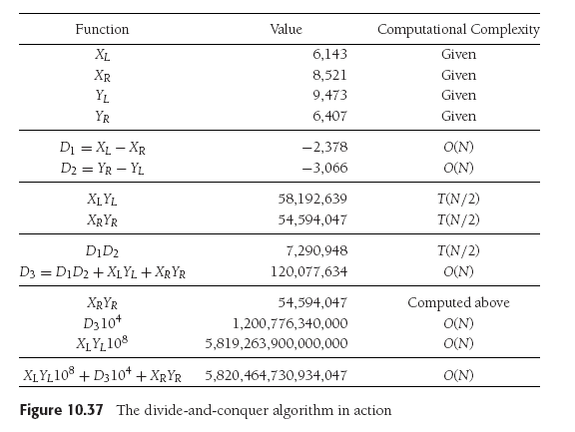
Multiplying Two Large Integers
Data Structures and Algorithms in Java, 3rd ed.
by Mark Allen Weiss
Pearson Education, Inc., 2012
ISBN 0-13-257627-9

Slide 23
Break

Slide 24
Dynamic Programming Algorithms
Break a problem into smaller subproblems.
But we don’t know exactly which subproblems to solve.
We solve them all and store the results in a table.
Use a table instead of recursion.
Use the stored results to solve larger problems.
Richard Bellman coined the term dynamic programming in the 1950s
when programming meant planning. Dynamic programming involved
optimally planning multistage processes.

Slide 25
Example Dynamic Programming Algorithm
Compute the fibonacci series.
The table consists of the last two computed numbers.
It’s extremely inefficient to use recursion to compute the series.

Slide 26
The Knapsack Problem
A thief burglarizing a safe finds that it contains N types of items of various weights and value.
The thief has a knapsack that can hold only W pounds.
The thief can take multiple items of each type.
Item i | Weight w | Value v
1 | 6 | $30
2 | 3 | $14
3 | 4 | $16
4 | 2 | $9
https://www.cs.berkeley.edu/~vazirani/algorithms/chap6.pdf

Slide 27
The Knapsack Problem, cont’d
What is the optimum (most valuable) haul that the thief can carry away in the knapsack?
The solution will use dynamic programming.
In other words, it will use a table.
What are the subproblems?
Consider smaller knapsacks that have a smaller capacities.
Solve for each knapsack size.

Slide 28
The Knapsack Problem, cont’d
Let K(w) = maximum value for a knapsack with capacity weight w
Suppose the optimum solution to K(w) includes item I
Then removing this item from the knapsack leaves an optimal solution for a smaller knapsack, K(w – w_{i})
In other words, K(w) = K(w – w_{i}) + v_{i} for some i.
We don’t know which i, so let’s try them all:

Slide 29
The Knapsack Problem, cont’d
Item i | Weight w | Value v
1 | 6 | $30
2 | 3 | $14
3 | 4 | $16
4 | 2 | $9
int K[] = new int[W+1];
K[0] = 0;
for (int ww = 1; ww <= W; ww++) {
K[ww] = K[ww-1];
int max = 0;
int item = 0;
for (int i = 1; i <= N; i++) {
if (w[i] <= ww) {
int value = K[ww - w[i]] + v[i];
if (max < value) {
max = value;
item = i;
}
K[ww] = max;
}
}
...
}
Compute
w item weight value K[w]
1 0
2 4 2 9 9
3 2 3 14 14
4 4 2 9 18
5 2 3 14 23
6 1 6 30 30
7 2 3 14 32
8 1 6 30 39
9 1 6 30 44
10 1 6 30 48

Slide 30
The Knapsack Problem, cont’d
Which items are in the knapsack?
w item weight value K[w]
1 0
2 4 2 9 9
3 2 3 14 14
4 4 2 9 18
5 2 3 14 23
6 1 6 30 30
7 2 3 14 32
8 1 6 30 39
9 1 6 30 44
10 1 6 30 48
w | item | value
10 | 1 | 30 | 48 – 30 = 18
18 | 4 | 9 | 18 – 9 = 9
9 | 4 | 9 | 9 – 9 = 0

Slide 31
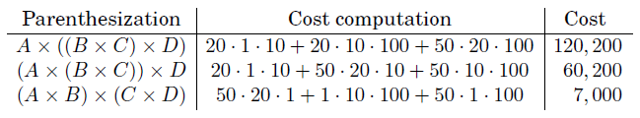
Ordering Matrix Multiplications
Suppose we want to multiply together four matrices:
Matrix multiplication is associative.
What order should we multiply them to minimize the cost?
Matrix | Size
A | 50 x 20
B | 20 x 1
C | 1 x 10
D | 10 x 100
Multiplying an m x n matrix by an
n x p matrix takes approximately
mnp multiplications.
https://www.cs.berkeley.edu/~vazirani/algorithms/chap6.pdf

Slide 32
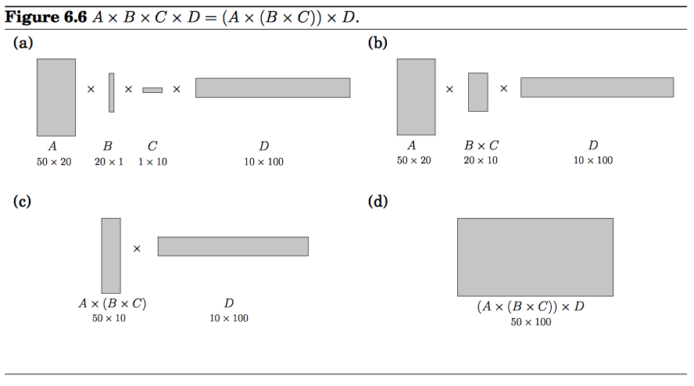
Ordering Matrix Multiplications, cont’d
https://www.cs.berkeley.edu/~vazirani/algorithms/chap6.pdf

Slide 33
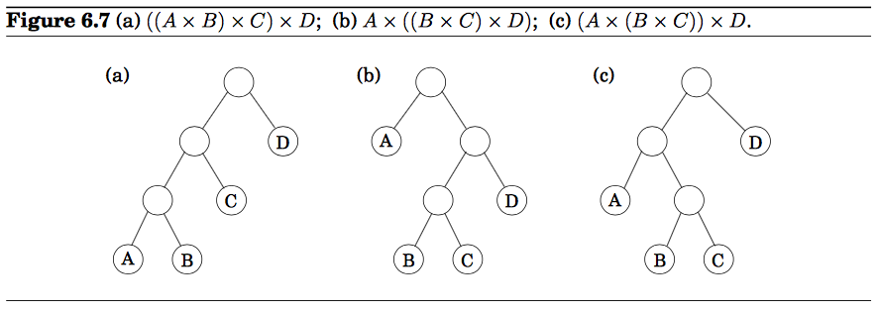
Ordering Matrix Multiplications, cont’d
Use a dynamic programming algorithm to find the optimal (least cost) multiplication order.
Represent each parenthesization as a binary expression tree:
https://www.cs.berkeley.edu/~vazirani/algorithms/chap6.pdf

Slide 34
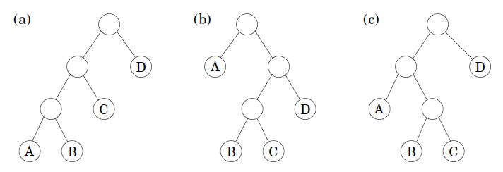
Ordering Matrix Multiplications, cont’d
((A x B) x C) x D
A x ((B x C) x D)
(A x (B x C)) x D
For a tree to be optimal, its subtrees must also be optimal.
What are the subproblems?
Consider the multiplications represented by the subtrees.
https://www.cs.berkeley.edu/~vazirani/algorithms/chap6.pdf

Slide 35
Ordering Matrix Multiplications, cont’d
Let C(i, j) = minimum cost of multiplying A_{i} x A_{i+1} x ... x A_{j}
The size of each subproblem is | j – i| multiplications.
The smallest problem is i = j, so C(i, i) = 0.
For j > i, consider the optimal subtree for C(i, j).
The uppermost branch splits the product into two parts, A_{i} x ... x A_{k} and A_{k+1} x ... x A_{j} for some k between i and j.
The cost of the subtree is the cost of the two partial products, plus the cost of combining them:
Find the
optimal
value of k

Slide 36
Ordering Matrix Multiplications, cont’d
for i = 1 to n {
C[i,i] = 0;
}
// s is the subproblem size
for s = 1 to n-1 {
for i = 1 to n-s {
j = i+s;
for k = i to j-1 {
cost = C[i,k] + C[k+1,j] + m[i-1]*m[k]*m[j];
if (cost < C[i,j]) {
C[i,j] = cost;
lastChange[i,j] = k;
}
}
}
}
Record costs in the two-dimensional array C[][]
Compute
Find the
optimal
value of k
Record changes in array lastChange[][]

Slide 37
Ordering Matrix Multiplications, cont’d
Recover the optimal parenthesization from the lastChange[][] array:
void order(i, j)
{
if (i == j) System.out.print(name[i]);
else {
System.out.print ("(");
order(i, lastChange[i,j]-1);
System.out.print ("*");
order(lastChange[i,j], j);
System.out.print (")");
}
}

Slide 38
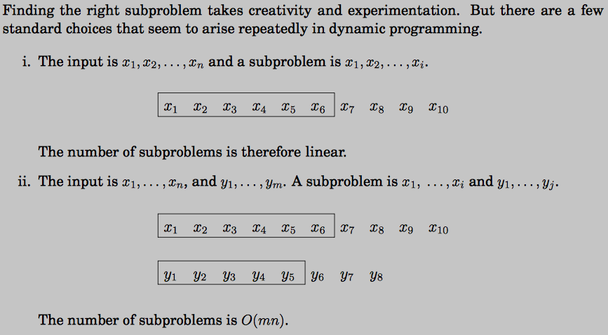
Common Subproblems of Dynamic Programming
https://www.cs.berkeley.edu/~vazirani/algorithms/chap6.pdf

Slide 39
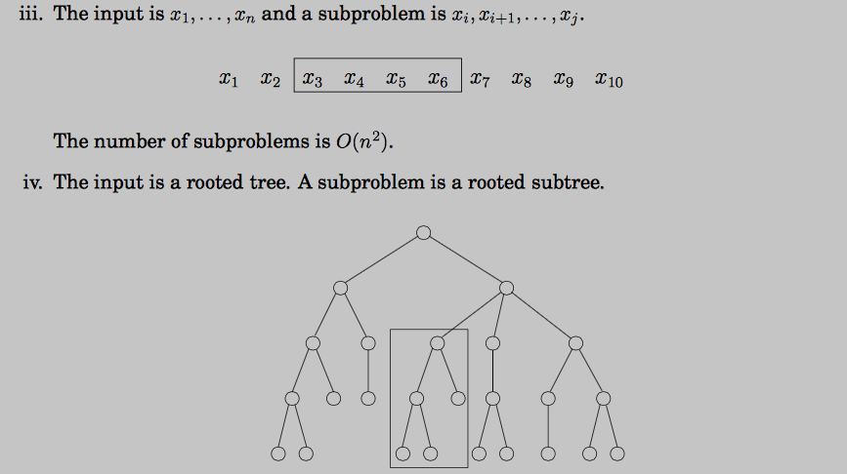
Common Subproblems of Dynamic Programming
https://www.cs.berkeley.edu/~vazirani/algorithms/chap6.pdf

