Slide 1


CS 146: Data Structures and Algorithms July 28 Class Meeting
Department of Computer Science San Jose State University Summer 2015 Instructor: Ron Mak
www.cs.sjsu.edu/~mak

Slide 2
A Solution to Assignment #5
Sort a linked list with mergesort.
Mergesort is ideal for sorting a linked list.
Does not require random, direct access to any list elements.
I used my own linked list class, not Java’s built-in class.
No get() and set() calls.

Slide 3
A Solution to Assignment #5, cont’d
Take advantage of the capabilities of a linked list.
You can split apart a list into two sublists.
You can splice together (concatenate) two sublists.
Count two moves.
Minimize the number of move operations.
Concatenate two sublists with only one move.
The head of one sublist joins up with the tail of the other sublist.
The other nodes of the two sublists don’t move.

Slide 4
Split a Linked List into Two Sublists
public MyLinkedList<AnyType>[] split()
{
int halfLength1 = size/2;
int halfLength2 = size%2 == 0 ? halfLength1 : halfLength1 + 1;
MyLinkedList<AnyType>[] lists =
(MyLinkedList<AnyType>[]) new MyLinkedList[2];
// Get to the node at the midpoint.
MyNode<AnyType> mid = head;
for (int i = 1; i < halfLength1; i++) mid = mid.next;
MyNode<AnyType> midNext = mid.next;
// Create the two sublists.
lists[0] = new MyLinkedList<AnyType>(this.head, mid, halfLength1);
lists[1] = new MyLinkedList<AnyType>(midNext, this.tail, halfLength2);
return lists;
}
MyLinkedList.java
Chasing links to the midpoint is faster than creating two sublists from scratch with alternating elements.

Slide 5
Concatenate Two Sublists
public void concatenate(MyNode<AnyType> otherNode,
MyLinkedList<AnyType> otherList)
{
// Splice the other list to the end of this list.
if (otherNode != null) {
this.tail.next = otherNode;
otherNode.prev = this.tail;
this.tail = otherList.tail;
}
// Update this list's size.
do {
size++;
otherNode = otherNode.next;
} while (otherNode != null);
}
MyLinkedList.java
Join the “other” linked list to the end of “this” one.
Attach using any node of the “other” list.
Need to chase links to update the size of “this” list.

Slide 6
Mergesort
MergeSortLinkedList.java
private Stats mergeSort(MyLinkedList<Integer> list)
{
Stats stats1 = new Stats();
Stats stats2 = new Stats();
Stats stats3 = new Stats();
int moves = 0;
if (list.size() > 1) {
// Split the list roughly in half.
MyLinkedList<Integer> lists[] = list.split();
moves += 2;
// Sort each sublist and merge.
stats1 = mergeSort(lists[0]);
stats2 = mergeSort(lists[1]);
stats3 = merge(list, lists[0], lists[1]);
}
return new Stats(moves + stats1.moves + stats2.moves + stats3.moves,
stats1.compares + stats2.compares + stats3.compares);
}
Pass the original list and the two sublists.

Slide 7
Merge Linked Lists
private Stats merge(MyLinkedList<Integer> list,
MyLinkedList<Integer> list1,
MyLinkedList<Integer> list2)
{
MyNode<Integer> node1 = list1.head();
MyNode<Integer> node2 = list2.head();
long moves = 0;
long compares = 0;
list.empty();
// Choose which node from sublist to add to the merged sublist.
while((node1 != null) && (node2 != null)) {
if (node1.data.compareTo(node2.data) <= 0) {
MyNode<Integer> nextNode = node1.next;
list.add(node1);
node1 = nextNode;
}
else {
MyNode<Integer> nextNode = node2.next;
list.add(node2);
node2 = nextNode;
}
moves++;
compares++;
}
...
}
MergeSortLinkedList.java

Slide 8
Merge Linked Lists, cont’d
private Stats merge(MyLinkedList<Integer> list,
MyLinkedList<Integer> list1,
MyLinkedList<Integer> list2)
{
...
// Choose which node from sublist to add to the merged sublist.
while((node1 != null) && (node2 != null)) {
...
}
// Concatenate the rest of the first sublist to list.
if (node1 != null) {
list.concatenate(node1, list1);
moves++;
}
// Concatenate the rest of the second sublist to list.
if (node2 != null) {
list.concatenate(node2, list2);
moves++;
}
return new Stats(moves, compares);
}
MergeSortLinkedList.java

Slide 9
Mergesort with a Linked List, cont’d
private static boolean checkSorted(Integer a[])
{
for (int i = 1; i < a.length; i++) {
if (a[i-1] > a[i]) return false;
}
return true;
}
private static void printStats(Integer a[], Stats stats)
{
if (!checkSorted(a)) {
System.out.println(" *** SORT ERROR ***");
}
else {
System.out.printf("%15s%15s%15s\n",
NumberFormat.getIntegerInstance().format(stats.moves),
NumberFormat.getIntegerInstance().format(stats.compares),
NumberFormat.getIntegerInstance().format(stats.time));
}
}
It doesn’t hurt to be a
paranoid programmer!
CountSort.java

Slide 10
Mergesort with a Linked List
N = 10,000
ALGORITHM MOVES COMPARES MILLISECONDS
Insertion sort 25,133,596 25,133,592 3,656
Shellsort suboptimal 208,811 265,559 140
Shellsort Knuth 220,569 241,482 125
Heap sort 148,167 292,365 94
Merge sort array 267,232 120,510 125
Merge sort linked list 150,466 120,469 172
Quicksort 77,154 138,626 47
Unsorted list: The number of comparisons and the timing should be similar to mergesort with an array.
The number of moves is significantly lower.

Slide 11
Mergesort with a Linked List
N = 10,000
ALGORITHM MOVES COMPARES MILLISECONDS
Insertion sort 0 9,999 0
Shellsort suboptimal 0 120,005 15
Shellsort Knuth 0 75,243 31
Heap sort 156,953 304,386 63
Merge sort array 267,232 69,008 94
Merge sort linked list 94,605 64,608 78
Quicksort 17,711 122,912 16
Sorted
N = 10,000
ALGORITHM MOVES COMPARES MILLISECONDS
Insertion sort 50,004,999 49,995,000 6,359
Shellsort suboptimal 124,592 172,578 63
Shellsort Knuth 93,666 120,190 31
Heap sort 136,693 277,845 47
Merge sort array 267,232 64,608 78
Merge sort linked list 99,005 69,008 78
Quicksort 46,733 193,965 31
Reverse sorted

Slide 12
Mergesort with a Linked List
N = 10,000
ALGORITHM MOVES COMPARES MILLISECONDS
Insertion sort 0 9,999 0
Shellsort suboptimal 0 120,005 31
Shellsort Knuth 0 75,243 16
Heap sort 19,998 29,994 15
Merge sort array 267,232 69,008 78
Merge sort linked list 94,605 64,608 79
Quicksort 118,747 120,316 31
All zeroes

Slide 13
String Algorithms: Important Applications
Information processing
Communications
Word processors and editors
Programming systems
Genomics
Computational biologists encode strands of DNA as strings over the characters A, C, G, and T (base molecules adenine, cytosine, guanine, and thymine).

Slide 14
Longest Common Subsequence
Find the longest common subsequence (LCS) of two strings.
In genomics, the longer a common subsequence we can find between two stands of DNA, the more similar they are.

Slide 15
String Subsequence
A subsequence Z of a string X is X, possibly with some characters removed.
Subsequences of the string “GAC”
“GAC” (no characters removed)
“GA” (C removed)
“GC” (A removed)
“AC” (G removed)
“G” (A and C removed)
“A” (G and C removed)
“C” (G and A removed)
empty string (all characters removed)
A string of length n
has 2^{n} subsequences.

Slide 16
Longest Common Subsequence, cont’d
If X and Y are strings, then Z is a common subsequence of X and Y if it is a subsequence of both strings.
Example: X = “CATCGA” Y = “GTACCGTCA”
“CCA” is a common subsequence
A longest common subsequence (LCS) is “CTCA”
But it is not unique: “TCGA” is another LCS.

Slide 17
Length of the LCS
A recursive algorithm to compute the length of the LCS of two strings.
private static int lcsLength(String X, String Y, int m, int n)
{
if ((m == 0) || (n == 0)) {
return 0;
}
else if (X.charAt(m-1) == Y.charAt(n-1)) {
return 1 + lcsLength(X, Y, m-1, n-1);
}
else {
return Math.max(lcsLength(X, Y, m, n-1),
lcsLength(X, Y, m-1, n));
}
}
Initially:
m = X.length()
n = Y.lengfth()
RecursiveLCS.java
Demo

Slide 18
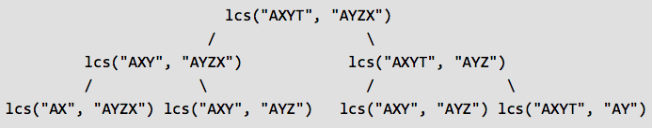
Length of the LCS, cont’d
A recursive solution is not recommended!
Worst case: O(2^{n})
An alternative to recursion?
Dynamic programming
Use a table instead

Slide 19
LCS with Dynamic Programming
What is a subproblem to finding the LCS of two strings X and Y?
Consider X = x₁x₂x₃…x_{m} and Y = y₁y₂y₃…y_{n}
Let X_{i} = x₁x₂x₃…x_{i} for i = 1…m be a prefix of string X.
Similar notation for a prefix of Y.
X and Y have an LCS Z = z₁z₂z₃…z_{k} for some length k from 0 through the smaller of m and n.

Slide 20
LCS with Dynamic Programming, cont’d
X = x₁x₂x₃…x_{m} , Y = y₁y₂y₃…y_{n} , Z = z₁z₂z₃…z_{k}
If the last characters of x_{m} and y_{n} are equal:
Then z_{k} must also be that character.
Prefix Z_{k-1} must be the LCS of prefixes X_{m-1} and Y_{n-1}
Last characters x_{m} and y_{n} are not equal:
Then z_{k} might equal x_{m} or y_{n}, but not both.
Or z_{k} might equal neither x_{m} nor y_{n}
If z_{k} doesn’t equal x_{m}, ignore the last character of X, and Z must be an LCS of prefix X_{m-1} and string Y.
If z_{k} doesn’t equal y_{n}, ignore the last character of Y, and Z must be an LCS of string X and prefix Y_{n-1}.

Slide 21
LCS with Dynamic Programming, cont’d
If the last characters x_{m} and y_{n} are equal:
We have one subproblem to solve.
Find the LCS of prefixes X_{m-1} and Y_{n-1}.
Append the last character to the LCS.
If the last characters x_{m} and y_{n} are unequal:
We have two subproblems to solve.
Find an LCS of X_{m-1} and Y.
Find an LCS of X and Y_{n-1}.
Use the longer of the two common subsequences as an LCS of X and Y.

Slide 22
LCS with Dynamic Programming, cont’d
Generation of table L:
Compute the lengths of the longest common subsequences of all prefixes of X and Y.
L[i, j ] = the length of the LCS of prefixes X_{i} and Y_{j}.
Then L[m, n ] = the length of the LCS of X and Y.
For X = “CATCGA” Y = “GTACCGTCA” Z = “TCGA” Length of Z is 4.
0 1 2 3 4 5 6 7 8 9
G T A C C G T C A
+--------------------
0 | 0 0 0 0 0 0 0 0 0 0
1 C | 0 0 0 0 1 1 1 1 1 1
2 A | 0 0 0 1 1 1 1 1 1 2
3 T | 0 0 1 1 1 1 1 2 2 2
4 C | 0 0 1 1 2 2 2 2 3 3
5 G | 0 1 1 1 2 2 3 3 3 3
6 A | 0 1 1 2 2 2 3 3 3 4

Slide 23
LCS with Dynamic Programming, cont’d
private static int[][] buildTable(String X, String Y)
{
int m = X.length();
int n = Y.length();
int L[][] = new int[m + 1][n + 1];
for (int i = 0; i <= m; i++) {
for (int j = 0; j <= n; j++) {
if (i == 0 || j == 0) {
L[i][j] = 0;
}
else if (X.charAt(i-1) == Y.charAt(j-1)) {
L[i][j] = L[i-1][j-1] + 1;
}
else {
L[i][j] = Math.max(L[i-1][j], L[i][j-1]);
}
}
}
return L;
}
DynamicProgrammingLCS.java

Slide 24
LCS with Dynamic Programming, cont’d
private static String lcs(int L[][], String X, String Y)
{
int m = X.length();
int n = Y.length();
String lcs = new String();
int i = m;
int j = n;
while (i > 0 && j > 0) {
if (X.charAt(i-1) == Y.charAt(j-1)) {
lcs = X.charAt(i-1) + lcs;
i--;
j--;
}
else if (L[i-1][j] > L[i][j-1]) i--;
else j--;
}
return lcs;
}
Start from the rightmost bottommost corner
and one by one store characters backwards in lcs.
The current characters in X and Y are the same:
Prepend that common character to the LCS.
Not the same: Go in the direction of
the larger table value.
Demo
DynamicProgrammingLCS.java

Slide 25
Break

Slide 26
String Pattern Matching Algorithms
Problem: Given a text string, find the index of the first occurrence of a pattern string within the text.
Example:
Text = “bacbabababacaca”
Pattern = “ababaca”
The pattern occurs in the text: “bacbabababacaca” and the index is 6.
How many character-by-character comparisons are required?

Slide 27
String Pattern Matching Algorithms, cont’d
“Find” command of a text editor.
Look for one strand of DNA within another.
Two algorithms today:
Brute search
Knuth-Morris-Pratt

Slide 28
Brute Search Pattern Matching, cont’d
Line up the start of the pattern to find with the start of the text to search.
Set text index i = 0 and pattern index j = 0;
Compare character-by-character the pattern with the text.
Increment i and j together.
As soon as there’s a mismatch, stop the comparisons and shift the pattern over one character to the right.
Backtrack the text after a “false start”.
Set i back j-1 characters and then j to 0.

Slide 29
Brute Search Pattern Matching, cont’d
Start the character-by-character comparisons again at the backtracked text position.
Repeat until a match is found, or you until reach the end of the text.
Brute search makes O(MN) character comparisons.
M = pattern length
N = text length

Slide 30
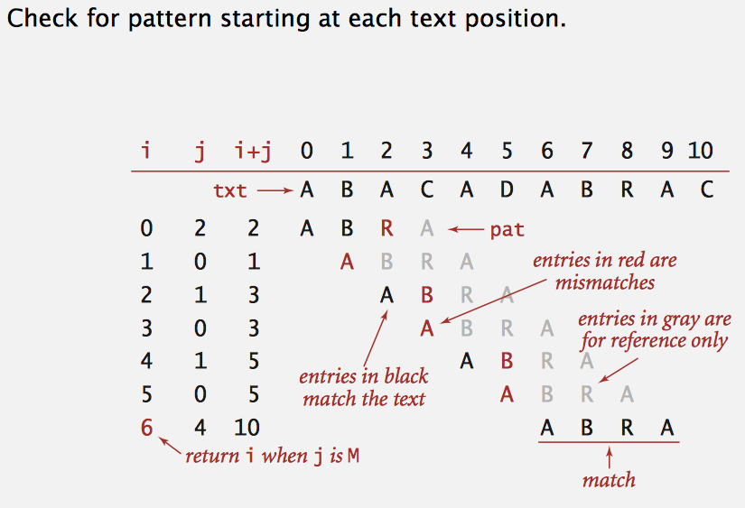
Brute Search Pattern Matching, cont’d
http://algs4.cs.princeton.edu/lectures/53SubstringSearch.pdf

Slide 31
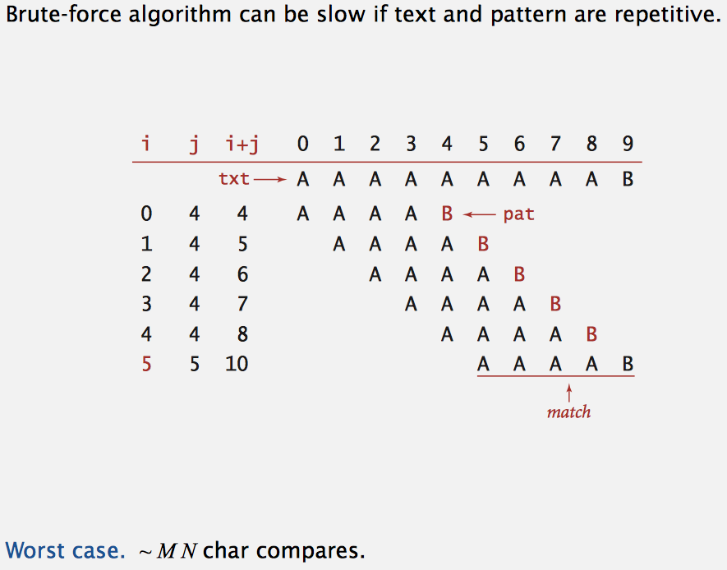
Brute Search Pattern Matching, cont’d
http://algs4.cs.princeton.edu/lectures/53SubstringSearch.pdf

Slide 32
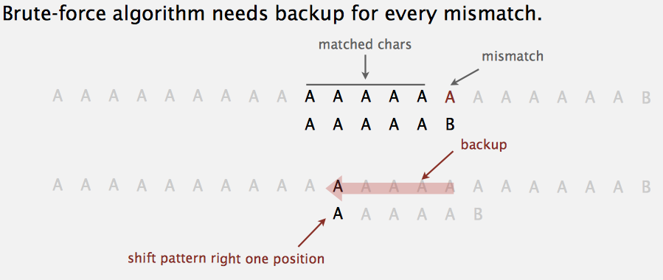
Brute Search Pattern Matching, cont’d
http://algs4.cs.princeton.edu/lectures/53SubstringSearch.pdf

Slide 33
Brute Search Pattern Matching, cont’d
public int match()
{
if ((text == null) || (text.length() == 0)) return -1;
int i = 0;
int j = 0;
do {
if (pattern.charAt(j) == text.charAt(i)) {
i++;
j++;
}
else {
i = i - j + 1;
j = 0;
}
compares++;
} while ((j < pattern.length()) && (i < text.length()));
return j >= pattern.length() ? i - pattern.length() : -1;
}
BruteSearch.java
Matching so far.
Not a match.
Backtrack i and reset j.
Demo
Return the index of the match, or -1 if no match.

Slide 34
Knuth-Morris-Pratt Algorithm
The Knuth-Morris-Pratt string pattern matching algorithm reduces the number of character comparisons.
Eliminates backtracking the text.
When a character mismatch is detected, the “false start” consists of characters we already know.
The characters are in the pattern.
Can we take advantage of this knowledge?

Slide 35
Knuth-Morris-Pratt Algorithm
Use a precomputed next[] array.
The array stores knowledge about how the pattern matches against itself.
Look for similar subpatterns.
This knowledge allows us to avoid useless shifts of the pattern when we match it against the text.

Slide 36
Knuth-Morris-Pratt Algorithm
When a subpattern fails after a partial match of the text:
If there is another similar subpattern …
We can realign the pattern to the other similar subpattern and try matching it against the text.
The next[] array enables us to realign the pattern and prevent backtracking the text.
This should remind us of the state transition matrix that we used to search for names in Assignment #1.

Slide 37
Knuth-Morris-Pratt Algorithm
KMT never backtracks.
Index i of the text never decrements.
KMT never makes more than M+N comparisons.
M = pattern length
N = text length

Slide 38
Computing KMP next[]
private int[] computeNext()
{
int next[] = new int[pattern.length()];
int i = 1;
int j = 0;
next[0] = 0;
while (i < pattern.length()) {
if (pattern.charAt(i) == pattern.charAt(j)) {
next[i] = j+1;
i++;
j++;
}
else if (j > 0) {
j = next[j-1];
}
else {
next[i] = 0;
i++;
}
}
return next;
}
i | j | next[i]
1 | 0 | 0
2 | 0 | 1
3 | 1 | 2
4 | 2 | 3
5 | 3 | 0
6 | 1 | 1
 | 0 | 1 | 2 | 3 | 4 | 5 | 6
Pattern | a | b | a | b | a | c | a
next[] | 0 | 0
 | 0 | 1 | 2 | 3 | 4 | 5 | 6
Pattern | a | b | a | b | a | c | a
next[] | 0 | 0 | 1
Match the pattern to
itself (similar subpattern).
 | 0 | 1 | 2 | 3 | 4 | 5 | 6
Pattern | a | b | a | b | a | c | a
next[] | 0 | 0 | 1 | 2
Size of the matching
subpattern.
 | 0 | 1 | 2 | 3 | 4 | 5 | 6
Pattern | a | b | a | b | a | c | a
next[] | 0 | 0 | 1 | 2 | 3
No matching
subpattern.
 | 0 | 1 | 2 | 3 | 4 | 5 | 6
Pattern | a | b | a | b | a | c | a
next[] | 0 | 0 | 1 | 2 | 3 | 0
 | 0 | 1 | 2 | 3 | 4 | 5 | 6
Pattern | a | b | a | b | a | c | a
next[] | 0 | 0 | 1 | 2 | 3 | 0 | 1
KnuthMorrisPratt.java

Slide 39
KMP Pattern Matching
public int match()
{
if ((text == null) || (text.length() == 0)) return -1;
int i = 0;
int j = 0;
while (i < text.length()) {
if (pattern.charAt(j) == text.charAt(i)) {
if (j == pattern.length()-1) {
return i - j;
}
else {
i++;
j++;
}
}
else if (j > 0) {
j = next[j-1];
}
else {
i++;
}
}
return -1;
}
Found a complete match!
Pattern characters
are matching the text.
Reset j from next[].
Shift pattern 1 right.
KnuthMorrisPratt.java

Slide 40
KMP Pattern Matching
next = [ 0 0 1 2 3 0 1 ]
i = 0, j=0, no match Shift pattern 1 right
Text | b | a | c | b | a | b | a | b | a | b | a | c | a | c | a
Pattern | a | b | a | b | a | c | a
i = 1, j=0, match
Text | b | a | c | b | a | b | a | b | a | b | a | c | a | c | a
Pattern |  | a | b | a | b | a | c | a
i = 2, j=1, no match Reset j = next[0] = 0
Text | b | a | c | b | a | b | a | b | a | b | a | c | a | c | a
Pattern |  | a | b | a | b | a | c | a
i = 2, j=0, no match Shift pattern 1 right
Text | b | a | c | b | a | b | a | b | a | b | a | c | a | c | a
Pattern |  |  | a | b | a | b | a | c | a

Slide 41
KMP Pattern Matching
next = [ 0 0 1 2 3 0 1 ]
i = 3, j=0, no match Shift pattern 1 right
Text | b | a | c | b | a | b | a | b | a | b | a | c | a | c | a
Pattern |  |  |  | a | b | a | b | a | c | a
i = 4..8, j=0..4, matches
Text | b | a | c | b | a | b | a | b | a | b | a | c | a | c | a
Pattern |  |  |  |  | a | b | a | b | a | c | a
i = 9, j=5, no match Reset j = next[4] = 3
Text | b | a | c | b | a | b | a | b | a | b | a | c | a | c | a
Pattern |  |  |  |  | a | b | a | b | a | c | a
i = 9..12, j=3..6, matches Pattern found in text.
Text | b | a | c | b | a | b | a | b | a | b | a | c | a | c | a
Pattern |  |  |  |  |  |  | a | b | a | b | a | c | a
Character matching in the text always moves forward. Text index i never decrements.
Demo

Slide 42
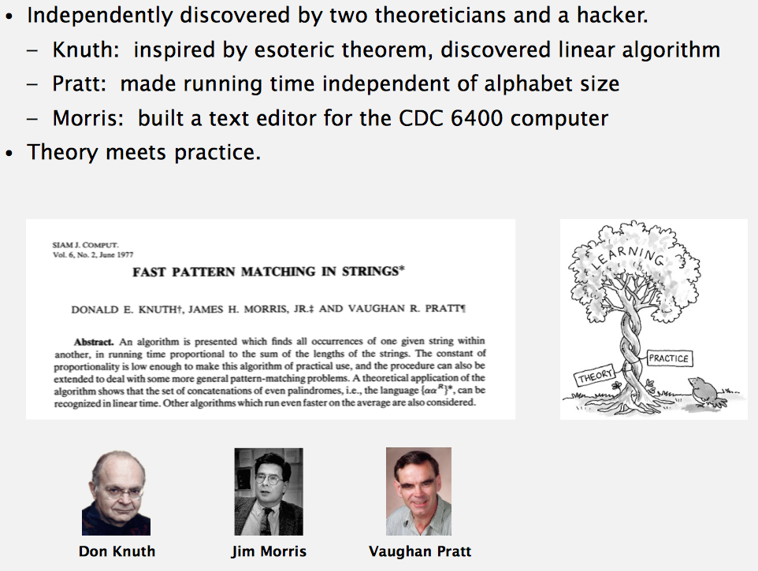
History of KMT
http://algs4.cs.princeton.edu/lectures/53SubstringSearch.pdf

