Slide 1
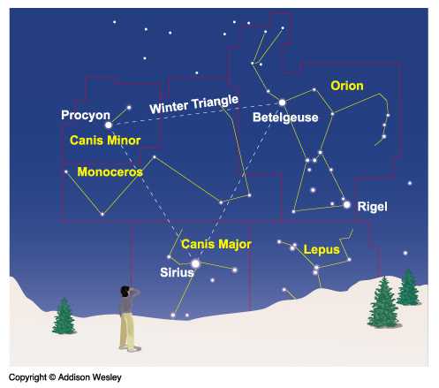
Constellations
A constellation is a region of the sky.
88 constellations fill the entire sky.
Notes:
Remind students that we often use the term “constellation” to describe a pattern of stars, such as the Big Dipper or the stars that outline Orion. However, technically a constellation is a region of the sky (and the patterns are sometimes called “asterisms”). A useful analogy for students: a constellation is to the sky as a state is to the United States. That is, wherever you point on a map of the U.S. you are in some state, and wherever you point into the sky you are in some constellation.

Slide 2
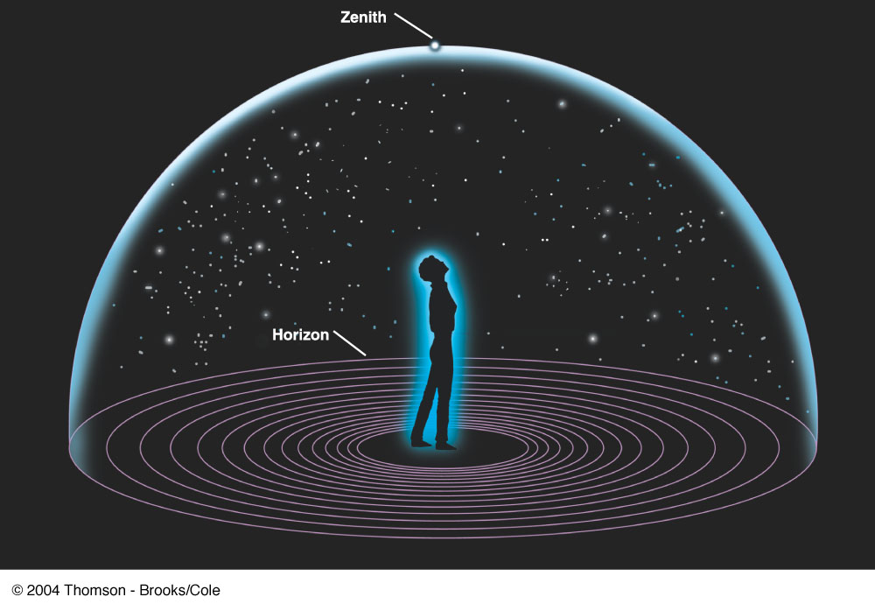
Picture yourself standing at the center of a sphere …
The Sky and How it Works
Fig 1-1, p.20
Notes:
Figure 1.1 The Sky Around Us The dome of the sky, as it appears to a naive observer. The horizon is where the sky meets the ground, and the observer's zenith is the point directly overhead.

Slide 3
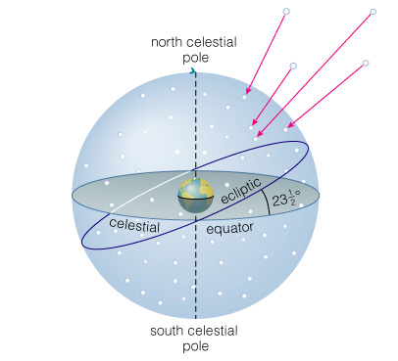
The Celestial Sphere
Stars at different distances all appear to lie on the celestial sphere.
Ecliptic is Sun’s apparent path through the celestial sphere.
Notes:
The illusion of stars all lying at the same distance in the constellations allows us to define the celestial sphere. It doesn’t really exist, but it’s a useful tool for learning about the sky. When discussing this slide, be sure to explain:
North celestial pole
South celestial pole
Celestial equator
Ecliptic
It’s also very useful to bring a model of the celestial sphere to class and show these points/circles on the model.

Slide 4
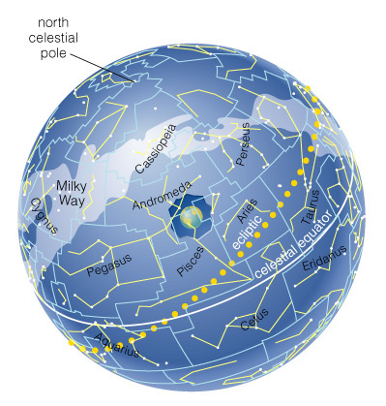
The Celestial Sphere
The 88 official constellations cover the celestial sphere.
Notes:
If you do not have a model of the celestial sphere to bring to class, you might wish to use this slide; you will probably want to skip it if you have a model that you can discuss instead…

Slide 5
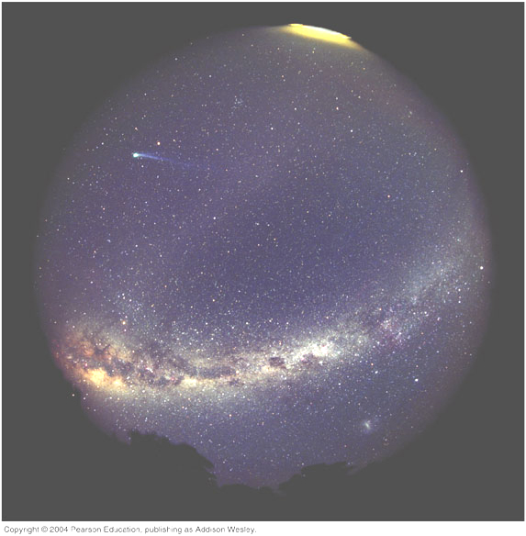
The Milky Way
A band of light making a circle around the celestial sphere.
What is it?
Our view into the plane of our galaxy.
Notes:
On the previous slide or your model, you can point out that the celestial sphere is also painted with the Milky Way. Many students may never have seen the Milky Way in the sky (especially if they live in a big city), so the photo here is also worth showing. Key points to emphasize:
We use the term Milky Way in two ways: for the band of light in the sky and as the name of our galaxy.
(2) The two meanings are closely related. We like to use the following analogy: Ask your students to imagine being a tiny grain of flour inside a very thin pancake (or crepe!) that bulges in the middle and a little more than halfway toward the outer edge. Ask, “What will you see if you look toward the middle?” The answer should be “dough.” Then ask what they will see if they look toward the far edge, and they’ll give the same answer. Proceeding similarly, they should soon realize that they’ll see a band of dough encircling their location, but that if they look away from the plane, the pancake is thin enough that they can see to the distant universe.

Slide 6
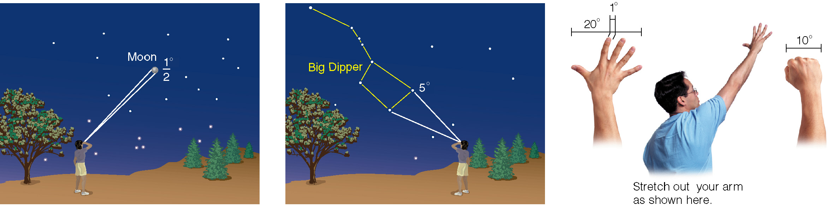
We measure the sky using angles
Notes:
Point out that in general we have no way of judging true (physical) sizes and distances of objects in the sky -- like the illusion of stars lying on the celestial sphere, this is due to our lack of depth perception in space. Thus, we can measure only angular sizes and distances. Use these diagrams as examples. Optional: You can show how angular sizes depend on distance by having students sitting at different distances from you in the class use their fists to estimate the angular size of a ball you are holding. Students in the back will measure a smaller angular size.

Slide 7
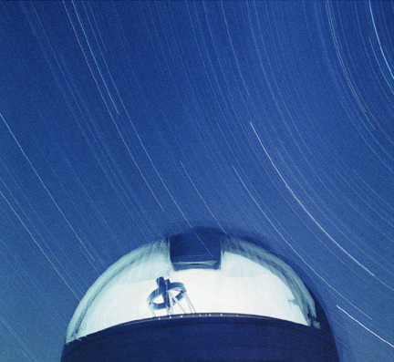
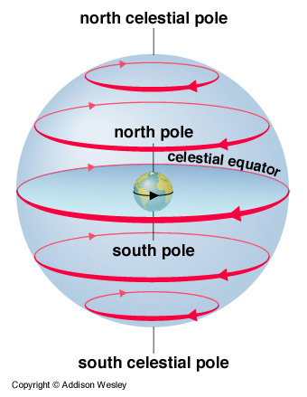
Why do stars rise and set?
Earth rotates west to east, so stars appear to circle from east to west.
Notes:
The answer to the question is very simple if we look at the celestial sphere from the “outside.” But of course, we are looking from our location on Earth, which makes the motions of stars look a little more complex…

Slide 8
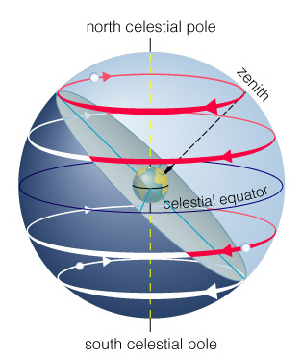
Our view from Earth:
Stars near the north celestial pole are circumpolar and never set.
We cannot see stars near the south celestial pole.
All other stars (and Sun, Moon, planets) rise in east and set in west.
A circumpolar star never sets
Celestial Equator
This star never rises
Your Horizon
Notes:
Now explain the basic motion of the sky seen from Earth.

Slide 9
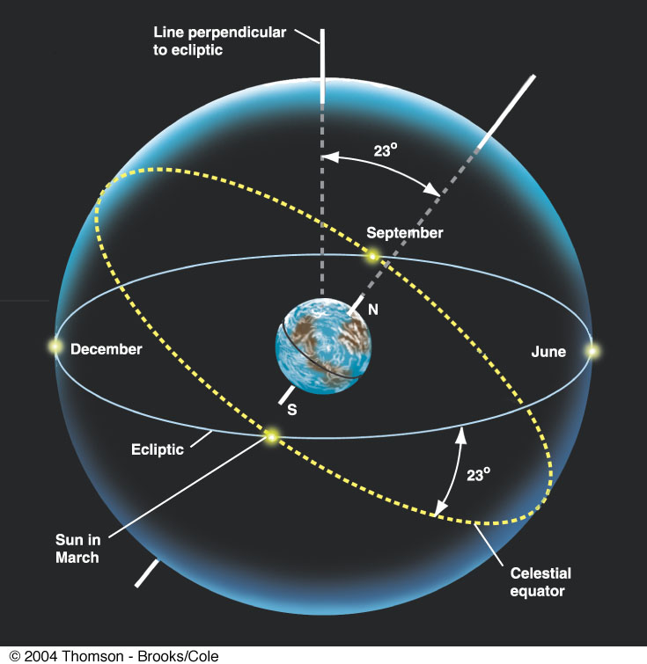
Plane of the
Earth’s orbit
around the
Sun
Fig 1-6, p.24
Notes:
Figure 1.6 The Celestial Tilt The celestial equator is tilted by 23° to the ecliptic. As a result, North Americans and Europeans see the Sun north of the celestial equator and high in our sky in June, and south of the celestial equator and low in the sky in December.

Slide 10
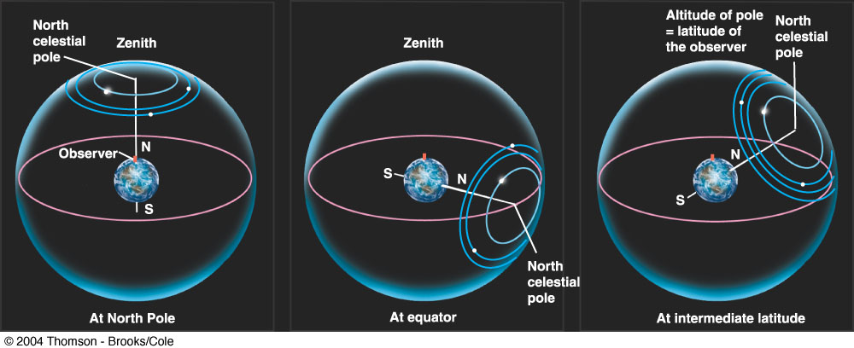
Santa Clara is at
Latitude 36 º North
Fig 1-4, p.23
Notes:
Figure 1.4 Star Circles at Different Latitudes The turning of the sky looks different depending on your latitude on Earth. (a) At the north pole, the stars circle the zenith and do not rise and set. (b) At the equator, the celestial poles are on the horizon, and the stars rise straight up and set straight down. (c) At intermediate latitudes, the north celestial pole is at some position between overhead and the horizon. Its angle turns out to be equal to the observer's latitude. Stars rise and set at an angle to the horizon.

Slide 11
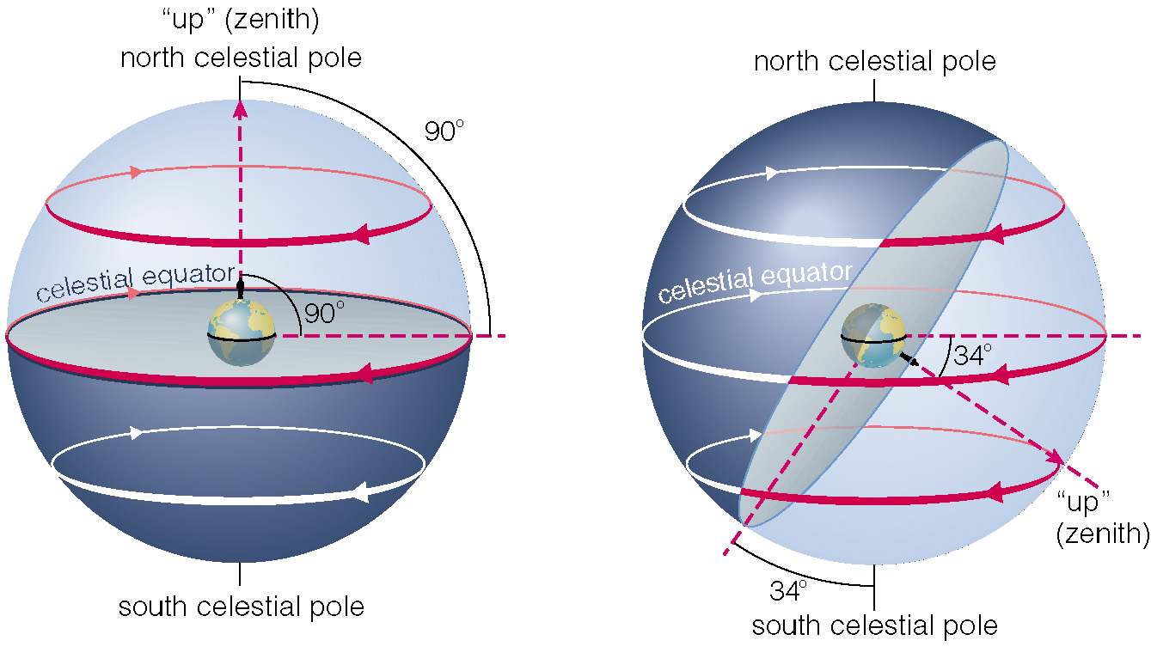
The sky varies with latitude but not longitude.
Notes:
Use this interactive figure to explain the variation in the sky with latitude. Show how the altitude of the NCP equals your latitude (for N. hemisphere)…

Slide 12
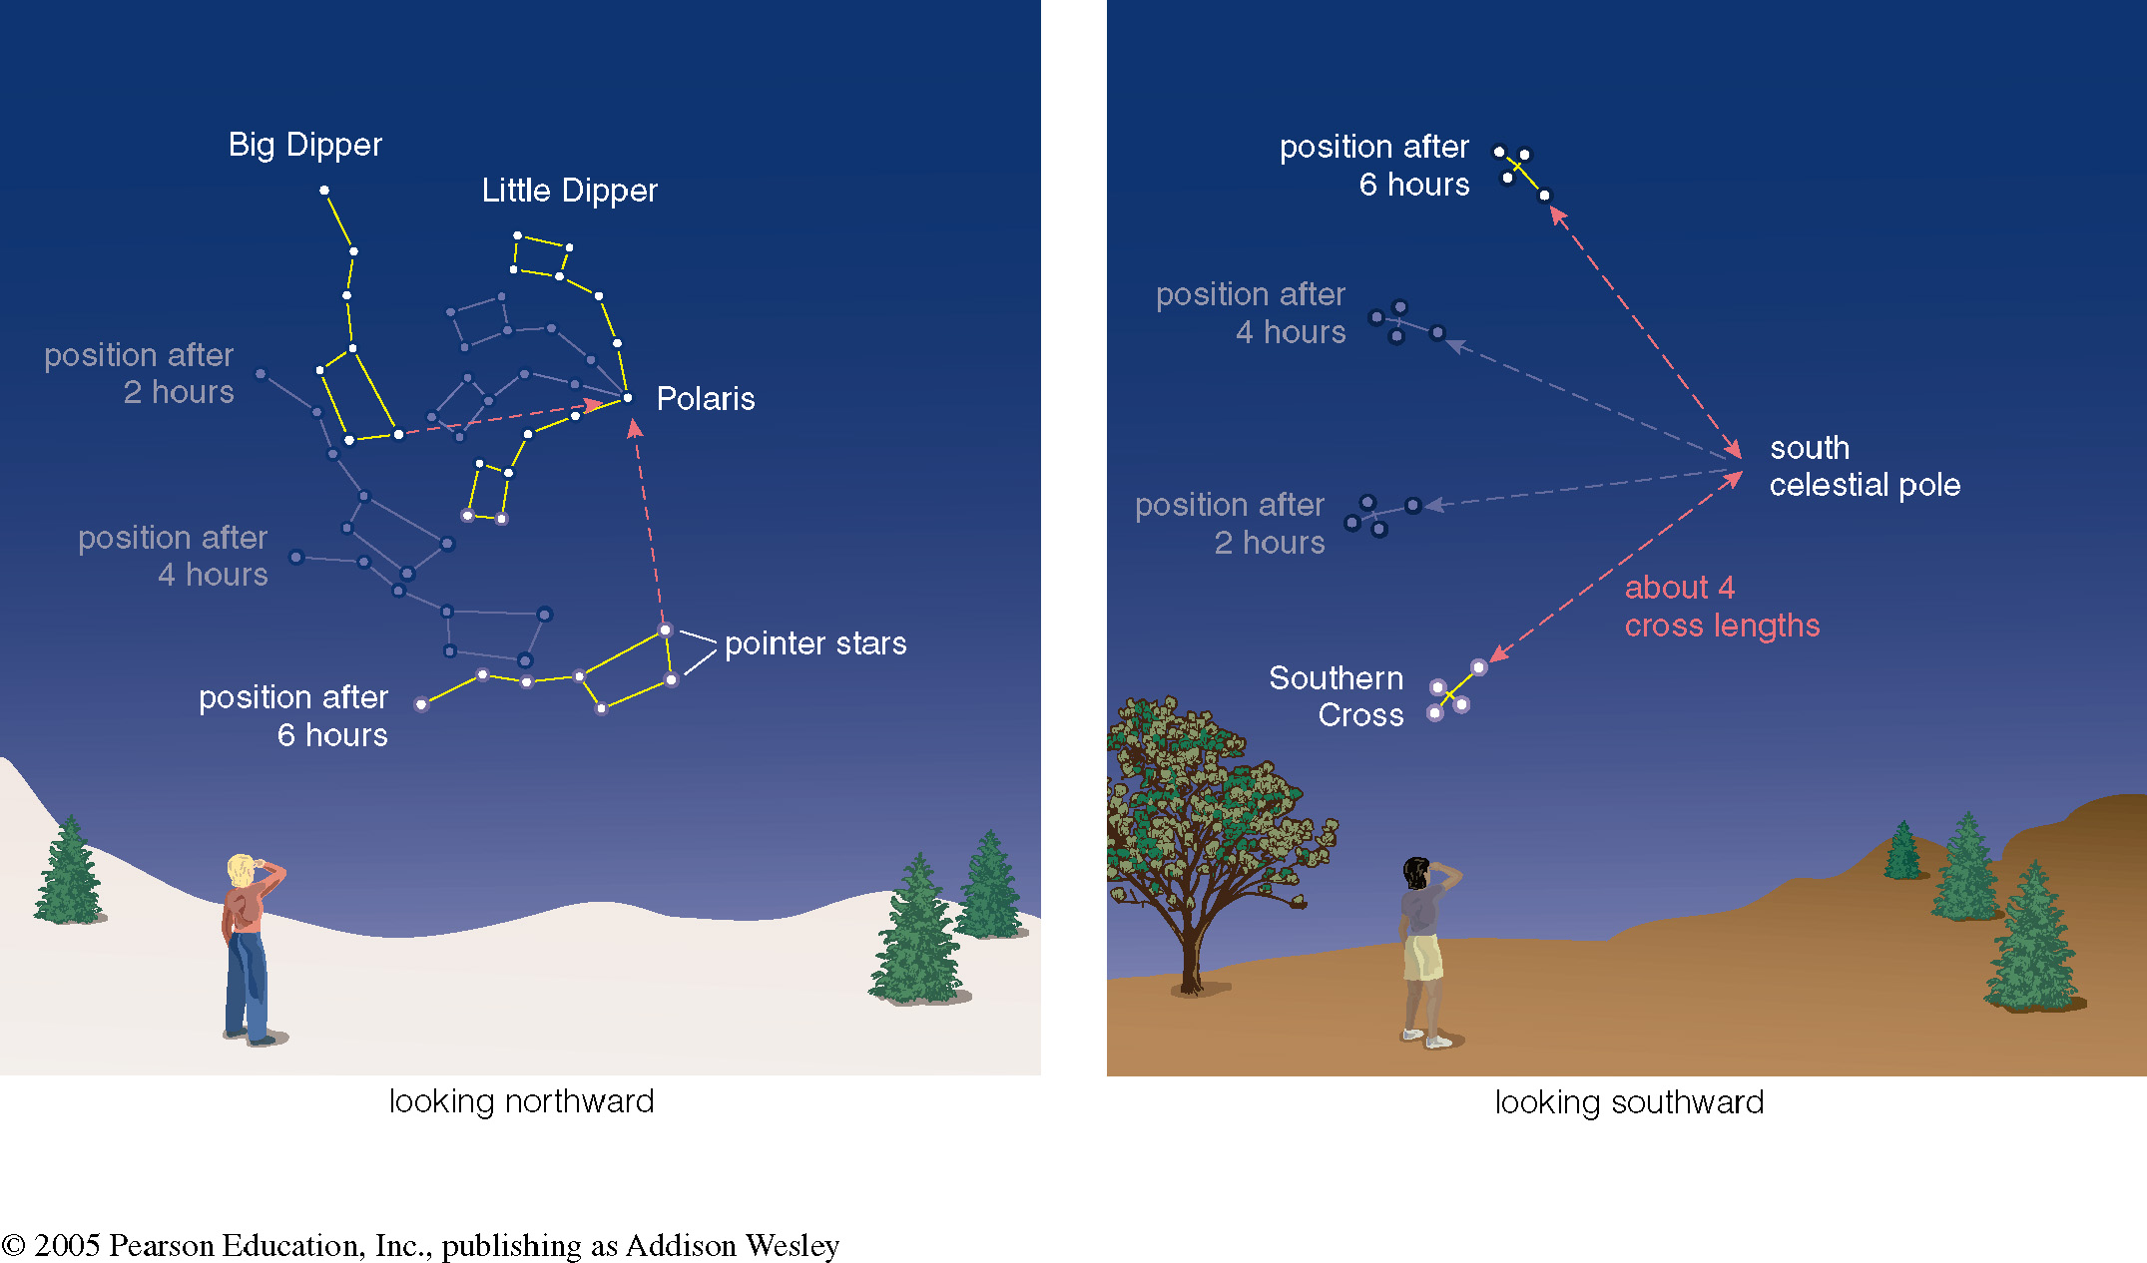

Altitude of the celestial pole = your latitude
Notes:
Show students how to locate the NCP and SCP, and how the sky moves around them. (You might wish to repeat the time exposure photo of the sky at this point to re-emphasize what we see.) Can also ask students where they’d find the north celestial pole in their sky tonight…

Slide 13
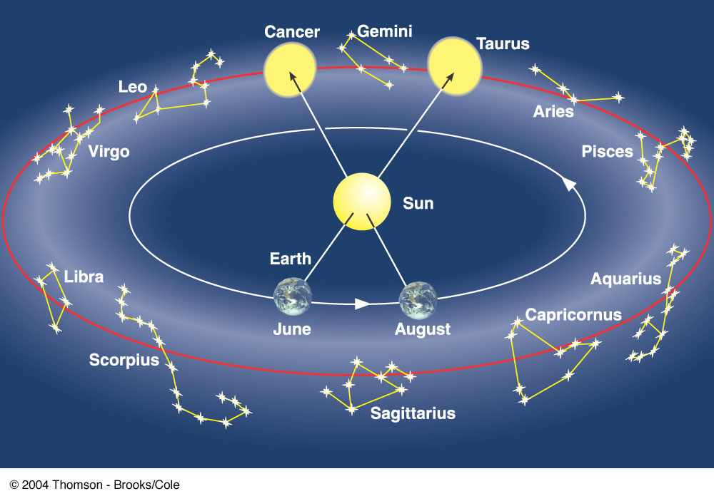
Fig 1-5, p.24
Notes:
Figure 1.5 Constellations on the Ecliptic As the Earth revolves around the Sun, we sit on “platform Earth” and see the Sun moving around the sky. The circle in the sky that the Sun appears to make around us in the course of a year is called the ecliptic. This circle (like all circles in the sky) goes through a set of constellations; the ancients thought that these constellations, which the Sun (and the Moon and planets) visited, must be special and incorporated them into their system of astrology (see Section 1.3). Note that at any given time of the year, some of the constellations crossed by the ecliptic are visible in the night sky and others are in the day sky and thus hidden by the brilliance of the Sun. As we discuss later in the chapter, today the zodiac constellations in which we “find” the Sun each month are no longer lined up with the signs the astrologers use.

Slide 14
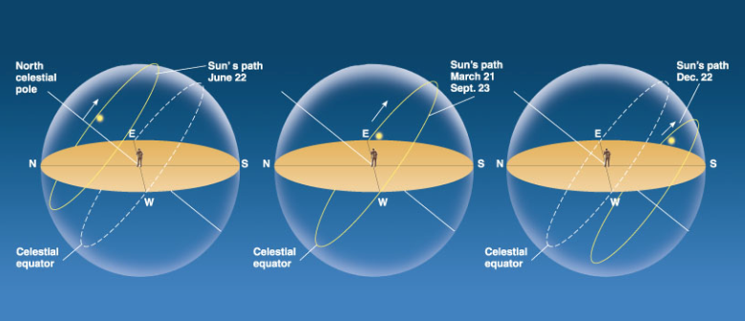
The path of the Sun through the sky
during the course of a year

Slide 15
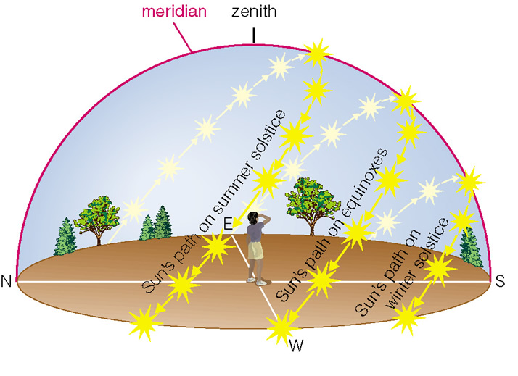
We can recognize solstices and equinoxes by Sun’s path across sky:
Summer solstice: Highest path, rise and set at most extreme north of due east.
Winter solstice: Lowest path, rise and set at most extreme south of due east.
Equinoxes: Sun rises precisely due east and sets precisely due west.
Notes:
Of course, the notes here are true for a N. hemisphere sky. You might ask students which part written above changes for S. hemisphere. (Answer: highest and lowest reverse above, but all the rest is still the same for the S. hemisphere; and remind students that we use names for the N. hemisphere, so that S. hemisphere summer actually begins on the winter solstice…)

Slide 16
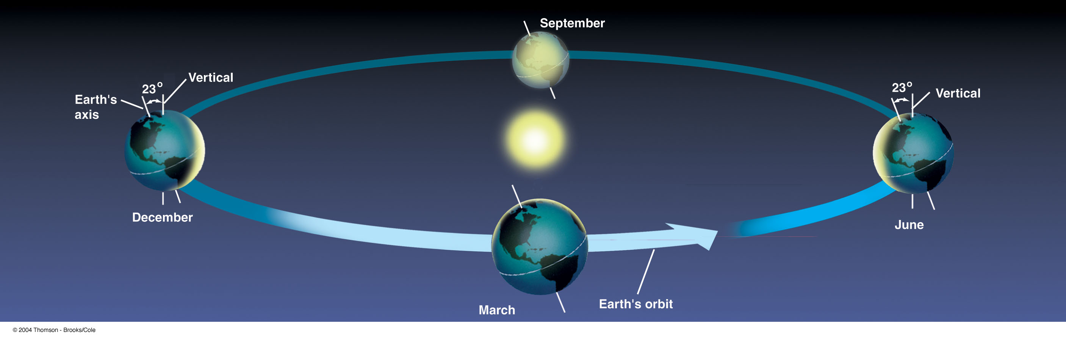
The Seasons, and what causes them
The Earth’s axis of rotation is tilted 23º with respect
to the Earth’s orbital plane.
The orientation of the tilted axis remains the
same as the Earth revolves around the Sun
Fig 3-4, p.64
Notes:
Figure 3.4 Seasons We see the Earth at different seasons as it circles the Sun. During our winter in the north, the Southern Hemisphere “leans into” the Sun and is illuminated more directly. In summer, it is the Northern Hemisphere that is leaning into the Sun and has longer days. In spring and autumn, the two hemispheres receive more equal shares of sunlight.

Slide 17
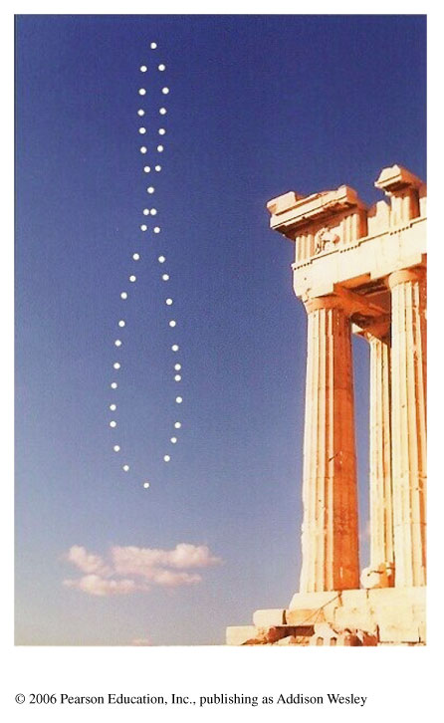
Sun’s altitude also changes with seasons
Sun’s position at noon in summer: higher altitude means more direct sunlight.
Sun’s position at noon in winter: lower altitude means less direct sunlight.
Notes:
This tool is taken from the Seasons tutorial on the Astronomy Place web site. You can use it to reinforce the ideas from the previous slide. As usual, please encourage your students to try the tutorial for themselves.

Slide 18
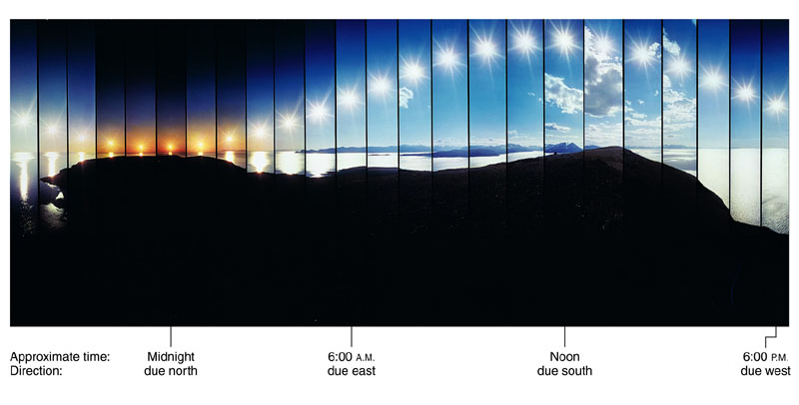
Seasonal changes are more extreme at high latitudes
Path of the Sun on the summer solstice at the Arctic Circle
Notes:
Other points worth mentioning:
Length of daylight/darkness becomes more extreme at higher latitudes.
The four seasons are characteristic of temperate latitudes; tropics typically have rainy and dry seasons (rainy seasons when Sun is higher in sky).
Equator has highest Sun on the equinoxes.
Optional: explain Tropics and Arctic/Antarctic Circles.

Slide 19
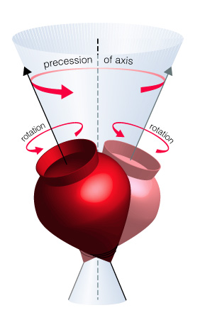
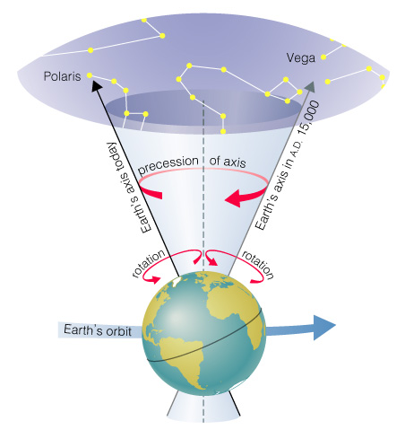
How does the orientation of Earth’s axis change with time?
Although the axis seems fixed on human time scales, it actually precesses over about 26,000 years.
  Polaris won’t always be the North Star.
  Positions of equinoxes shift around orbit; e.g., spring equinox, once in Aries, is now in Pisces!
Earth’s axis precesses like the axis of a spinning top
Notes:
Precession can be demonstrated in class in a variety of ways. E.g., bring a top or gyroscope to class, or do the standard physics demonstration with a bicycle wheel and rotating platform.
You may wish to go further with precession of the equinoxes, as in the Common Misconceptions box on “Sun Signs” --- this always surprises students, and helps them begin to see why astrology is questionable (to say the least!). Can also mention how Tropics of Cancer/Capricorn got their names from constellations of the solstices, even though the summer/winter solstices are now in Gemini/Sagittarius.

Slide 20
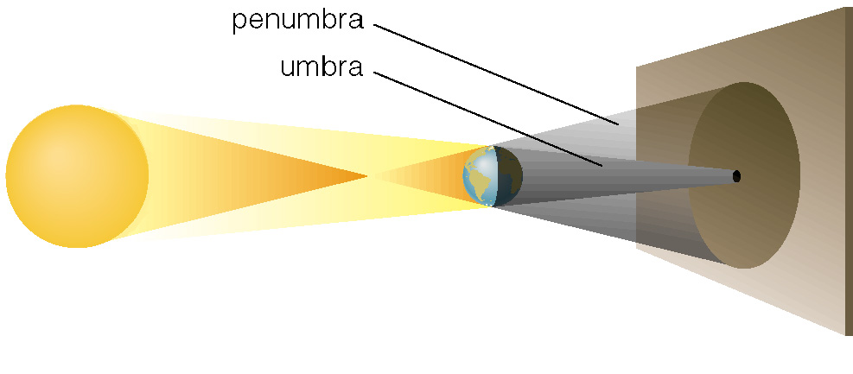
What causes eclipses?
The Earth and Moon cast shadows.
When either passes through the other’s shadow, we have an eclipse.
Notes:
This slide starts our discussion of eclipses. Use the figure to explain the umbra/penumbra shadows.

Slide 21
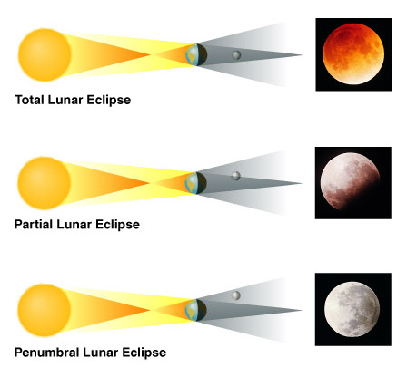
When can eclipses occur?
Lunar eclipses can occur only at full moon.
Lunar eclipses can be penumbral, partial, or total.
Notes:
Use the interactive figure to show the conditions for the 3 types of lunar eclipse.

Slide 22
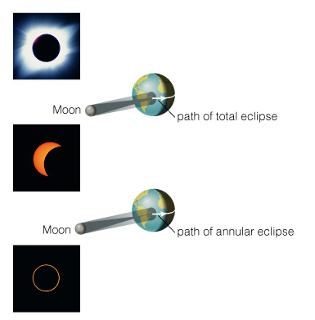
When can eclipses occur?
Solar eclipses can occur only at new moon.
Solar eclipses can be partial, total, or annular.
Notes:
Use the interactive figure to show the conditions for the 3 types of solar eclipse.

Slide 23
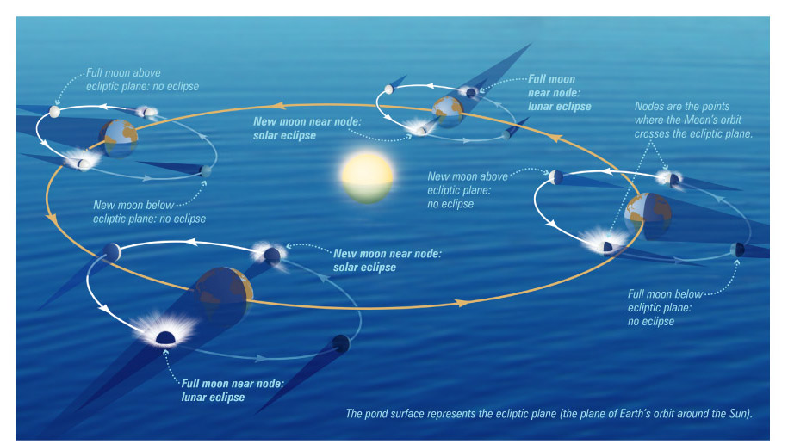
Why don’t we have an eclipse at every new and full moon?
  The Moon’s orbit is tilted 5° to ecliptic plane…
  So we have about two eclipse seasons each year, with a lunar eclipse at new moon and solar eclipse at full moon.
Notes:
Use this pond analogy to explain what we mean by nodes and how we get 2 eclipse seasons each year (roughly).
Note: You may wish to demonstrate the Moon’s orbit and eclipse conditions as follows. Keep a model “Sun” on a table in the center of the lecture area; have your left fist represent the Earth, and hold a ball in the other hand to represent the Moon. Then you can show how the Moon orbits your “fist” at an inclination to the ecliptic plane, explaining the meaning of the nodes. You can also show eclipse seasons by “doing” the Moon’s orbit (with fixed nodes) as you walk around your model Sun: the students will see that eclipses are possible only during two periods each year. If you then add in precession of the nodes, students can see why eclipse seasons occur slightly more often than every 6 months.

Slide 24
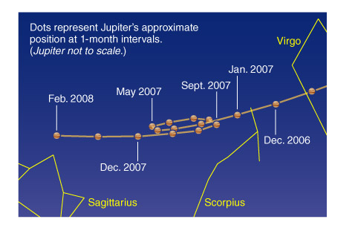
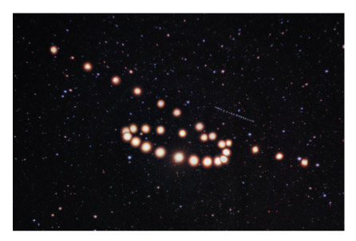
What was once so mysterious about planetary motion in our sky?
Planets usually move slightly eastward from night to night relative to the stars.
But sometimes they go westward relative to the stars for a few weeks: apparent retrograde motion
Notes:
The diagram at left shows Jupiter’s path with apparent retrograde motion in 2004-5. The photo composite shows Mars at 5-8 day intervals during the latter half of 2003.

Slide 25
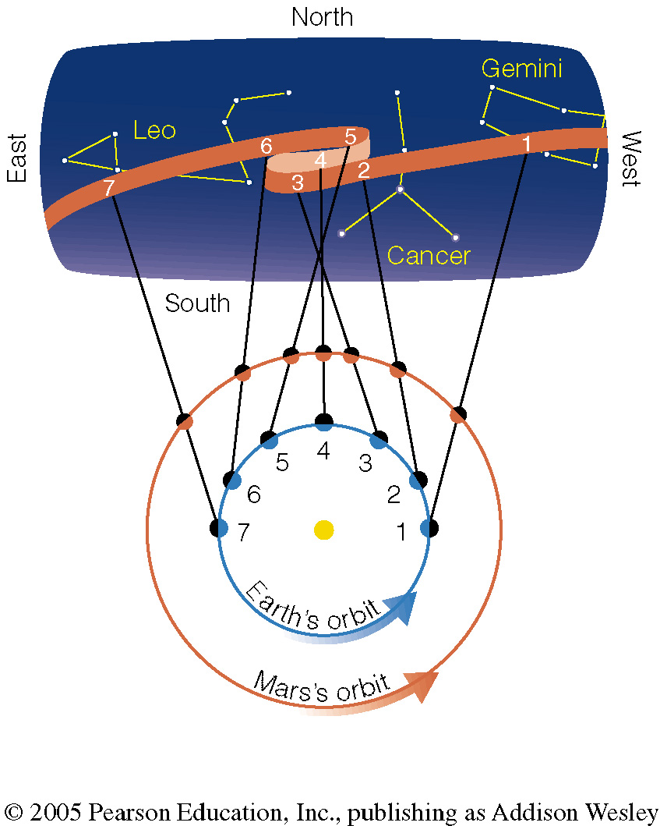
We see apparent retrograde motion when we pass by a planet in its orbit.
Notes:
We also recommend that you encourage students to try the apparent retrograde motion demonstration shown in the book in Figure 2.33a, since seeing it for themselves really helps remove the mystery…

