Slide 1
Kovrin sat with Tanya all the evening, and after midnight went out with her into the garden. It was cold...
"Even as a child I used to sneeze from the smoke here," he said, shrugging his shoulders, "but to this day I don't understand how smoke can keep off frost."
"Smoke takes the place of clouds when there are none . . ." answered Tanya. "In overcast and cloudy weather there is no frost.”
Anton Chekhov, The Black Monk

Slide 2
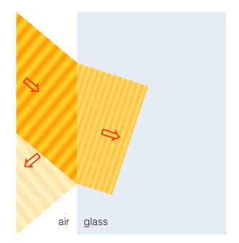
Refraction
Refraction is the bending of light when it passes from one substance into another

Slide 3
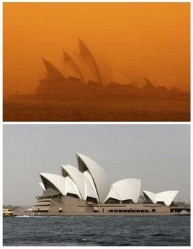

Slide 4
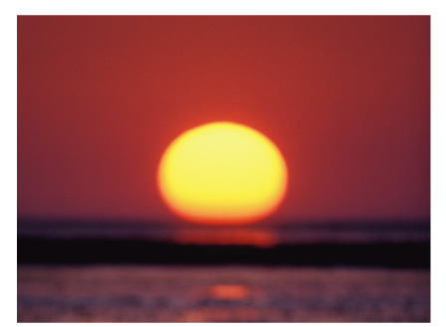
Example: Refraction at Sunset
Sun appears distorted at sunset because of how light bends in Earth’s atmosphere

Slide 5
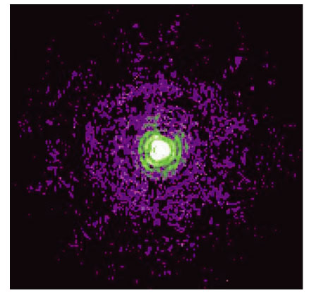
Angular Resolution
The rings in this image of a star come from interference of light wave.
This limit on angular resolution is known as the diffraction limit
Close-up of a star from the Hubble
Space Telescope

Slide 6
What are the two basic designs of telescopes?
Refracting telescope: Focuses light with lenses
Reflecting telescope: Focuses light with mirrors

Slide 7
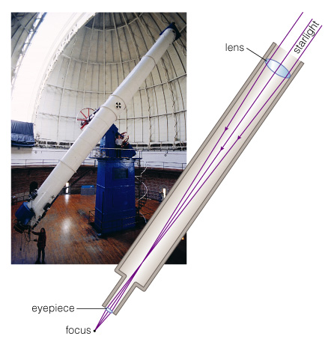
Refracting Telescope
Refracting telescopes need to be very long, with large, heavy lenses

Slide 8
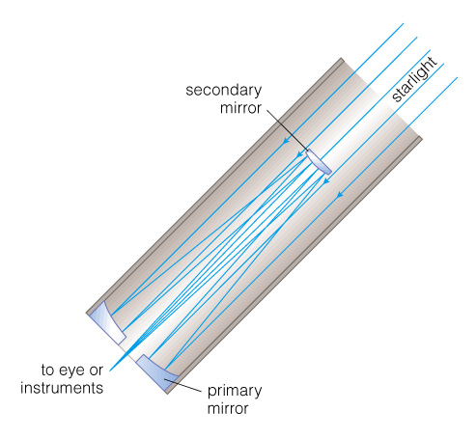
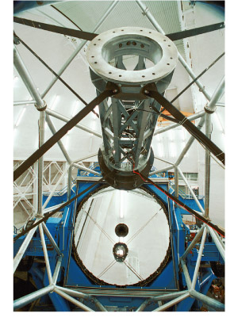
Reflecting Telescope
Reflecting telescopes can have much greater diameters
Most modern telescopes are reflectors

Slide 9
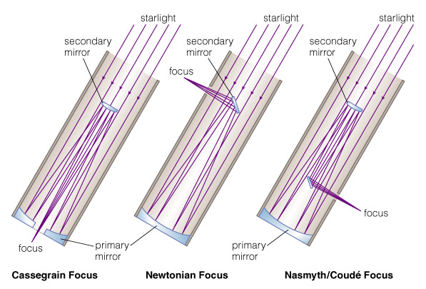
Designs for Reflecting Telescopes

Slide 10
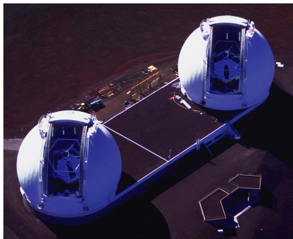
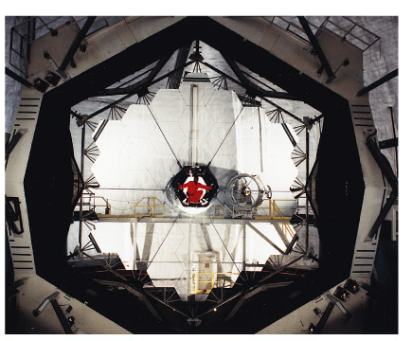
Mirrors in Reflecting Telescopes
Twin Keck telescopes on
Mauna Kea in Hawaii
Segmented 10-meter mirror of a Keck telescope

Slide 11
What do astronomers do with telescopes?
Imaging: Taking pictures of the sky
Spectroscopy: Breaking light into spectra
Timing: Measuring how light output varies with time

Slide 12
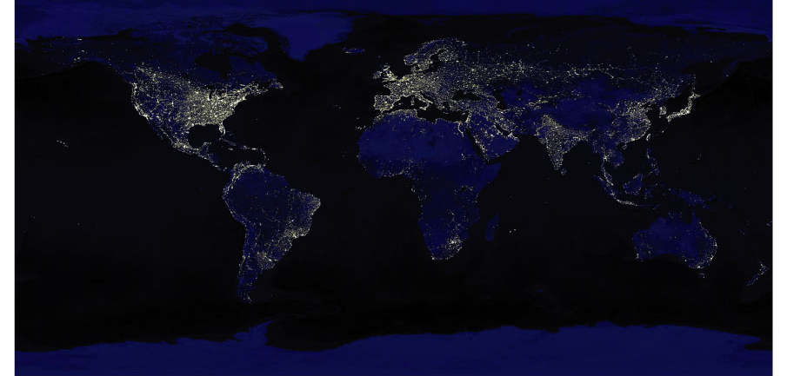
Light Pollution
Scattering of human-made light in the atmosphere is a growing problem for astronomy

Slide 13
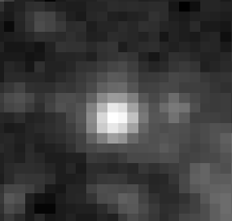
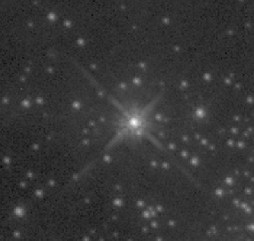
Twinkling and Turbulence
Star viewed with ground-based telescope
Same star viewed with Hubble Space Telescope
Turbulent air flow in Earth’s atmosphere distorts our view, causing stars to appear to twinkle

Slide 14
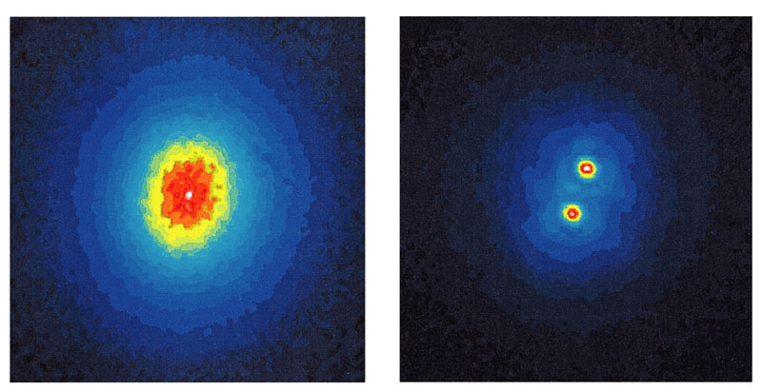
Adaptive Optics
Without adaptive optics
With adaptive optics
Rapidly changing the shape of a telescope’s mirror compensates for some of the effects of turbulence

Slide 15
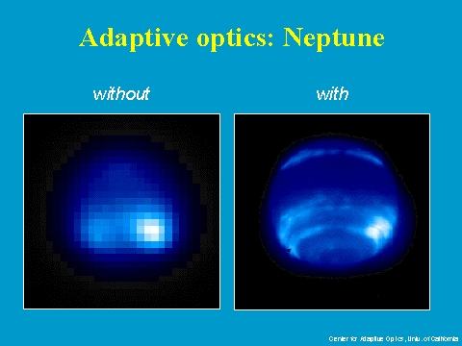
Notes:
Another example of adaptive optics.

Slide 16
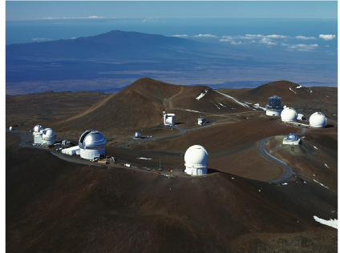
Calm, High, Dark, Dry
The best observing sites are atop remote mountains
Summit of Mauna Kea, Hawaii

Slide 17
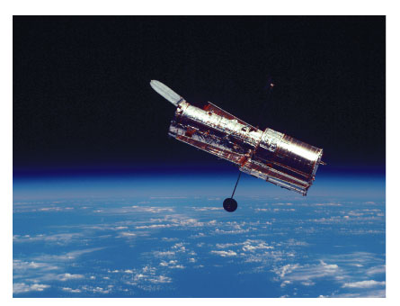
Why do we put telescopes into space?

Slide 18
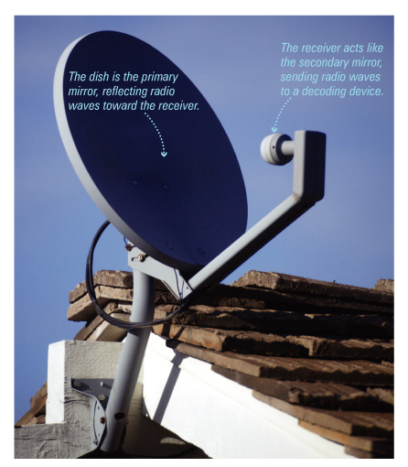
How can we observe nonvisible light?
A standard satellite dish is essentially a telescope for observing radio waves

Slide 19
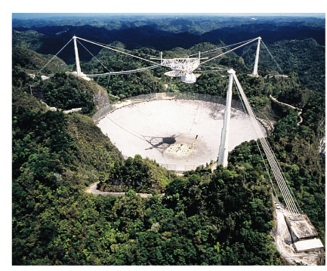
Radio Telescopes
A radio telescope is like a giant mirror that reflects radio waves to a focus

Slide 20
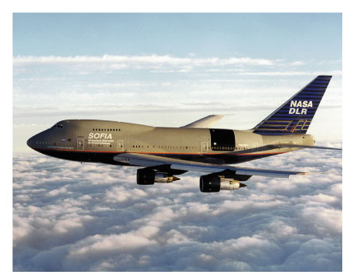
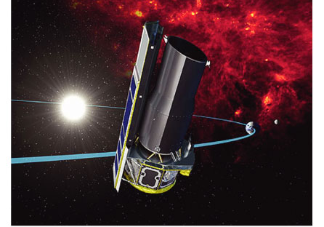
IR & UV Telescopes
SOFIA
Spitzer
Infrared and ultraviolet-light telescopes operate like visible-light telescopes but need to be above atmosphere to see all IR and UV wavelengths

Slide 21
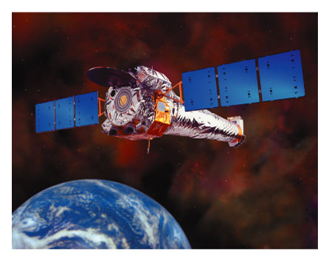
X-Ray Telescopes
X-ray telescopes also need to be above the atmosphere
Chandra

Slide 22
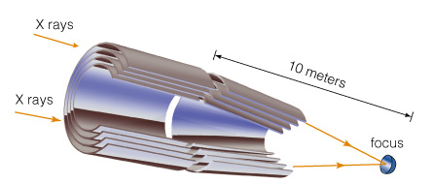
X-Ray Telescopes
Focusing of X-rays requires special mirrors
Mirrors are arranged to focus X-ray photons through grazing bounces off the surface

Slide 23
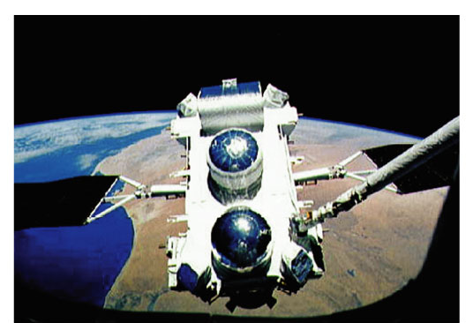
Gamma Ray Telescopes
Gamma ray telescopes also need to be in space
Focusing gamma rays is extremely difficult
Compton Observatory

Slide 24
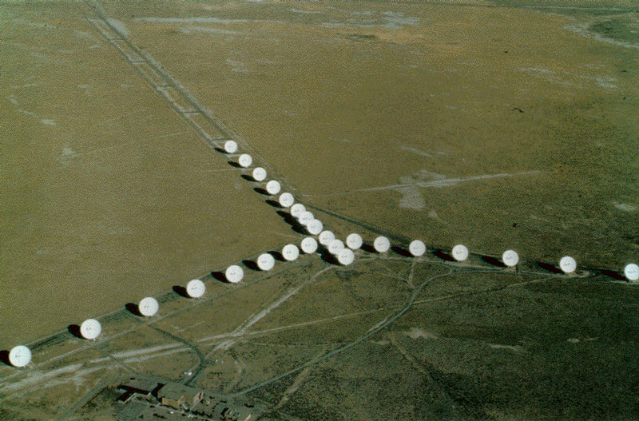
How can multiple telescopes work together?

Slide 25
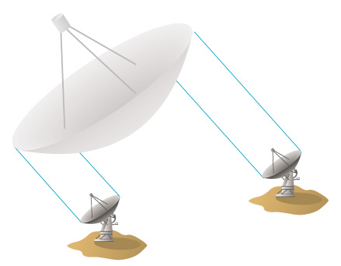
Interferometry
Interferometery is a technique for linking two or more telescopes so that they have the angular resolution of a single large one

Slide 26
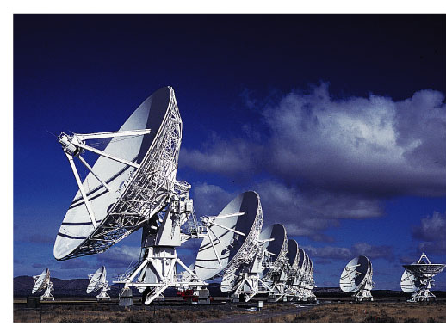
Interferometry
Easiest to do with radio telescopes
Now becoming possible with infrared and visible-light telescopes
Very Large Array (VLA)

Slide 27
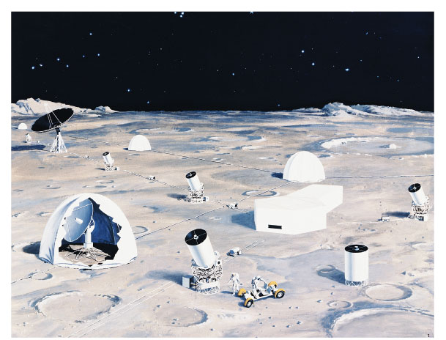
Future of Astronomy in Space?

