Slide 1
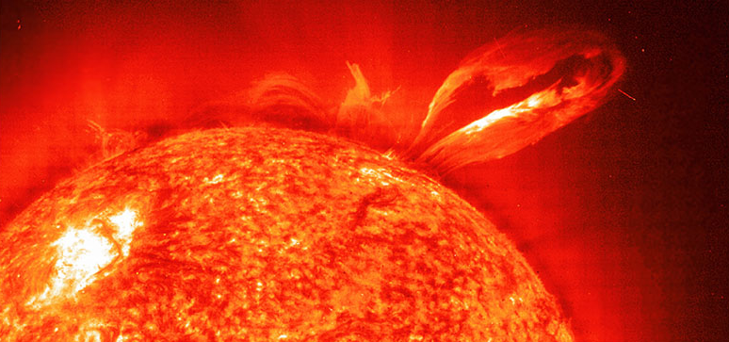
E = mc²
- Einstein, 1905
It can be powered by NUCLEAR ENERGY!
Nuclear Potential Energy (core)
~ 10 billion years
Luminosity

Slide 2
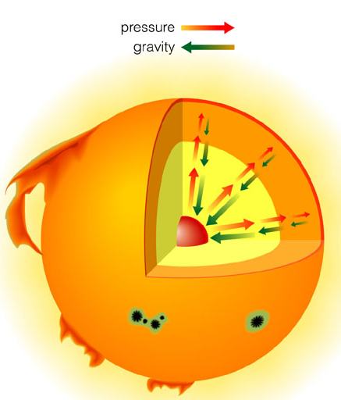
Gravitational contraction:
Provided energy that heated core as Sun was forming
Contraction stopped when fusion began

Slide 3
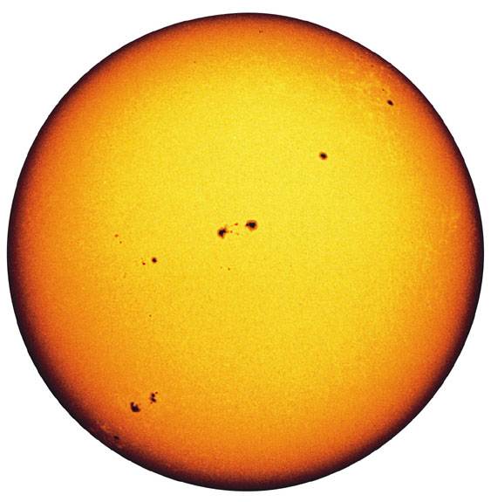
Radius:
6.9 x 10⁸ m
(109 times Earth)
Mass:
2 x 10³⁰ kg
(300,000 Earths)
Luminosity:
3.8 x 10²⁶ watts
Notes:
Good Sun movies to download:
http://es.rice.edu/ES/humsoc/Galileo/Things/g_sunspots.html
Images compiled from Owen Gingerich’s copy of the first edition of Istoria e Dimostrazioni
Wave_fade.mpg photosphere:chromosphere:corona, optical:UV:X-ray
http://www.lmsal.com/YPOP/FilmFestival/index.html
C2_1mth.mpg
http://lasco-www.nrl.navy.mil/

Slide 4
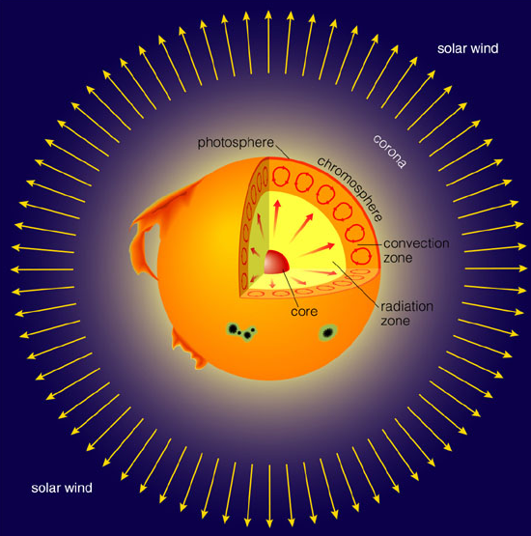

Corona:
Outermost layer of solar atmosphere
~1 million K

Slide 5
Photosphere:
Visible surface of Sun
~ 6,000 K

Slide 6
Convection Zone:
Energy transported upward by rising hot gas

Slide 7
Radiation Zone:
Energy transported upward by photons

Slide 8
Core:
Energy generated by nuclear fusion
~ 15 million K

Slide 9
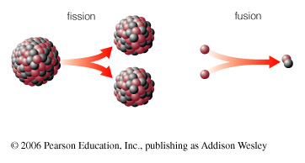
How does nuclear fusion occur in the Sun?

Slide 10
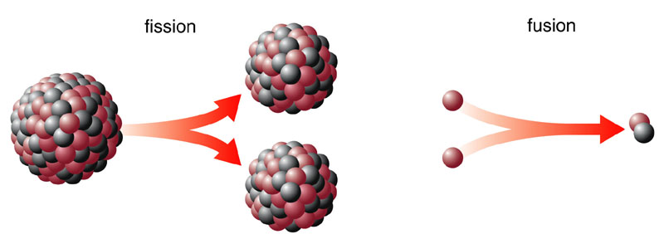
Fission
Big nucleus splits into smaller pieces
(Nuclear power plants)
Fusion
Small nuclei stick together to make a bigger one
(Sun, stars)

Slide 11
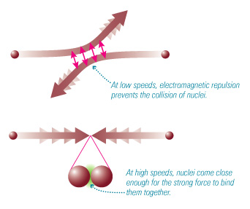
High temperature enables nuclear fusion to happen in the core

Slide 12
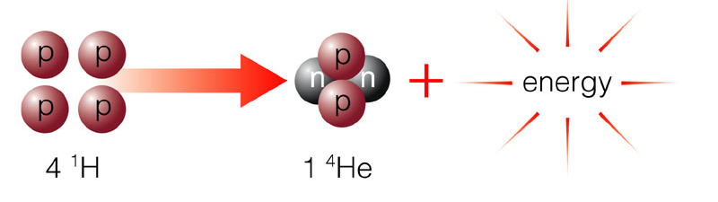
Sun releases energy by fusing four hydrogen nuclei into one helium nucleus

Slide 13
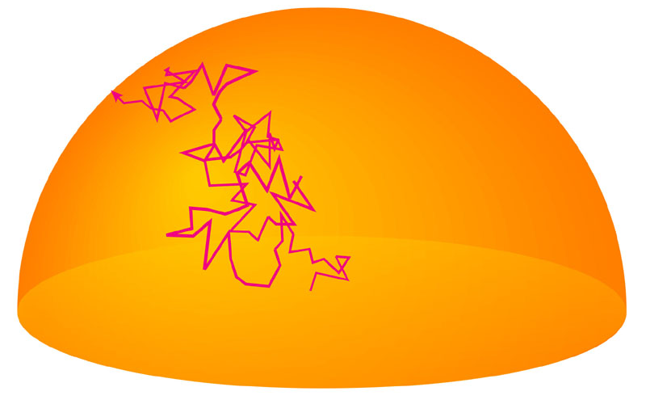
How does the energy from fusion get out of the Sun?

Slide 14
Energy gradually leaks out of radiation zone in form of randomly bouncing photons

Slide 15
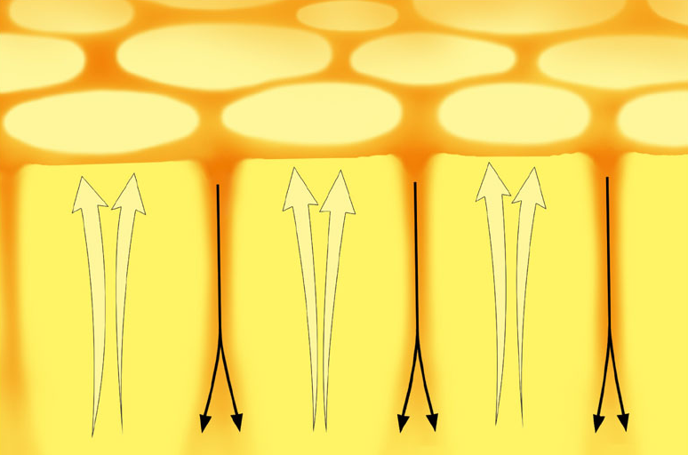
Convection (rising hot gas) takes energy to surface

Slide 16
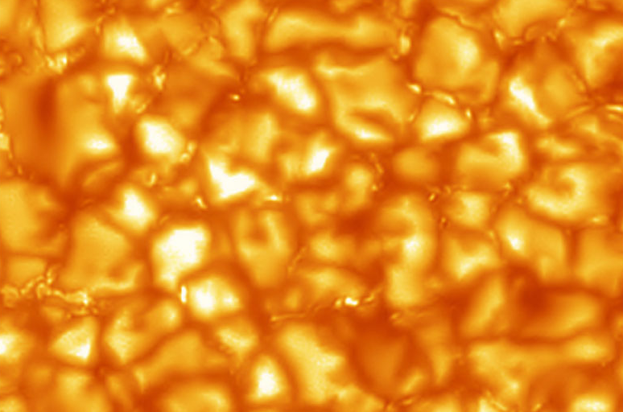
Bright blobs on photosphere are where hot gas is reaching surface

Slide 17
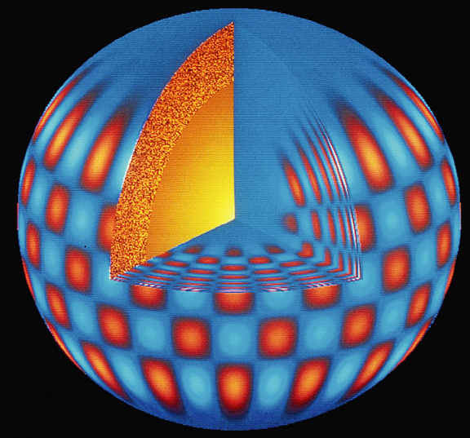
How we know what is happening inside the Sun?

Slide 18
We learn about inside of Sun by …
Making mathematical models
Observing solar vibrations
Observing solar neutrinos

Slide 19
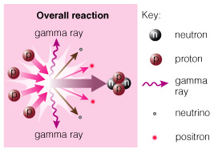
Neutrinos created during fusion fly directly through the Sun
Observations of these solar neutrinos can tell us what’s happening in core
Notes:
John Updike poem - permissions needed ?

Slide 20
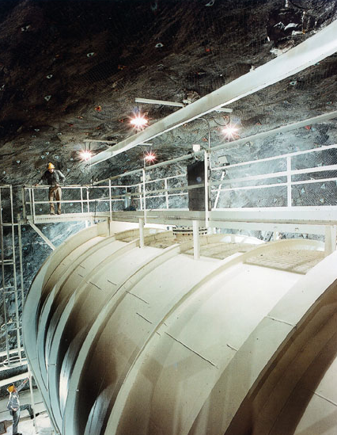
Solar neutrino problem:
Early searches for solar neutrinos failed to find the predicted number

Slide 21
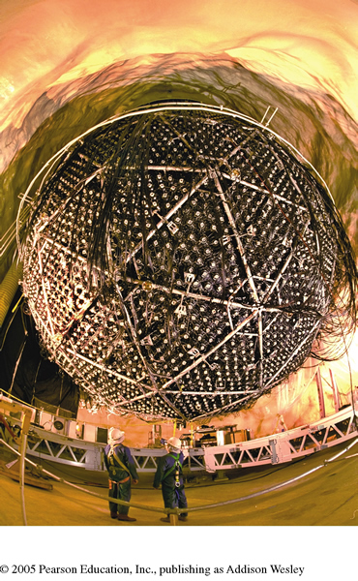
Solar neutrino problem:
Early searches for solar neutrinos failed to find the predicted number
More recent observations find the right number of neutrinos, but some have changed form

Slide 22
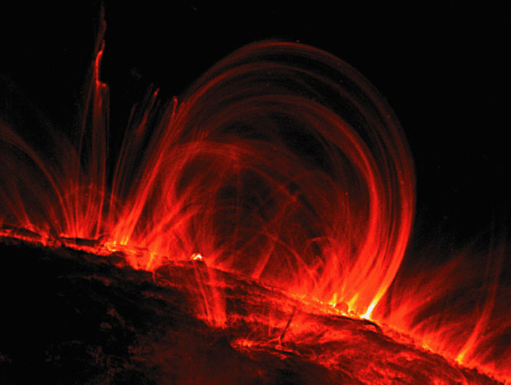
What causes solar activity?

Slide 23
Solar activity is like “weather”
Sunspots
Solar Flares
Solar Prominences
All are related to magnetic fields

Slide 24
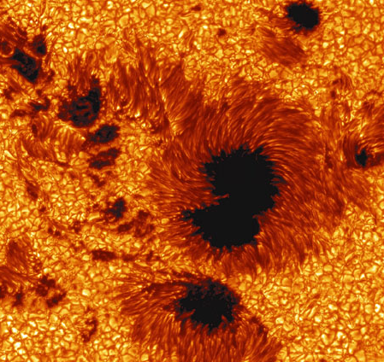
Sunspots
Are cooler than other parts of the Sun’s surface (4000 K)
Are regions with strong magnetic fields

Slide 25
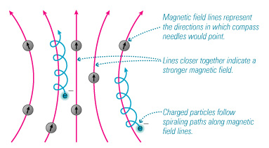
Charged particles spiral along magnetic field lines

Slide 26
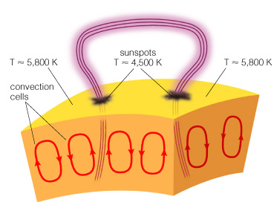
Loops of bright gas often connect sunspot pairs

Slide 27
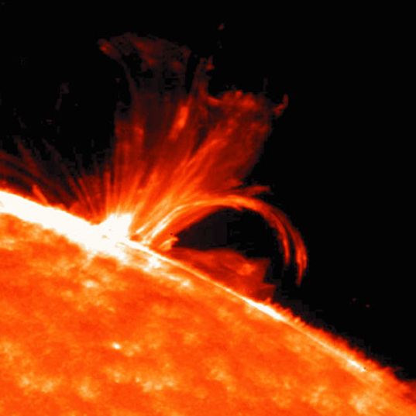
Magnetic activity causes solar flares that send bursts of X-rays and charged particles into space

Slide 28
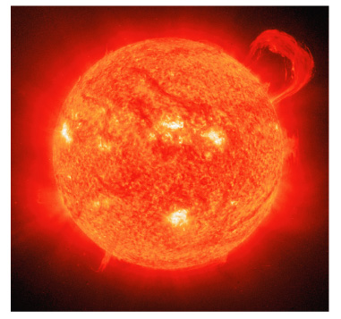
Magnetic activity also causes solar prominences that erupt high above the Sun’s surface

Slide 29
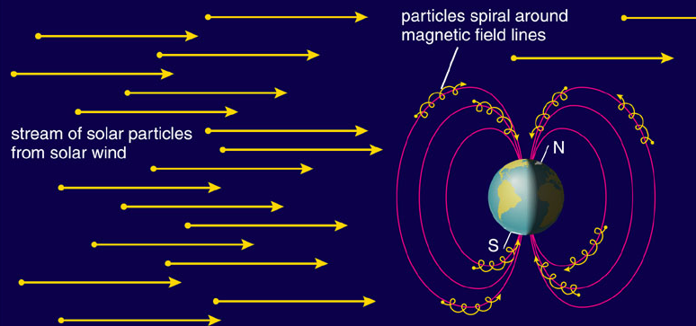
Charged particles streaming from Sun can disrupt electrical power grids and can disable communications satellites

Slide 30
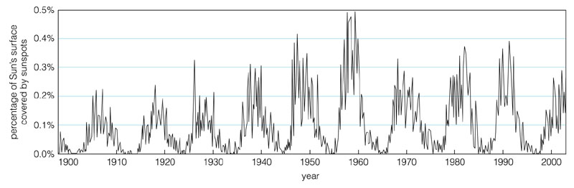
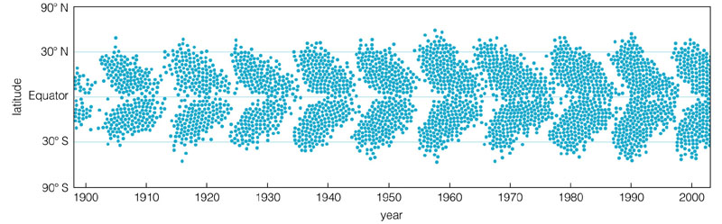
Number of sunspots rises and falls in 11-year cycle

Slide 31
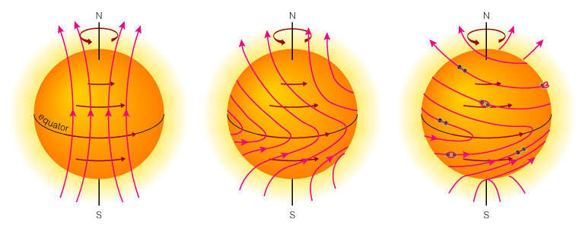
Sunspot cycle has something to do with winding and twisting of Sun’s magnetic field

