Slide 1
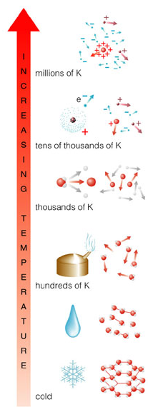
10⁶ K
Level of ionization also reveals a star’s temperature
10⁵ K
Ionized
Gas
(Plasma)
10⁴ K
10³ K
Neutral Gas
10² K
Molecules
10 K
Solid

Slide 2
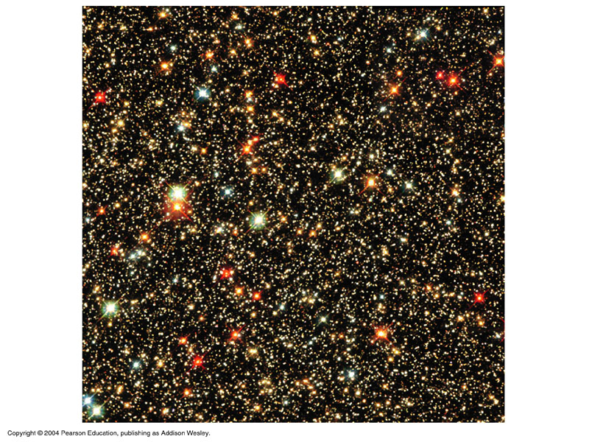
The brightness of a star depends on both distance and luminosity

Slide 3
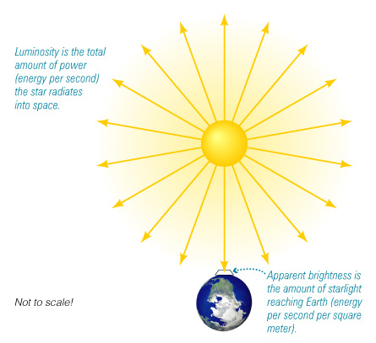
Luminosity:
Amount of power a star radiates
(energy per second = Watts)
Apparent brightness:
Amount of starlight that reaches Earth
(energy per second per square meter)

Slide 4
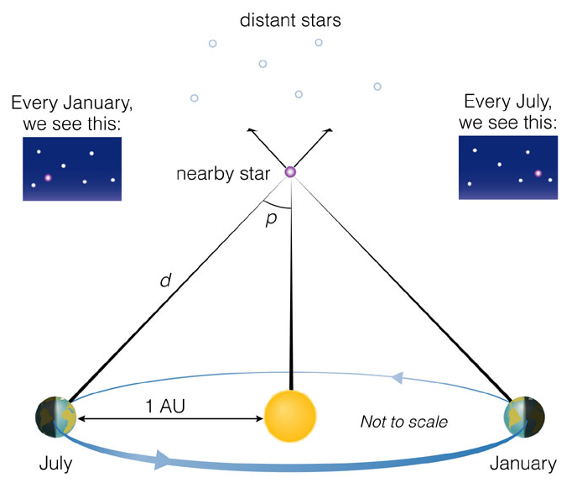

Slide 5
Most luminous stars:
10⁶ L_{Sun}
Least luminous stars:
10⁻⁴ L_{Sun}
(L_{Sun} is luminosity of Sun)

Slide 6
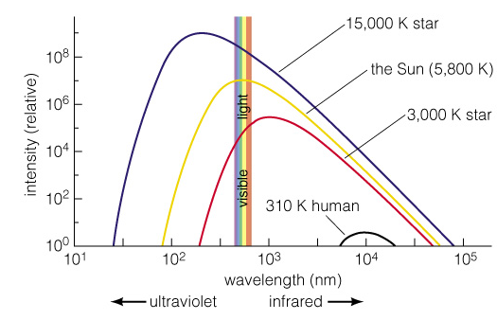
Properties of Thermal Radiation
Hotter objects emit more light per unit area at all frequencies.
Hotter objects emit photons with a higher average energy.
Notes:
Remind students that the intensity is per area; larger objects can emit more total light even if they are cooler.

Slide 7
Hottest stars:
50,000 K
Coolest stars:
3,000 K
(Sun’s surface is 5,800 K)

Slide 8
Remembering Spectral Types
(Hottest) O B A F G K M (Coolest)
Oh, Be A Fine Girl, Kiss Me
Only Boys Accepting Feminism Get Kissed Meaningfully

Slide 9
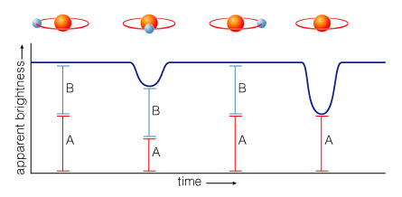
How do we measure stellar masses?

Slide 10
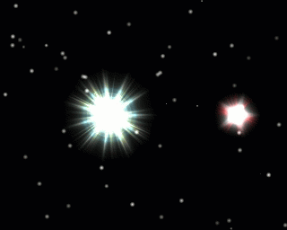
The orbit of a binary star system depends on strength of gravity
Notes:
I’m not sure where this came from, if it’s not on the CD, let me know.

Slide 11
Types of Binary Star Systems
Visual Binary
Eclipsing Binary
Spectroscopic Binary
About half of all stars are in binary systems

Slide 12
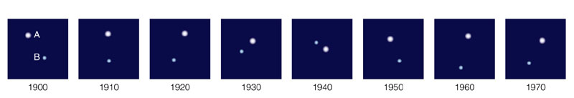
Visual Binary
We can directly observe the orbital motions of these stars

Slide 13
Eclipsing Binary
We can measure periodic eclipses
Notes:
Download an eclipsing binary animation from:
http://www-astronomy.mps.ohio-state.edu/~pogge/Ast162/Movies/eclbin.gif

Slide 14
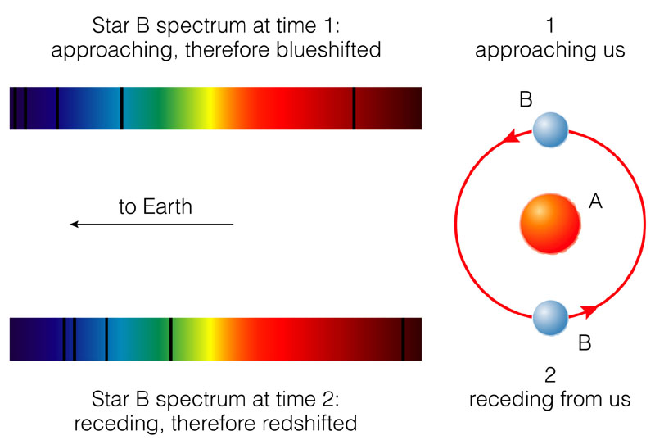
Spectroscopic Binary
We determine the orbit by measuring Doppler shifts
Notes:
Download a spectroscopic binary animation from:
http://www-astronomy.mps.ohio-state.edu/~pogge/Ast162/Movies/spanim.gif
R. Pogge, Ohio State University

Slide 15
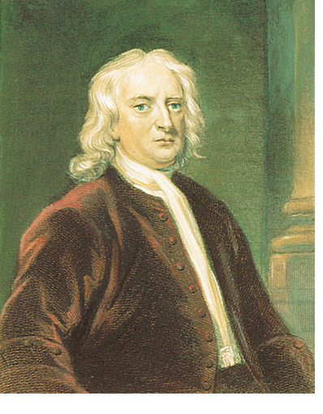
We measure mass using gravity
Direct mass measurements are possible only for stars in binary star systems
p = period
a = average separation
4π²
G (M₁ + M₂)
p² = a³
Isaac Newton

Slide 16
Most massive stars:
100 M_{Sun}
Least massive stars:
0.08 M_{Sun}
(M_{Sun} is the mass of the Sun)

Slide 17
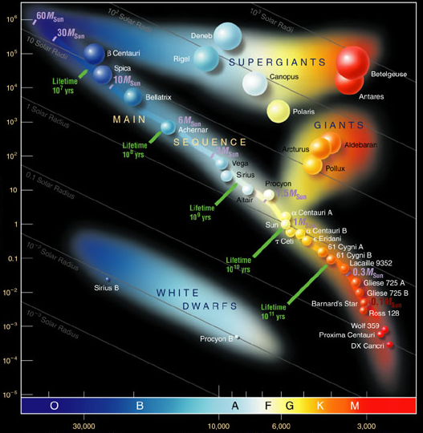
An H-R diagram plots the luminosity and temperature of stars
Luminosity
Temperature

Slide 18
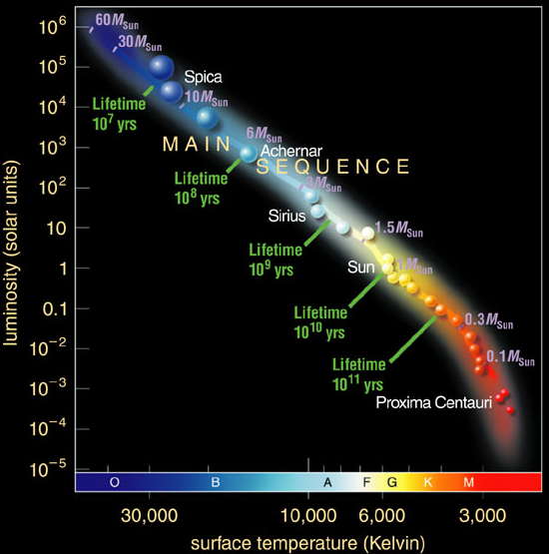
Most stars fall somewhere on the main sequence of the H-R diagram

Slide 19
Large radius
Stars with lower T and higher L than main-sequence stars must have larger radii:
giants and supergiants

Slide 20
Stars with higher T and lower L than main-sequence stars must have smaller radii:
white dwarfs
Small radius

Slide 21
H-R diagram depicts:
Temperature
Color
Spectral Type
Luminosity
Radius
Luminosity
Temperature

Slide 22
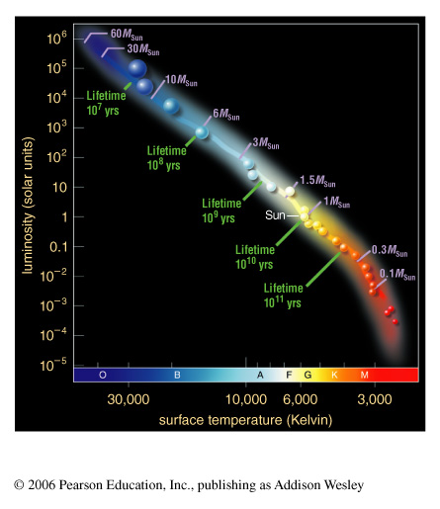
What is the significance of the main sequence?

Slide 23
Main-sequence stars are fusing hydrogen into helium in their cores like the Sun
Luminous main-sequence stars are hot (blue)
Less luminous ones are cooler (yellow or red)

Slide 24
Mass measurements of main-sequence stars show that the hot, blue stars are much more massive than the cool, red ones
High-mass stars
Low-mass stars

Slide 25
The mass of a normal, hydrogen-burning star determines its luminosity and spectral type!
High-mass stars
Low-mass stars

Slide 26
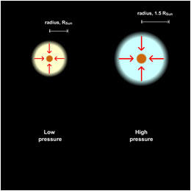
Core pressure and temperature of a higher-mass star need to be larger in order to balance gravity
Higher core temperature boosts fusion rate, leading to larger luminosity

Slide 27
Stellar Properties Review
Luminosity: from brightness and distance
10⁻⁴ L_{Sun} - 10⁶ L_{Sun}
Temperature: from color and spectral type
3,000 K - 50,000 K
Mass: from period (p) and average separation (a)
of binary-star orbit
0.08 M_{Sun} - 100 M_{Sun}

Slide 28
Stellar Properties Review
Luminosity: from brightness and distance
10⁻⁴ L_{Sun} - 10⁶ L_{Sun}
Temperature: from color and spectral type
3,000 K - 50,000 K
Mass: from period (p) and average separation (a)
of binary-star orbit
0.08 M_{Sun} - 100 M_{Sun}
(0.08 M_{Sun})
(100 M_{Sun})
(0.08 M_{Sun})
(100 M_{Sun})

Slide 29
Mass & Lifetime
Sun’s life expectancy: 10 billion years

Slide 30
Mass & Lifetime
Until core hydrogen
(10% of total) is
used up
Sun’s life expectancy: 10 billion years

Slide 31
Mass & Lifetime
Until core hydrogen
(10% of total) is
used up
Sun’s life expectancy: 10 billion years
Life expectancy of 10 M_{Sun} star:
10 times as much fuel, uses it 10⁴ times as fast
10 million years ~ 10 billion years x 10 / 10⁴

Slide 32
Mass & Lifetime
Until core hydrogen
(10% of total) is
used up
Sun’s life expectancy: 10 billion years
Life expectancy of 10 M_{Sun} star:
10 times as much fuel, uses it 10⁴ times as fast
10 million years ~ 10 billion years x 10 / 10⁴
Life expectancy of 0.1 M_{Sun} star:
0.1 times as much fuel, uses it 0.01 times as fast
100 billion years ~ 10 billion years x 0.1 / 0.01

Slide 33
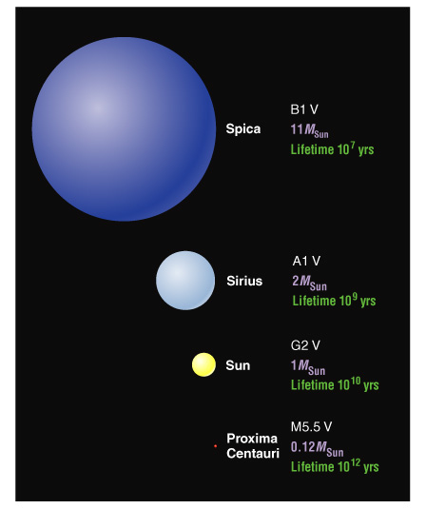
Main-Sequence Star Summary
High Mass:
High Luminosity
Short-Lived
Large Radius
Blue
Low Mass:
Low Luminosity
Long-Lived
Small Radius
Red

Slide 34
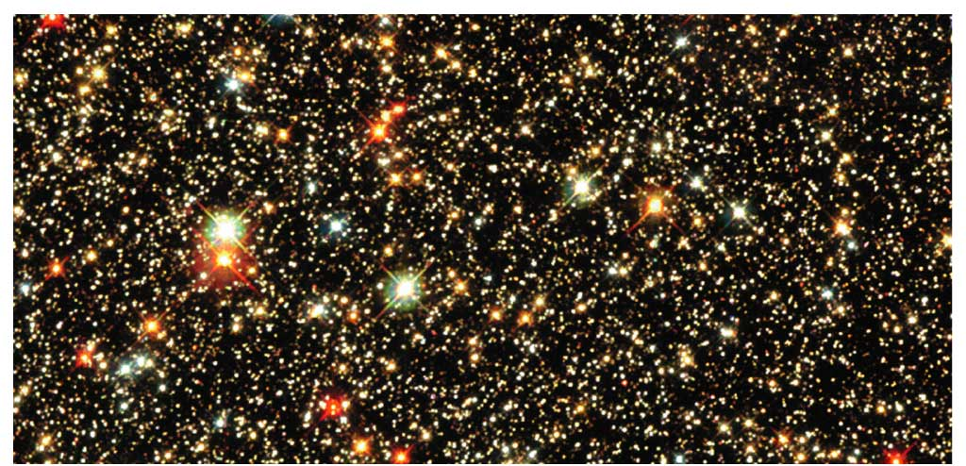
What are giants, supergiants, and white dwarfs?

Slide 35
Off the Main Sequence
Stellar properties depend on both mass and age: those that have finished fusing H to He in their cores are no longer on the main sequence
All stars become larger and redder after exhausting their core hydrogen: giants and supergiants
Most stars end up small and white after fusion has ceased: white dwarfs

Slide 36
C
B
Which star is the hottest?
Luminosity
D
A
Temperature

Slide 37
C
B
Which star is the most luminous?
Luminosity
D
A
Temperature

Slide 38
C
B
Which star is a main-sequence star?
Luminosity
D
A
Temperature

Slide 39
C
B
Which star has the largest radius?
Luminosity
D
A
Temperature

Slide 40
A
Which star is most like our Sun?
D
Luminosity
B
C
Temperature

Slide 41
A
Which of these stars will have changed the least 10 billion years from now?
D
Luminosity
B
C
Temperature

Slide 42
A
Which of these stars can be no more than 10 million years old?
D
Luminosity
B
C
Temperature

Slide 43
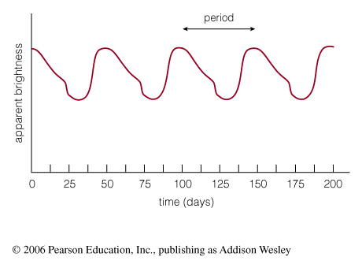
Why do the properties of some stars vary?

Slide 44
Variable Stars
Any star that varies significantly in brightness with time is called a variable star
Some stars vary in brightness because they cannot achieve proper balance between power welling up from the core and power radiated from the surface
Such a star alternately expands and contracts, varying in brightness as it tries to find a balance

Slide 45
Pulsating Variable Stars
The light curve of this pulsating variable star shows that its brightness alternately rises and falls over a 50-day period

Slide 46
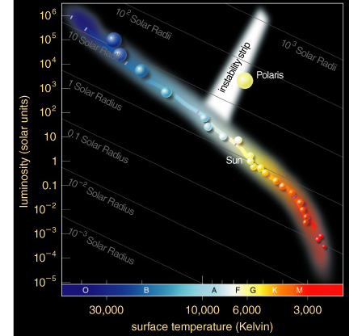
Cepheid Variable Stars
Most pulsating variable stars inhabit an instability strip on the H-R diagram
The most luminous ones are known as Cepheid variables

Slide 47
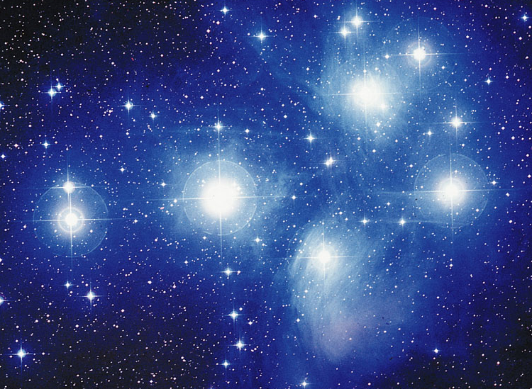
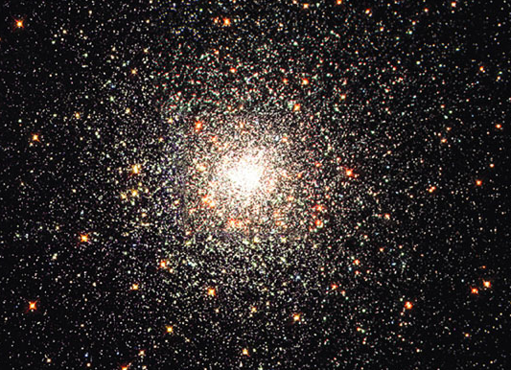
What are the two types of star clusters?

Slide 48
Open cluster: A few thousand loosely packed stars

Slide 49
Globular cluster: Up to a million or more stars in a dense ball bound together by gravity
Notes:
Useful movies to download:
Globular cluster visualization
http://terpsichore.stsci.edu/~summers/viz/scviz/spz.html
Stellar collision simulation:
http://www.ifa.hawaii.edu/faculty/barnes/research/stellar_collisions/

Slide 50
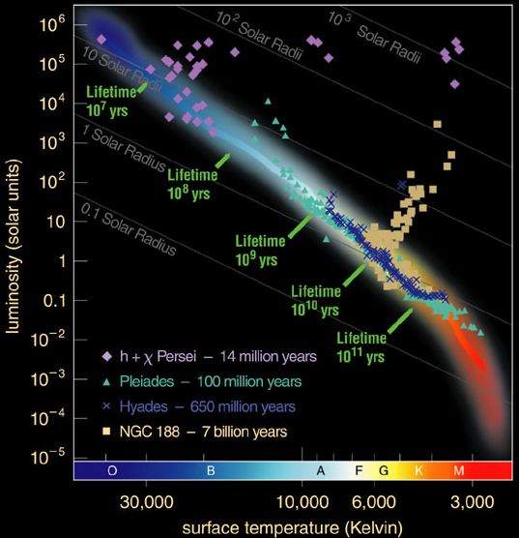
Main-sequence turnoff point of a cluster tells us its age

