Slide 1


CS 146: Data Structures and Algorithms June 18 Class Meeting
Department of Computer Science San Jose State University Summer 2015 Instructor: Ron Mak
www.cs.sjsu.edu/~mak

Slide 2
Trees
A tree is a collection of nodes:
One node is the root node.
A node contains data and has pointers (possibly null) to other nodes, its children.
The pointers are directed edges.
Each child node can itself be the root of a subtree.
A leaf node is a node that has no children.
Each node other than the root node has exactly one parent node.
Data Structures and Algorithms in Java, 3rd ed.
by Mark Allen Weiss
Pearson Education, Inc., 2012

Slide 3
Trees, cont’d
The path from node n₁ to node n_{k} is the sequence of nodes in the tree from n₁ to n_{k}.
What is the path from A to Q? From E to P?
The length of a path is the number of its edges.
What is the length of the path from A to Q?
Data Structures and Algorithms in Java, 3rd ed.
by Mark Allen Weiss
Pearson Education, Inc., 2012

Slide 4
Trees, cont’d
The depth of a node is the length of the path from the root to that node.
What is the depth of node J? Of the root node?
Data Structures and Algorithms in Java, 3rd ed.
by Mark Allen Weiss
Pearson Education, Inc., 2012

Slide 5
Trees, cont’d
The height of a node is the length of the longest path from the node to a leaf node.
What is the height of node E? Of the root node?
Depth of a tree = depth of its deepest node = height of the tree
Data Structures and Algorithms in Java, 3rd ed.
by Mark Allen Weiss
Pearson Education, Inc., 2012

Slide 6
Tree Implementation
In general, a tree node can have an arbitrary number of child nodes.
Therefore, each tree node should have
a link to its first child, and
a link to its next sibling:
class TreeNode
{
Object element;
TreeNode firstChild;
TreeNode nextSibling;
}

Slide 7
Tree Implementation, cont’d
Conceptual view of a tree:
Implementation view of the same tree:
Data Structures and Algorithms in Java, 3rd ed.
by Mark Allen Weiss
Pearson Education, Inc., 2012

Slide 8
Tree Traversals
There are several different algorithms to “walk” or “traverse” a tree.
Each algorithm determines a unique order that each and every node in the tree is “visited”.

Slide 9
Preorder Tree Traversal
First visit a node.
Visit the node before (pre) visiting its child nodes.
Then recursively visit each of the node’s child nodes in sibling order.

Slide 10
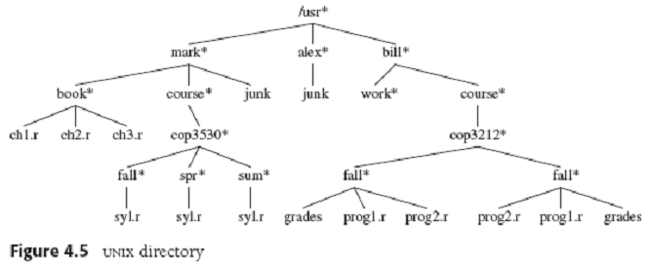
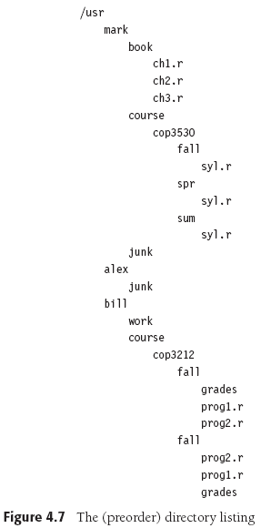
Preorder Tree Traversal, cont’d
private void listAll(int depth)
{
printName(depth);
if (isDirectory()) {
for each file f in directory {
f.listAll(depth+1);
}
}
}
public void listAll()
{
listAll(0);
}
Data Structures and Algorithms in Java, 3rd ed.
by Mark Allen Weiss
Pearson Education, Inc., 2012

Slide 11
Postorder Tree Traversal
First recursively visit each of a node’s child nodes in sibling order.
Then visit the node itself.

Slide 12
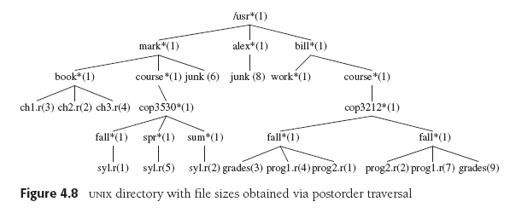
Postorder Tree Traversal, cont’d
private void size()
{
int totalSize = sizeOfThisFile();
if (isDirectory()) {
for each file f in directory {
totalSize += f.size();
}
}
return totalSize;
}
Data Structures and Algorithms in Java, 3rd ed.
by Mark Allen Weiss
Pearson Education, Inc., 2012

Slide 13
Binary Trees
A binary tree is a tree where each node can have 0, 1, or 2 child nodes.
The depth of an average binary tree with N nodes is much smaller than N:
Data Structures and Algorithms in Java, 3rd ed.
by Mark Allen Weiss
Pearson Education, Inc., 2012

Slide 14
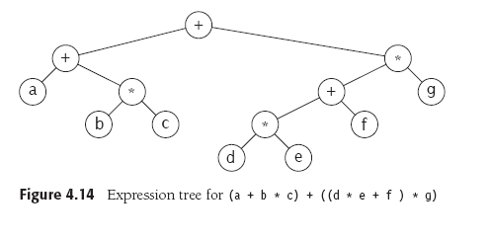
Binary Trees, cont’d
An arithmetic expression tree:
Understand from the textbook how this tree is built.
Or take CS 153: Concepts of Compiler Design

Slide 15
Conversion from Infix to Postfix Notation
Do a postorder walk of our expression tree to output the expression in postfix notation:
abc*+de*f+g*+
Data Structures and Algorithms in Java, 3rd ed.
by Mark Allen Weiss
Pearson Education, Inc., 2012

Slide 16
Binary Search Trees
A binary search tree has these properties for each of its nodes:
All the values in the node’s left subtree is less than the value of the node itself.
All the values in the node’s right subtree is greater than the value of the node itself.
Data Structures and Algorithms in Java, 3rd ed.
by Mark Allen Weiss
Pearson Education, Inc., 2012

Slide 17
Inorder Tree Traversal
Recursively visit a node’s left subtree.
Visit the node itself.
Recursively visit the node’s right subtree.
If you do an inorder walk of a binary search tree, you will visit the nodes in sorted order.

Slide 18
Inorder Tree Traversal, cont’d
An inorder walk of the left tree visits the nodes in sorted order: 1 2 3 4 6 8
Data Structures and Algorithms in Java, 3rd ed.
by Mark Allen Weiss
Pearson Education, Inc., 2012

Slide 19
The Binary Search Tree ADT
The node class of our binary search tree ADT.
private static class BinaryNode<AnyType>
{
AnyType element; // data in the node
BinaryNode<AnyType> left; // left child
BinaryNode<AnyType> right; // right child
BinaryNode(AnyType theElement)
{
this(theElement, null, null);
}
BinaryNode(AnyType theElement, BinaryNode<AnyType> lt,
BinaryNode<AnyType> rt)
{
element = theElement;
left = lt;
right = rt;
}
}

Slide 20
The Binary Search Tree ADT
public class BinarySearchTree<AnyType extends Comparable<? super AnyType>>
{
private BinaryNode<AnyType> root;
public BinarySearchTree()
{
root = null;
}
private BinaryNode<AnyType> findMin(BinaryNode<AnyType> t)
{
...
}
...
private static class BinaryNode<AnyType>
{
...
}
}

Slide 21
The Binary Search Tree: Min and Max
Finding the minimum and maximum values in a binary search tree is easy.
The leftmost node has the minimum value.
The rightmost node has the maximum value.
You can find the minimum and maximum values recursively or (better) iteratively.

Slide 22
The Binary Search Tree: Min and Max, cont’d
Recursive code to find the minimum value.
Chase down the left child links.
private BinaryNode<AnyType> findMin(BinaryNode<AnyType> t)
{
if (t == null) {
return null;
}
else if (t.left == null) {
return t; // found the leftmost node
}
else {
return findMin(t.left);
}
}

Slide 23
The Binary Search Tree: Min and Max, cont’d
Iterative code to find the maximum value.
Chase down the right child links.
private BinaryNode<AnyType> findMax(BinaryNode<AnyType> t)
{
if (t != null) {
while (t.right != null) {
t = t.right;
}
}
return t;
}

Slide 24
The Binary Search Tree: Contains
Does a binary search tree contain a target value?
Search recursively starting at the root node:
If the target value is less than the node’s value, then search the node’s left subtree.
If the target value is greater than the node’s value, then search the node’s right subtree.
If the values are equal, then yes, the target value is contained in the tree.
If you “run off the bottom” of the tree, then no, the target value is not contained in the tree.

Slide 25
The Binary Search Tree: Contains, cont’d
private boolean contains(AnyType x, BinaryNode<AnyType> t)
{
if (t == null) return false;
int compareResult = x.compareTo(t.element);
if (compareResult < 0) {
return contains(x, t.left);
}
else if (compareResult > 0) {
return contains(x, t.right);
}
else {
return true; // Match
}
}

Slide 26
Break

Slide 27
The Binary Search Tree: Insert
To insert a target value into the tree:
Proceed as if you are checking whether the tree contains the target value.
As you’re recursively examining left and right subtrees, if you encounter a null link (either a left link or a right link), then that’s where the new value should be inserted.
Create a new node containing the target value and replace the null link with a link to the new node.
So the new node is attached to the last-visited node.

Slide 28
The Binary Search Tree: Insert, cont’d
If the target value is already in the tree, either:
Insert a duplicate value into the tree.
Don’t insert but “update” the existing node.

Slide 29
The Binary Search Tree: Insert
Data Structures and Algorithms in Java, 3rd ed.
by Mark Allen Weiss
Pearson Education, Inc., 2012

Slide 30
The Binary Search Tree: Insert
private BinaryNode<AnyType> insert(AnyType x, BinaryNode<AnyType> t)
{
// Create a new node to be attached
// to the last-visited node.
if (t == null) {
return new BinaryNode<>(x, null, null);
}
int compareResult = x.compareTo(t.element);
// Find the insertion point.
if (compareResult < 0) {
t.left = insert(x, t.left);
}
else if (compareResult > 0) {
t.right = insert(x, t.right);
}
else {
// Duplicate: do nothing.
}
return t;
}
Only when a null link is encountered is a
node created and returned.
The newly created node
will be attached to the
last-visited node.

Slide 31
The Binary Search Tree: Remove
After removing a node from a binary search tree, the remaining nodes must still be in order.
No child case: The target node to be removed is a leaf node.
Just remove the target node.

Slide 32
The Binary Search Tree: Remove, cont’d
One child case: The target node to be removed has one child node.
Change the parent’s link to the target node to point instead to the target node’s child.
Data Structures and Algorithms in Java, 3rd ed.
by Mark Allen Weiss
Pearson Education, Inc., 2012

Slide 33
The Binary Search Tree: Remove, cont’d
Two children case: The target node to be removed has two child nodes.
This is the complicated case.
How do we restructure the tree so that the order of the node values is preserved?

Slide 34
The Binary Search Tree: Remove, cont’d
Recall what happens you remove a list node.
Assume that the list is sorted.
If we delete target node 5, which node takes its place?
The replacement node is the node that is immediately after the target node in the sorted order.
0
1
2
3
4
5
6
7
8
9
0
1
2
3
4
6
7
8
9

Slide 35
The Binary Search Tree: Remove, cont’d
A somewhat convoluted way to do this:
Replace the target node’s value with the successor node’s value.
Then remove the successor node, which is now “empty”.
0
1
2
3
4
5
6
7
8
9
0
1
2
3
4
6
7
8
9
0
1
2
3
4
6
7
8
9

Slide 36
The Binary Search Tree: Remove, cont’d
0
1
2
3
4
5
6
7
8
9
0
1
2
3
4
6
7
8
9
0
1
2
3
4
6
7
8
9
The same convoluted process happens when you remove a node from a binary search tree.
The successor node is the node that is immediately after the deleted node in the sorted order.
Replace the target node’s value with the successor node’s value.
Remove the successor node, which is now “empty”.

Slide 37
The Binary Search Tree: Remove, cont’d
If you have a target node in a binary search tree, where is the node that is its immediate successor in the sort order?
The successor’s value is ≥ than the target value.
It must be the minimum value in the right subtree.
General idea:
Replace the value in the target node with the value of the successor node.
The successor node is now “empty”.
Recursively delete the successor node.

Slide 38
The Binary Search Tree: Remove, cont’d
X
X
The second deletion
is easy because the node
has no left child.
Replace the value of the target node 2 with the value of the successor node 3.
Now recursively remove node 3.
Data Structures and Algorithms in Java, 3rd ed.
by Mark Allen Weiss
Pearson Education, Inc., 2012

Slide 39
The Binary Search Tree: Remove, cont’d
private BinaryNode<AnyType> remove(AnyType x, BinaryNode<AnyType> t)
{
if (t == null) return t;
int compareResult = x.compareTo(t.element);
if (compareResult < 0) {
t.left = remove(x, t.left);
}
else if (compareResult > 0) {
t.right = remove(x, t.right);
}
else if (t.left != null && t.right != null) {
t.element = findMin(t.right).element;
t.right = remove(t.element, t.right);
}
else {
t = (t.left != null) ? t.left : t.right;
}
return t;
}
Item not found: do nothing.
Two children:
Replace the target value
with the successor value.
Then recursively remove
the successor node.
No children or one child.

Slide 40
The Binary Search Tree Animations
Download Java applets from http://www.informit.com/content/images/0672324539/downloads/ExamplePrograms.ZIP
These are from the book Data Structures and Algorithms in Java, 2nd edition, by Robert LaFlore: http://www.informit.com/store/data-structures-and-algorithms-in-java-9780672324536
The binary search tree applet is in Chap08/Tree
Run with the appletviewer application that is in your java/bin directory: appletviewer Tree.html
Demo

