Slide 1


CS 146: Data Structures and Algorithms June 23 Class Meeting
Department of Computer Science San Jose State University Summer 2015 Instructor: Ron Mak
www.cs.sjsu.edu/~mak

Slide 2
Binary Search Trees
A binary search tree has these properties for each of its nodes:
All the values in the node's left subtree is less than the value of the node itself.
All the values in the node's right subtree is greater than the value of the node itself.

Slide 3
AVL Trees
An AVL tree is a binary search tree (BST) with a balance condition.
Named after its inventors, Adelson-Velskii and Landis.
For each node of the BST, the heights of its left and right subtrees can differ by at most 1.
Remember that the height of a tree is the length of the longest path from the root to a leaf.
The height of the root = the height of the tree.
The height of an empty tree is -1.

Slide 4
AVL Trees, cont’d
Data Structures and Algorithms in Java, 3rd ed.
by Mark Allen Weiss
Pearson Education, Inc., 2012

Slide 5
Balancing AVL Trees
We need to rebalance the tree whenever the balance condition is violated.
We need to check after every insertion and deletion.
Data Structures and Algorithms in Java, 3rd ed.
by Mark Allen Weiss
Pearson Education, Inc., 2012

Slide 6
Balancing AVL Trees, cont’d
Assume the tree was balanced before an insertion.
If it became unbalanced due to the insertion, then the inserted node must have caused some nodes between itself and the root to be unbalanced.
An unbalanced node must have the height of one of its subtrees exactly 2 greater than the height its other subtree.

Slide 7
Balancing AVL Trees, cont’d
Let the deepest unbalanced node be α.
Any node has at most two children.
A new height imbalance means that the heights of α’s two subtrees now differ by 2.
α
α
1
2
3
4

Slide 8
Balancing AVL Trees, cont’d
α
Therefore, one of the following had to occur:
Case 1 (outside left-left): The insertion was into the left subtree of the left child of α.
Case 2 (inside left-right): The insertion was into the right subtree of the left child of α.
Case 3 (inside right-left): The insertion was into the left subtree of the right child of α.
Case 4 (outside right-right): The insertion was into the right subtree of the right child of α.
1
2
3
4
Cases 1 and 4 are mirrors of each other,
and cases 2 and 3 are mirrors of each other.

Slide 9
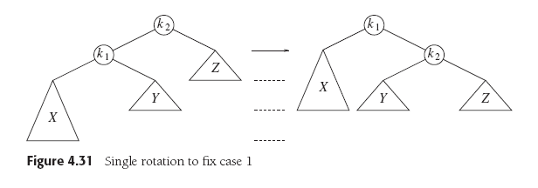
Balancing AVL Trees: Case 1
Case 1 (outside left-left): Rebalance with a single right rotation.
Data Structures and Algorithms in Java, 3rd ed.
by Mark Allen Weiss
Pearson Education, Inc., 2012

Slide 10
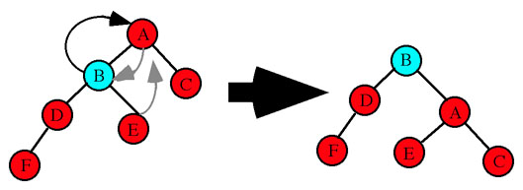
Balancing AVL Trees: Case 1, cont’d
Case 1 (outside left-left): Rebalance with a single right rotation.
Node A is unbalanced.
Single right rotation: A's left
child B becomes the new
root of the subtree.
Node A becomes the right
child and adopts B's right child
as its new left child.
Node 8 is unbalanced.
Single right rotation: 8's left
child 7 becomes the new
root of the subtree.
Node 8 is the right child.
http://www.cs.uah.edu/~rcoleman/CS221/Trees/AVLTree.html
Data Structures and Algorithms in Java, 3rd ed.
by Mark Allen Weiss
Pearson Education, Inc., 2012

Slide 11
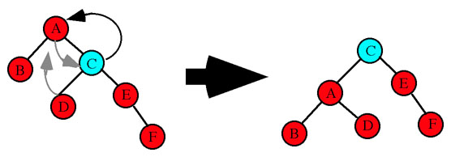
Balancing AVL Trees: Case 4
Case 4 (outside right-right): Rebalance with a single left rotation.
Data Structures and Algorithms in Java, 3rd ed.
by Mark Allen Weiss
Pearson Education, Inc., 2012
Node A is unbalanced.
Single left rotation: A's right
child C becomes the new
root of the subtree.
Node A becomes the left
child and adopts C's left child
as its new right child.
http://www.cs.uah.edu/~rcoleman/CS221/Trees/AVLTree.html

Slide 12
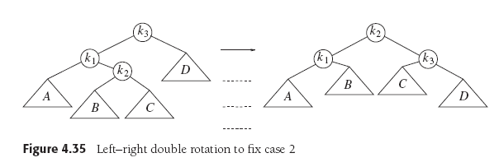
Balancing AVL Trees: Case 2
Case 2 (inside left-right): Rebalance with a double left-right rotation.
Data Structures and Algorithms in Java, 3rd ed.
by Mark Allen Weiss
Pearson Education, Inc., 2012

Slide 13
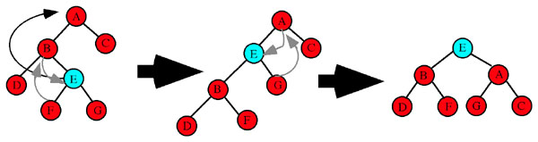
Balancing AVL Trees: Case 2, cont’d
Case 2 (inside left-right): Rebalance with a double left-right rotation.
http://www.cs.uah.edu/~rcoleman/CS221/Trees/AVLTree.html
Node A is unbalanced.
Double left-right rotation: E becomes the new root of the subtree after two rotations. Step 1 is a single left rotation between B and E. E replaces B as the subtree root. B becomes E's left child and B adopts E's left child F as its new right child. Step 2 is a single right rotation between E and A. E replaces A is the subtree root. A becomes E's right child and A adopts E's right child G as its new left child.

Slide 14
Balancing AVL Trees: Case 3
Case 3 (inside right-left): Rebalance with a double right-left rotation.
Data Structures and Algorithms in Java, 3rd ed.
by Mark Allen Weiss
Pearson Education, Inc., 2012

Slide 15
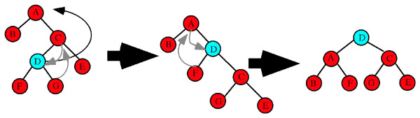
Balancing AVL Trees: Case 3, cont’d
http://www.cs.uah.edu/~rcoleman/CS221/Trees/AVLTree.html
Case 3 (inside right-left): Rebalance with a double right-left rotation.
Node A is unbalanced.
Double right-left rotation: D becomes the new root of the subtree after two rotations. Step 1 is a single right rotation between C and C. D replaces C as the subtree root. C becomes D's right child and C adopts D's right child G as its new left child. Step 2 is a single left rotation between D and A. D replaces A is the subtree root. A becomes D's left child and A adopts D's left child F as its new right child.

Slide 16
AVL Tree Implementation
Since an AVL tree is just a BST with a balance condition, it makes sense to make the AVL tree class a subclass of the BST class.
Both classes can share the same BinaryNode class.
public class AvlTree extends BinarySearchTree

Slide 17
The AVL Tree Node
With so many height calculations, it makes sense to store each node's height in the node itself.
public class BinaryNode
{
private int data; // data in this node
private int height; // height of this node
private BinaryNode left; // left child
private BinaryNode right; // right child
...
}

Slide 18
AVL Tree Implementation, cont’d
Class AVLTree overrides the insert() and remove() methods of class BinarySearchTree.
Each method calls the superclass's method and wraps the result in a call to the balance() method.
protected BinaryNode insert(int data, BinaryNode node)
{
return balance(super.insert(data, node));
}
protected BinaryNode remove(int data, BinaryNode node)
{
return balance(super.remove(data, node));
}

Slide 19
AVL Tree Implementation, cont’d
The private AVLTree method balance() checks whether the balance condition still holds, and rebalances the tree with rotations whenever necessary.

Slide 20
AVL Tree Implementation, cont’d
private BinaryNode balance(BinaryNode node)
{
...
if (height(node.getLeft()) - height(node.getRight()) > 1) {
if (height(node.getLeft().getLeft())
>= height(node.getLeft().getRight())) {
node = singleRightRotation(node);
}
else {
node = doubleLeftRightRotation(node);
}
}
else if (height(node.getRight()) - height(node.getLeft()) > 1) {
if (height(node.getRight().getRight())
>= height(node.getRight().getLeft())) {
node = singleLeftRotation(node);
}
else {
node = doubleRightLeftRotation(node);
}
}
...
return node;
}
Case 1
Case 2
Case 4
Case 3

Slide 21
AVL Tree Implementation, cont’d
private BinaryNode singleRightRotation(BinaryNode k2)
{
BinaryNode k1 = k2.getLeft();
k2.setLeft(k1.getRight());
k1.setRight(k2);
k2.setHeight(Math.max(height(k2.getLeft()), height(k2.getRight())) + 1);
k1.setHeight(Math.max(height(k1.getLeft()), k2.getHeight()) + 1);
return k1;
}
private BinaryNode singleLeftRotation(BinaryNode k1)
{
BinaryNode k2 = k1.getRight();
k1.setRight(k2.getLeft());
k2.setLeft(k1);
k1.setHeight(Math.max(height(k1.getLeft()), height(k1.getRight())) + 1);
k2.setHeight(Math.max(height(k2.getRight()), k1.getHeight()) + 1);
return k2;
}
Case 1
Case 4

Slide 22
AVL Tree Implementation, cont’d
private BinaryNode doubleLeftRightRotation(BinaryNode k3)
{
k3.setLeft(singleLeftRotation(k3.getLeft()));
return singleRightRotation(k3);
}
private BinaryNode doubleRightLeftRotation(BinaryNode k1)
{
k1.setRight(singleRightRotation(k1.getRight()));
return singleLeftRotation(k1);
}
Case 2
Case 3

Slide 23
Break

Slide 24
Assignment #3
This assignment will give you practice with binary search trees (BST) and AVL trees.
You are provided a TreePrinter class that has a print() method that will print any arbitrary binary tree.
A template for how it prints a tree:
xx
/\
------------------------------ ------------------------------
/ \
xx xx
/\ /\
-------------- -------------- -------------- --------------
/ \ / \
xx xx xx xx
/\ /\ /\ /\
------ ------ ------ ------ ------ ------ ------ ------
/ \ / \ / \ / \
xx xx xx xx xx xx xx xx
/\ /\ /\ /\ /\ /\ /\ /\
-- -- -- -- -- -- -- -- -- -- -- -- -- -- -- --
/ \ / \ / \ / \ / \ / \ / \ / \
xx xx xx xx xx xx xx xx xx xx xx xx xx xx xx xx
/\ /\ /\ /\ /\ /\ /\ /\ /\ /\ /\ /\ /\ /\ /\ /\
/ \ / \ / \ / \ / \ / \ / \ / \ / \ / \ / \ / \ / \ / \ / \ / \
xx xx xx xx xx xx xx xx xx xx xx xx xx xx xx xx xx xx xx xx xx xx xx xx xx xx xx xx xx xx xx xx

Slide 25
Assignment #3, cont’d
TreePrinter is able to print trees with height up to 5, i.e., 32 node values on the bottom row.
An example of an actual printed tree:
TreePrinter.java
24
/\
-------------- --------------
/ \
18 73
/\ /\
------ ------ ------ ------
/ \ / \
12 19 38 87
/ /\ \
-- -- -- --
/ / \ \
10 37 41 90
\
\
64

Slide 26
Assignment #3: First Part
The first part of the assignment makes sure that you can successfully insert nodes into, and delete nodes from, a binary search tree (BST) and an AVL tree.

Slide 27
Assignment #3: First Part, cont’d
First generate a random BST that has height 5 and contains random values from 10 through 99.
You may have to generate dozens of trees until you get one that's exactly height 5.
Don't worry that the tree is unbalanced.
Print the tree.
Now repeatedly delete the root of the tree.
Print the tree after each deletion to verify that you did the deletion correctly.
Stop when the tree becomes empty.

Slide 28
Assignment #3: First Part, cont’d
Second, create an AVL tree node by node.
Generate 35 unique random integers 10-99 to insert into the tree.
Print the tree after each insertion to verify that you are keeping it balanced.
Each time you do a rebalancing, print a message indicating which rotation operation and which node.
Example:
As you did with the BST, repeatedly delete the root of your AVL tree.
Print the tree after each deletion to verify that you are keeping it balanced.
Double left-right rotation: 76

Slide 29
Assignment #3: First Part, cont’d
A handy AVL tree balance checker:
private int checkBalance(BinaryNode node) throws Exception
{
if (node == null) return -1;
if (node != null) {
int leftHeight = checkBalance(node.getLeft());
int rightHeight = checkBalance(node.getRight());
if ( (Math.abs(height(node.getLeft()) - height(node.getRight())) > 1)
|| (height(node.getLeft()) != leftHeight)
|| (height(node.getRight()) != rightHeight)) {
throw new Exception("Unbalanced trees.");
}
}
return height(node);
}
Demo

Slide 30
Assignment #3: Second Part
The second part of the assignment compares the performance of a BST vs. an AVL tree.

Slide 31
Assignment #3: Second Part
First, generate n random integers.
n is some large number, explained on the next slide.
Time and print how long it takes to insert the random integers one at a time into an initially empty BST.
Do not print the tree after each insertion.
Time and print how long it takes to insert the same random integers one at a time into an initially empty AVL tree.
Do not print the tree after each insertion.

Slide 32
Assignment #3: Second Part, cont’d
Choose a value of n large enough to give you consistent timings that you can compare.
Try values of n = 1,000 10,000 100,000 1,000,000
If T(n) is the time function, how does the growth of T_{BST}(n) compare with the growth of T_{AVL}(n)?

Slide 33
Assignment #3: Second Part, cont’d
Second, generate k random integers.
k is some large value.
Time how long it takes to search your n-node BST for all k random integers.
It doesn’t matter whether or not the search succeeds.
Time how long it takes to search your n-node AVL tree for the same k random integers.
Compare the grow rates of these two time functions.

Slide 34
Assignment #3: Second Part, cont’d
Third, perform a random mixture of m insertions and searches on your BST and then on your n-node AVL tree.
m is some large number.
Perform the same sequence of insertions and searches on both trees.
Try different ratios of insertions vs. searches.
Empirically estimate the ratio where an AVL tree has better performance than a BST for a mixture of insertions and searches.

Slide 35
Assignment #3, cont’d
You can use any code from the lectures or from the textbook.
You do not have to use parameterized generic types.
You can use raw (nongeneric) types, or <Integer>.

Slide 36
Assignment #3, cont’d
You may choose a partner to work with you on this assignment.
Both of you will receive the same score.
Create a zip file containing:
Your Java source files.
Any instructions on how to build and run your code.
Text files containing your outputs.
A 1- or 2-page that briefly describes your conclusions from doing this assignment.

Slide 37
Assignment #3, cont’d
Email the zip file to ron.mak@sjsu.edu
Subject line: CS 146 Assignment #3: Your Name(s)
If you work with a partner, both of you turn in one assignment.
CC your partner's email address so I can “reply all” to you both.
Due Friday, July 3.

Slide 38
Splay Trees
Not a new type of tree, but a reimplementation of the BST insert, delete, and search methods.
The goal is to improve their performance.
No single operation on a splay tree is guaranteed to have better performance.
But a series of m operations will take O(m log n) time for a tree of n nodes, whenever m > n.
Not highly balanced like an AVL tree.
Lowering the cost of an entire series of operations is more important then keeping the tree balanced.

Slide 39
Splay Trees, cont’d
Whenever a splay tree node is accessed, the tree performs splaying operations that moves the accessed node to the root of the tree.
Splaying a node consists of a series of rotations.
Similar to AVL tree rotations.
The goal is to move the accessed node to the root.
A side benefit is to make the tree more balanced.

Slide 40
Splay Trees, cont’d
The theory is that once a node has been accessed, it will soon be accessed again.
Future accesses are fast if the node is the root.

Slide 41
Splay Trees, cont’d
How is a worst-case BST created ?
When all the nodes are entered in sorted order.
Suppose the bottom node is accessed in such a tree:
Data Structures and Algorithms in Java, 3rd ed.
by Mark Allen Weiss
Pearson Education, Inc., 2012

Slide 42
Splay Trees, cont’d
If a node hasn’t been accessed in a while, then the next time it’s accessed, you pay the performance penalty of splaying.
But accesses of that node in the near future will be very fast.
And so we amortize the cost of splaying over future operations.

Slide 43
Splay Trees, cont’d
Data Structures and Algorithms in Java, 3rd ed.
by Mark Allen Weiss
Pearson Education, Inc., 2012

Slide 44
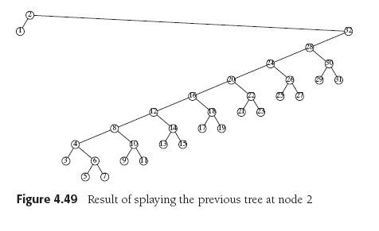
Splay Trees, cont’d
Data Structures and Algorithms in Java, 3rd ed.
by Mark Allen Weiss
Pearson Education, Inc., 2012

Slide 45
Splay Trees, cont’d
Data Structures and Algorithms in Java, 3rd ed.
by Mark Allen Weiss
Pearson Education, Inc., 2012

Slide 46
Splay Trees, cont’d
Data Structures and Algorithms in Java, 3rd ed.
by Mark Allen Weiss
Pearson Education, Inc., 2012

Slide 47
Splay Trees, cont’d
Data Structures and Algorithms in Java, 3rd ed.
by Mark Allen Weiss
Pearson Education, Inc., 2012

Slide 48
Splay Trees, cont’d
Data Structures and Algorithms in Java, 3rd ed.
by Mark Allen Weiss
Pearson Education, Inc., 2012

Slide 49
Splay Trees, cont’d
Data Structures and Algorithms in Java, 3rd ed.
by Mark Allen Weiss
Pearson Education, Inc., 2012

Slide 50
Splay Trees, cont’d
Data Structures and Algorithms in Java, 3rd ed.
by Mark Allen Weiss
Pearson Education, Inc., 2012

Slide 51
Splay Trees, cont’d
Data Structures and Algorithms in Java, 3rd ed.
by Mark Allen Weiss
Pearson Education, Inc., 2012

