Slide 1


CS 146: Data Structures and Algorithms June 23 Class Meeting
Department of Computer Science San Jose State University Summer 2015 Instructor: Ron Mak
www.cs.sjsu.edu/~mak

Slide 2
B-Trees
A B-tree is a tree data structure suitable for disk drives.
It may take up to 11 ms to access data on disk.
Today's modern CPUs can execute billions of instructions per second.
Therefore, it's worth spending a few CPU cycles to reduce the number of disk accesses.
B-trees are often used to implement databases.

Slide 3
Memory/Storage Speed Comparisons
Suppose your computer ran at human speeds.
1 CPU cycle: 1 second
Then the time to retrieve one byte from:
SRAM
5 seconds
DRAM
2 minutes
Flash
1 day
Hard drive
2 months
Tape
1,000 years

Slide 4
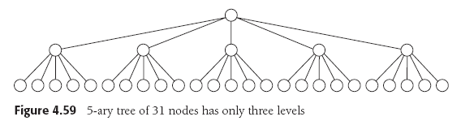
B-Trees, cont’d
A B-tree is an m-ary tree.
Data Structures and Algorithms in Java, 3rd ed.
by Mark Allen Weiss
Pearson Education, Inc., 2012

Slide 5
B-Trees, cont’d
A B-tree of order 5 for a disk drive:
Data Structures and Algorithms in Java, 3rd ed.
by Mark Allen Weiss
Pearson Education, Inc., 2012

Slide 6
B-Tree Insertion of 57
Data Structures and Algorithms in Java, 3rd ed.
by Mark Allen Weiss
Pearson Education, Inc., 2012

Slide 7
B-Tree Insertion of 55
Data Structures and Algorithms in Java, 3rd ed.
by Mark Allen Weiss
Pearson Education, Inc., 2012

Slide 8
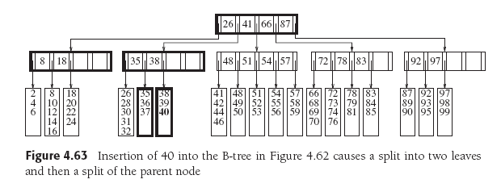
B-Tree Insertion of 40
Data Structures and Algorithms in Java, 3rd ed.
by Mark Allen Weiss
Pearson Education, Inc., 2012

Slide 9
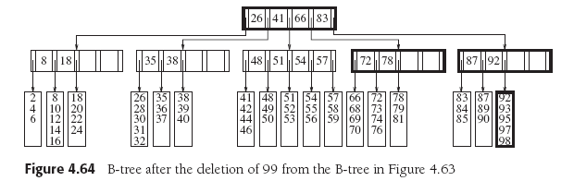
B-Tree Deletion of 99
Data Structures and Algorithms in Java, 3rd ed.
by Mark Allen Weiss
Pearson Education, Inc., 2012

Slide 10
How to Eliminate a Summation
How to solve ?
(a)
(b)
Subtract (a) – (b).

Slide 11
A Harmonic Number
See page 5 of the textbook!

Slide 12
OK, But Can You Prove It?
Intuitively, we know that an operation on a binary search tree (search, insert, delete) of N nodes should take O(log N) time.
For a specific node at depth d, each operation should take O(d) time.
Therefore, we can prove that the average-case running time of a BST operation is O(log N) if we can prove that the average depth over all the nodes of a BST is O(log N).
Remember that logs
in computer science
are base 2 by default.

Slide 13
Proof that the Average Depth is O(log N)
Internal path length D(N) is the sum of the depths of all the nodes of a tree with N nodes.
D(1) = 0
A BST of N nodes has a left subtree containing i nodes and a right subtree of N – i – 1 nodes for 0 ≤ i < N.
So we have the recurrence relation
We add the (N – 1) to account that each node in the two subtrees is 1 deeper, and there are N – 1 such nodes. The root of the tree is at depth 0.

Slide 14
Proof that the Average Depth is O(log N)
We can assume that all subtree sizes in a BST are equally likely. Then the average value of both D(i) and D(N – i – 1) is each
We make this substitution twice, and our recurrence relation becomes:
{
N = 1
D(N) =
N > 1

Slide 15
Proof that the Average Depth is O(log N)
To solve:
Drop the insignificant -1 and multiply both sides by N.
How can we eliminate the summation?

Slide 16
Proof that the Average Depth is O(log N)
To solve:
Drop the insignificant -1 and multiply both sides by N.
(a)
First replace N by N-1.
(b)
Then subtract (a) - (b). Remember that (N-1)² = N² -2N + 1. Drop the insignificant +1.
Rearrange terms.

Slide 17
Proof that the Average Depth is O(log N)
Divide through by N(N+1).
Telescope.
Add together.
Many convenient
cancellations of
terms will occur.

Slide 18
Proof that the Average Depth is O(log N)
But (a harmonic number, see p.5 of the textbook).
We started by solving:
And so

Slide 19
Proof that the Average Depth is O(log N)
Therefore, we’ve successfully proven that if D(N) is the sum of the depths of all N nodes in a BST, then the average depth of a node is O(log N).
And therefore, a BST operation should take on average O(log N) time.

Slide 20
Break

Slide 21
The Priority Queue ADT
A priority queue ADT is
Similar to a queue, except that
Items are removed from the queue in priority order.
If lower-numbered items have higher priority, then the operations on a priority queue are:
Insert: Enqueue an item.
Delete minimum: Find and remove the minimum-valued (highest priority) item from the queue.

Slide 22
Priority Queue Implementation
Unsorted list
Insert: Insert at the end of the list.
Delete minimum: Scan the list to find the minimum.
Sorted list
Insert: Insert in the proper position to maintain order.
Delete minimum: Delete from the head of the list.
Binary tree
Inserts and deletes take O(log N) time on average.
Binary heap
Inserts and deletes take O(log N) worst-case time.
No links required!

Slide 23
Binary Heap
A binary heap (or just heap) is a binary tree that is complete.
All levels of the tree are full except possibly for the bottom level which is filled from left to right:
Data Structures and Algorithms in Java, 3rd ed.
by Mark Allen Weiss
Pearson Education, Inc., 2012

Slide 24
Binary Heap
Conceptually, a heap is a binary tree.
But we can implement it as an array.
For any element in array position i:
Left child is at position 2i
Right child is at position 2i + 1
Parent is at position
Data Structures and Algorithms in Java, 3rd ed.
by Mark Allen Weiss
Pearson Education, Inc., 2012

Slide 25
Heap-Order Priority
We want to find the minimum value (highest priority) value quickly.
Make the minimum value always at the root.
Apply this rule also to roots of subtrees.
Weaker rule than for a binary search tree.
Not necessary that values in the left subtree be less than the root value and values in the right subtree be greater than the root value.

Slide 26
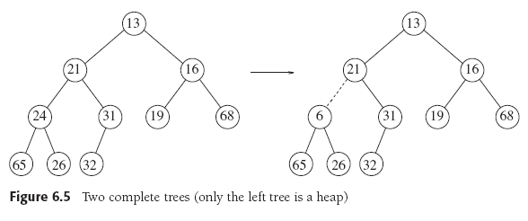
Heap-Order Priority
Data Structures and Algorithms in Java, 3rd ed.
by Mark Allen Weiss
Pearson Education, Inc., 2012

Slide 27
Heap Insertion
Create a hole in the next available position at the bottom of the (conceptual) binary tree.
The tree must remain complete.
The hole is at the end of the implementation array.
While the heap order is violated:
Slide the hole’s parent into the hole.
“Bubble up” the hole towards the root.
The new value percolates up to its correct position.
Insert the new value into the correct position.

Slide 28
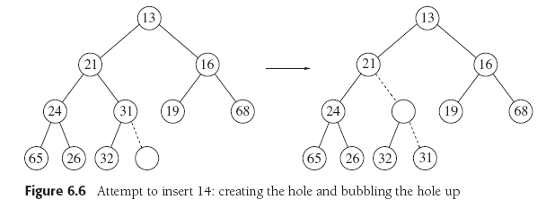
Heap Insertion
Data Structures and Algorithms in Java, 3rd ed.
by Mark Allen Weiss
Pearson Education, Inc., 2012

Slide 29
Heap Insertion
public void insert(AnyType x)
{
if (currentSize == array.length - 1) {
enlargeArray(array.length*2 + 1);
}
// Percolate up.
int hole = ++currentSize;
for (array[0] = x; x.compareTo(array[hole/2]) < 0; hole /= 2) {
array[hole] = array[hole/2];
}
array[hole] = x;
}

Slide 30
Heap Deletion
Delete the root node of the (conceptual) tree.
A hole is created at the root.
The tree must remain complete.
Put the last node of the heap into the hole.
While the heap order is violated:
The hole percolates down.
The last node moves into the hole at the correct position.

Slide 31
Heap Deletion
Data Structures and Algorithms in Java, 3rd ed.
by Mark Allen Weiss
Pearson Education, Inc., 2012

Slide 32
Heap Deletion
public AnyType deleteMin() throws Exception
{
if (isEmpty()) throw new Exception();
AnyType minItem = findMin();
array[1] = array[currentSize--];
percolateDown(1);
return minItem;
}
It’s the root node.
Store the last value
temporarily into the root.

Slide 33
Heap Deletion
private void percolateDown(int hole)
{
int child;
AnyType tmp = array[hole];
for (; hole*2 <= currentSize; hole = child) {
child = hole*2;
if ( (child != currentSize)
&& (array[child + 1].compareTo(array[child])) < 0) {
child++;
}
if (array[child].compareTo(tmp) < 0) {
array[hole] = array[child];
}
else {
break;
}
}
array[hole] = tmp;
}
Percolate the root hole down.
Does the last value fit?

Slide 34
Heap Animation
appletviewer Chap12/Heap/Heap.html

