Slide 1


CS 146: Data Structures and Algorithms July 14 Class Meeting
Department of Computer Science San Jose State University Summer 2015 Instructor: Ron Mak
www.cs.sjsu.edu/~mak

Slide 2
Review of Sorting Algorithms
Insertion sort
Shellsort
Heapsort
Mergesort
Quicksort
What is going on with these sorts?
Demo

Slide 3
Analysis of Quicksort
What is the running time to quicksort a list of N?
Partition the array into two subarrays (constant cN time).
A recursive call on each subarray.
A recurrence relation:
where i is the number of values in the left partition.
{
1 if N = 0 or 1
T(i) + T(N – i –1) + cN if N > 1
T(N) =

Slide 4
Analysis of Quicksort
The performance of quicksort is highly dependent on ...
... the quality of the choice of pivot.

Slide 5
Quicksort: Worst Case Analysis
{
1 if N = 0 or 1
T(i) + T(N – i –1) + cN if N > 1
T(N) =
The pivot is always the smallest value of the partition, and so i = 0.
Telescope:
Add and cancel:

Slide 6
Quicksort: Worst Case Analysis, cont’d
{
1 if N = 0 or 1
T(i) + T(N – i –1) + cN if N > 1
T(N) =
The pivot is always the smallest value of the partition, and so i = 0.
How does this explain the very bad behavior of quicksort when the data is already sorted?

Slide 7
Quicksort: Worst Case Analysis, cont’d
N = 100,000
ALGORITHM MOVES COMPARES MILLISECONDS
Insertion sort 0 99,999 0
Shellsort suboptimal 0 1,500,006 4
Shellsort Knuth 0 967,146 4
Heap sort 1,900,851 3,882,389 12
Merge sort array 3,337,856 853,904 17
Merge sort linked list 1,115,021 815,024 29
Quicksort suboptimal 400,000 5,000,150,000 4,857
Quicksort optimal 400,000 1,968,946 6

Slide 8
Quicksort: Best Case Analysis
{
1 if N = 0 or 1
T(i) + T(N – i –1) + cN if N > 1
T(N) =
The pivot is always the median. Each subarray is the same size.
Add and cancel (there are log N equations):
Divide through by N:
Telescope:
Therefore:

Slide 9
Quicksort: Average Case Analysis
{
1 if N = 0 or 1
T(i) + T(N – i –1) + cN if N > 1
T(N) =
Each size for a subarray after partitioning is equally likely, with probability 1/N:
Since there are
two partitions:
Multiply by N:
(a)
Substitute N by N-1:
(b)
Subtract (a) – (b):

Slide 10
Quicksort: Average Case Analysis
Rearrange and drop the insignificant –c:
Divide through by N(N+1):
Telescope:
Add and cancel

Slide 11
Quicksort: Average Case Analysis
Add and cancel:
Recall the harmonic number:
And so:
Therefore:

Slide 12
Assignment #5
Add heapsort, mergesort, and quicksort to your work for Assignment #4.
Do two versions of mergesort:
Sort an array.
Sort a linked list.
Do two versions of quicksort:
Suboptimal first element as the pivot choice.
Median-of-three pivot choice.

Slide 13
Assignment #5
Total sorts:
Insertion sort
Shellsort (two versions, optimal and suboptimal h sequences)
Heapsort
Mergesort (two versions, array and linked list)
Quicksort (two versions, optimal and suboptimal pivot choices)

Slide 14
Assignment #5, cont’d
For each sort, your program should output:
How much time it took.
Count comparisons it made between two values.
Count moves it made of the values.
Verify that your arrays are properly sorted!
You should output these results in a single table for easy comparison.

Slide 15
Assignment #5, cont’d
You may choose a partner to work with you on this assignment.
Both of you will receive the same score.
Email your answers to ron.mak@sjsu.edu
Subject line: CS 146 Assignment #5: Your Name(s)
CC your partner when you email your solution.
Due Friday, July 24 at 11:59 PM.

Slide 16
Break

Slide 17
A General Lower Bound for Sorting
Any sorting algorithm that uses only comparisons requires Ω(N log N) comparisons in the worst case.
Prove: Any sorting algorithm that uses only comparisons requires comparisons in the worst case and log(N!) comparisons on average.
log(N!) = Ω(N log N)

Slide 18
A General Lower Bound for Sorting, cont’d
Every sorting algorithm that uses only comparisons can be represented by a decision tree.
The number of comparisons is equal to the depth of the deepest leaf.
How many
possible
combinations
for 3 elements?
3!
Data Structures and Algorithms in Java, 3rd ed.
by Mark Allen Weiss
Pearson Education, Inc., 2012

Slide 19
Some Decision Tree Properties
A binary tree of depth d has at most 2^{d} leaves.
A binary tree with L leaves must have depth at least .
Any sorting algorithm that uses only comparisons between elements requires at least comparisons in the worst case.
A decision tree to sort N elements must have N! leaves.

Slide 20
A General Lower Bound for Sorting, cont’d
Prove: Any sorting algorithm that uses only comparisons between elements requires Ω(N log N) comparisons.

Slide 21
A General Lower Bound for Sorting
Delete the first half of the terms:
Replace each remaining term by the smallest one, log(N/2):
There are N/2 of these log(N/2) terms:
Therefore:

Slide 22
A General Lower Bound for Sorting
Therefore, you cannot devise a sorting algorithm based on comparing elements that will be faster than Ω(N log N) in the worst case.

Slide 23
Bucket Sort and Radix Sort
Bucket sorting relies on using a number of bins, or buckets, into which the values to be sorted are entered.
Sorting time is linear rather than O(N log N).
Does not rely on comparisons.
A form of bucket sort is the radix sort.
Used to sort values each of which has a limited number of characters.
Example: 3-digit numbers.
Radix sort was used by the old electromechanical IBM card sorters to sort punched cards.

Slide 24
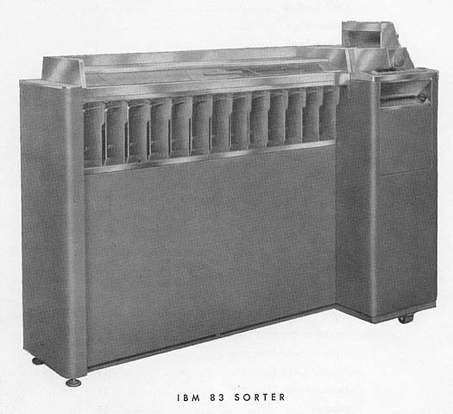
IBM 083 Card Sorter
1950s vacuum-tube and mechanical technology.
Sorted up to 1000 cards per minute.

Slide 25
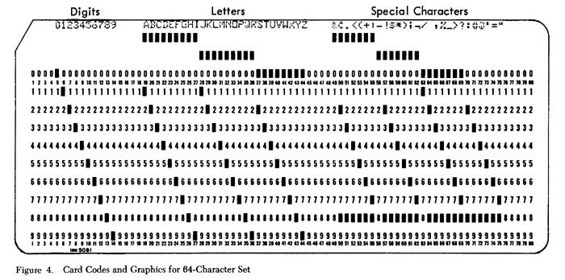
IBM 083 Card Sorter
A punched card had up to 12 punches per column, numbered 0-9 and 11 and 12.
The card sorter had 12 bins (plus a reject bin).

Slide 26
IBM 083 Card Sorter
How to sort cards punched with 3-digit numbers (in the same columns):
First sort on the units digit.
Each card drops into the appropriate bin based on the units digit.
Carefully remove the cards from the bins, keeping them in order.
Next sort on the tens digit.
Each card drops into the appropriate bin based on the 10s digit.
Carefully remove the cards from the bins, keeping them in order.
Finally sort on the hundreds digit.
Each card drops into the appropriate bin based on the 100s digit.
Carefully remove the cards from the bins, keeping them in order.

Slide 27
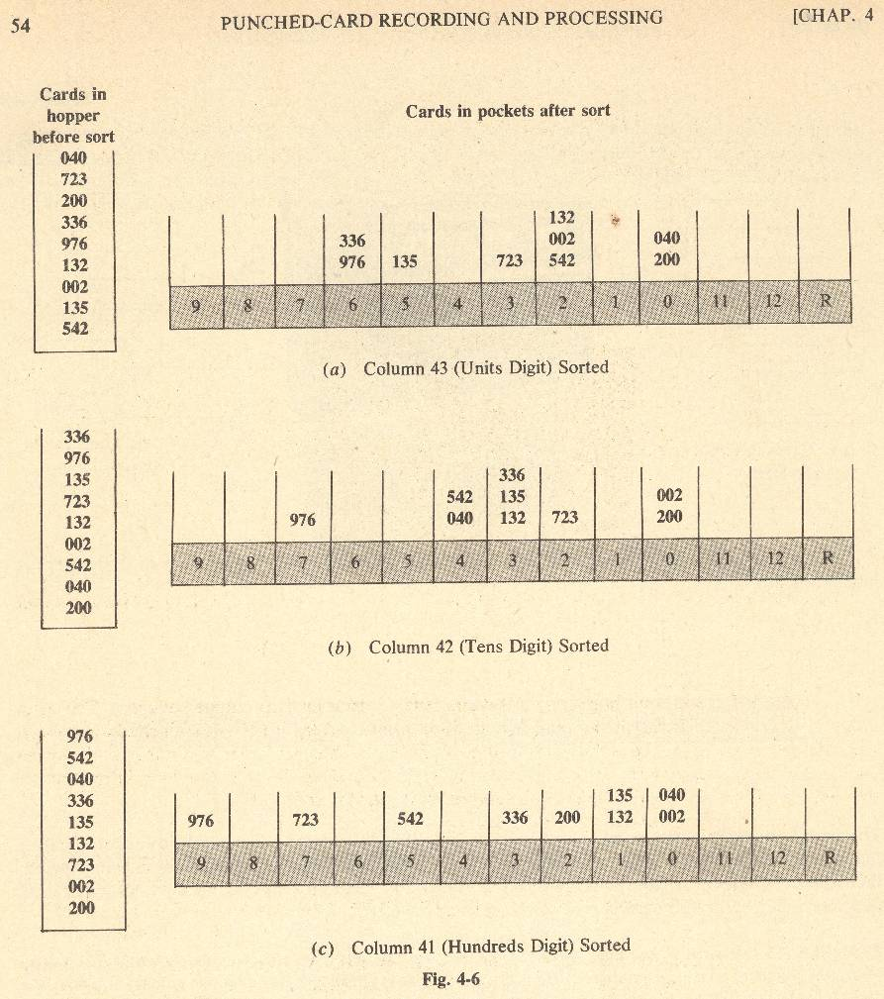
Radix sorting with an old
electromechanical
punched card sorter.

Slide 28

Magnetic Tape Sorting
Magnetic tape can be read and written in one direction only.
You can also rewind a tape.

Slide 29
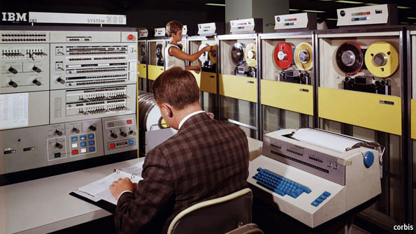
Magnetic Tape Sorting, cont’d

Slide 30
Magnetic Tape Sorting, cont’d
Suppose you have data you want to sort.
The data records initially all reside on one magnetic tape.
You have 4 tape drives and 3 blank tapes.
The computer memory can hold and sort 3 data records at a time.
Perform an external merge sort.

Slide 31
Magnetic Tape Sorting, cont’d
T1 | 81 94 11 96 12 35 17 99 28 58 41 75 15
T2
T3
T4
Can you follow
what’s happening?
T1
T2
T3
T4
11 81 94
17 28 99
15
12 35 96
41 58 73
T1
T2
T3
T4
11 12 35 81 94 96
15
17 28 41 58 75 99

Slide 32
Magnetic Tape Sorting, cont’d
T1 | 11 12 35 81 94 96 15
T2 | 17 28 41 58 75 99
T3
T4
T1
T2
T3
T4
11 12 17 28 35 41 58 75 81 94 96 99
15
T1
T2
T3
T4
11 12 15 17 28 35 41 58 75 81 94 96 99

