Slide 1
Bluetooth low energy (BLE)
www.ti.com/ble

Slide 2
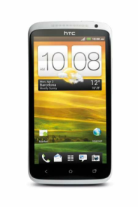
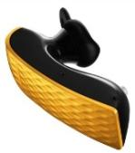
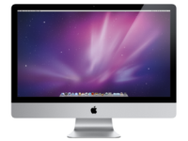
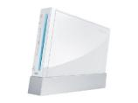

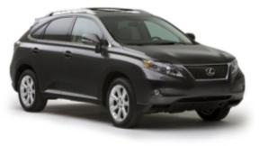
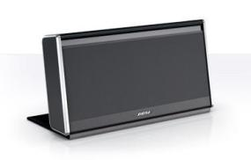
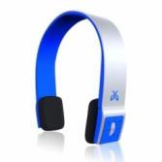
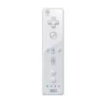

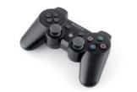
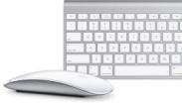
Bluetooth – The 1st Wave
Point-to-point solutions
Wireless audio was the main application
7 billion Bluetooth enabled devices
Focus on cable replacement

Slide 3
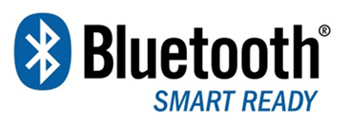
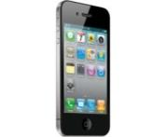
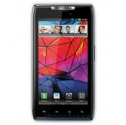
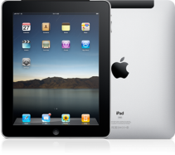
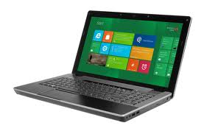
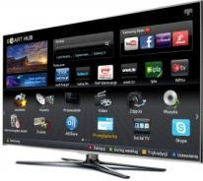
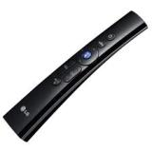
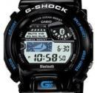
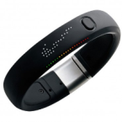
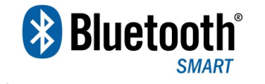

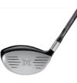

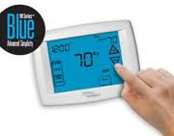
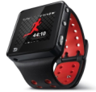
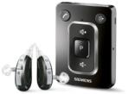
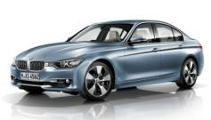
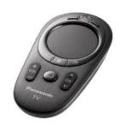
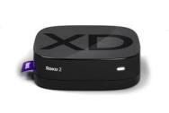
Bluetooth low energy – 2nd Wave
Billions of Bluetooth Smart Ready devices turning data into information through apps
Mobile Phones
Tablets
Personal Computers
Connected Televisions
New Applications
Lower cost. Lower power
Billions of Bluetooth Smart & Classic Bluetooth devices securely sending data
Health & Fitness
Automotive
Consumer Electronics
Smart Home/Energy

Slide 4

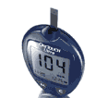
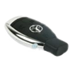
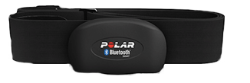

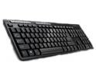
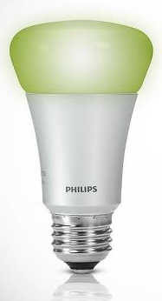

Bluetooth low energy target markets
Proximity tag
Health / Fitness
Medical
Automotive
Heart-rate
Speed/Cadence
Watches
Remote-Keyless-Entry
Tire Pressure
Non-critical sensors
Find-me
Locationing
Thermometer
Blood-Glucose-Meter
Remote control
Keyboard and Mouse
Toys
Home Automation
Simple RC
Motion RC RC+keyboard
Keyboard
Mouse
Toys
Professional toys
Lighting
Home Automation

Slide 5
Projected Growth by Market
Automotive
Health & Wellness
PC & Peripherals
Mobile Telephone
Sports & Fitness
Consumer Electronics
34.5 million Bluetooth enabled set-top boxes will ship by 2015 (ABI)
Shipments of Bluetooth v4.0 handsets will exceed 370 million units by end of 2012 (IMS Research)
Bluetooth technology in consumer health devices to exceed 200 million IC shipments in 2015 (IMS Research)
128 million Bluetooth v4.0 laptops will ship in 2013; tablet sales will approach 250 million units by 2017 (ABI)
Over 60 million Bluetooth enabled sports, fitness and health devices will be shipped between 2010 and 2015 (IMS Research)
70 percent of all new vehicles will have Bluetooth connectivity by 2016 (Strategy Analytics)

Slide 6
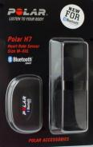
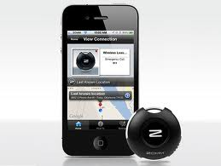
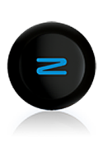

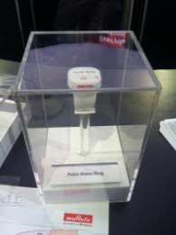
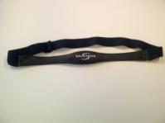
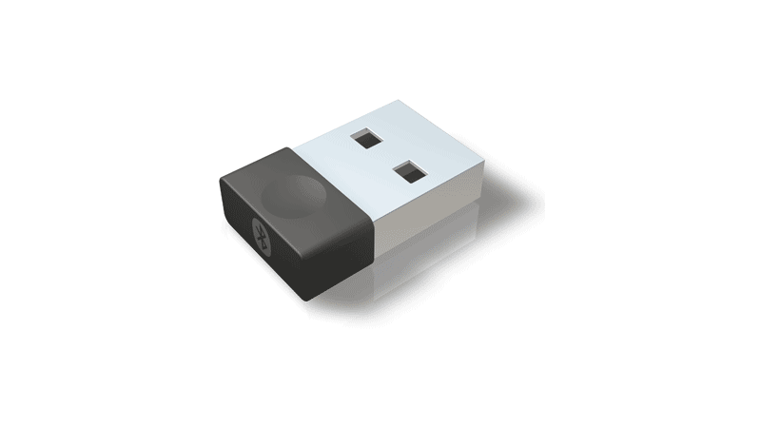
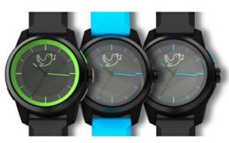
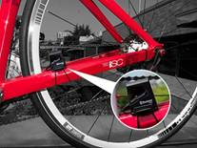
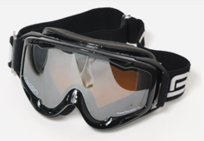
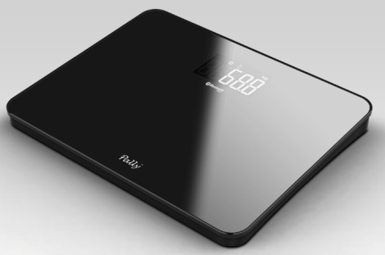
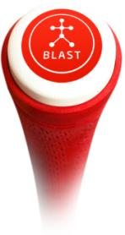
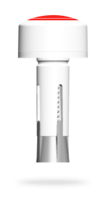
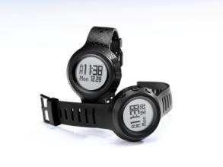
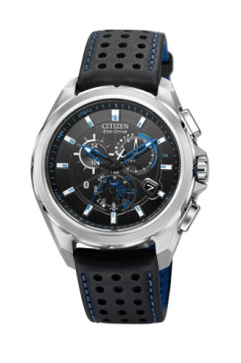
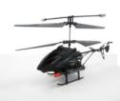
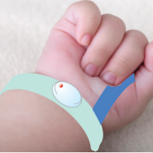
TI Bluetooth low energy enabled Products
Murata
Polar
Salutron
ZOMM
Schneider
Bluetrek
SoundOfMotion
Recon
Ace Sensor
Blast Motion
IDT
Griffin
MonBaby
Citizen
Notes:
Murata Module
Polar HRM
Salutron HRM, watch
ZOMM Proximity tag
Schneider Proximity tag, tag, BLE dev kit
Bluetrek Watch
SoundOfMotion Cycle sensors
Recon Remote control for goggles
Blastmotion Golf trainer
IDT Sports watch
Griffin Toys
MonBaby Baby Monitor

Slide 7

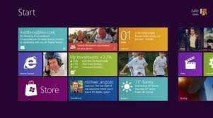
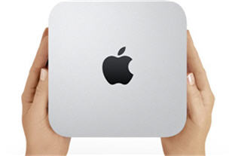


Bluetooth Smart Ready Devices
Bluetooth Smart Ready devices are phones, tablets, PCs and TVs that sit at the center of the consumers’ connected world.
Bluetooth Smart Ready devices:
MUST
Be built to Bluetooth v4.0 specifications w/ GATT-based architecture
Feature a dual-mode low energy and classic radio
Allow for the device software to be updated by the consumer
SHOULD
Provide a way for third-parties to create applications that can be loaded onto the device

Slide 8




Bluetooth Smart Devices
Bluetooth Smart devices are designed to gather specific types of information – are all the windows on my house locked, what is my insulin level, how much do I weigh? – and send it to a Bluetooth Smart Ready device.
Bluetooth Smart devices
MUST:
Be built to Bluetooth v4.0 specifications w/ GATT-based architecture
Feature a single mode low energy radio

Slide 9



Bluetooth low energy Benefits
Low power consumption
Easy to connect
Low solution cost

Slide 10








TI Bluetooth low energy offering
HW
SW
Royalty free, in-house BLE-stack
Broadest range of certified profiles
BLEv1.3 – OAD (Dec 2012)
CC2540
Flash SoC
USB
CC2541
Flash SoC I2C
CC2541S
Flash WNP
Development tools and reference designs
CC2540DK-Mini
CC2541DK-MINI Q4 2012
USB dongles
Remote Control
Motion RC ref.des
Sensor kit
(CC2541DK-SENSOR)

Slide 11
Kits / Tools

Slide 12








TI CC2540DK-MINI Kit
Debugger
Works with CC2540 Keyfob and USB dongle
Supports IAR and TI flash programmer
CC2540 Keyfob
Powered by CR2032 coin cell battery
LED, buttons, buzzer, accelerometer
Usually acts as peripheral, application is on chip.
USB Dongle
Use Btool.exe to or custom app to send HCI commands.
Usually acts as master (cell phone)
Power Meas.
App Note
Sniffer
IAR Workbench
BTool
Flash
Programmer

Slide 13





Sensor Tag – Bluetooth low energy made easy!
6 sensors + buttons/LEDs available in TI BLE sensor tag!
+
+
TI BLE sensor tag
iOS reference app on Appstore
iOS device with Bluetooth low energy
= app possibilities
IR temp
humidity
pressure
accelerometer
gyroscope
magnetometer
Buttons/LEDs

Slide 14





So what can YOU create?
TMP006 Temperature Sensor
Humidity Sensor
Pressure Sensor
Accelerometer
Gyroscope
Magnetometer/
Compass

Slide 15

How can YOU create?
CC2541 Bluetooth low energy development kit
6 sensors (temperature, humidity, pressure, accelerometer, gyroscope and magnetometer) available
Years of battery life on a single coin cell battery
Compact solution - 36x66x15.5 mm (including plastic enclosure)
Focus on App developers
All sensors can individually be controlled from the smartphone/tablet – we make RF easy
No embedded SW knowledge needed
App available from the App Store to demonstrate the use of all the sensors
iOS available today, Android support will follow in 2013
FCC, IC and ETSI certified solution
Qualified as if it was an end product
Notes:
No embedded SW design knowledge required, the setup of sensors are done with commands directly from the smart phone

Slide 16


How can YOU create?

Slide 17


Bluetooth low energy SensorTag - Hardware
Compass
Pressure sensor
IR Temperature
sensor
Accelerometer
Gyroscope
Interface Connector
For EZ430 battery packs
(optional)
User
Buttons
Debug Header
MCU + BLE Transciever
Airflow for
Humidity Sensor
LEDs
DCDC
Converter
PCB Antenna
CR2032 Coincell
Battery Holder
Pairing Button
Humidity sensor

