Slide 1
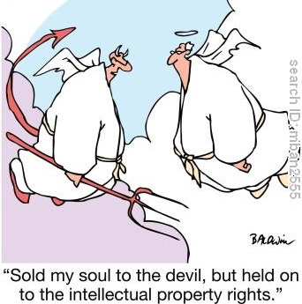
Intellectual Property
CS110: Computer Science and the Internet
Notes:
http://www.petervaldivia.com/technology/networks/index.php

Slide 2
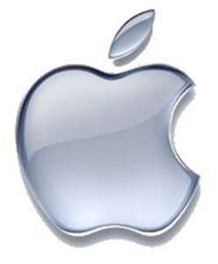
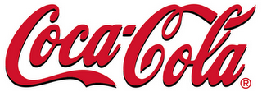
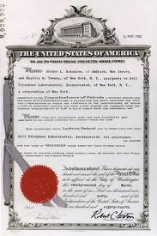
Intellectual property areas
Trademarks
Recognizable mark of a company
Famous marks are registered and watched by web crawlers
Patents
Issued after careful review of prior work
Copyright
Assume everything on the web is copyrighted
Notes:
The results of intellectual work are covered by three distinctly different legal areas:
A trademark is the recognizable mark that a company has made to market its products. It is not only the name of the product that is covered by the trademark (e.g., Coca Cola), but also the shape (e.g., the recognizable Coca Cola bottle shape, or the font of the Coca Cola name used on the product). This means that one cannot create, say, LTCola and have it bottled in a Coca Cola-shaped bottle or have its name written with a Coca Cola-looking type of font. All famous marks are registered and watched by webcrawlers.
The work of an inventor is covered by a patent. A patent is issued after careful review by the patent office, which must be persuaded that the work described in the patent is not a trivial extension of an existing work (“prior art”).
In your project, it is not likely that you will produce or infringe upon a patent. You might violate a trademark if, for example, you decide to have the picture of a a Coca Cola bottle on your page or you use the same font, color, and style to write something. What you need to pay particular attention, though, is on the Copyright Law.

Slide 3
Copyright basics
What is copyrightable?
Original work of authorship that is fixed in a tangible medium
Copyright is automatic – © symbol is advised but not required
Ignorance is no defense against copyright infringement
Not copyrightable: Facts, ideas, public domain information
Who owns the copyright?
author, publisher, artist, photographer, performer, composer, programmer, company, you…
How long does the copyright last?
by author: life +70 years
by employer: 95 years from publication or 125 from creation
Notes:
To get preliminary understanding of copyright law we need to first answer 3 questions:
Note that copyright applies to things, in the sense that your creative endeavor has to be fixed in some medium: paper, videotape or whatever. You can't copyright an idea; that idea has to be expressed somehow.
The movie industry got the copyright law extended so that the movies that were released in the 1920s, where the copyright was about to expire, are still copyrighted. Now the copyright is held by the employer for 95 years since publication or 125(!) years from creation.
When a work is no longer copyrighted, it is in the public domain and therefore is owned by society in general. This is where society really benefits from the new works created by copyright law. Once something is in the public domain, the author no longer has any rights and anyone can do with it what they want. For example, someone wrote West Side Story without having to pay any royalties to Shakespeare's estate, because Romeo and Juliet is now in the public domain. Similarly, anyone can perform the works of J. S. Bach, because he's been dead for more than 70 years.

Slide 4
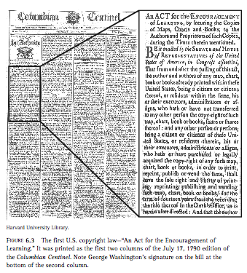
5 rights of the copyright holder
To reproduce
To prepare derivative work
To distribute
To display publicly
To perform publicly
Purpose of copyright:
Article I, Section 8, Clause 8, gave Congress the power:
“To promote the progress of science and useful arts, by securing for limited times to authors and inventors the exclusive right to their respective writings and discoveries.”
Notes:
Copyright is about the rights of the author, artist, or creator. What rights does an author have?
Under this Act, additional works made in 1923 or afterwards that were still protected by copyright in 1998 will not enter the public domain until 2019 or afterward
Suppose you're the author of a novel. You can:Reproduce copies of the work. In other words, you can print up 100,000 copies of your novel to sell, but no one else can.Prepare derivative works. You can write a sequel to your novel, a different version (maybe with a different ending) and so forth, but no one else can.Distribute copies. You can sell or give away the copies that you made, but if you decide to keep them all in your attic, no one else can give them away for you.Publicly perform it. Suppose instead of a novel, you've written a play. You can decide who can and cannot perform your play.Publicly display it. Suppose instead of a novel, you've painted a painting: you can control whether it is displayed in a gallery or stays under your bed.Of course, as the owner of the copyright, you can decide to sell or lease the rights, piecemeal or in total, to other people. Musicians often sell their rights to the record company. Sometimes in the fine print at the end of a movie, you'll see “for the purposes of copyright, the owner of this film is Paramount Pictures, Inc.”
Lets talk about fanfiction and fan art.

Slide 5
Fair use: Exemption to copyright monopoly
The right of the public to reproduce and distribute without permission for:
Criticism and commentary
News reporting
Teaching, scholarship, research
Home use
Fair use is not granted automatically!
Determining fair use is subject to a four-factor test:
Non-profit vs. commercial use
Number of copies made
Amount of text copied
Effect on market potential
Notes:
In creating and enforcing IPRs, then, we must carefully balance the need for creation incentives versus the need for later creators to build on past creations
We must resist the temptation to analogize information to tangible property
Information is not a zero-sum game
Protection of information is economically inefficient, but for the need for creation incentives
Notions of “fairness” or “natural rights,” while highly emotive, should not play much, if any, role in analyzing either the existence or the scope of IPRs
The effect of the use on the potential market of the copyrighted work. This factor is the key factor from which the others are derived. If your use significantly reduces the potential revenues an author gets from the work, the court may rule against you. People sometimes forget this when they say “but I'm not making any money!” In fact, no one really cares whether you're making any money. The author cares about whether your use is depriving her of money. If you use your CD burner to give away free copies of Britney Spears's latest oeuvre, you're depriving her of sales, even though you don't make a dime.

Slide 6
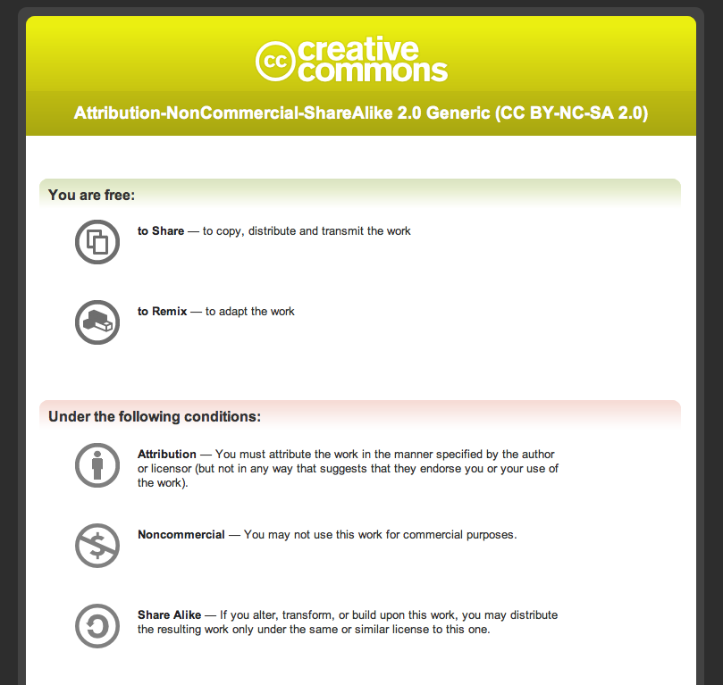
Share, Remix, Reuse — Legally
Notes:
Copyright was created long before the emergence of the Internet, and can make it hard to legally perform actions we take for granted on the network: copy, paste, edit source, and post to the Web. The default setting of copyright law requires all of these actions to have explicit permission, granted in advance, whether you’re an artist, teacher, scientist, librarian, policymaker, or just a regular user. To achieve the vision of universal access, someone needed to provide a free, public, and standardized infrastructure that creates a balance between the reality of the Internet and the reality of copyright laws. That someone is Creative Commons.

Slide 7
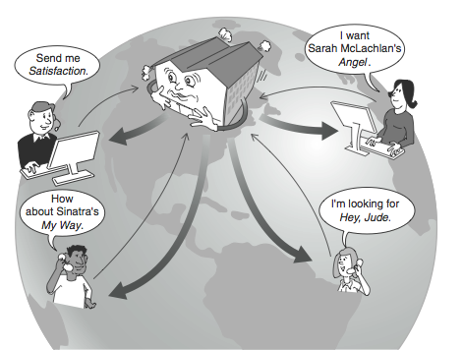
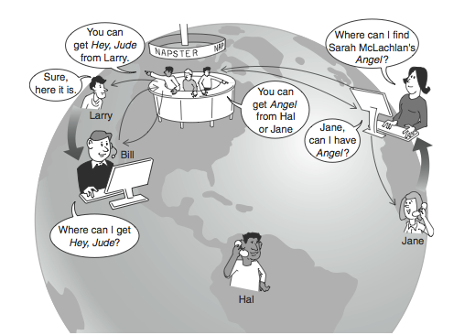
Types of Infringement: the Napster case
HTTP protocol
- central web server
Napster:
P2P (Peer to Peer) protocol
every client is a server
no central web server
Notes:
Napster was founded byShawn Fanning and his uncle John Fanning while the former was attending Northeastern University in Boston. Note that despite representations in the movie "The Social Network" and elsewhere, Sean Parker was not a co-founder of Napster but rather an early employee.[1] At its founding, it was envisioned as an independent peer-to-peer file sharing service that was known for the free online music it offered. The service, named after Fanning's hairstyle-based nickname, operated between June 1999 and July 2001.[2]
Its technology allowed people to easily share their MP3 files with other participants, bypassing the established market for such songs and thus leading to massive copyright violations of music and film media as well as other intellectual property. Although the original service was shut down by court order, it paved the way for decentralized peer-to-peer file distribution programs, which have been much harder to control. Napster's brand and logo were purchased after the company closed its doors and continue to be used by a pay service. John and Shawn Fanning released the original Napster in June 1999.[3] Fanning wanted an easier method of finding music than by searching IRC or Lycos. John Fanning of Hull, Massachusetts was the founding Chairman and CEO and ran all aspects of the company's operations from the launch from his office on Nantasket Beach. The final agreement gave Shawn 30% control of the company, with the rest going to his uncle. It was the first of the massively popular peer-to-peer file distribution systems, although it was not fully peer-to-peer since it used central servers to maintain lists of connected systems and the files they provided, while actual transactions were conducted directly between machines.

Slide 8
Napster vs. HTTP
Technically
Culturally
More efficient – no server overload
More reliable – many machines could crash and the system will operate fine
Only maintains a directory of files, stores no files at all!
“The universal juke box”
Napster parties
26M users in 2 years
26M copyright violators?
Judge finds Napster guilty of secondary copyright infringement:
Enabling others to infringe and not preventing them

Slide 9
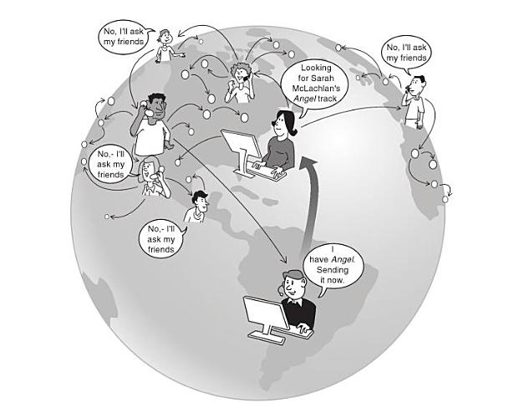
Napster is dead: Long live Napster
2000: Grockster, Morpheus, Kazaa – no central directory

Slide 10
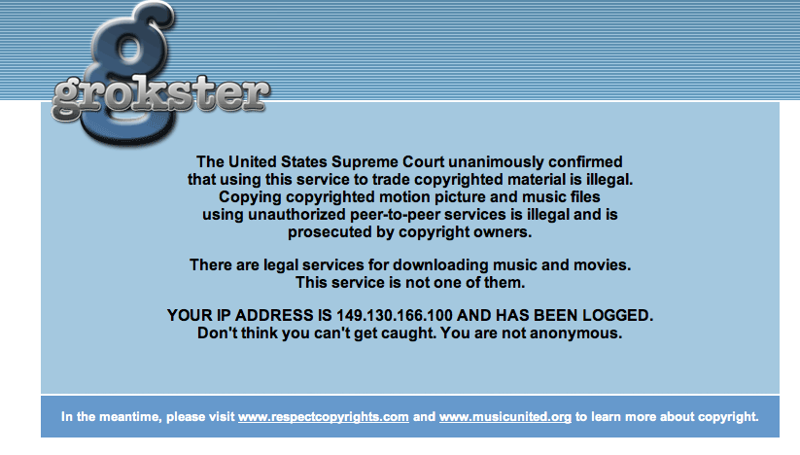
RIAA vs. Grockster 2005, Supreme Court: “The question is under what circumstances the distributor of a product capable of both lawful and unlawful use is liable for acts of copyright infringement by third parties using the product. We hold that one who distributes a device with the object of promoting its use to infringe copyright, as shown by clear expression or other affirmative steps taken to foster infringement, is liable for the resulting acts of infringement by third parties.”
Notes:
RIAA record industry association of america

Slide 11
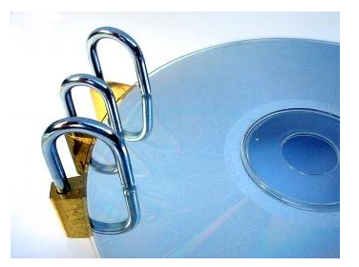
Digital Rights Management
Technical and legal methods to protect copyright of digital information
- e.g. software or hardware to “prevent” copying, via encryption
Security researcher:
“Digital files cannot be made uncopyable, any more than water can be made not wet”
Asserting control beyond the bounds of copyright law?
Notes:
Copying digital information is extremely easy. This encourages people to freely share digital music, videos, books, software, etc., even though such sharing may violate copyright laws.
Digital Rights Management (DRM) refers to technological and legal methods of protecting the copyright of digital information.
On the technology side, digital information may be associated with "copy protection" or "content protection" systems that try to prevent the information from being copied. For example, some distributors of digital music use a combination of DRM information in music files and DRM software in the music players to limit the number of times the music file can be copied or played or the duration of time in which it can be played. Software available for trial download uses DRM to ensure that the software can't be used after the trial period expires. DVD video discs use a Content Scramble System (CSS) to encrypt the contents of the discs as an attempt to prevent the discs from being copied or being played by devices not licensed by the DVD Copy Control Association.Software-only approaches to DRM can be circumvented by skilled technologists, who often publish descriptions of how to circumvent the DRM or applications that circumvent the DRM. In response, the computer industry has developed hardware-assisted approaches to Trusted Computing, whose goal is to prevent uncertified programs from manipulating copyrighted digital information. A popular incarnation of this idea is the Trusted Platform Module (TPM), a chip that uses cryptography to verify that the operating system and applications manipulating the DRM-protected digital information have not been compromised. This chip is also known as the "Fritz chip" after former Senator Ernest "Fritz" Hollings, who championed its adoption. Many computers sold today are equipped with a Fritz chip.Because many forms of digital information must ultimately be converted to analog forms in order to be displayed, DRM systems suffer from an analog hole that fundamentally limits their efficacy.

