Slide 1

Encryption
CS110: Computer Science and the Internet
Notes:
Encryption is the art of encoding messages so they can’t be understood by eavesdropper or adversaries.
An encrypted message may be visible to the world (think about a postcard) but one can’t read read it unless she has a key that shows how to descramble the message.
Think about a box that contains a message. The content is secret unless you have a box?
Why are we going to talk about encryption in CS110?
Anyone using the internet for commerce needed the protection of encryption. Consumers don’t want their credit card numbers birthdates and ssn exposed on the internet. Bits move like postcards and anyone can examine and analyze messages unless they are encrypted.
http://computer.howstuffworks.com/vpn7.htm

Slide 2
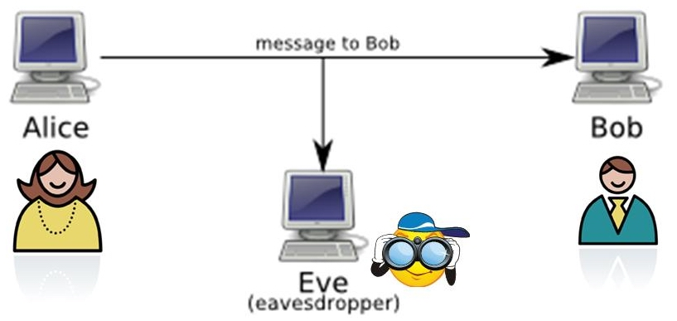
Encryption and security
Notes:
Encryption allows machines to communicate in a secure way. Traditionally when we introduce methods of encryption, we consider the following cast of characters :Alice, who wants to say something privately to Bob, Bob, who wants to hear from AliceEve, the person who is trying to eavesdrop on their conversation Messages may be sent by radio, phone, email or carrier pigeon. All media are potentially insecure - radio waves can be picked up by other receivers, phone wires and computer networks can be tapped, and carrier pigeons can be captured.
Alice an agent try to convince bob to defect, eve is an eavesdropper looking for traitors.

Slide 3
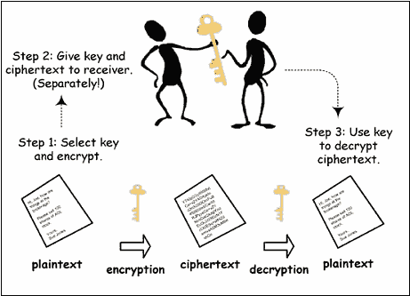
Ciphers
Encryption terminology:
plaintext: message to be sent, in readable form
ciphertext: message in coded form, unreadable without a key
encrypt: turn plaintext into ciphertext
decrypt: turn ciphertext back into plaintext
cryptanalysis: cracking a code without the required special information
cryptography: study of codes and code-breaking
Notes:
Ciphers One approach to secure communication is to put the message in code. Code-making and code-breaking have a long history - some notable examples:Julius Caesar used so-called Caesar Codes to communicate with his troopsAlan Turing and his code-breakers in England were able to break the codes sent by the Germans with the Enigma machine in WWII, Navajo Indians used their native language as an unbreakable code in the war in the PacificEncryption terminology:plaintext: message to be sent, in readable formciphertext: message in coded form, unreadable without special information such as a keyencrypt: turn plaintext into ciphertextdecrypt: turn ciphertext back into plaintextcryptanalysis: cracking a code - attempting to decrypt without the required special informationcryptography: study of codes and code-breaking

Slide 4
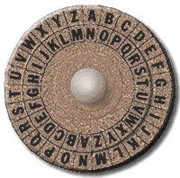
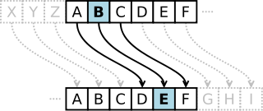
Caesar ciphers
The idea behind Caesar ciphers is letter substitution
One strategy uses rotation
Substitution codes are easy to break
One strategy uses letter frequencies
Notes:
The idea behind substitution is replacing each letter with another symbol.
One substititution strategy is rotation. turn the inner wheel and then replace the outer letters (plaintext) with those in the inner wheel (ciphertext):

Slide 5
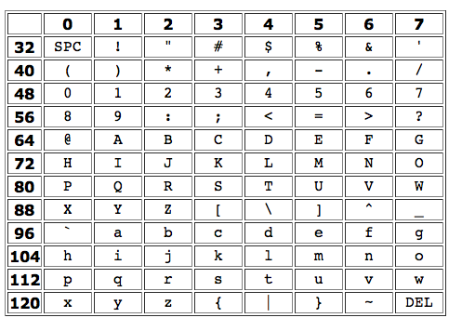
How can we implement a Caesar cipher using the ASCII table?
Notes:
Earlier, we ignored punctuation and anything other than a letter. Obviously, that makes for a bad code. What we really should do is treat all characters the same. How is this done? First, we have to say what a character is.As you know, everything in a computer is just numbers. How does it deal with characters? Essentially, early computer designers agreed on a set of characters and a standard numbering for each one. For example, A is a 65. One such system was ASCII: American Standard Code for Information Interchange. Here's part of the ASCII code:

Slide 6
Vigenere cipher: Multiple Caesar ciphers
Using a Vigenere cipher to encrypt a message:
Select a keyword (e.g. CAT)
Convert the letters of the keyword to a sequence of rotations, each in the range from 0 to 25 (e.g. "CAT" is converted to the rotation sequence 2-0-19)
Use the sequence of rotations to encode successive letters of the message, repeatedly cycling through the rotations
(e.g. 2-0-19-2-0-19-2-0-19...)
Unbreakable for 300 years!
Notes:
Caesar ciphers are relatively easy to break, as is any cipher based just on substitution of letters. For example, the most common letter in the ciphertext is probably the encypted form of a very common letter, such as “e” or “t” or “a”. With more sophisticated statistics, and trial and error, both of which computers are good at, it's fairly easy to crack a substitution cipher.
One way to spoil the statistics of a Caesar cipher is to use multiple Caesar ciphers. In other words, suppose we rotate the first letter of the plaintext by 2, the second letter by 0, and the third letter by 19. Then we repeat, rotating by 2, 0, 19, until we're done with the plaintext. Such a technique is called a Vigenere Cipher, named for its inventor, Blaise de Vigenere from the court of Henry III of France in the sixteenth century. It was considered unbreakable for some 300 years!Another way to think of the Vigenere Cipher is as follows. Write down a keyword, such as “cat”. Then, use the index of each letter as the amount to rotate. For example, if the keyword is “cat”, then we will use a 2 rotation, a 0 rotation, and a 19 rotation (“t” is the 19th letter of the alphabet if you start from zero: “A” is the 0th letter). Write down the keyword above the plaintext and use it to select the correct rotation. It helps to have a table of all the rotations:

Slide 7
Private key encryption
Key distribution problem: finding a secure way to send a private key in order to have a secure way to communicate
Notes:
Now that we understand something about encryption, let's go back to our initial scenario and see how it works. Alice wants to send a message to Bob, without Eve or anyone else being able to read the message. She encrypts it using the secret key, and sends it to Bob. Even if Eve intercepts the message, she won't be able to read it. Bob uses the secret key to decrypt the message and read what Alice says.Suppose that Alice is behind enemy lines and Bob is back at home base. She gets to a radio transmitter, gets out her secret code book, encrypts her message using today's key, and sends it to Bob. Bob has to get out the matching code book to decrypt the message. If Eve is able to capture the code book, disaster!If Eve captures the code book, Alice needs to send a new secret key to Bob. She needs to send it securely, so that Eve can't read it. Thus, we're back at square one: Alice needs to send a key securely to Bob, so that she can send a message securely to Bob. Consider the secret codes we used earlier, when we said you could send email messages in code, just by agreeing on a rotation amount, but if you had to send the rotation amount by email, you're stuck!For thousands of years, this was the essential paradox of encryption: you had to have a secure way of communicating in order to have a secure way of communicating. A real-life chicken-and-egg problem!The kernel of the paradox is that all of these encryption methods are kinds of private key systems: they required a shared private key.

Slide 8
Public key encryption
1977, RSA method (Rivest, Shamir and Adleman):
First practical implementation of public key encryption
Main ideas of public key encryption:
Instead of one key, you have two: one to encrypt and a different one to decrypt
The encryption key can be public
Knowing the encryption key doesn't help you figure out the decryption key

Slide 9
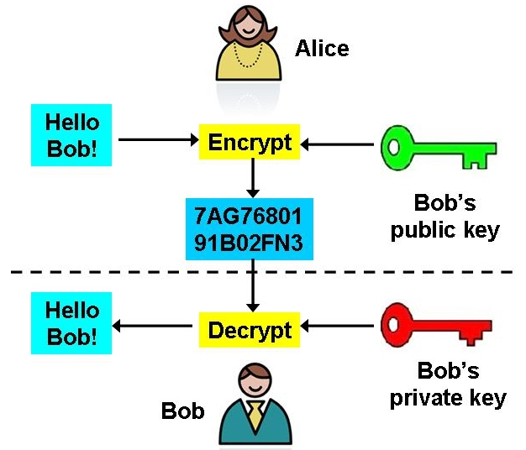
Public key encryption
Notes:
How does this help? Bob knows that Alice wants to send him a message, and creates a pair of keys. He advertises his public key, maybe on his web page! Alice sees it, and so does Eve. Alice uses the public key to encrypt her message, and sends it to Bob. Eve intercepts the message, but can't decrypt it — only Bob can decrypt the message, because only Bob has the secret key.
The description of public key encryption is simple, but the implementation is not. The RSA method involves advanced number theory. The pair of keys are mathematically related — you can generate them efficiently and use them to encrypt and decrypt messages, but trying to determine one key from the other involves solving a problem that is mathematically “hard.” This makes the RSA method difficult to crack. For their contribution, the RSA team won the Turing Award, considered the Nobel-equivalent for Computer Science.

Slide 10
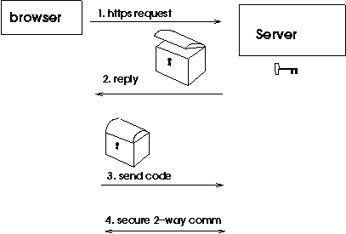
Secure communication
Notes:
When you access a secure web server, your browser and the server become Alice and Bob. Public key encryption is used to establish a cryptographically secure connection, so credit card numbers and other private information is safe from the Eves on the network connections between your browser and the server:
The browser makes an HTTPS request to the server for secure communication
The server responds by sending a digital "trunk" — only the server has the key that unlocks the trunk, but anyone can put something in the trunk and lock it
The browser makes up a secret code, puts it in the trunk, closes the lid, and sends it to the server.
Only the server can unlock the trunk, so no one along the path can get the secret code
4)The server unlocks the trunk, gets the secret code, and uses it to securely transmit the page.
The server and browser can then communicate in both directions using the secret code, and no one else can read their conversation
The preceding description is relatively straightforward, but the implementation is not. The solution, called the RSA method, involves advanced number theory that can cause grown men to burst into tears (or maybe it's just me), but the idea is very cool. (If you're interested, please consult the Wikipedia article on the RSA method, but be warned that the article assumes a good deal of knowledge of number theory, but there are good examples and references.)The pair of keys are mathematically related, andYou can reasonably efficiently generate them and use them to encrypt and decrypt messages, butTo try to determine one key from the other involves solving a problem that is mathematically “hard.”The last fact makes the RSA method difficult to crack. For their contribution, the members of the RSA team received the 2002 TURING AWARD, which is considered the Nobel-equivalent for Computer Science.

Slide 11
Is your information secure?
Someone can hack into the server
The server may not be trustworthy
Someone can pretend to be you
Someone may look over your shoulder when you type
Notes:
Is your information safe? Not entirely. Maybe someone can hack into the server. Maybe someone at the destination isn't trustworthy. Maybe the server is a complete fraud, put up by Eve. Maybe someone was looking over your shoulder when you typed. There is probably no such thing as perfect security. We all have to decide how much effort to put into security.Encryption isn't just for web traffic. It could also be used for email and for telephone messages, including cell phones. Right now, anyone with a radio scanner and a little know-how can listen to cell phone conversations. Similarly, tapping a phone is very easy. Encryption lets us use any of these insecure media to send a private message.

Slide 12



Using public key for digital signatures
Call off the attack, it’s a trap! Signed Alice
Go on with the attack, it’s all clear! Signed Alice
Problem: How does Bob know the identity of the sender?
Solution: Alice encrypts the message with her private key
Anyone can decrypt using Alice’s public key but she is the only one who can encrypt
Notes:
Suppose Alice wants to send Bob the message:Call off the attack, it's a trap! Signed, AliceShe encrypts her message with Bob's public key and radios it to him. Meanwhile, Eve sends Bob the message:Go on with the attack, it's all clear! Signed, AliceShe also encrypts the message with Bob's public key and radios it to him. She's pretending to be Alice! What is Bob to think?There's a cool aspect to public key encryption that we haven't mentioned. We said that one key decrypts what the other encrypts. In fact, both keys can encrypt, and the two keys are opposites, which means that one can decrypt what the other encrypts.So, here's what Alice does: she encrypts her message with her own private key. Bob gets it and successfully decrypts it with Alice's public key. (She has a web site with her public key listed.) He then realizes that only Alice could have sent this message, since only her private key can create a message that her public key can decrypt.Thus, public key encryption can give us digital signatures . The purpose of a regular, real-life signature is that, presumably, only you can sign your name the way you do. By comparison to a known signature on file, your bank or any other interested party can verify that something has been signed by you.The “signing” of digital certificates, which we discuss in the lecture on certificates, actually uses digital signatures just like this. It just involves a different use of public key encryption: a trusted third party signs the public key, using its own private key! This is confusing, so think about it for a while...Similarly, if there was a public key on file for a person, they can use their private key to “sign” an electronic document, even an email.

Slide 13
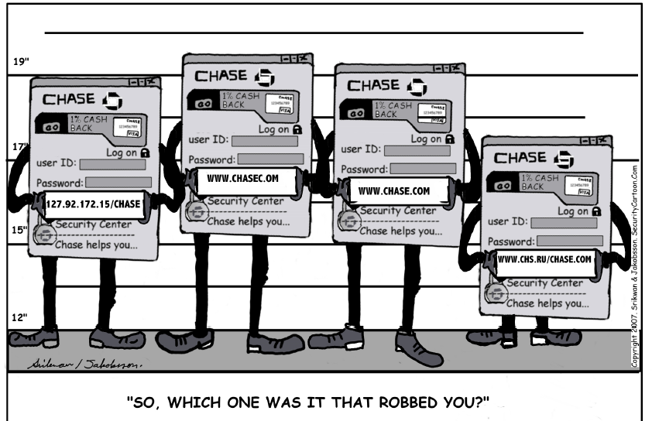
Spoofing
Notes:
Spoofing means to impersonate a website - it takes some hacking ability, but that's common enough. Let's make some (illegal) money:Set up a web server that claims to be Amazon.comFake a bunch of web pages (by copying some of theirs)Wait for people to order merchandise by credit cardTake their credit cards and buy stuffWhat can be done about this? How do we deal with possible impersonation in real life? We have id cards.

Slide 14
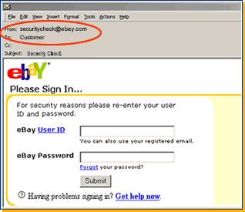
Spoofing (2)

Slide 15
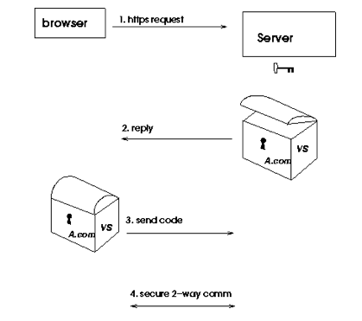
Certificates and signing authorities
Notes:
Imagine that the "trunk" from the secure server is labeled with the owner's name and signed by some authority, just as a driver's license has the signature of a state official on it. Of course, the electronic signature is digital. The signed, identified trunk is called a certificate.A signature can only come from a valid signing authority - a company that makes money signing trunks, such as "Verisign." The IT people at Amazon.com go to Verisign, prove that they are valid representatives of Amazon.com, and present their trunk for signature. Verisign signs the trunk, and Amazon.com is now ready to set up a secure server. We now have:
The browser requests a web page via HTTPSThe server replies with a certificate — a signed, labeled trunkThe browser verifies the signature and whether it trusts the signer — if they check out, it uses the trunk to send a secret code to the serverThe server unlocks the trunk and uses the secret code to send the web page securely

Slide 16
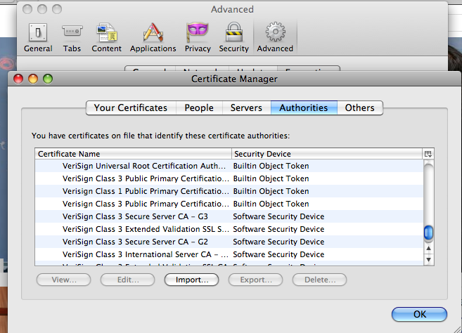
Whom do you trust?
Verified website: https://firstclass.wellesley.edu/
Unknown signer: https://cs.wellesley.edu/

