Slide 1
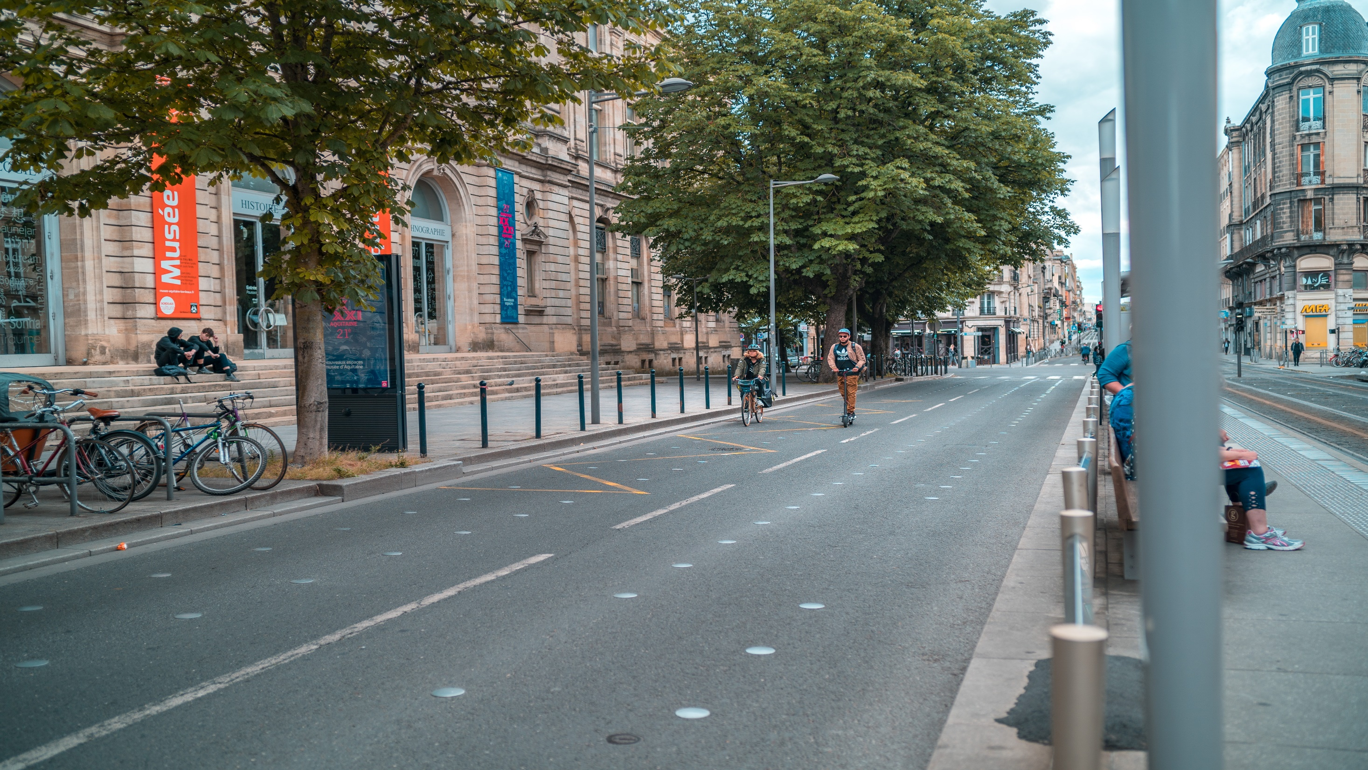
Cyclistic Bike-share
A Case Study
January 2023
Scott John Villaruel Esguerra

Slide 2

Hello!
2
SCOTT JOHN VILLARUEL ESGUERRA
BS in COMPUTER ENGINEERING
ASPIRING DATA ANALYST

Slide 3
Case – How Does a Bike-share Navigate Speedy Success?

Slide 4
4
Executive Summary
Cyclistic is a bike-share company in Chicago. The director of marketing believes the company’s future success depends on maximizing the number of members (annual subscribers).
The marketing analytics team will design a new marketing strategy to convert casual riders (single pass purchasers) into members.

Slide 5
5
Objective
Identify and understand how annual members and casual riders use Cyclistic bikes differently.

Slide 6
Key Findings

Slide 7
6
On average, casual riders ride 2.3 times longer than annual members
Data overview
The data is collected from January 2022 to December 2022.
Bike trips are only limited to Chicago, USA.

Slide 8
7
Casual riders doubles the trip duration of annual members per day
Data overview
The data is collected from January 2022 to December 2022.
Bike trips are only limited to Chicago, USA.

Slide 9
8
Most casual riders prefer Saturday and Sunday to ride a bike
January 2022 – December 2022

Slide 10
8
Number of rides peaks during warmer months but significantly decreases in colder months

Slide 11
8
Number of rides peaks during warmer months but significantly decreases in colder months

Slide 12
Most annual members use Cyclistic bikes to commute during rush hours
Data overview
Number of bike trips peaks at 8:00 am in the morning while 5:00 pm in the afternoon.
Number of bike rides from January 2022 to December 2022.
Bike trips are only limited to Chicago, USA.

Slide 13
The Next Step

Slide 14
Conclusions
Casuals often ride for 2.3 times longer than members. Weekend trips have the longest ride length for both user groups. Casual riders also prefer to rent a bike on Saturdays and Sundays, where they make up 37.13% of all trips.
Recommendation
Weekend Pass
Yearly plan that provides unlimited bike rides every weekend.
Has lower cost than regular subscription.
Target casuals who only rent bikes on a weekend.

Slide 15
Conclusions
The number of riders for both casual riders and annual members increases during warmer months but significantly decreases in colder seasons. Classic and electric bikes are the most used bike type.
Recommendation
Focus on advertising during peak season (May to October) for cost efficiency and to maximize profit.

Slide 16
Conclusions
The number of rides peaks at 8:00 am in the morning and 5:00 pm in the afternoon mostly for members. The could indicate that most members use their bikes to commute on and off from work or school.
Recommendation
Reservation system privileges for members
Prevents hassle from members during rush hours.
Marketing ploy for casuals to buy an annual subscription.

