Slide 1
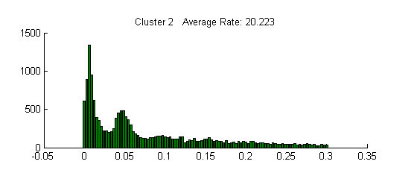

Unsupervised Batch Clustering of Neural Spikes
Scott Grimes - HIWI

Slide 2
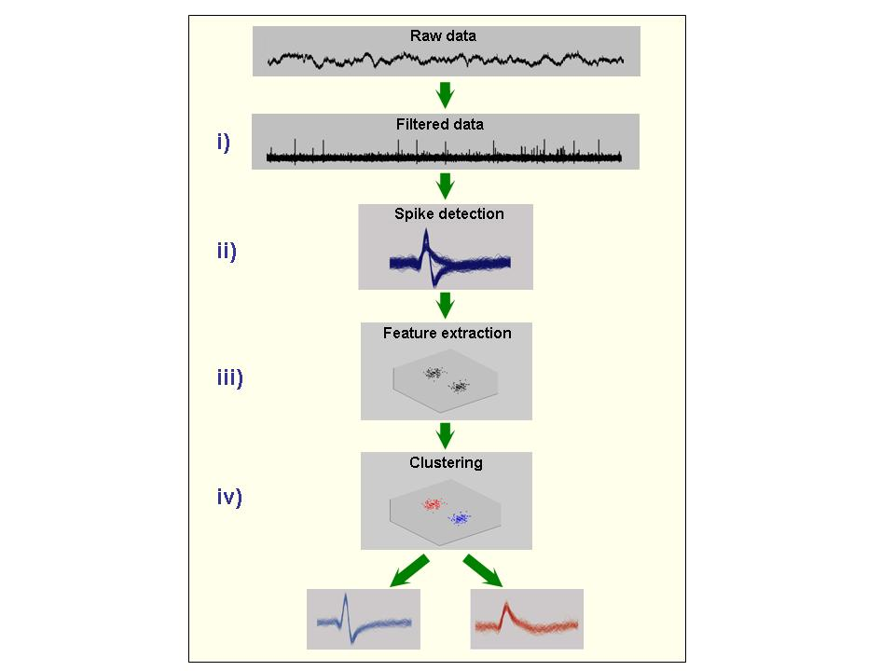
Manual Spike Sorting is Tedious
General Sorting Steps:
i) The raw data is filtered
ii) Spikes are extracted from the data using an amplitude threshold
iii) Spikes features are determined (giving a dimensionality reduction)
iv) Spikes are clustered
Adapted from Quian Quiroga et al. (2004)

Slide 3
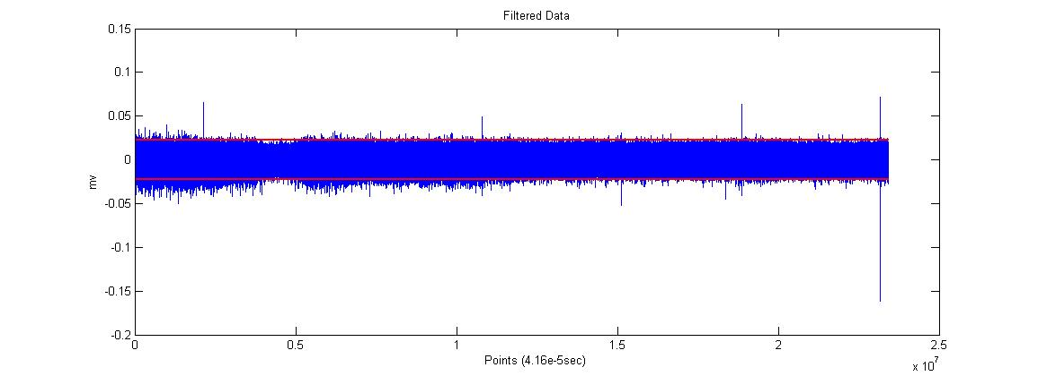
Automated Procedure
Spikes are extracted from filtered data using amplitude detection (positive, negative, or both) in standard deviations

Slide 4
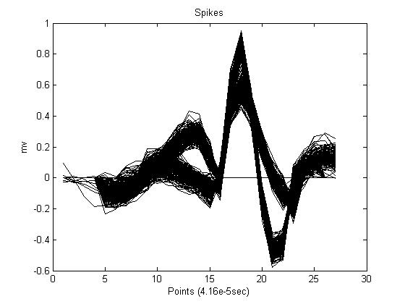
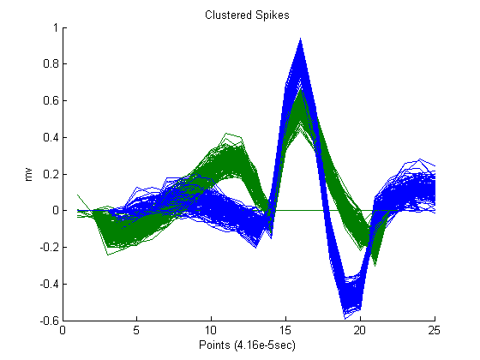
Automated Procedure
Spikes are aligned to each other using their extreme amplitudes for sorting. There are two primary clustering methods available: Principal Component Analysis and Superparamagetic Clustering. Artifacts may be removed at this point using an amplitude threshold if they were not already removed during the initial importation.
Pre-Clustered Post-Clustered

Slide 5
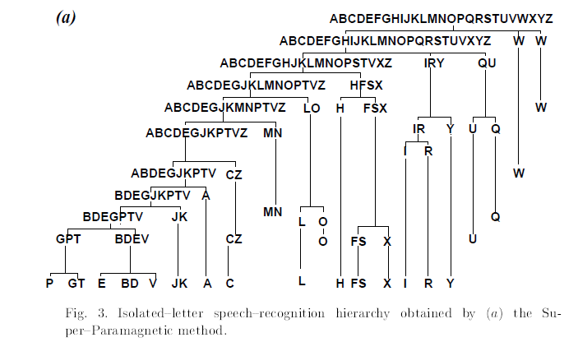
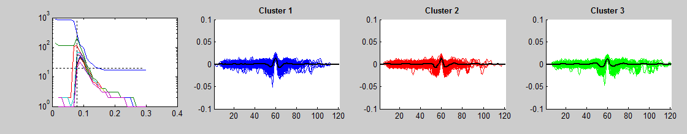
Superparamagnetic Clustering
Low T
Not Clustered
High T
Over-Clustered
As T increases, the number of clusters increases and the size of the clusters decreases. The cost function which determines which spikes to include in a given cluster is fixed, which can leave many spikes un-clustered or ill-clustered.
For sorting the Principal Component Loadings without knowing the final number of clusters initially we can work backwards, over-clustering and then merging similar clusters until convergence
Superparamagnetic clustering of data--The definitive solution of an ill-posed problem
E Domany - Physica A: Statistical Mechanics and its Applications, 1999 - Elsevier

Slide 6
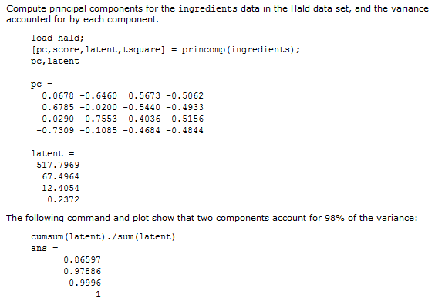
Principal Component Analysis for N-Unknown Clusters
The loadings for n spikes are computed. In this example The vector latent is the eigenvalues of the covariance matrix of ingredients
Here the first two components account for ~98% of the variance in the set. We can reduce each spike vector to loadings with a small dimension which reduces the computation time required for clustering.
Example Adapted from MATLAB User Guide

Slide 7
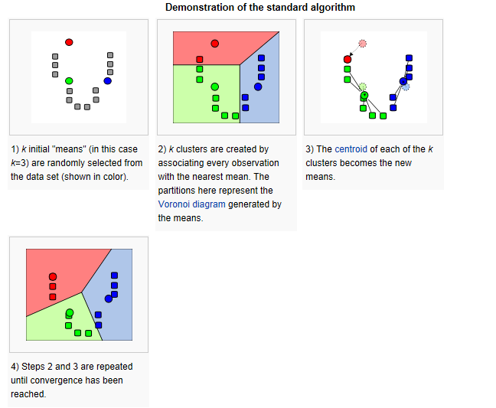

Principal Component Analysis for N-Unknown Clusters
Once the number of required components are know we can begin clustering.
K-means clustering attempts to minimize the sum of squares within each cluster for an initial cluster guess M.
However we do not know the final number of clusters, so k-means is initialized with an arbitrary value M, known to be greater than N, the final number of clusters.
kmeans infographic

Slide 8
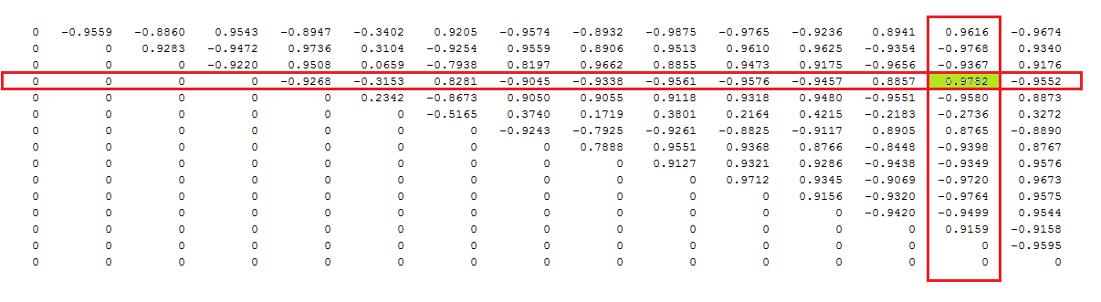
Principal Component Analysis for N-Unknown Clusters
A similarity matrix is computed for M clusters where M_{ij} is the similarity of the clusters i and j.
For M-1 iterations the clusters with the greatest similarity are combined, and a new similarity matrix is computed…
In this example cluster 14 is merged into cluster 4

Slide 9
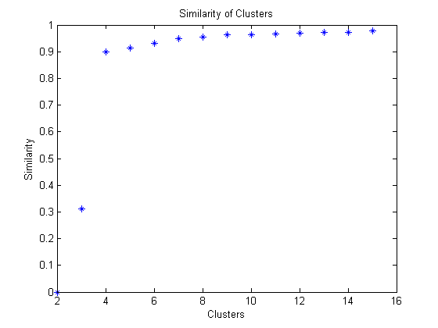
Principal Component Analysis for N-Unknown Clusters
When the number of clusters has been reduced from M to 2, the maximum similarity between clusters for every iteration of M is taken:
The maximum cluster similarity in iteration 3 was far greater than previous iterations, all similar clusters have been collected together at this point. We can use the cluster indexes of this iteration (3 final number of clusters).

Slide 10
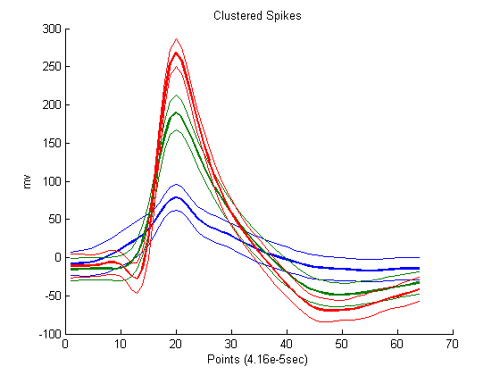
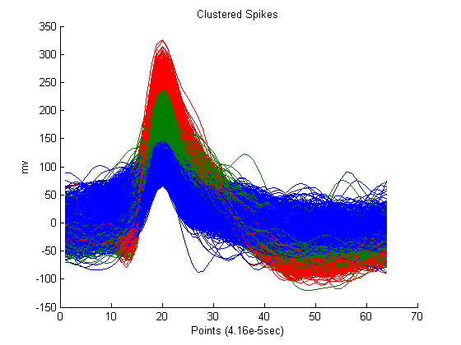
Post-Processing Review
Several tools are included to review the clusters after they have been sorted:
Clusters can be combined or discarded. Spikes shapes and ISI histograms can be plotted. Clusters may be overlaid for comparison.

Slide 11
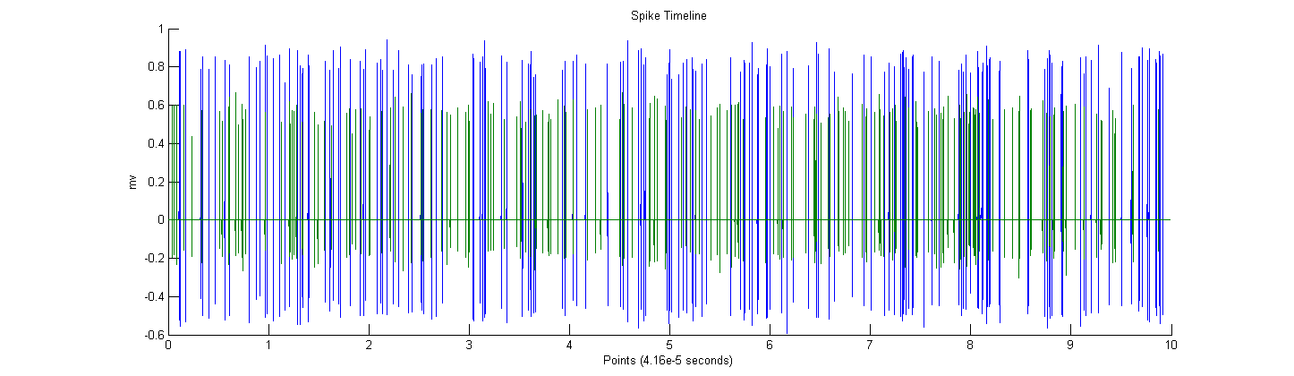
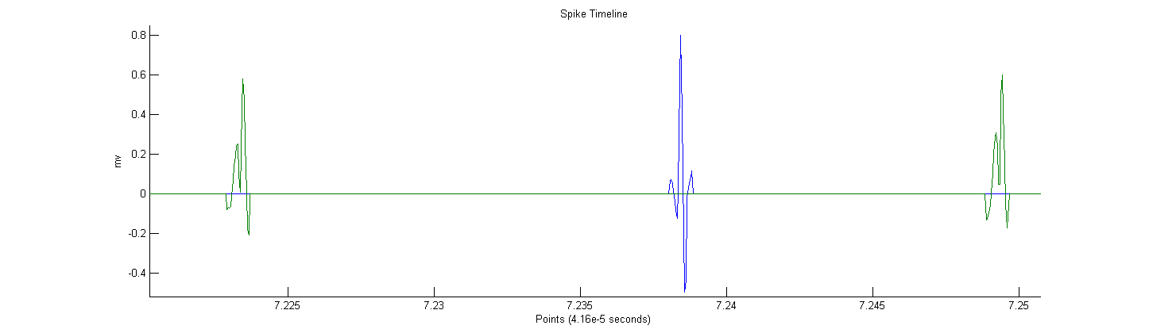
Post-Processing Review
Timelines for each cluster can be created using the spike shapes and timestamps for each event (plotted together or separately for comparison)

Slide 12
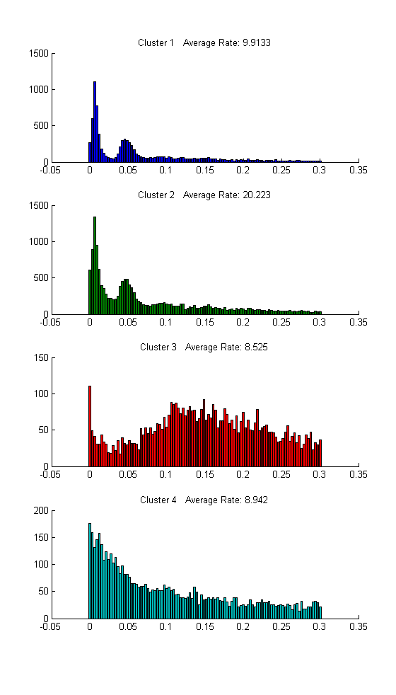
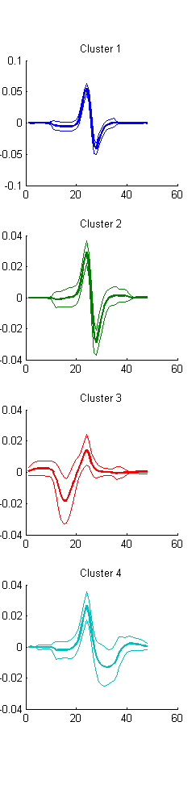
Post-Processing Review
The inter-spike interval histogram and average rate of fire for each cluster is shown on the left.
Cluster shapes with standard deviation shown on the right

Slide 13
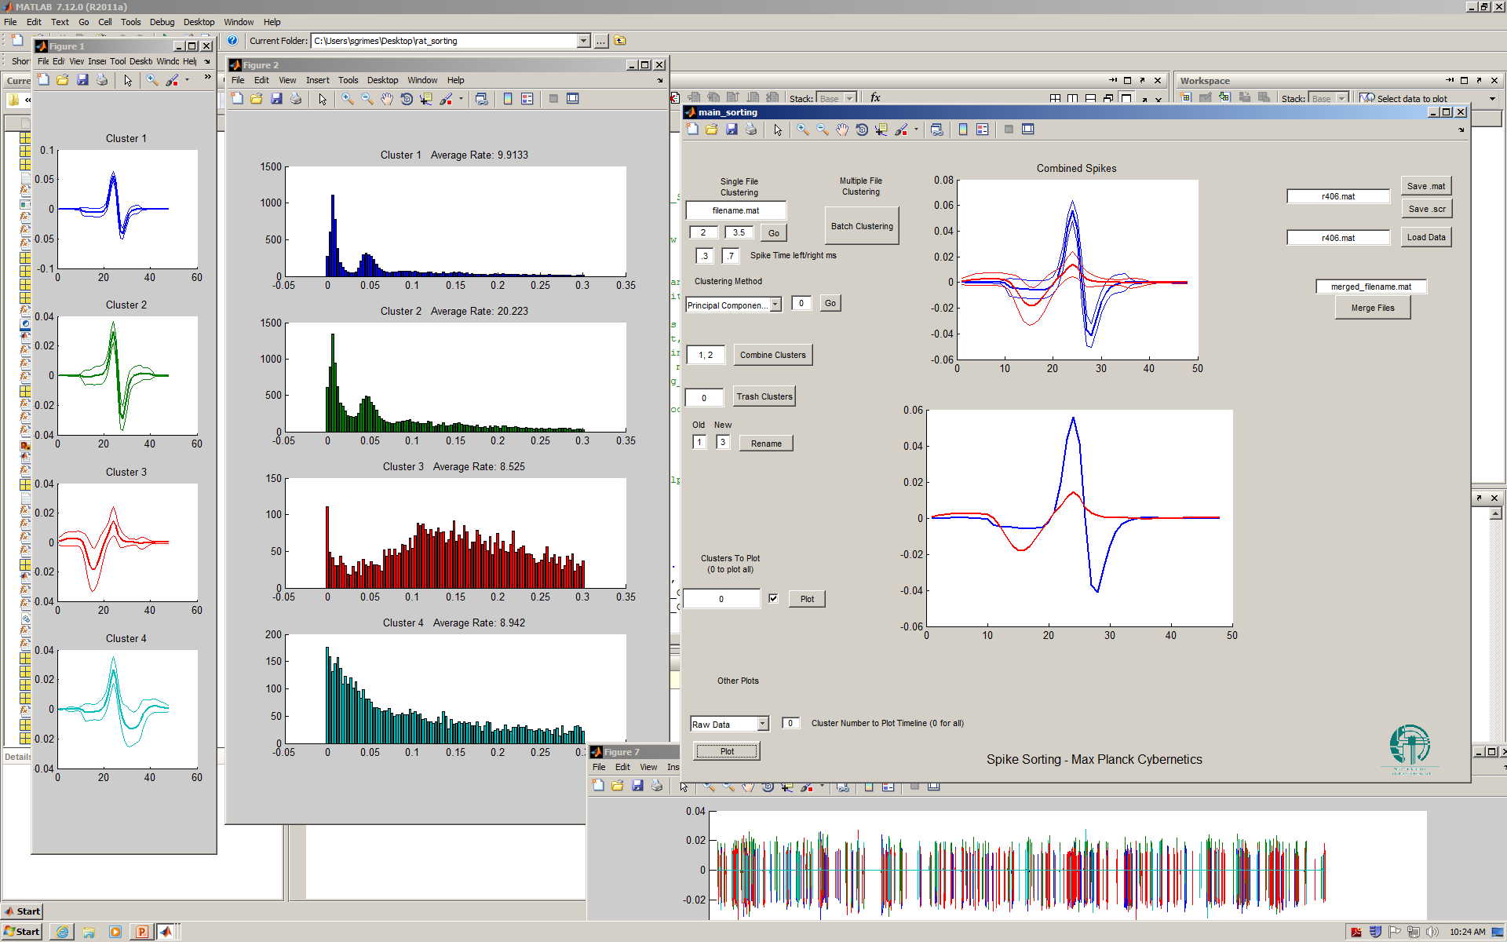
Interface

