Slide 1
Gears, Pulley Drives, and Sprockets

Slide 2
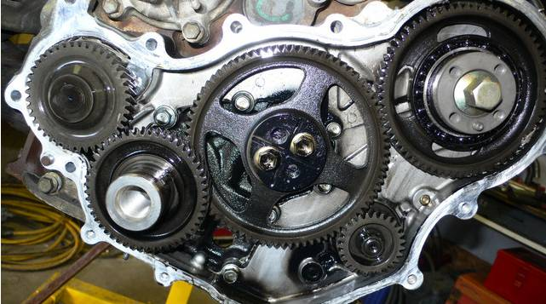
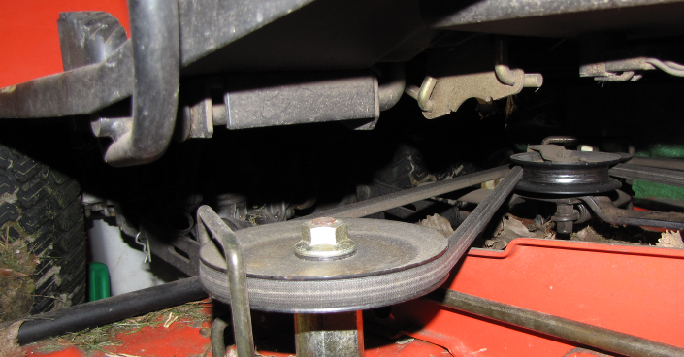
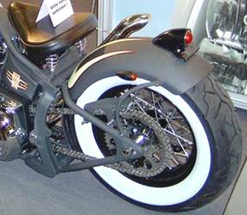
Gears, Pulleys, & Sprockets
Mechanisms used to transfer energy through rotary motion.
Change the speed of rotation
Change the direction of rotation
Change the amount of torque available to do work

Slide 3

Gears
A gear train is a mechanism used for transmitting rotary motion and torque through interlocking teeth.
A gear train is made when two or more gears are meshed
Driver gear causes motion
Motion is transferred to the driven gear

Slide 4
Gears
Mating gears always turn in opposite directions.
An Idler Gear allows the driver and driven gears to rotate in the same direction.
Mating gears always have the same size teeth (diametric pitch).

Slide 5
Gears
The rpm of the larger gear is always slower than the rpm of the smaller gear.
Gears locked together on the same shaft will always turn in the same direction and at the same rpm.

Slide 6
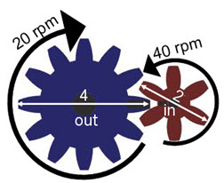
Gear Ratios
Variables to know
n = number of teeth
d = diameter
ω = angular velocity (speed)
τ = torque
** Subscripts in and out are used to distinguish between gears **
4”
6
2in.
40rpm
40 ft-lb
n_{in}= | n_{out} =
d_{in} = | d_{out} =
ω_{in} = | ω_{out} =
τ_{in} = | τ_{out} =
12
4in.
20rpm
80 ft-lb
Notes:
In order to effectively work among the ratios, you must be able to distinguish the following symbols.
The symbol for angular velocity is the Greek lower case Omega.
The symbol for torque is the Greek lower case Tau.
The subscript “in” and “out” simply identify whether or not the characteristic of the gear refers to the input or output gear.
Note the rotation direction of the gears.

Slide 7
Gear Ratios
Equations to know
GR = Gear Ratio
GR = MA

Slide 8
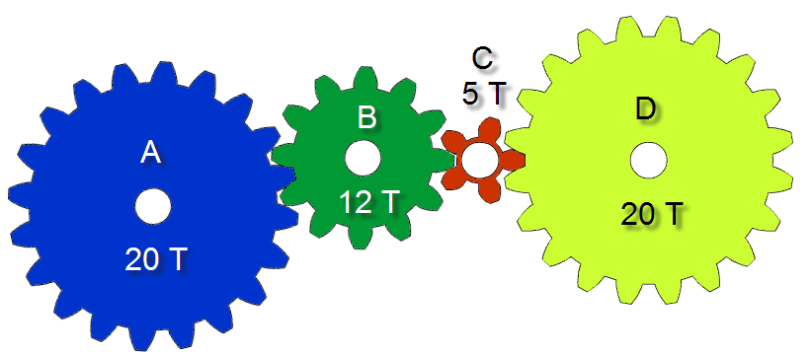
Gear Ratios
What is the gear ratio between gear A and B?
What is the gear ratio between gear B and C?
What is the gear ratio between gear C and D?

Slide 9
Gear Ratios
What is the TOTAL gear train gear ratio?
If gear A and D were directly connected to each other, what would the resulting gear ratio be?
What would the total gear ratio be if the last gear had 40 teeth?
or

Slide 10
Compound Gear Train
Driver
The two middle gears share a common axle, so they rotate at the same speed.
This allows the final gear to rotate slower and produce more torque than if it were connected only to the driver gear.
Notes:
A simple method to gain torque would be to turn the final gear that was added into the driver gear.

Slide 11
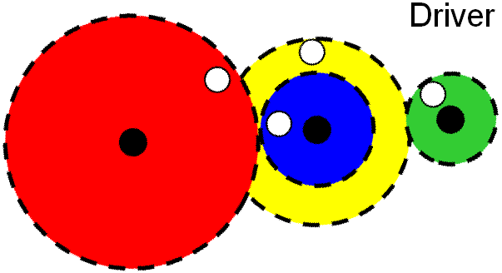
Compound Gear Ratios
D
B
C
A
20 T
10 T
What is the gear ratio between gear A and B?
40 T
50 T
What is the gear ratio between gear C and D?
What is the gear ratio of the entire gear train?

Slide 12
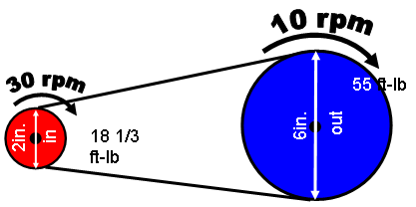
Pulley and Belt Systems
2in.
in
out
Equations
d = diameter ω = angular velocity (speed) τ = torque
Notes:
The belt is a continuous band that wraps around the pulleys to transmit power. The ratios are the same as for gears. The only exception is that there are no teeth to count.
Another difference is that two pulleys connected by a belt will rotate in the same direction.

Slide 13
Sprocket and Chain Systems
45rpm
90rpm
60 ft-lb
3in.
1.5in.
in
120 ft-lb
out
n = number of teeth d = diameter ω = angular velocity (speed) τ = torque
Notes:
Sprockets and gears are often confused. Gears mesh with gears, while sprockets use chains to transfer power between sprockets.

Slide 14
Comparing Pulleys and Sprockets
 | Pulley | Sprocket
Method of Transmitting Force | Belt | Chain
Advantages | Quiet, no lubrication needed, inexpensive | No slip, greater strength
Disadvantages | Can slip | Higher cost, needs lubrication, noisy

Slide 15
Image Resources
Microsoft, Inc. (2008). Clip art. Retrieved January 15, 2008, from http://office.microsoft.com/en-us/clipart/default.aspx

