Slide 1
Simple Machines
Inclined Plane, Wedge, & Screw

Slide 2
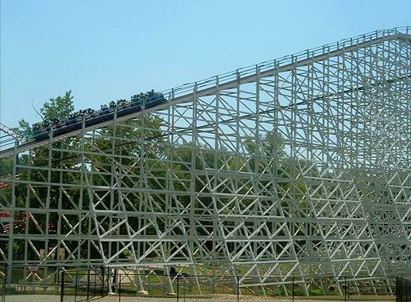
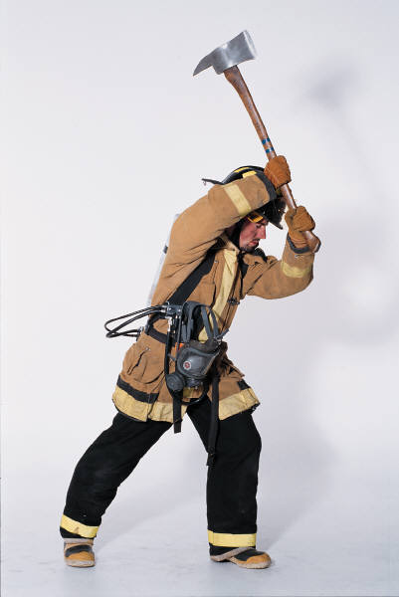
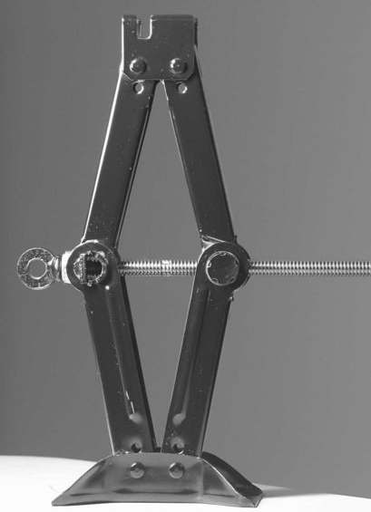
Inclined Plane
Wedge
Screw

Slide 3
Mechanical Advantage
Ratio of the magnitude of the resistance and effort forces
Ratio of distance traveled by the effort and the resistance force
Calculated ratios allow designers to manipulate speed, distance, force, and function

Slide 4
Mechanical Advantage Example
A mechanical advantage of 4:1 tells us
what about a mechanism?
Magnitude of Force:
Effort force magnitude is 4 times less than the magnitude of the resistance force.
Distance Traveled by Forces:
Effort force travels 4 times greater distance than the resistance force.

Slide 5
Mechanical Advantage Ratios
One is the magic number
If MA is greater than 1:
Proportionally less effort force is required to overcome the resistance force
Proportionally greater effort distance is required to overcome the resistance force
If MA is less than 1:
Proportionally greater effort force is required to overcome the resistance force
Proportionally less effort distance is required to overcome the resistance force
MA can never be less than zero.

Slide 6
Ideal Mechanical Advantage (IMA)
Theory-based calculation
Friction loss is not taken into consideration
Ratio of distance traveled by effort and resistance force
Used in efficiency and safety factor design calculations
D_{E} = Distance traveled by effort force
D_{R} = Distance traveled by resistance force

Slide 7
Actual Mechanical Advantage (AMA)
Inquiry-based calculation
Frictional losses are taken into consideration
Used in efficiency calculations
Ratio of force magnitudes
F_{R} = Magnitude of resistance force
F_{E} = Magnitude of effort force

Slide 8
Inclined Plane
A flat surface set at an angle or incline with no moving parts
Able to lift objects by pushing or pulling the load

Slide 9
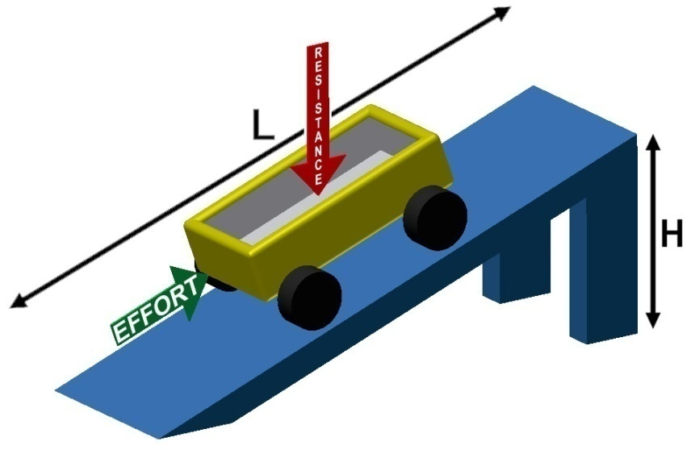
Inclined Plane IMA
15.0 ft
4.0 ft
D_{E} = Distance traveled by the effort = L
D_{R} = Distance traveled by the resistance = H
What is the IMA of the inclined plane above?
IMA = 15.0 ft / 4.0 ft = 3.75 = 3.8:1

Slide 10
Inclined Plane AMA
15 ft
50. lbs
4 ft
20. lb
What is the AMA of the inclined plane above?
AMA = 2.5 = 2.5:1
What is the efficiency of the inclined plane above?
Efficiency =
= .67 or 67%

Slide 11
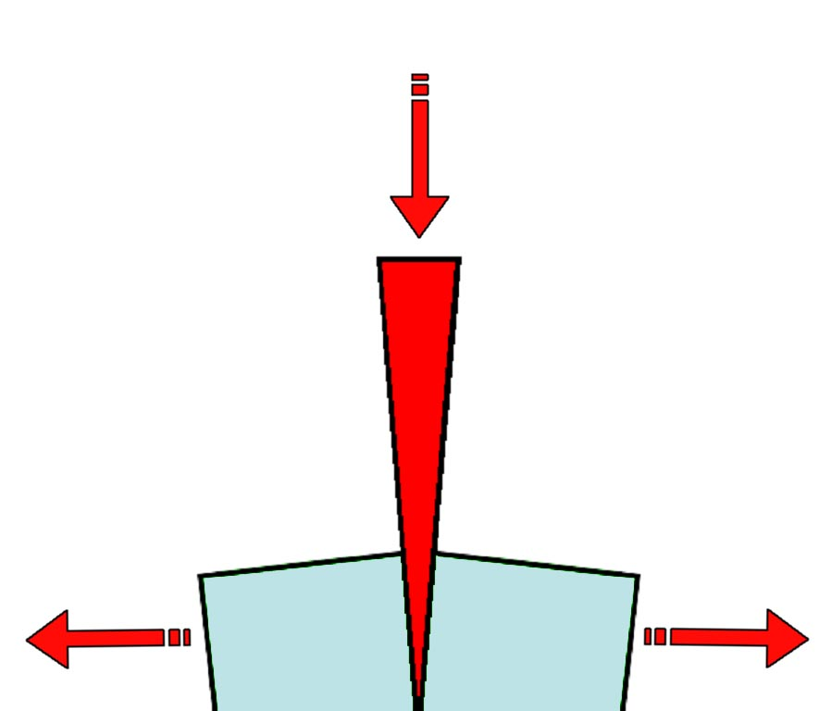
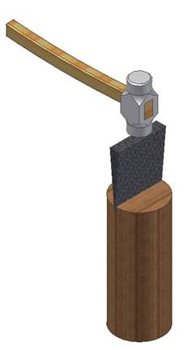
Wedge
Functions as a moving inclined plane
Tapers to a thin edge and is used for splitting, raising heavy bodies, or for tightening by being driven into something

Slide 12
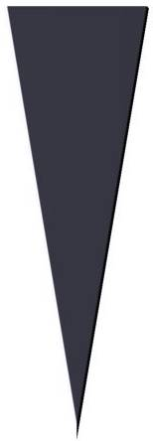
Wedge IMA
H 3.0 in.
L 10.0 in.
D_{E} = Distance traveled by the effort = L
D_{R} = Distance traveled by the resistance = H
What is the IMA of the wedge on the right?
IMA = 10.0 in. / 3.0 in. = 3.33 = 3.3:1
Notes:
There is debate about whether the “length” is perpendicular to the height or the length of the sloped surface. Upon research both methods are used and there is little difference in the calculation of IMA with wither measurement. Using two separate formulas and the reason why one formula makes more sense than the other is beyond the scope of this course. If students desire an answer, though, the explanation is below.
Method A - Length is equal to the perpendicular distance to the height (the method used in POE): If the resistance force is constrained such that it can only move perpendicular to the height. i.e. a doorstop.
Method B - Length is equal to slope: If the resistance force moves parallel to the height measurement of the wedge. i.e.

Slide 13
Wedge AMA
250. lb
H 3.0 in.
L 10.0 in.
What is the AMA of the wedge on the right?
700. lb
700. lb
AMA = 2.80 = 2.80:1
What is the efficiency of the wedge on the right?
Efficiency =
= .84 or 84%

Slide 14
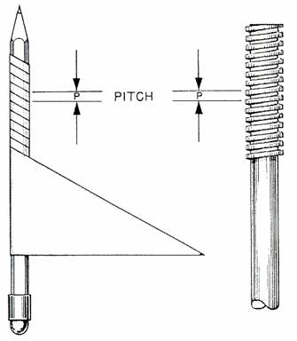
Screw
Two Components
An inclined plane wrapped around a cylinder, forming the path and pitch
A wheel and axle used to create rotary motion
Properties
Change rotary motion into linear motion
Used as a threaded fastener
Large MA
Large amount of friction loss

Slide 15
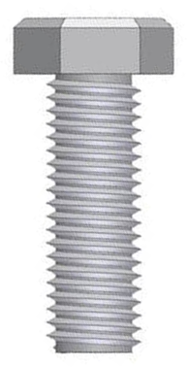
Screw Identification
Effort Arm Distance – If using a wrench, effort arm distance would be the length of the wrench
Thread Information
1/2 13 NC
Pitch
Diameter
Threads per inch
Thread description coarse or fine
Distance between threads and linear distance traveled by 1 rotation of the screw
If 13 threads per inch, then pitch or distance between threads is 1/13 of an inch
Diameter
How far will a screw with 13 threads per inch move linearly if turned one full rotation?
1/13 of a inch

Slide 16
Screw IMA
1/4 20 NC
D_{E} = One rotation of the effort arm = Circumference
D_{R} = Linear distance traveled during one rotation of the effort arm = Pitch
What is the IMA of the screw above if effort is applied by an 8.0in. long wrench?

Slide 17
Screw AMA
1/4 20 NC
8 in.
35 lb
What is the AMA of the screw on the right?
1200 lb
AMA = 34.29 = 34:1
What is the efficiency of the screw on the right?
Efficiency =
= 0.0341 or 3.4%
Why is efficiency so low?

Slide 18
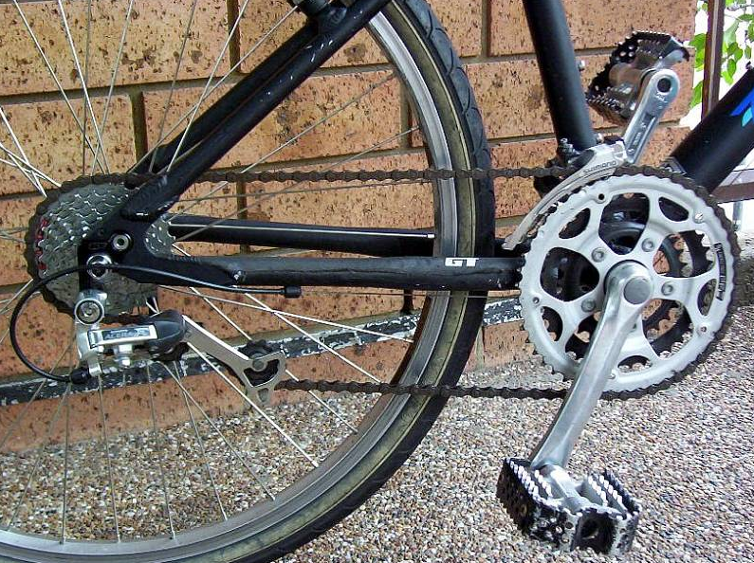
Compound Machines
Simple machines working in combination to complete a task
Calculating mechanical advantage

Slide 19
Image Resources
Microsoft, Inc. (2008). Clip art. Retrieved January 10, 2008, from http://office.microsoft.com/en-us/clipart/default.aspx

