Slide 1
Mechanisms Simple Machines
Lever, Wheel and Axle, & Pulley

Slide 2
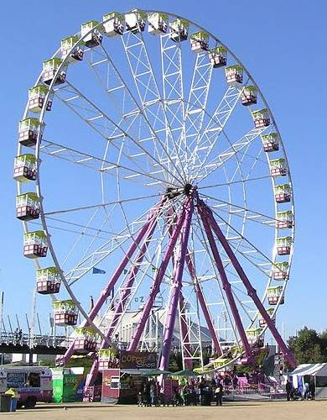
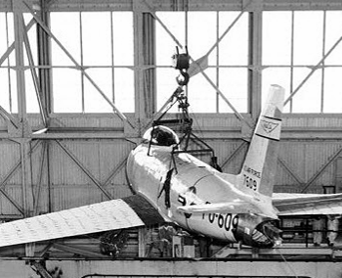
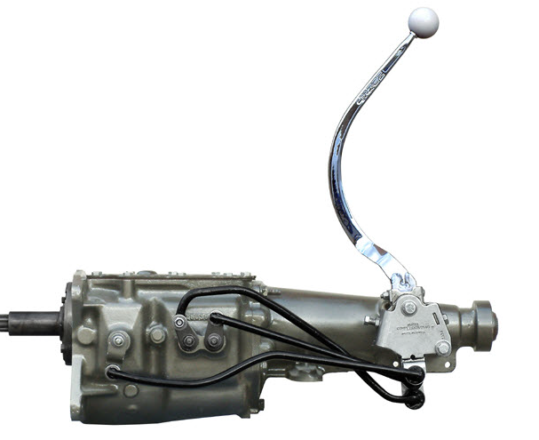
Simple Machines
Mechanisms that manipulate magnitude of force and distance.
The Six Simple Machines
Lever
Wheel and Axle
Pulley

Slide 3
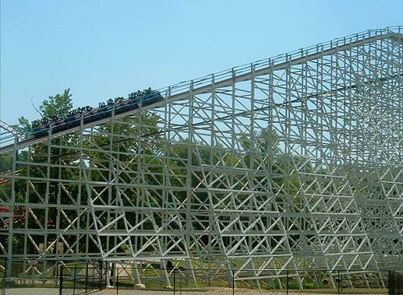
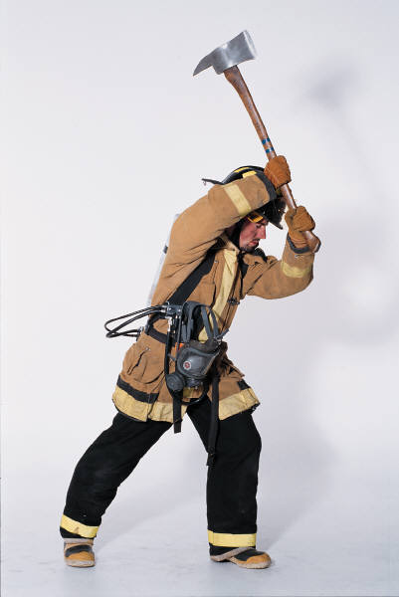
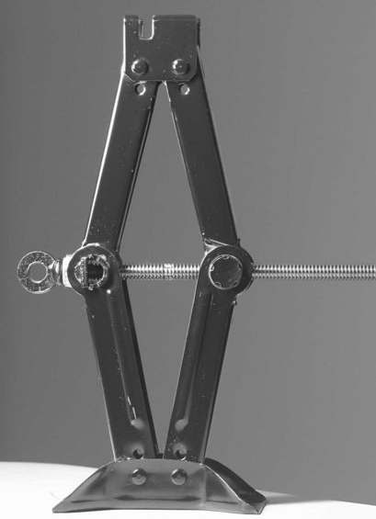
The Six Simple Machines
Inclined Plane
Wedge
Screw

Slide 4
Mechanical Advantage
Ratio of the magnitude of the resistance and effort forces
Ratio of distance traveled by the effort and the resistance force
Calculated ratios allow designers to manipulate speed, distance, force, and function

Slide 5
Mechanical Advantage Example
A mechanical advantage of 4:1 tells us
what about a mechanism?
Magnitude of Force:
Effort force magnitude is 4 times less than the magnitude of the resistance force.
Distance Traveled by Forces:
Effort force travels 4 times greater distance than the resistance force.

Slide 6
Work
The force applied on an object times the distance traveled by the object
Initial position
Final position
Force (F)
Distance (d)
Work = Force * Distance = F*d
*The force needed to overcome friction is not considered*

Slide 7
Work
The product of the effort times the distance traveled will be the same regardless of the system mechanical advantage

Slide 8
Mechanical Advantage Ratios
One is the magic number
If MA is greater than 1:
Proportionally less effort force is required to overcome the resistance force
Proportionally greater effort distance is required to overcome the resistance force
If MA is less than 1:
Proportionally greater effort force is required to overcome the resistance force
Proportionally less effort distance is required to overcome the resistance force
MA can never be less than or equal to zero.

Slide 9
Ideal Mechanical Advantage (IMA)
Theory-based calculation
Friction loss is not taken into consideration
Ratio of distance traveled by effort and resistance force
Used in efficiency and safety factor design calculations
D_{E} = Distance traveled by effort force
D_{R} = Distance traveled by resistance force

Slide 10
Actual Mechanical Advantage (AMA)
Inquiry-based calculation
Frictional losses are taken into consideration
Used in efficiency calculations
Ratio of force magnitudes
F_{R} = Magnitude of resistance force
F_{E} = Magnitude of effort force

Slide 11
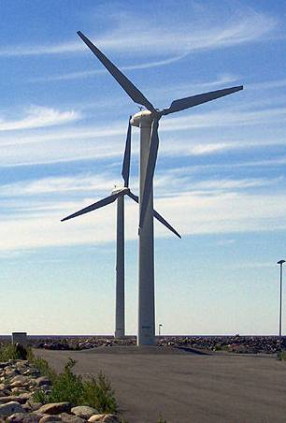
Real World Mechanical Advantage
Can you think of a machine that has a mechanical advantage greater than 1?

Slide 12
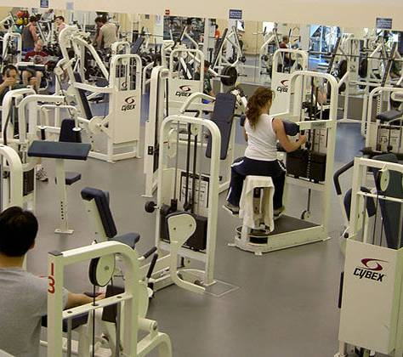
Real World Mechanical Advantage
Can you think of a machine that has a mechanical advantage less than 1?

Slide 13
Lever
A rigid bar used to exert a pressure or sustain a weight at one point of its length by the application of a force at a second and turning at a third on a fulcrum.

Slide 14
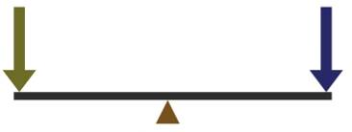
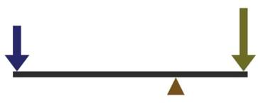
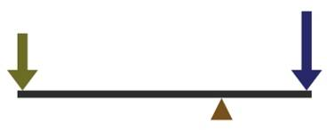
1st Class Lever
Fulcrum is located between the effort and the resistance force
Effort and resistance forces are applied to the lever arm in the same direction
Only class of lever that can have a MA greater than or less than 1
Effort
Resistance
MA =1
Effort
Resistance
Resistance
Effort
MA <1
MA >1

Slide 15
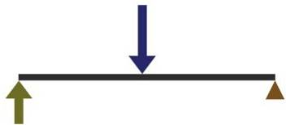
2nd Class Lever
Fulcrum is located at one end of the lever
Resistance force is located between the fulcrum and the effort force
Resistance force and effort force are in opposing directions
Always has a mechanical advantage >1
Resistance
Effort

Slide 16
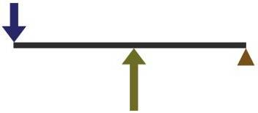
3rd Class Lever
Fulcrum is located at one end of the lever
Effort force is located between the fulcrum and the resistance
Resistance force and effort force are in opposing directions
Always has a mechanical advantage < 1
Resistance
Effort

Slide 17
Moment
The turning effect of a force about a point equal to the magnitude of the force times the perpendicular distance from the point to the line of action from the force.
Moment = Force x Distance
Torque: A force that produces or tends to produce rotation or torsion.

Slide 18
Lever Moment Calculation
5.5 in.
Resistance
15 lb
15 lbs
Effort
Calculate the effort moment acting on the lever above.
Moment =
Force x Distance
Effort Moment =
15 lb x 5.5 in.
Effort Moment =
82.5 in. lb

Slide 19
Lever Moment Calculation
When the effort and resistance moments are equal, the lever is in static equilibrium.
Static equilibrium:
A condition where there are no net external forces acting upon a particle or rigid body and the body remains at rest or continues at a constant velocity.

Slide 20
Lever Moment Calculation
Effort
Resistance
5.5 in.
?
15 lbs
36 2/3 lb
15 lb
Using what you know regarding static equilibrium, calculate the unknown distance from the fulcrum to the resistance force.
Static equilibrium:
Effort Moment = Resistance Moment
82.5 in.-lb = 36 2/3 lb x D_{R}
82.5 in.-lb /36.66 lb = D_{R}
D_{R} = 2.25 in.

Slide 21
Lever IMA
Resistance
Effort
Both effort and resistance forces will travel in a circle if unopposed.
Circumference is the distance around the perimeter of a circle.
Circumference = 2 π r
D_{E} = 2 π (effort arm length)
D_{R} = 2 π (resistance arm length)
2 π (effort arm length)
______________________
IMA =
2 π (resistance arm length)

Slide 22
Lever AMA
The ratio of applied resistance force to applied effort force
2.25 in.
5.5 in.
32 lb
16 lb
Effort
Resistance
What is the AMA of the lever above?
AMA = 2:1
Why is the IMA larger than the AMA?
What is the IMA of the lever above?
IMA = 2.44:1

Slide 23
Efficiency
In a machine, the ratio of useful energy output to the total energy input, or the percentage of the work input that is converted to work output
The ratio of AMA to IMA
What is the efficiency of the lever on the previous slide? Click to return to previous slide
AMA = 2:1
Efficiency
= .82 or 82.00%
IMA = 2.44:1
No machine is 100% efficient.

Slide 24
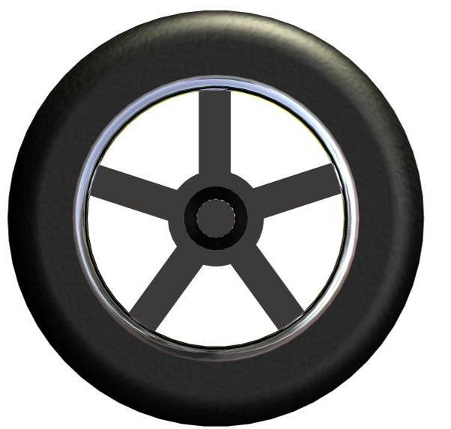
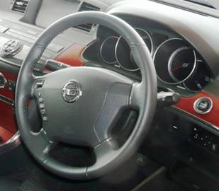
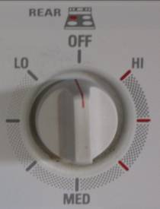
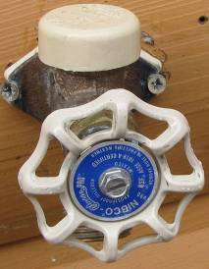
Wheel & Axle
A wheel is a lever arm that is fixed to a shaft, which is called an axle.
The wheel and axle move together as a simple lever to lift or to move an item by rolling.
It is important to know within the wheel and axle system which is applying the effort and resistance force – the wheel or the axle.
Can you think of an example of a wheel driving an axle?

Slide 25
Wheel & Axle IMA
Ǿ6 in.
Ǿ20 in.
Both effort and resistance forces will travel in a circle if unopposed.
Circumference = 2 π r or π d
D_{E} = π [Diameter of effort (wheel or axle)]
D_{R} = π [Diameter resistance (wheel or axle)]
π (effort diameter)
______________________
IMA =
π (resistance diameter)
What is the IMA of the wheel above if the axle is driving the wheel?
6 in. / 20 in. = .3 = .3:1 = 3:10
What is the IMA of the wheel above if the wheel is driving the axle?
20 in. / 6 in. = 3.33 = 3.33:1

Slide 26
Wheel & Axle AMA
Ǿ6 in.
Ǿ20 in.
200lb
Use the wheel and axle assembly illustration to the right to solve the following.
70lb
What is the AMA if the wheel is driving the axle?
200lb/70lb = 2.86 = 2.86:1
What is the efficiency of the wheel and axle assembly?
2.86/3.33 = .859 or 85.9%

Slide 27
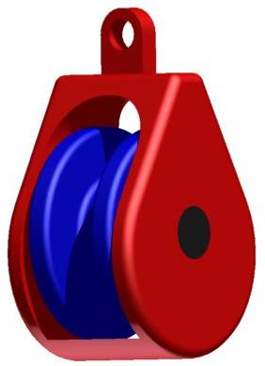
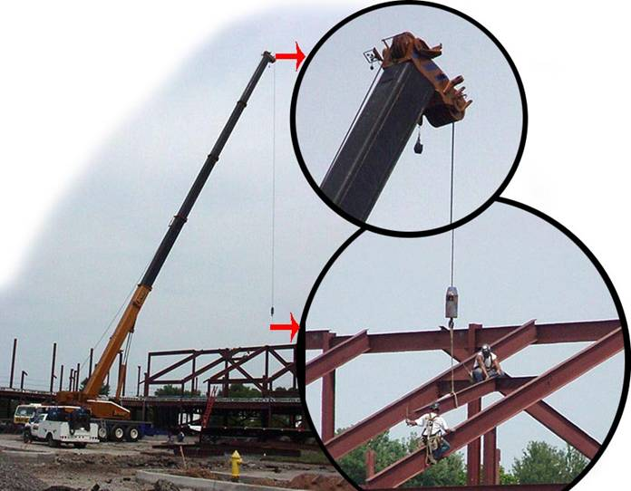
Pulley
A pulley is a lever consisting of a wheel with a groove in its rim which is used to change the direction and magnitude of a force exerted by a rope or cable.

Slide 28
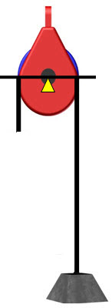
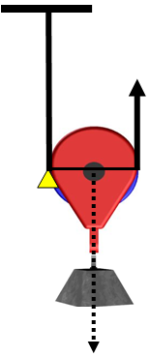
Pulley IMA
Fixed Pulley
- 1st class lever with an IMA of 1
- Changes the direction of force
10 lb
5 lb
5 lb
Movable Pulley
- 2nd class lever with an IMA of 2
- Force directions stay constant
10 lb
10 lb

Slide 29
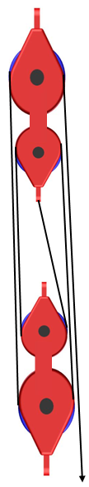

Pulleys In Combination
Fixed and movable pulleys in combination provide mechanical advantage and a change of direction for effort force.
10 lb
10 lb
What is the IMA of the pulley system on the right?
4
20 lb
20 lb
Movable pulleys in combination provide mechanical advantage without change in effort force direction.
40 lb
40 lb
What is the IMA of the pulley system on the left?
8
800 lb
80 lb

Slide 30
Pulley AMA
What is the AMA of the pulley system on the right?
AMA = 3.48 = 3.48:1
What is the efficiency of the pulley system on the right?
230 lb
Efficiency =
= .87 or 87%
800 lb

Slide 31
1st Class lever
MA = 1
A
Pulleys in combination or Block and tackle are a compound machine.
B
2nd Class lever
MA = 2
Calculating mechanical advantage
C
MA_{T} = MA_{A} * MA_{B} * MA_{C} * MA_{D}
D
MA_{T} = 1 * 1 * 2 * 2
MA_{T} = 4

Slide 32
Image Resources
Microsoft, Inc. (2008). Clip art. Retrieved January 10, 2008, from http://office.microsoft.com/en-us/clipart/default.aspx

