Slide 1
A Little Bit About Me

Slide 2










About me - professionally speaking
89-96
96-98
98-04
04-11
11-13
13-15
15-20
20-21
Current
Software Development
Technical Marketing
Product Marketing

Slide 3
Career Highlights
Active Duty (Deployed) Desert Storm/Shield
75th Ranger Regiment, Military Intelligence Battalion
Theater Information Broadcast System
Designer and Author; Deployed on US Army’s RC-135
ISS Caution and Warning Subsystem
Designer and Author; Runs on large Right Monitor at NASA
Co-founded and Sold a Startup
From Living Room to Office to Exit; Elsinore Technologies
Authored Enterprise Software
Firmware, SCSI Drivers, User Interfaces, Extensions
Published Author
Virtualization Changes Everything (coauthor); Data Governance for Dummies (author); Various articles
Coached and Mentored Awesome Leaders
Transformed teams, developed rockstars, retained talent

Slide 4

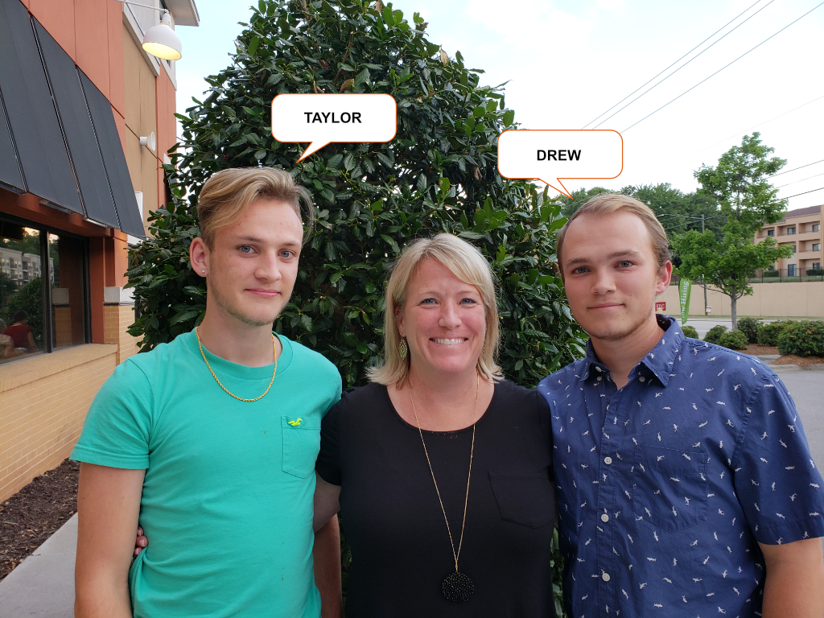


About me - personally speaking
My Family
My Hobbies
My Wife, (2) Sons, and (2) Pups
San Jose, CA → Moving to Austin, TX
I’m a PADI Master Scuba Diver Trainer
Creative Design - Digital Art, Photography, Logos, Etc.

Slide 5

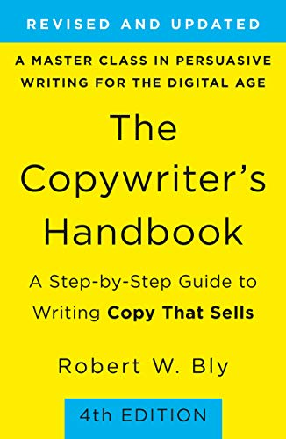





My Go-To Reference Material

Slide 6
My Personal “WHY” Statement
It is my responsibility to help EVERYONE find THEIR VOICE and deliver THEIR MESSAGE with CONVICTION and PURPOSE in order to drive others to ACT.
How I summarize and answer why I am on this planet and in your life right now with what motivates me, inspires me to push through the hard times, and double-down the value of surrounding myself with great people like you.

Slide 7
An Overview of the Role of Product Marketing
Scott Baker

Slide 8
Agenda
Introduction to “Product Marketing”?
How Most Companies Approach Product Marketing
Product Marketing vs. Other Functions
The State of Product Marketing
High Performing Product Marketing Team Execution
Wrap Up

Slide 9
Introduction to Product Marketing

Slide 10
What is a Product Marketer?
Voice of the Product to the Market
Voice of the Market to the Product
Notes:
SPEAKER SCRIPT
The evolution of Product Marketing is one of the newest and most important trends in marketing today, so it’s important to understand the role, what it’s responsible for and know how to apply it to your career or company.
Product Marketing is what connects the dots between the product and the market in both directions. This means that the Product Marketing role is responsible for two flows: understanding the market (demand/need), shaping the product, and communicating the product (solution) to the market.

Slide 11
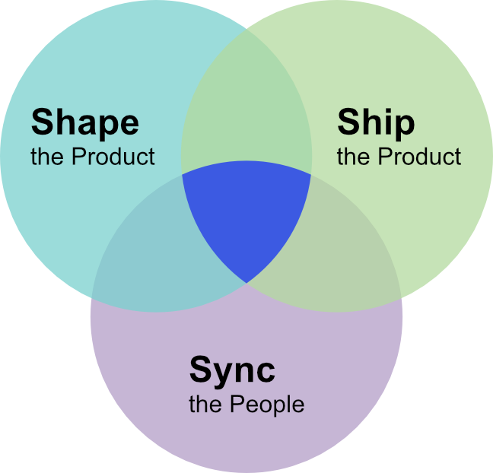
What is a Product Marketer?
Product Marketing
Notes:
SPEAKER SCRIPT
In (a) shaping the product (the Voice of the Market to the Product), Product Marketers will undertake activities such as:
Customer and competitor research (to help identify unmet needs)
Persona development and segmentation (to better define the target audience)
Messaging and position (the magic that is our story to evoke emotion and call people to action)
Ship the Product (Sales)
In (b) communicating the product (the Voice of the Product to the Market), Product Marketers will undertake activities such as:
Content and collateral creation (to enable sales, success, support teams)
Promoting the product/feature (to educate the market)
Launch management (coordinating the whole team in the delivery process)
GTM execution (full marketing mix leverage to ensure marketing is contributing to the bottom-line objectives)
In short, we make magic happen

Slide 12
Core Product Marketing Manager Skills
Strong Verbal and Visual Communication
80%
Collaboration
78%
Creativity and Problem Solving
77%
Strategic Planning and Business Acumen
62%
Empathy and Ability to Connect with Others
59%
Research and Analytic Skills
52%
Content Creation, Storytelling, and Copywriting
50%
Notes:
Source: “55 Product Marketing Stats”; Lawrence Chapman, Product Marketing Alliance, Sept. 2020

Slide 13
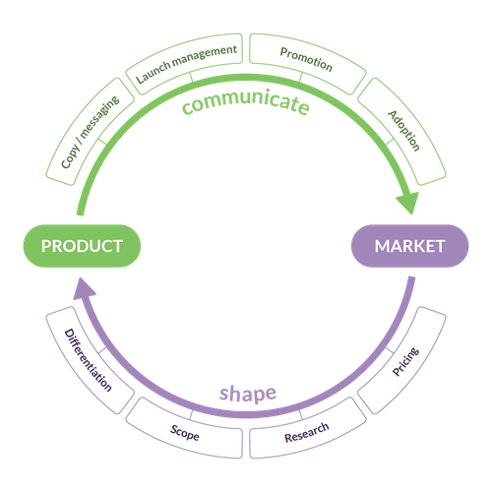
Main Tasks of Product Marketing
Messaging / Positioning
Influence Product Roadmap
Define / Execute the Go-to-Market Strategy
Persona Research and Development
Competitive Intelligence
Navigates the Launch; Advocates for the Product
Increase Product Demand and Use
And much more
Notes:
SPEAKER SCRIPT
The confusion regarding product marketing comes from the fact that it's often difficult to distinguish what it does or how it's different from the job of other departments. But it is true that product marketing does a little bit of everything.
Like the sales department, the product marketer has to be in charge of driving business growth through various marketing strategies. They also need to be in synch with engineers and developers, deciding what to build, how to build it, and the most important thing: WHY building it. Finally, as its own name says, the product marketing manager must make sure that the final product reaches the final customer.
The product marketer's responsibilities vary according to the type of company. In some, they are more of an engineer, in others a salesperson, and in some, a member of the marketing department. But it shouldn't be this way.
Product Marketing is a discipline of its own that every day has more weight in companies, and that's why we have to distinguish it perfectly. In most cases, a product marketer has three main tasks:

Slide 14
Standard PMM Bill of Materials
Create
Product / Solution messaging
GTM Strategy - the single source of business growth truth
Standard EBC Presentation with customer-facing product roadmap
The basic set of deliverables a product-focused Product Marketing Manager is responsible for.
This is just a basic list - more items may come and go depending on the effort, project, and/or task.
AR, PR, Influencer Presentations product demonstrations (recorded)
Persona and Competitive Research
Influence
Product Roadmap
All Core and Channel Sales Enablement
Special Items for Product / Solution Launches
Launch Delta messaging and copy blocks
Launch GTM Presentation (visual representation of launch deliverables across all functions and on a delivery schedule)
Launch Pitch Deck (for analyst, press, influencer briefings and global spokesperson enablement and amplification)

Slide 15

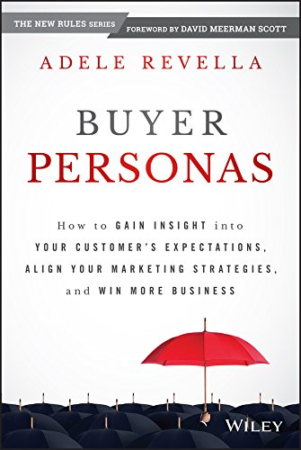



Typical PMM Go-To Reference Materials

Slide 16

Questions
I know you must have some. If you don’t, I get to ask you something

Slide 17
How Most Companies Approach Product Marketing

Slide 18
How Most Companies Do PMM
Figure Out:
Persona
Use-Cases
Value Prop
Competition
Feature Benefits
Positioning
Target Markets
Messaging
Buyer’s Journey
Build Product or Solution
Launch Product or Solution
Market Product or Solution
Notes:
First companies build the product. Then just before they launch the product or service (or in some cases they launched it already and it does not sell very well) they then try to figure out:
Who they built the product for (personas)
How it might be used (use cases)
Who the competition is
What the features are that were built into the product
How to position it in the market
What markets to target
What is the messages that will be used to try to sell the product
All too frequently, by being late with answers to these questions the end result is failure.

Slide 19
How SUCCESSFUL Companies Approach Product Marketing

Slide 20
What Great Product Marketing Looks Like
Figure Out:
Persona
Use-Cases
Value Prop
Competition
Feature Benefits
Positioning
Target Markets
Messaging
Buyer’s Journey
Build Product or Solution
Figure Out: Messaging around “Do”
Launch Product or Solution
Market Product or Solution
Notes:
From the “flow” above, Apple, on the other hand, seems to figure out first what people “do”!
Why they do it
When they do it
Where they do it
How they do it
If they find in their research lots of people doing the same kinds of things… then they look at the technologies available or that could be developed or acquired, that would enable people to get their “dos” done faster, better, and more enjoyably than ever before.
Think about what Apple has done over the years:
Think personal computing: Macintosh
Mobile music delivery: iPod
Portable computer that does more than just make phone calls… Internet in your pocket: iPhone
Mobile media delivery device: iPad
And now a computer output/input device on your wrist, Apple’s most personal device: Apple Watch
By computer, I am just using that as a shorthand for all the things people do on their computers… Get information, communicate, entertain, learn etc.
So at Apple it’s all about the “do”. Not what competitors are doing. Not about market sizes or even market share. Its about the “do”.

Slide 21
So How is Product Marketing different Compared to Other Functions

Slide 22
Product Marketing Function vs. Product Management Function
Product Marketing
Both
Product Management
Market Size / Segmentation
Buyer Persona / Needs
Messaging / Positioning
Buying Cycle
Marketing Plans / Strategy
Marketing Requirements
Competitive Analysis
Business Case
Go-To-Market Strategy
Product Roadmap Priorities
Pricing / Packaging
Field Enablement Plans
User / Persona Needs
Product Strategy
Prototyping / Concept Testing
Product Requirements
Product Development
Strategy
Content Briefings
Campaign Planning
Demand Generation Planning
Content Strategy Planning
Digital Strategy Planning
Channel Marketing Planning
Product Launch Plans
User Stories
Go-To-Market Execution
Buyer’s Journey
Field Training / Briefing
Functional Specifications
Alpha / Beta Testing
Release Readiness
Field Support
Execution
Marketing / BU Reporting
Win / Loss Analysis
Advocacy / Case Studies
Customer Retention Strategy
Up-Sell / Cross-Sell Strategies
Market Expansion Strategies
Future Roadmaps
Customer Feedback / Analysis
Feature Adoption Analysis
Run-Rate Analysis
Pipeline Analysis
Lifecycle Management
Product NPS / Customer Sat
Customer Success Updates
Growth

Slide 23
Product Marketing Function vs. Marketing Manager Function
Product Marketing
Both
Marketing Manager
Market Size / Segmentation
Buyer Persona / Needs
Messaging / Positioning
Buying Cycle
Marketing Strategy / Requirements
Content Development
Product + Market Fit
Content / Digital Strategy
Copywriting / Storytelling
Demand Strategy
Marketing + Field Activities
Market Research / Funnel
Campaign Strategy
Digital Plans
Content Plans
Demand Plans
Field Marketing Alignment
Strategy
Content Briefings
Campaign Support
Demand Generation Support
Content Performance Analysis
Digital Strategy Guidance
Channel Marketing Support
Product Launch
Campaign Refinement
Demand Refinement
Content Refinement
Measurements / Metrics
Campaign Execution
Field Marketing Alignment
SEO / Social / Paid-Search
Inbound / Outbound Strategies
Retargeting / Nurture Strategies
Channel Marketing Enablement
Execution
Marketing / BU Reporting
Win / Loss Analysis
Advocacy / Case Studies
Customer Retention Strategy
Up-Sell / Cross-Sell Strategies
Market Expansion Analysis
Pipeline Build Analysis
Measurements / Metrics
Run-Rate Analysis
Acquisition / Engagement Plans
ABM Strategies / Execution
Market Behavior / Feedback
Cross-Portfolio Strategies
Growth

Slide 24
So How Do PMMs Fit Support Other Groups?
Product Management
PM’s Help Create the Product; PMM’s Make it Marketable
PM’s and PMM’s Brainstorm Feature-Centric Marketing Strategies
Demand Generation
DG’s Researches the Platforms and Personas to Target
PMM’s Work with DG’s to Ensure the Right Comms are in Place
Content Marketing
CM’s Create Customer-Facing Content
PMM’s are the Subject Matter Experts (SMEs) for CM’s
Sales Enablement
Enablement Trains the Sales Team; PMM’s are the SMEs
PMM’s Research Competitors and Analyze Product Data
PMM’s Identify Distinguishing Product Features and Benefits

Slide 25
What is The State of Traditional Product Marketing

Slide 26







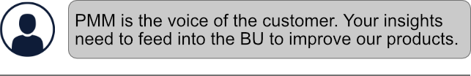

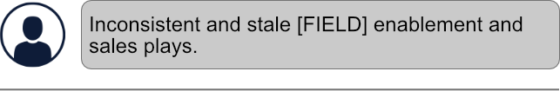


Current State vs. Desired State of PMM
What have I observed so far, versus what am I hearing from around the company?

Slide 27
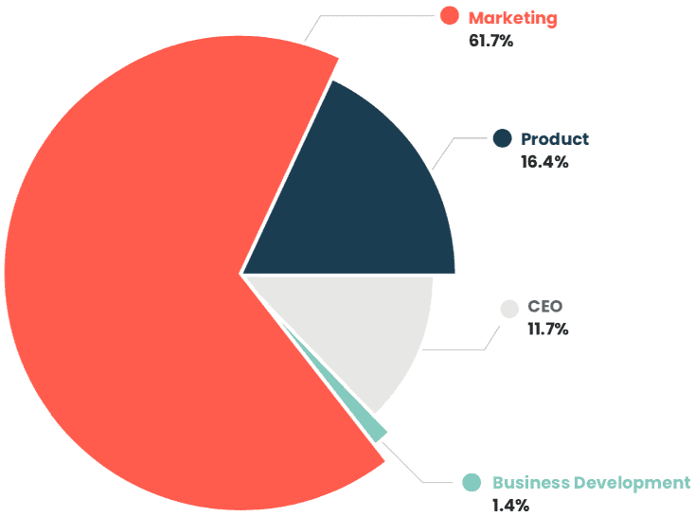
Where Does Product Marketing Fit
Product Marketing Outside of IBM: Survey conducted by the Product Marketing Alliance in 2020

Slide 28
What’s the Focus When PMM Reports to the CMO
Product Marketing’s Goals are Tied to Sales
Know the Business 24x7: Pipeline, Conversions, Revenue Attainment, Product/Feature Adoption, Account Penetration
Driving Force Hammering on the GTM Strategy Daily
We are Responsible for GTM Success
We are in the Trenches with Sales
We Focus on What Message Works Best
We Know What They Need to be Successful
We Know Where They are Struggling and How to Mitigate it
Product Marketing reports into the CMO for company when it:
Wants to experience hypergrowth
Is experiencing hypergrowth
This is because you need Product Marketing as close to the Sales process as possible.
We are Promoting IBM and our Products to Analysts, Journalists, Influencers and Partners
We know EVERYTHING About Our Competition
We are the Subject Matter Expert for our Products

Slide 29





What Does GREAT Product Marketing Look Like?
Puts the CUSTOMER at the CENTER of everything they do.
NAILS the MESSAGING -- completely, every time.
Sadly… we are not there today for one reason or another - the reasons are irrelevant.
What is important is that we will be great STARTING today.
Is TIMELY
Focus on BOLD and CREATIVE Solutions
MEASURES and TRACKS for Business Success
Notes:
Puts the customer at the center of everything: Product marketers must have a deep understanding of the customer and the market. In other words: they need to put customers at the center of everything they do. Success here often happens behind the scenes through great customer engagement and internal enablement.
Nails messaging: You might have a killer product, amazing services, and unparalleled internal support. But none of that matters if you aren’t doing a good job explaining what your product does and how it helps your customers.
Is timely: Product launches should be well-executed and well-timed to the needs of customers and the market. Product marketing should work alongside business and product leaders to position messaging and releases appropriately.
Focuses on bold and creative solutions: Today’s product marketers are creative, out-of-the-box thinkers. For the examples in this section, we focused on brands that are leveling up product marketing across the board. Who got creative in the face of challenges? Who spearheaded new ideas and delivered for their clients?
Measures and tracks for business success: Nothing we do, or should every willingly do, should be taken on without established success metrics that map back to revenue attainment

Slide 30
How Does Great Product Marketing Flow
BU Leadership
AR / PR
(Influencer Relations)
Market
GAPS / PRIORITIES
Market Position
MARKET
INSIGHTS
PRODUCT MARKETING
Customers
GTM Exec.
CORP MARKETING / SALES / CHANNEL
(Segments and, Verticals)
Competitive
REQUIREMENTS
Product Management
CUSTOMER INTIMACY
Deep understanding of market, competitors, use-cases and customers
PRODUCTS CUSTOMERS WANT
Market requirements that guide whole
product / solution development
PRODUCTS STRATEGY / GTM
Guide marketing and sales with market strategy, focus, positioning, and insights

Slide 31
Questions
I know you must have some. If you don’t, I get to ask you something

Slide 32
What are My Expectations of You

Slide 33
What I Expect From You
The collection of individual commitment and ownership leads to a higher functioning team.

Slide 34
What I Expect Out of Our Team
We Must Be Greater At All Levels
Be The Most Admired Brand In Technology
Set The Bar For Product Marketing Excellence At IBM
Make It Easier For Our Sales Teams To Crush The Quarter
Operate With Urgency, Purpose And Agility - Like The Number 1 F1 Race Team On The Track

Slide 35
How Do You Get There? SAMPLE Team Goals

Slide 36
SAMPLE: 2H Product Goals - Focus on Awareness and Business Growth
Own Block
(Bias on Enterprise)
Beyond Block
(File, Cloud and SDS)
The Business of [Cyber] Security
Business Velocity and Efficiency
People Development
Increase Block Storage Market awareness by 10%
Simplify and Differentiate bold and unique “single product” led message for distributed file and object
Broaden Data Protection Messaging pivot to the bigger Data Resilience focus for BC/DR and Cyber Protection.
Inbound Marketing Responsibility formalize market insights and key learnings into MRDs - at least (1) per quarter
Create a World-Class Product Marketing organization; mentor/learn from other PMMs.
Drive STaaS influence no less than 50 opportunities driven to sales close/win in 2H
Identify and drive retention of key talent. Build primary and secondary SME base. Plan for succession.
Narrow the Focus so that sales wins. Generate 4 specific use cases by end of Q3, targeted sales plays, and a 45% or better rep participation rate.
Know Your Business learn how business is transacted and measured, keep and report on monthly dashboards
FlashSystem Challenge develop and present a viral customer engagement plan - including proposal, cost, options, and success metrics before [DATE]
Invest in You, Inc. complete one skills development, mentoring program, etc. per quarter.
Master the Competition complete battle cards for our top (3) competitors
Employee Recognition: Send a weekly thank you, write a review on LinkedIn, formally acknowledge someone’s greatness!
Be Part of the Future define, draft, and submit at least (1) patent.

Slide 37
SAMPLEPMM: 2H Product STRETCH Goals
Own Block
(Bias on Enterprise)
Beyond Block
(File, Cloud and SDS)
The Business of [Cyber] Security
Business Velocity and Efficiency
People Development
Increase Block Storage Market awareness by 10%
Simplify and Differentiate bold and unique “single product” led message for distributed file and object
Broaden Data Protection Messaging pivot to the bigger Data Resilience focus for BC/DR and Cyber Protection.
Inbound Marketing Responsibility formalize market insights and key learnings into MRDs - at least (1) per quarter
Create a World-Class Product Marketing organization; mentor/learn from other PMMs.
Drive STaaS influence no less than 50 opportunities driven to sales close/win in 2H
Identify and drive retention of key talent. Build primary and secondary SME base. Plan for succession.
Narrow the Focus so that sales wins. Generate 4 specific use cases by end of Q3, targeted sales plays, and a 45% or better rep participation rate.
Data Encryption Solution Play partner with Thales to drive an always-on, no penalty data encryption solution. Target NA, S2 and 10 successful deployments by year end
Know Your Business learn how business is transacted and measured, keep and report on monthly dashboards
FlashSystem Challenge develop and present a viral customer engagement plan - including proposal, cost, options, and success metrics before [DATE]
Invest in You, Inc. complete one skills development, mentoring program, etc. per quarter.
DAS Consolidation Play leverage scale to drive DAS consolidation to shared storage with bias toward unstructured analytics
Master the Competition complete battle cards for our top (3) competitors
Ransomware Recovery Runbook partner with engineering delivering MRD on using storage config details to build and automate an array-based recovery runbook.
Employee Recognition: Send a weekly thank you, write a review on LinkedIn, formally acknowledge someone’s greatness!
Pump Up The Volume install-base play targeting Safeguarded Copy with no less than 25% feature adoption rate.
Be Part of the Future define, draft, and submit at least (1) patent.

Slide 38
IBM Storage PMM: 2H Functional Goals - Focus on Scale and Success
PMM Scale and Efficiency
Market Success Accountability
Customer and Market Knowledge
Communicate Market Position
Equip Sales for Success
Align to PMM Framework by [DATE]
Quarterly Win/Loss analysis completed no later than 3 weeks prior to earnings call
Complete Buyer Persona Database for decision makers, influencers, and implementers reviewed and updated quarterly.
Published Social Media Plan current month+1 with end of month channel performance reports.
Quarterly Enablement metrics and reporting no less than 3 weeks prior to current qtr. end.
Stay Agile and Dynamic participate in daily or weekly standups
Quarterly Reference dashboard report no later than 3 weeks prior to current qtr. end.
Source and Publish Monthly Storage Newsletter transmitted on the first Monday of the month to internal and external field sales.
Accurate and updated IBM Storage Content / Asset Tracker refreshed monthly, link in newsletter.
Protect Your Time no meetings without agendas, no tasks that can’t be measured or mapped to revenue
Case Studies / Reviews grow Gartner Peer Insight reviews by 50% QoQ. Keep updated case study repository adding (2) per quarter
Launch Success make all product launches INSANE -- meeting no less than 80% of pre-launch objectives
Quarterly Analyst and Influencer Briefings based on defined format, target at least Tier 1 analysts firms and influencers
GTM Strategy Ownership and Success Plan by [DATE] - guides EVERYDAY activity; if it’s not on the plan, it’s not relevant

Slide 39
IBM Storage PMM: 2H Functional STRETCH Goals
PMM Scale and Efficiency
Market Success Accountability
Customer and Market Knowledge
Communicate Market Position
Equip Sales for Success
Align to PMM Framework by [DATE]
Quarterly Win/Loss analysis completed no later than 3 weeks prior to earnings call
Complete Buyer Persona Database for decision makers, influencers, and implementers reviewed and updated quarterly.
Published Social Media Plan current month+1 with end of month channel performance reports.
Quarterly Enablement metrics and reporting no less than 3 weeks prior to current qtr. end.
Stay Agile and Dynamic participate in daily or weekly standups
Quarterly Reference dashboard report no later than 3 weeks prior to current qtr. end.
Source and Publish Monthly Storage Newsletter transmitted on the first Monday of the month to internal and external field sales.
Accurate and updated IBM Storage Content / Asset Tracker refreshed monthly, link in newsletter.
Protect Your Time no meetings without agendas, no tasks that can’t be measured or mapped to revenue
Case Studies / Reviews grow Gartner Peer Insight reviews by 50% QoQ. Keep updated case study repository adding (2) per quarter
Launch Success make all product launches INSANE -- meeting no less than 80% of pre-launch objectives
Sales Content Steering Committee geo representation, held monthly with focus on stage-based assets.
Quarterly Analyst and Influencer Briefings based on defined format, target at least Tier 1 analysts firms and influencers
Website Refresh reviewed monthly on the first Monday of the month to internal and external field sales.
A Day in the Life: Pick (2) customers per quarter - get to know them, find out what their challenges are, why they chose IBM, share your experience on our PMM quarterly business review
GTM Strategy Ownership and Success Plan by 02/01/2022 - guides EVERYDAY activity; if it’s not on the plan, it’s not relevant
Maintain accurate events calendar supporting them as needed
Consistent and accurate content layout in Siesmic, reviewed monthly.

Slide 40
Product Marketing On a Page

Slide 41
The Role of PMM on a Page
Disciplines
Key Stakeholders
Process Interlocks
Segmentation and Targeting
Persona Development
Competitive Research
Messaging
GTM Strategy / Workflow
Field Enablement
Within Marketing
Outside Marketing
GTM Planning
Campaign Planning
Content Development
Budgeting
Field Enablement
Influencer Strategy
AR / PR Strategy
Content Strategy and Ops
Field, Channel and Demand
Brand and Comms
Marketing Ops
Campaigns and Programs
Field Leadership
Sales Enablement Team
Offering Management
Legal
Service and Support
Activities
Success Metrics
GTM Strategy
Buyer Insights
Messaging
Offers to Market
Enablement
Revenue / Win Target
GTM Initiatives
Pipeline Value, Volume & Velocity
Win Rates, Conversion Rates
AR, PR, Influencer Amplification
Enablement
Asset Utilization
Rep Participation Rates
Deal Cycles, Win/Loss Ratios
Marketing Support
Campaign Performance
Site Traffic / Social
MQLs and SQLs
Win/Loss Ratios
Product / Feature Adoption
Onboarding Data
Feature Adoption
Churn Rates
Audience Segmentation
Portfolio to Buyer’s Need Mapping
GTM Framework
Status and Reporting
Persona Development
Buyer’s Journey Mapping
Persona Specific Messaging
Accurate and Complete Product Messaging Guide
Value Props and Narratives
Define content needs
KPI Reporting
Cross-Portfolio
Blue-on-Blue if it makes sense
Define Launch Tiers
Define Launch Calendar
Align to Campaigns and Programs
Create, Execute, and Measure Launch Plan
Stage-Based Enablement
Content and Messaging for Targeted Personas
Participation Rate and Asset Perf. Tracking
Notes:
GO-TO-MARKET INITIATIVES
Establishing clear messaging to connect product to buyer is at the heart of any effective product marketing team. Between extensive buyer persona research, gaining product expertise, and understanding the competitive landscape inside and out, creating a go-to-market strategy is nuanced, time-intensive, and its success is often hard to gauge. With that said, a few metrics can be useful in determining how your positioning is landing.
Win rates: though closing an opportunity takes a village, it’s dramatically harder to win a prospect’s favor without a strong messaging foundation for marketing and sales to effectively nurture them throughout an entire deal cycle. Increases in win rates after re-positioning exercises or large product updates can be reliable indicators that product marketing is delivering as expected.
Conversion rates: If product marketing is fueling your demand generation engine (as it should be), there are several ways to identify the potency of your messaging. Identifying the right segments for your marketing team to target sets the stage for their success, and as such, should be considered a critical stat for any well-integrated product marketing team to monitor.
Analyst reports: If analyst relations falls under product marketing at your organization, this is a tremendous way to understand how your messaging is differentiating you from competitors. By subjecting your product and messaging to scrutinization by industry experts, you’ll know just how potent your offering is. As analyst reports are incredibly popular in the market (and are significantly important in the researching buyer’s journey), this can be a risky undertaking for startups or unsophisticated products, but the learnings you can obtain year over year will undoubtedly help you identify where your messaging and strategy need improvement or, conversely, can drive immense demand should your be received favorably.
SALES ENABLEMENT
Product marketing is often on the hook for ensuring sales teams and customer success managers have the information, resources, and confidence to comfortably handle relations with prospects and existing customers. There are several tasks that go into a strong sales enablement process, and the following metrics are likely to be strong indicators of its effectiveness.
Asset utilization: When you make collateral to support your sales team in prospecting and progressing pipeline through the funnel, are they using it? If your intranet (Google Drive, Sharepoint, etc) captures usage data, this can be a tremendous indicator of the saliency of your internal-facing content. Depending on how targeted the asset is (job title, industry, sales stage), this can lend itself to further analysis around specific segments and product features.
Deal cycles: How long, on average, does a sale take? From the discovery call to signing the contract, are there bottlenecks or points of contention that proper sales enablement could alleviate? The right preparatory material at the right time can help sales step on the gas and shorten deal cycles, a tremendous indicator of strong product marketing influence.
Win/Loss ratio: At its most basic level, sales enablement strives to increase success rates - the percentage of wins sales captures. Notice the nuance here versus the total number of wins; enablement doesn’t lead to a higher volume of opportunities, but should increase the rate of success in the opportunities they’re given.
MARKETING SUPPORT
This could span from messaging frameworks to be leveraged by demand generation and content marketing to product announcements to high-level brand identity. Depending on the size of your company, this will be nuanced, but one statistic almost always reveals the strength of product marketing’s impact on the greater marketing team’s success.
Campaign performance: Is the messaging you’ve prescribed to your demand generation team landing? What about your paid/organic social teams? A/B testing of new vs. old content can certainly help identify the delta of a reimagined messaging framework, and is one of the most objective measures of product-market fit available. If you’re using a sophisticated ESP, use campaign data as a feedback loop, understanding which links and incentives generate higher levels of engagement to help fine-tune your go-to-market strategy.
Site traffic: Increasing the volume of visitors to your website is certainly a cross-functional endeavor, but product marketing lays its foundation. Brand awareness, product specifications, and release updates are rooted in the go-to-market strategy that product marketing builds, and improvements to search performance (impressions, average position, clicks, etc) and an increase in site visitors are reliable indicators of the message’s potency.
MQLs and SQLs: Once visitors reach your site or engage with your messaging across channels, are they raising their hands? Has product marketing positioned the product as something your visitors need to have? By identifying spikes or dips in MQLs and SQLs, we can get a sense of how receptive the market is to the story product marketing creates. SQLs provide an added layer: did we reach and compel the audience that’s actually a fit for our product, or does the conversation end at the discovery/MQL stage?
PRODUCT ADOPTION
One of, if not THE most direct indicator of a strong product marketing output is product adoption. If PMM’s high-level responsibility is to translate product features into customer value points, measuring the onboarding and usage rates of your products is a critical litmus test for any product marketer.
Onboarding data: At the onset of a contract, are customers using the product as much as you think they should? Are they using all the features available to them? If they aren’t, is there collateral that can help them understand how to maximize the usage of their new platform? The first quarter of a customer’s engagement with a tool is a strong reflection of product marketing’s ability to showcase the product to those who are already bought-in (and likely more engaged with your marketing materials than prospects).
Feature adoption: Similarly, when product marketing creates messaging around new features or cross-sell options, how quickly is that translating to adoption? Are customers signing up for beta programs at a high volume, and are their renewals increasing in price over time? Keeping an eye on how new offerings are performing can be indicative of appropriate messaging around them.
Churn rates: While product marketing might not directly help a customer accomplish their goals, throughout the market there are competing product marketers that are making a compelling argument to leave your brand for theirs. If your messaging doesn’t instill trust in your customers, they’ll be more willing to evaluate other options. It’s the product marketers job to ensure that customers know you’re innovating and can solve their needs better than the rest of the market. Changes in churn rates signal a lack of trust in the product and, ultimately, the messaging supporting it.

Slide 42
IBM Storage Product Marketing Deliverables

Slide 43
Standard PMM Bill of Materials
The Product / Solution messaging guide
All Core Sales Enablement assets by sales stage
GTM Strategy - the single source of business growth truth
The basic set of deliverables a product-focused Product Marketing Manager is responsible for.
This is just a basic list - more items may come and go depending on the effort, project, and/or task.
AR, PR, Influencer Presentations product demonstrations (recorded)
Product Maturity Model or other self-assessment with recommendations
Standard EBC Presentation with customer-facing product roadmap
Special Items for Product / Solution Launches
Launch Delta messaging and copy blocks
Launch Presentation (visual representation of launch deliverables across all functions and on a delivery schedule)
Launch Pitch Deck (for analyst, press, influencer briefings and global spokesperson enablement and amplification)

Slide 44
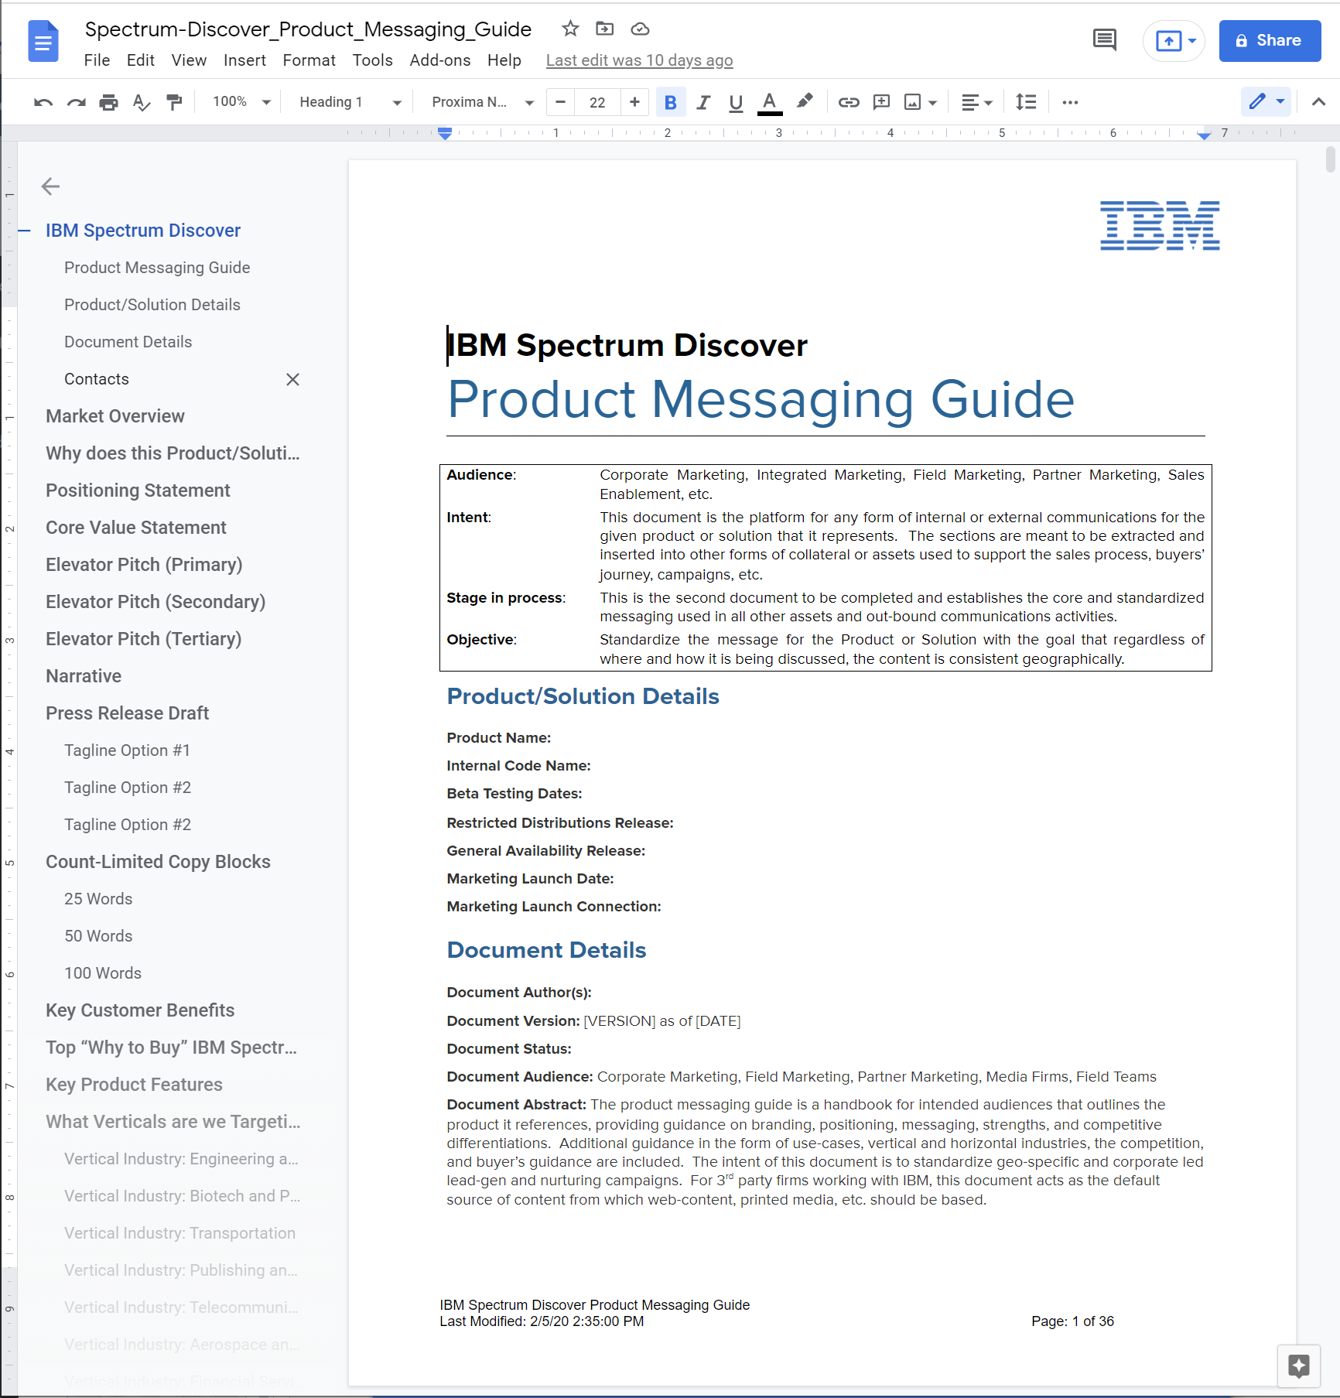
The Product Messaging Guide
This is the single source of marketing truth for the storage products that are considered “Growth Targets” by the business.

Slide 45
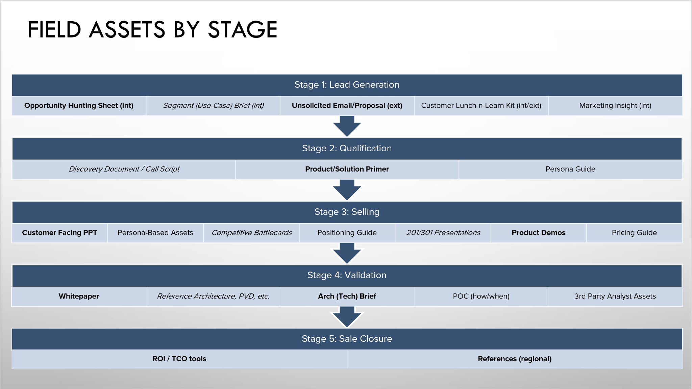
Stage-Based Sales Enablement
With a complete product messaging guide, you can copy/paste your way to creating every key sales asset to enable our field to transact deals faster!
Notes:
These are the assets that you need to run PLG enablement based on the Sales person’s perspective. I don’t know the sales stages off the top of my head.

Slide 46
Questions
I know you must have some. If you don’t, I get to ask you something

Slide 47
That’s It
Let’s Talk About This

