Slide 1

Git
A Version-control system.

Slide 2
Agenda
What is repository?
What is version-control system?
What is git?
Introduction to git.
Git terminologies/buzz words
Why git is used?
Where git can be used?
How git can be used?
Features of git.

Slide 3
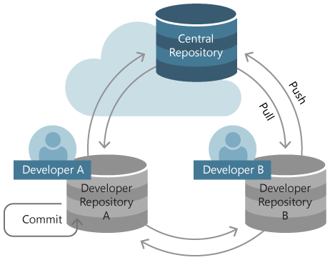
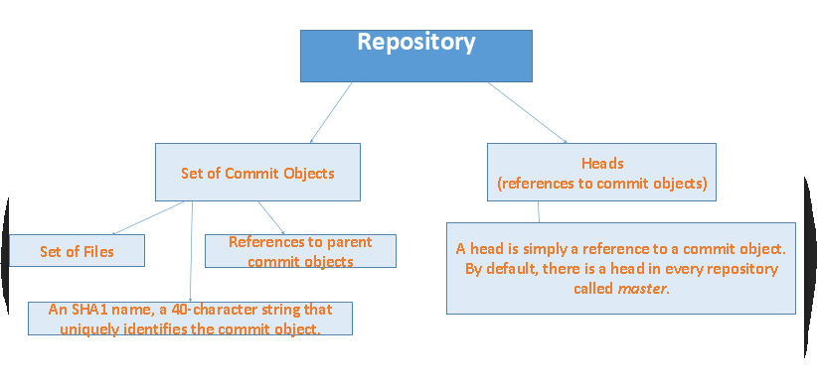
What is repository?
Its central location in which data is stored, managed and packages may be retrieved and installed on a computer.
It has a hierarchical structure.

Slide 4
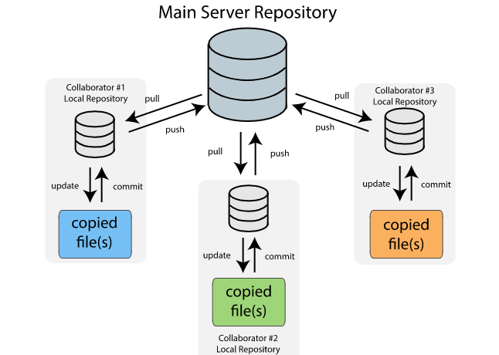
What is version-control system?
A version control system is a repository of files, often the files for the source code of computer programs, with monitored access.
Every change made to the source is tracked, along with who made the change, why they made it, and references to problems fixed, or enhancements introduced, by the change.

Slide 5
What is Git?
Git is a distributed, open-source version control system (VCS) that enables :-
store code
track revision history
merge code changes
revert to earlier code version when needed.

Slide 6
Introduction of Git
Created by Linus Torvalds, creator of Linux, in 2005 – Came out of Linux development community – Designed to do version control on Linux kernel.
Goals of Git:
Speed
Support for non-linear development (thousands of parallel branches)
Fully distributed
Able to handle large projects efficiently

Slide 7
Git terminologies/buzz words
> git clone :- It copies the git remote repository to the local machine(local repository) .
> git add :-

Slide 8
Title and Content Layout with Chart

Slide 9
Two Content Layout with Table
First bullet point here
Second bullet point here
Third bullet point here
Class | Group A | Group B
Class 1 | 82 | 95
Class 2 | 76 | 88
Class 3 | 84 | 90

Slide 10
Two Content Layout with SmartArt
Group A
Task 1
Task 2
Group B
Task 1
Task 2
Group C
Task 1
First bullet point here
Second bullet point here
Third bullet point here

Slide 11
Add a Slide Title - 1

Slide 12
Add a Slide Title - 2

Slide 13
Add a Slide Title - 3

Slide 15
Add a Slide Title - 4

Slide 16
Add a Slide Title - 5

