Slide 1
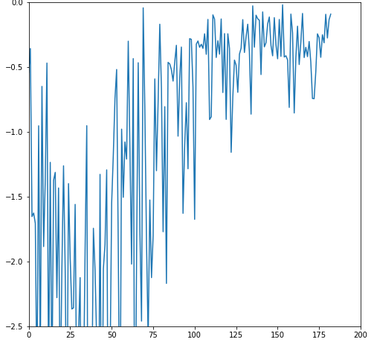
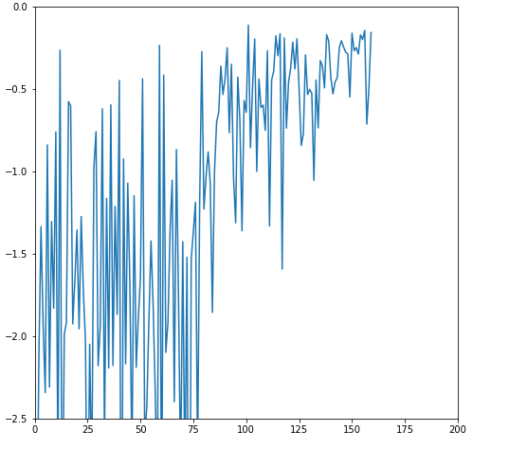
Always 20 steps
Always 20 steps
20 steps, but episode cutoff if reward=-0.1 or more

