Slide 1


Distributed Network
Weichun Xu
Advisor: Fareena Saqib

Slide 2
Content
Introduction
Design Structure and Command Format
Debug Structure
Verification Environment and Test List
Simulation Result and Code Coverage
Reference

Slide 3
Introduction
Distributed Network
Distributed computing network system
Part of distributed computing architecture
Deliver the data to remote computers for processing
2 kinds of distributed computing system
Multiprocessing that takes place on one computer
Run programs in parallel on multiple computers
Distributed computing system models
Traditional client/server computing model
Cloud computing model

Slide 4
Introduction
Current research focus on using CPUs or GPUs to process data in parallel, e.g.:
Using tens of thousands of CPU cores to realize large scale distributed deep networks
In the presentation, we will focus on using FPGA parallel computing

Slide 5
Design Structure
dn_host
dn_device0~3
fifo0
spi_m0
spi_s0
fifo0
fifo1
spi_m1
spi_s1
fifo1
rx
uart2fifo_ctrl
fifo2
spi_m2
spi_s2
fifo2
fifo3
spi_m3
spi_s3
fifo3
tx_fsm_start
register
fifo0
spi_s0
spi_m0
fifo0
fifo1
spi_s1
spi_m1
fifo1
rx
uart2fifo_ctrl
fifo2
spi_s2
spi_m2
fifo2
fifo3
spi_s3
spi_m3
fifo3

Slide 6
Command Format
Command Byte Format:
cmd[2] | cmd[1] | cmd[0] | broadcast/unicast | fifo/register | addr[2] | addr[1] | addr[0]
cmd[2:0]: 0x1 – write; 0x2 - read
broadcast/unicast: 1 – broadcast; 0 – unicast #broadcast is useless for writing/reading register
fifo/register: 1 – fifo; 0 – register
addr[2:0]: register address; range in [0:7] #addr is useless for writing/reading fifo
Write Register
0 | 0 | 1 | x | 0 | addr[2] | addr[1] | addr[0]
data[7] | data[6] | data[5] | data[4] | data[3] | data[2] | data[1] | data[0]
Read Register
0 | 1 | 0 | x | 0 | addr[2] | addr[1] | addr[0]

Slide 7
Command Format
Write Fifo
Unicast Mode
0 | 0 | 1 | 0 | 1 | x | x | x
length[7] | length[6] | length[5] | length[4] | length[3] | length[2] | length[1] | length[0]
data[0][7] | data[0][6] | data[0][5] | data[0][4] | data[0][3] | data[0][2] | data[0][1] | data[0][0]
……
data[length-1][7] | data[length-1][6] | data[length-1][5] | data[length-1][4] | data[length-1][3] | data[length-1][2] | data[length-1][1] | data[length-1][0]
Broadcast Mode
0 | 0 | 1 | 1 | 1 | x | x | x
length[7] | length[6] | length[5] | length[4] | length[3] | length[2] | length[1] | length[0]
data[0][7] | data[0][6] | data[0][5] | data[0][4] | data[0][3] | data[0][2] | data[0][1] | data[0][0]
……
data[length-1][7] | data[length-1][6] | data[length-1][5] | data[length-1][4] | data[length-1][3] | data[length-1][2] | data[length-1][1] | data[length-1][0]
Read Fifo
0 | 1 | 0 | x | 1 | x | x | x

Slide 8
Debug Structure
fifo0
spi_m0
spi_s0
fifo0
fifo1
spi_m1
spi_s1
fifo1
rx
uart2fifo_ctrl
fifo2
spi_m2
spi_s2
fifo2
fifo3
spi_m3
spi_s3
fifo3
rx_tx_loopback_en
uart2spi_fifo_loopback_en
spi_loopback_en
spi_fifo_loopback_en
fifo0
spi_s0
spi_m0
fifo0
fifo1
spi_s1
spi_m1
fifo1
rx
uart2fifo_ctrl
fifo2
spi_s2
spi_m2
fifo2
fifo3
spi_s3
spi_m3
fifo3

Slide 9
Debug Structure
ctrl register
Pin
virtual_env
dn_host
2
1
0
0
0
dn_host_debug_en
ctrl
0
spi_loopback_en
ctrl[2]
2
ctrl
2
0
uart2spi_fifo_loopback_en
ctrl[1]
1
1
ctrl[0]
0
0
0
rx_tx_loopback_en
ctrl
0
spi_fifo_loopback_en
ctrl[3]
3
0
dn_device_debug_en
dn_device

Slide 10
Verification Environment
uart transaction
uart scoreboard (include RM)
uart transaction
DUT
uart sequencer
uart driver
uart monitor
uart transaction
tx
rx

Slide 11
Test List
Test Name | Description
uart_multiple_write_reg_test | Check register path
uart_multiple_write_fifo_unicast_test | Check data path, verify unicast mode and write one byte
uart_multiple_write_fifo_burst_unicast_test | Check data path, verify unicast mode and write multiple bytes
uart_multiple_write_fifo_broadcast_test | Check data path, verify broadcast mode and write one byte
uart_multiple_write_fifo_burst_broadcast_test | Check data path, verify broadcast mode and write multiple bytes
uart_multiple_write_fifo_randcast_test | Check data path, write one byte, random unicast and broadcast
uart_multiple_write_fifo_burst_randcast_test | Check data path, write multiple bytes, random unicast and broadcast
uart_rx_tx_loopback_test | Loopback uart tx to uart tx
uart_hard_uart2spi_fifo_loopback_test | Use pin to enable debug mode and enable SPI fifo loopback in dn_host
uart_soft_uart2spi_fifo_loopback_test | Use register to enable debug mode and enable SPI fifo loopback in dn_host
uart_hard_spi_loopback_test | Use pin to enable debug mode and enable SPI loopback in dn_host
uart_soft_spi_loopback_test | Use register to enable debug mode and enable SPI loopback in dn_host

Slide 12
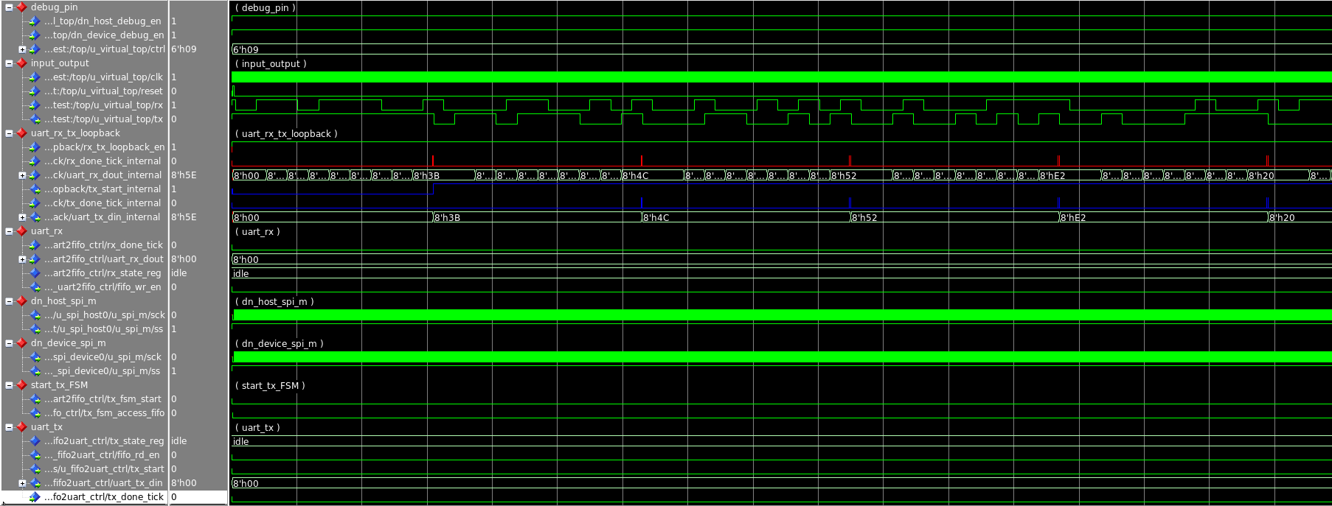
Simulation Result
Rx to Tx loopback

Slide 13
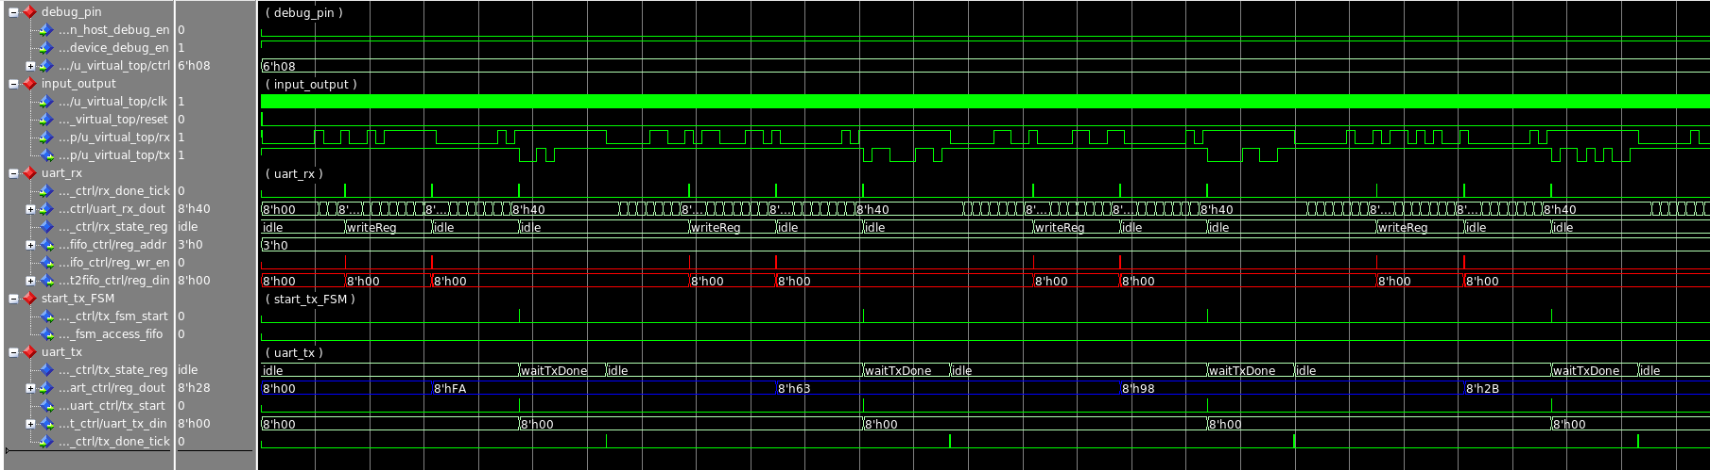
Simulation Result
Write/Read Register

Slide 14
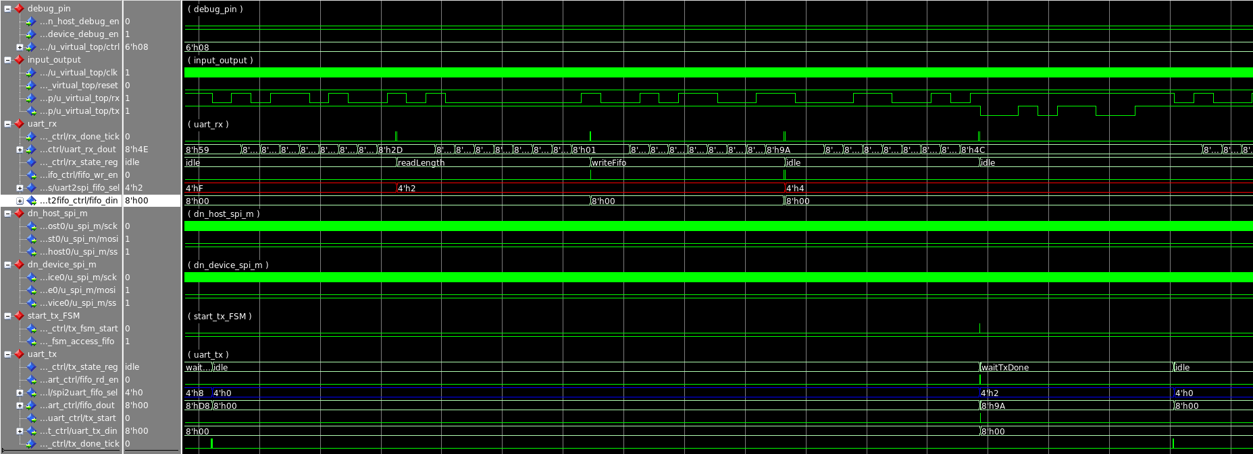
Simulation Result
Write/Read one byte with Unicast mode

Slide 15
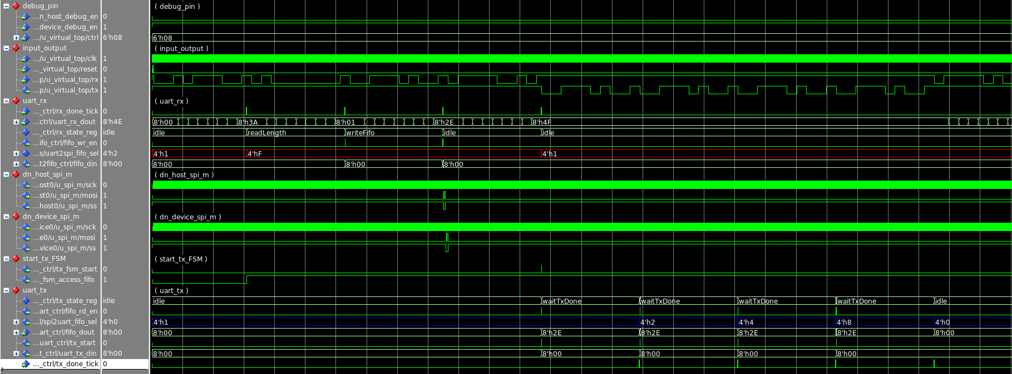
Simulation Result
Write/Read one byte with Broadcast mode

Slide 16
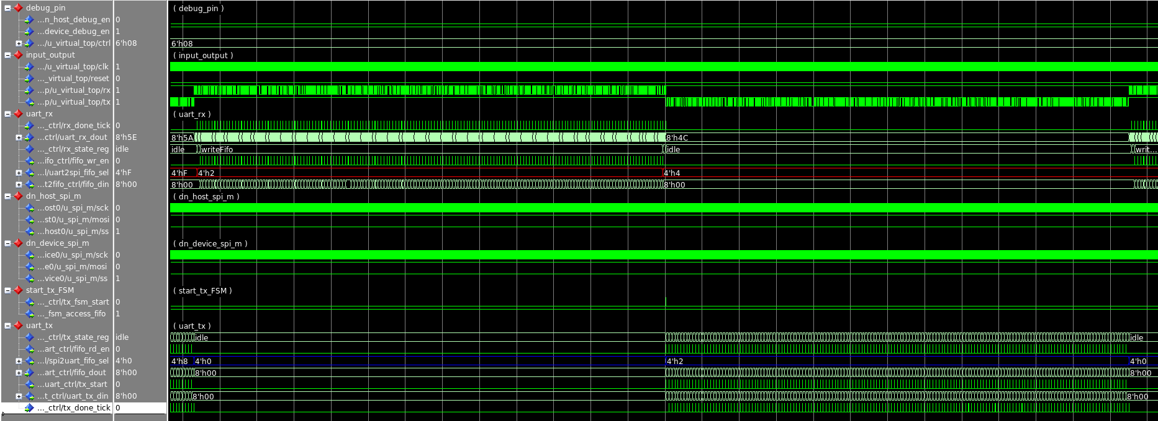
Simulation Result
Write/Read multiple bytes with Unicast mode

Slide 17
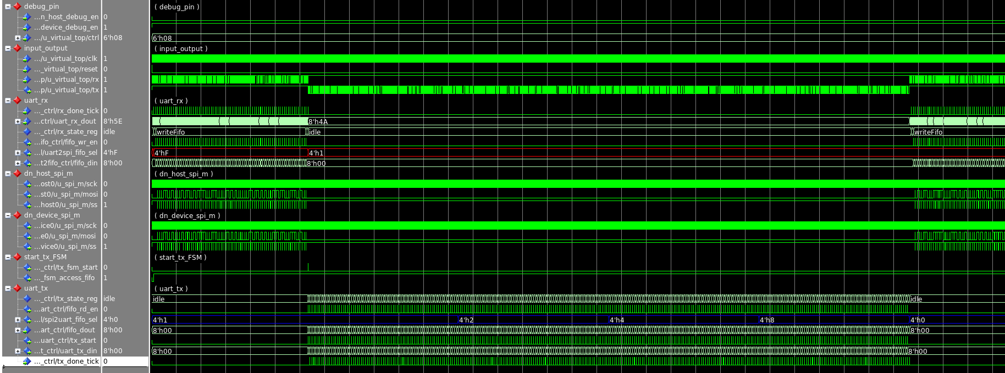
Simulation Result
Write/Read multiple bytes with Broadcast mode

Slide 18
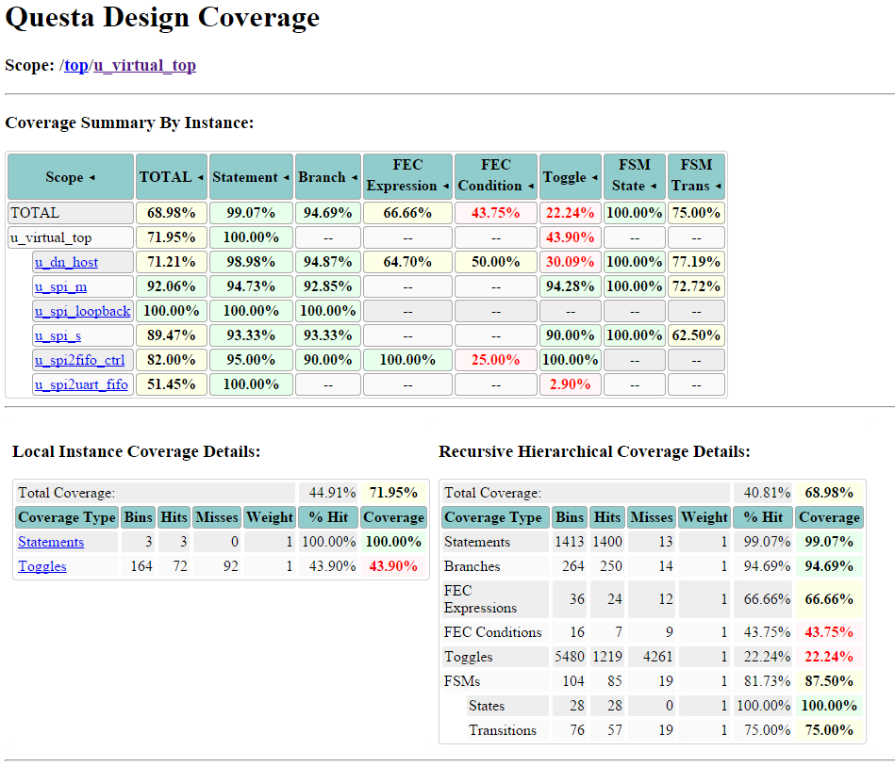
Code Coverage

Slide 19
Future Work
Design
Use High Speed Interface (SATA, PCIE, etc.)
Parity check or CRC check between UART transmission
Handshake between dn_host and dn_device for quality assurance
Control the start of SPI Master in dn_host
Verification
Enhance code coverage
Enhance the scoreboard to make it more flexible
Add assertion on loopback path
Add Functional coverage

Slide 20
Reference
Jeffrey Dean, Greg S. Corrado, Rajat Monga, Kai Chen, Matthieu Devin, Quoc V. Le, Mark Z. Mao, Marc’Aurelio Ranzato, Andrew Senior, Paul Tucker, Ke Yang and Andrew Y. Ng: Large Scale Distributed Deep Networks
Erik Nygren, Ramesh K. Sitaraman and Jennifer Sun: The Akamai Network: A Platform for High-Performance Internet Applications
Chee Shin Yeo, Rajkumar Buyya, Hossein Pourreza, Rasit Eskicioglu, Peter Graham and Frank Sommers: Cluster Computing: High-Performance, High-Availability, and High-Throughput Processing on a Network of Computers
David P. Anderson, Eric Korpela and Rom Walton: High-Performance Task Distribution for Volunteer Computing

Slide 21
Q&A
Thank You

