Slide 1
DEFCON 31 SAO
Market Research
SWAP-CR
Approach

Slide 2
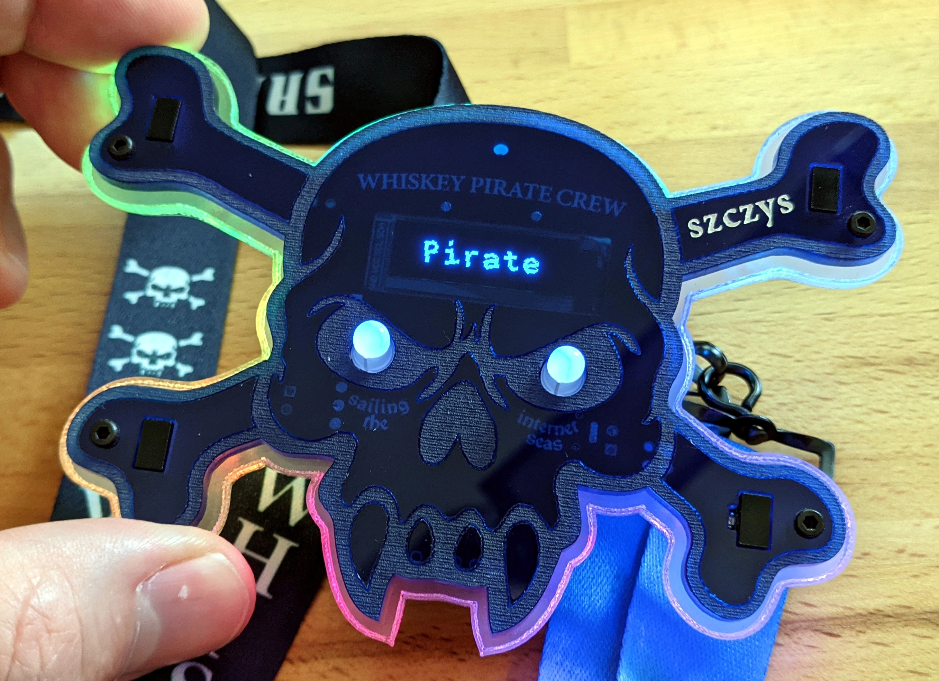
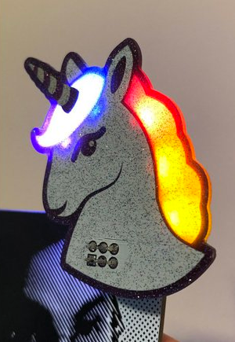
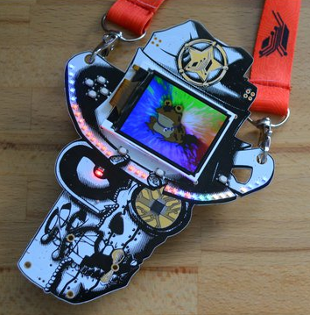
Market Research
Silly Add Ons (SAO) have been made for other conventions
  #badgelife
    https://www.youtube.com/watch?v=YqdBiOj8uXw
  Often use Light Emitting Diodes (LEDs) and Printed Circuit Boards (PCBs)
  Most have 2*2 or 2*3 100 mil header to collect power from the host badge

Slide 3
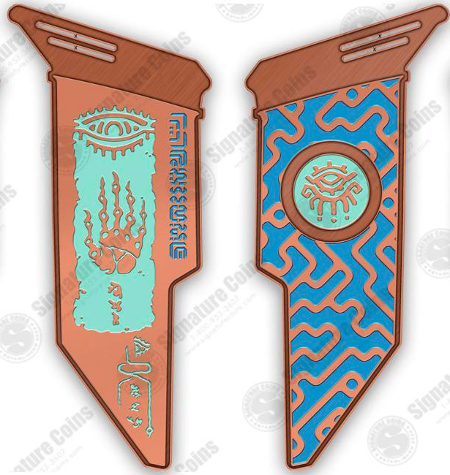
Market Research
Specs posted May 17
  https://media.defcon.org/DEF%20CON%2031/DEF%20CON%2031%20badge/
    Svg board outline
    Blender File shell
      Cleaned up for 3D print here:
        https://www.thingiverse.com/thing:6060558
Limited time (June 9 as of writing) for designs to appear online
  One example -->
    https://www.reddit.com/r/Defcon/comments/13yoc96/my_final_proof_submitted_for_release_to_pressing/

Slide 4
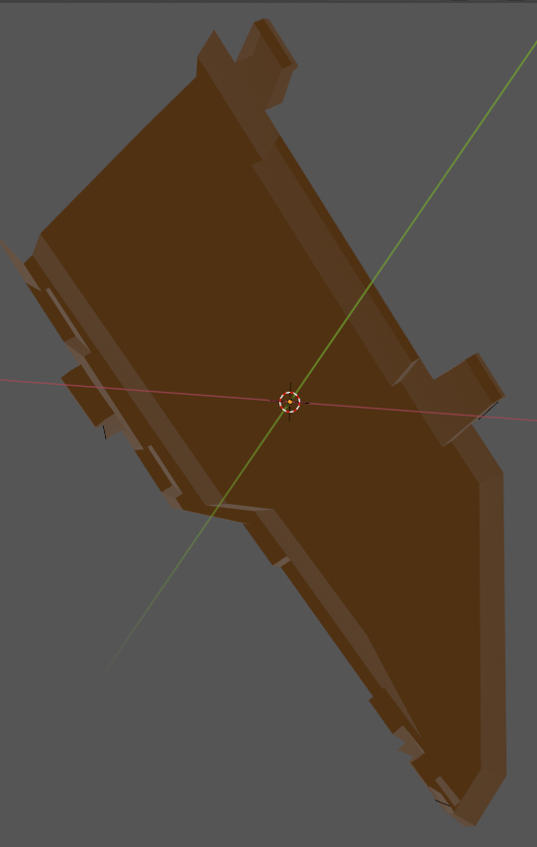
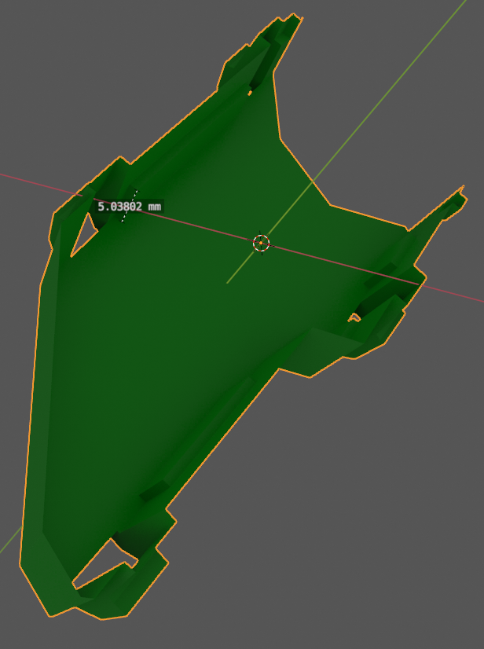
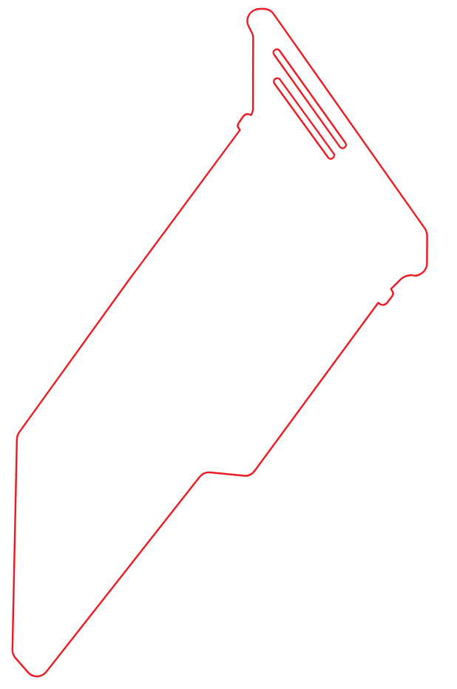
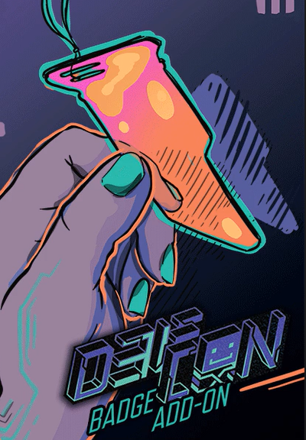
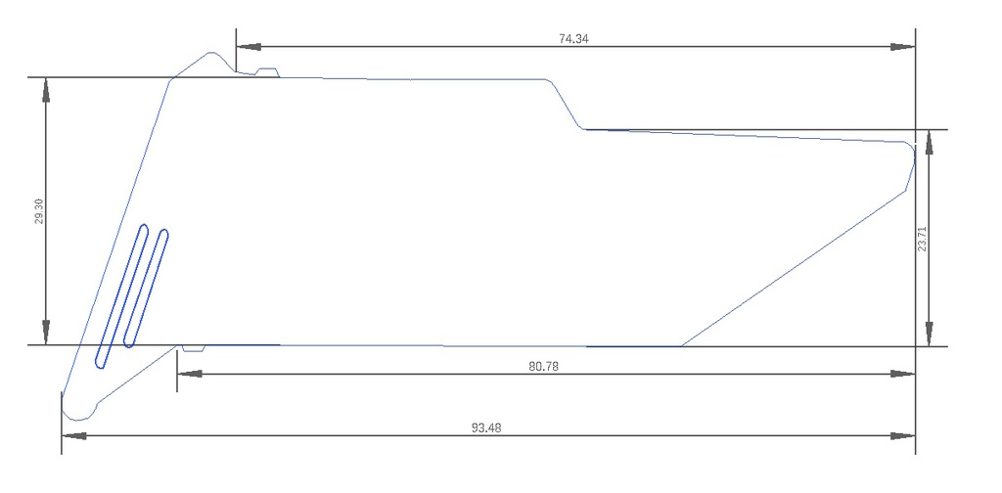
Size
Front shell cavity (atop PCB)
Clam Shell
Front/back
Rear shell cavity (behind PCB)
1.08 mm
SAO slides into the (provided) clam shell case
SAO outline is dictated by badge slot dimensions on 3 sides
  Roughly 3.5” * 1”
  Extensible in long dimension
3D complex geometry
Front/rear
PCB
Contact
points
Extensibility
Gravity
Dimensions in mm
Slides into cavity
this way

Slide 5
Weight
Bulk (>50%) of weight will come from battery
  9 grams for 400 mAh (<0.02 lb)
  http://www.ibt-power.com/Battery_packs/Li_Polymer/Lithium_polymer_cells.html
  Assumed to be a non-issue
    Expecting badge to weigh notably more than SAO

Slide 6
Power
Cavity behind badge is roughly 5mm deep
  Roughly 26.5 mm “wide” and 38m “tall”
  LiPo battery naming is DDWWHH, in mm, where depth omits decimal place
    ex. Common CR2032 dime cell is 20 mm diameter and 3.2 mm deep
    LP452530, 420 mAh
      https://www.lipobattery.us/lipo-battery-lp452530-3-7v-310mah-with-protection-circuit-and-wires-15mm/
  LiPos charge at 0.5C: 0.5*capacity per hour: 200 mAh/hour
    Most LiPos take 2 hours to charge fully, regardless of size
400 mAh/(10-hour day) = 40 mA continuous
  LEDs draw 5-20 mA, so enough for 2 bright LEDs, or many dim ones

Slide 7
Cost
Prototype
  Qty 5: $
Space/Team
  Qty 50: $
Pony/Cute/Art-y
  Qty 300: $
  Assuming sales (~$20) to 1% of DEFCON attendees
Sum
  All: $
  Per person: $

Slide 8
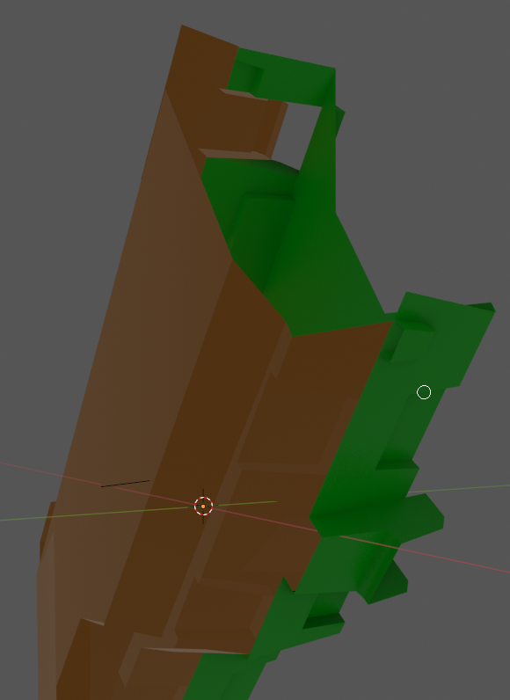
Eratta
Note: Only the front side of the SAO will be visible
  The rear will be obscured by a battery, electronics and the rear of the badge
The long dimension does not align with gravity, the SAO hangs crooked
DEFCON 31 badge is un-powered. SAOs need to provide their own power
The nubs on either side of the PCB interlock with divets in the case.
  Aside from gravity, this is the only mechanism preventing the SAO from jumping out of the badge
  NOTE: The divets only extend for 3 mm (measured from the front face) of the 4.8 mm SAO depth. Any design leveraging these slip fit points cannot be more than 3 mm thick here
3 mm
5 mm

Slide 9
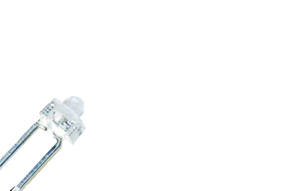
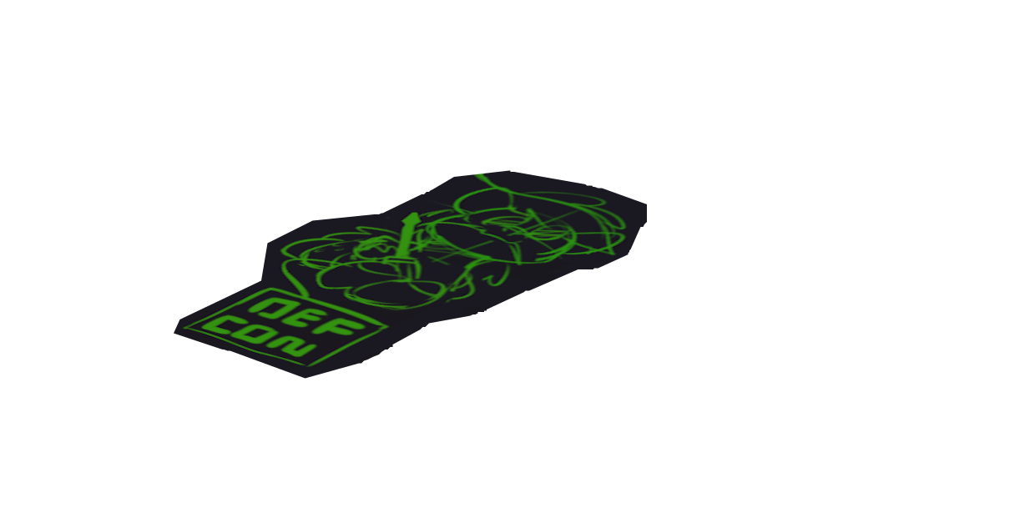

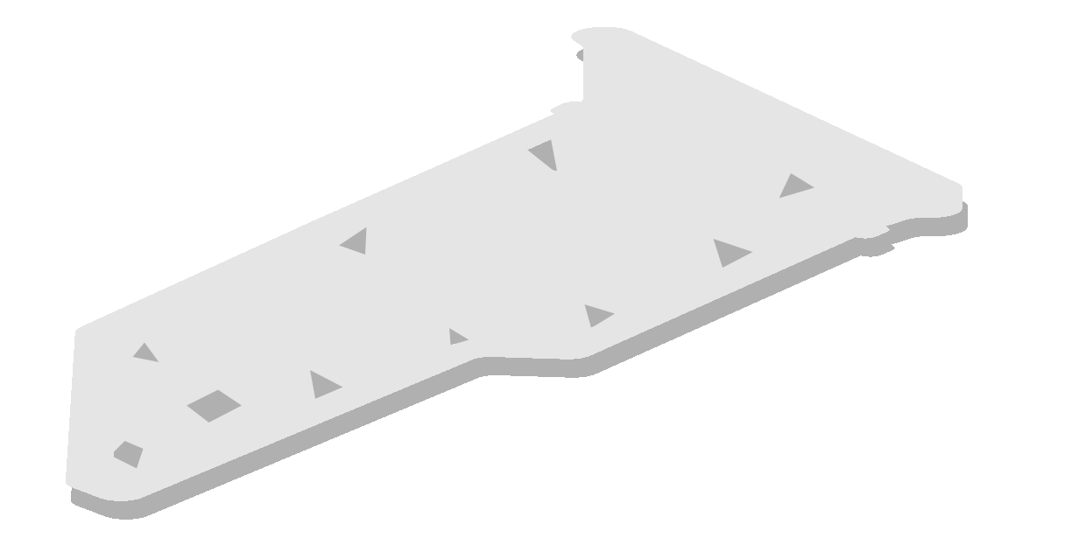
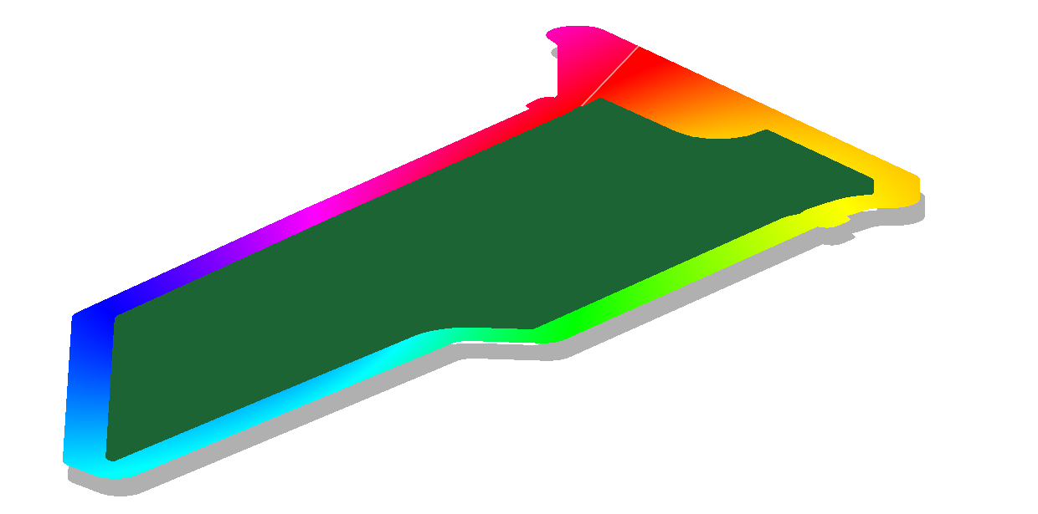
Approach: Depth/Stack-up
Though hole LEDs
(space SAO only)
2-layer PCB
  Copper traces on front & back
Single-side SMT assembly
  Surface Mount (SMT) parts only on back to save cost
  Through-hole parts for front, battery, mic/speaker
Sticker, 3 mil, <0.1mm
(pony SAO only)
Processor, SMT LEDs on back/bottom
PCB 1/16”
1.6 mm
Laser cut acrylic
1/8” 3.2 mm
+ glue
Holes for SMT parts
Assembly
3/16”, 4.8 mm
(1/8”, 3.2 mm, in contact with badge rails)

Slide 10
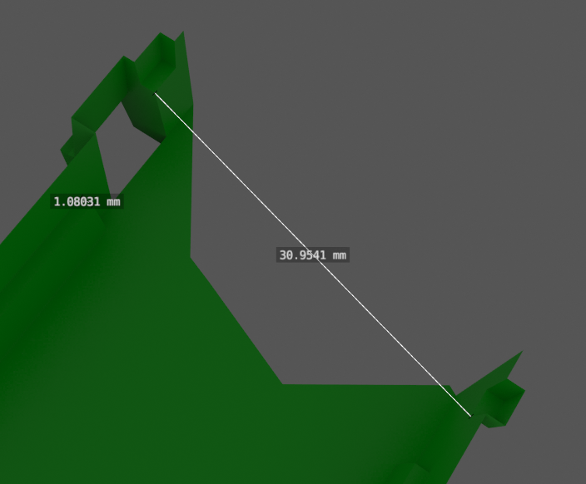
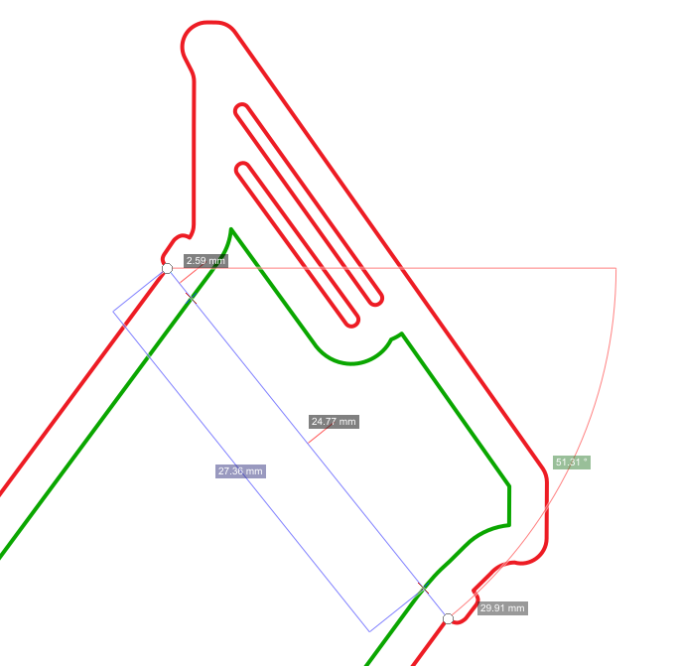
Geometric Dimension & Tolerancing
Shell
30.95 mm
Hard to take consistent measurements between models
  Dimensional png drawing appears to be 1.5% bigger than stl files
    Focusing on matching stl dimensions over pngs: more consistent with blender files
    Result is 130.906% dimension ratio of source svg file
  Measuring under locking nubs: 0.5 mm tolerance on either side of cavity, in line with 3D print tolerancing (0.2 mm clearance on 0.4 mm diameter filament)
svg
29.91 mm

Slide 11
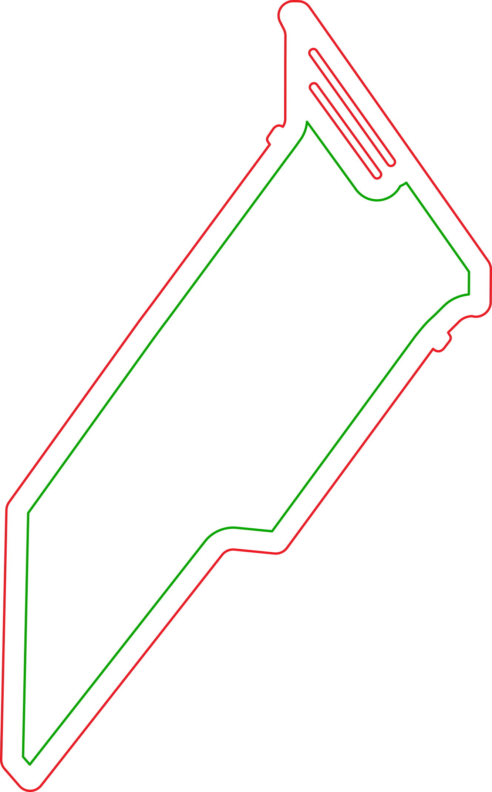
Pony Art Canvas
Choosing 2.5 mm inlet between acrylic outline and PCB
  Ledges supporting acrylic are ~1 mm wide
  PCB v-score is +/-0.4 mm
  Gives ~1mm clear view of RGB acrylic, minimum
2.5mm

Slide 12
Sales
Each team member is given several badges in exchange for $TBR
  1x space badge
  ~6x pony badges (~4x LED powered, ~2x un-powered acrylic)
    The assumption being the team member will sell at least one before and after each event day (on average)

Slide 13
Post mortem notes
Follow SAO power header standard
Use pins per standard
  https://hackaday.com/2019/03/20/introducing-the-shitty-add-on-v1-69bis-standard/
JLCPCB not really stock “Brick nogging” (SMD) connectors, makes sourcing costly or long-lead
  https://www.eevblog.com/forum/chat/where-does-all-the-weird-chinese-component-terminology-come-from/
Castellated pads, clears up through-hole part, reduce BOM (up-charge for castellation)
  Need to make 50x jig, pogo pins

Slide 14
LEDs
250 Hz update rate recommended
  https://www.youtube.com/watch?v=5SQt1f4PsRU
STM8 can only handle ~20mA across all pins
  Appears more geared for signaling than LED control
  Adding line drivers makes everything very complicated (limited real estate on PCB)
Move to 328p…? (40mA abs max per IO)

Slide 15
Schedule
6/10/23 and 6/17/23 weekend doing schematic and layout, plus bulk ordering
Weekday evenings 6/12 planning design/approach
Software
  6/17 kick-off

Slide 16
todo
Stars
Crysal
Led driver
Lipo charger
  passives
Resistors
Equi-distant led placement
Silk screen orbital dynamics equations
Astroids game, asteroid/craft?
Characters in cramped box meme?
Program header pins
User led; charging LED
Power switch
Which is better: only logo as sticker, or entire face (minus sun) as sticker?
  Sticker has color gradients…
Lanyard
70*80 mm min size

Slide 17
todo
WARNING to front page: do not toggle debug LED during charging, leave as input or floating. Pin is used to detect charging and setting it as an output will drive access current through this pin. First read the value on the value on the pin; if it is low then it can be set as an output. Recommend only using this led for user feedback that buttons have been pressed.
DIP header pinout to documentation
  5V charge
  SWIM
  UART/I2C
Diagram of 5V, VDD, GND, switch relationship on power
  These are LIR2032, rechargable dime cells, fitted with a 0.5C charge circuit. Yes they can be recharged in 20 hours by applying 5V and GND, note the dim blue LED
Vendors used (JLCPCB, sticker shop)
Schematic with each part number labeled (since doesn’t fit on silk screen)

Slide 18
SW API builds
Get debug readout from IC
  UART or SWIM
Blink debug LED
  NOTE: Do not connect 5V
Read button
Step through all LEDs with button push
Dim led with pwm
Matrix led drive, charlie plex
Read audio
Use external crystal

Slide 19
Objective SW Architecture
2 main layers
  Peripheral interface (API)
    Controls the stuff that changes between IDEs
  Application layer
    Controls stuff that is uniform across IDEs

Slide 20
APIs
LEDs
  Debug
  Matrix
    RGB
    White
Buttons
Audio
Administrative
  is_team_sao()
  UART
  I2C

Slide 21
API LED
set_led_count(uint8_t count)
  Default: 43
  To improve brightness, inform the API the max number of LEDs you intend to illuminate simultaneously. The renderer will skip all unused LEDs and spend more time illuminating the ones that are set
flush_leds()

Slide 22
API LED Debug
set_led_debug(bool)
  True for LED ON
  False for LED OFF

Slide 23
API LED RGB
set_led_rgb(uint8_t index,uint8_t red,unit8_t green,uint8_t blue)
  Index: 0 to 11
  Red, green, blue: 0 to 255
    255 full brightness ON, 0 is OFF

Slide 24
API LED White
set_led_white(uint8_t index,uint8_t value)
  Index: 0-9
  Value: 0-255

Slide 25
Debug LED
5V
PMIC
When PMIC charging, blue LED is ON
When NOT charging, line is floating
  If uP drive line high, LED is ON
  If uP floats the line, LED is OFF
NOTE: DO NOT drive debug LED LOW While charging
  Will short out the debug pin, making it permanantlely inoperaable as a debug output
5V?
uP

Slide 26
State Transition Diagram Menus
Slide ON/OFF Switch to “ON”
Hold left button during boot to enter developer mode
Is left button pressed for >200 ms?
Developer mode
User mode

Slide 27
User Mode
Left button (when held with the buttons towards the bottom of the badge) control top-level menu selection (short <0.5 second press)
  Long press >2 seconds puts SAO into sleep mode (LEDs OFF, but remembers what time it is)
    Wake with left button press
    Long press WHILE right button is down = hibernate (forgets what time it is)
      Wake with left button press
Right button is interaction

Slide 28
LED Double Buffer
uint8_t swap[42]
Each time a flush command is run, the lowest-level api swaps the active and standby buffers
flush_led()
uint8_t active_display[]
uint8_t standby_display[]

Slide 29
Screen Savers
Rainbow around periphery
  Each LED a different color, slowly cycling clockwise (~3 second period)
  All LEDs the same color, slowly cycling (~3 second period)
Flame effect

Slide 30
Timing
Application
polling
API
Event 1-4 kHz
CAPCOM event
is_button_press()
interrupt
Button state update, audio checking, 1 ms counter update
Chareliplex LEDs
buttons
Peripherals

Slide 31
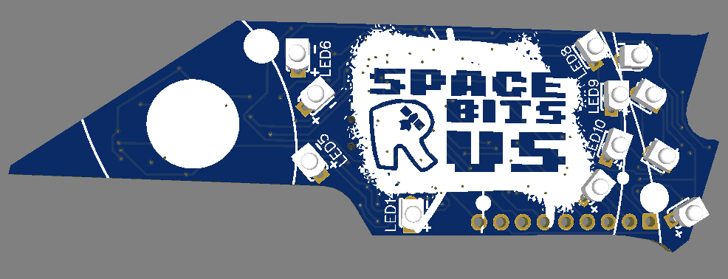
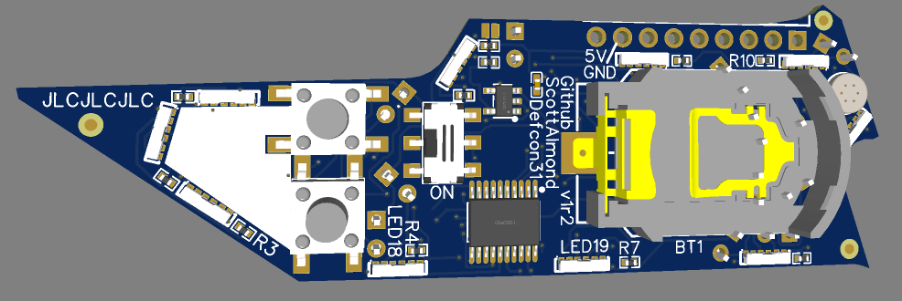
Interfaces
Mic
5V & GND Charging Pins
8
11
Indx 4
Left button for admin and menus
Right button for user features
RGB admin
  Red is debug (light when either button is pressed)
  Blue for 5V present
  Green for Charging
4
On(right)/Off(left) Switch
7
Left button
Right button
Indx 0
3
2
White LEDs (qty 12)
RGB LEDs (qty 10)
Indx 9
Indx 0
Indx 2

Slide 32
LED Mapping
sw api rgb index | hw rgb designator |  | sw api rgb index | hw white designator |  | hw mat | v1r2
0 | 7 |  | 0 | 6 |  | 0 | PD4
1 | 3 |  | 1 | 4 |  | 1 | PD2
2 | 1 |  | 2 | 5 |  | 2 | PC7
3 | 20 |  | 3 | 14 |  | 3 | PC6
4 | 22 |  | 4 | 8 |  | 4 | PC5
5 | 23 |  | 5 | 9 |  | 5 | PC4
6 | 21 |  | 6 | 10 |  | 6 | PC3
7 | 19 |  | 7 | 16
8 | 18 |  | 8 | 17
9 | 2 |  | 9 | 12
 |  |  | 10 | 13
 |  |  | 11 | 11
Physical layer interfacing (right) is handled by the api.c layer; only the sw api index is needed
  set_rgb() or set_hue()
  set_white()
  set_debug()

Slide 33
LED Mapping
Physical layer interfacing is handled by the api.c layer
  This is which LED will illuminate when driving one matrix pin high (left column), another low (top row), and floating the rest
 | 0 | 1 | 2 | 3 | 4 | 5 | 6 | -
0 |  | 7R | 7G | 2R | 18R | 19R | 19G
1 | 3R |  | 7B | 2G | 18G | 8 | 19B
2 | 3G | 3B |  | 2B | 18B | 9 | 17
3 | 6 | 4 | 5 |  | 21R | 21G | 21B
4 | 14 | 10 | 16 | 23R |  | 13 | 12
5 | 1R | 1G | 1B | 23G | 22B |  | 11
6 | 20R | 20G | 20B | 23B | 22G | 22R
+

Slide 34
Audio
If weak audio
  Light up small number of green leds ex 0-2
If strong audio
  Light up large number of LEDs
    All green, yellow and some red
Magic numbers used to define “weak/strong”

Slide 35
Full Program Arch.
- Set peripheral clock to 16 MHz (API method call)
- Check if left button pressed
Boot
- If left button pressed
DIAG
- Immediate transition
USER
System Check
- auto cycle all LEDs for functionality
- Any valid UART activity
UART Cmd
- Set Time at pulse
“t1023456632\n”

Slide 36
Full Program Arch.
Boot
- If left button NOT pressed
- Any Button Push
Fade an LED for 2s then Sleep (LEDs OFF)
DIAG
USER
- Immediate transition
SubMenu 0
- left button long (>2s) press
Top Menu
SubMenu 1
- Timeout (2s)
Top Menu illuminates a single LED corresponding to the submenu it is ABOUT to move into. If timout occurs, that submenu is launched If user short presses left button, a different RGB led illuminates indicating a different submenu is about to be selected
- Short (<0.5s) left button push
SubMenu 2
- Short (<0.5s) left button push
Etc

Slide 37
Top Menu
While inside any submenu, short-pressing the left button will take the user to the top menu
Display the current submenu selection as one colored LED
Short pressing the left button changes which submenu is selected, as indicated by which LED is lit which color
No user interaction for 2 seconds times out and the submenu is selected and entered

Slide 38
SubMenu 0: Screensavers
Default (most common) user experience
  Desire the device to do something nifty with no/minimal user interaction (also low power for the dime cell versions)
  Device plays one screen saver on infinite loop
    “Fireworks” One “random” RGB LED of pure white for 1/60th of a second, then fade a “random” color over 1 second, all LEDs OFF for ~1 second, repeat
    Which LED and which color needs to be state-ly deterministic (derived from millis(), NO use of delay())
  Short press right button to change to the next screen saver and loop that
  Long-press right-button to automatically cycle between screen savers after a period (~60 seconds)
    The screen saver to display, and when to change, is derived from the system clock time NOT delay(), ex set the screensaver to display to be (millis()/60000)%screen_saver_count. This allows all the Space Bits badges to auto-transition and display content in synchronization
Other screensavers are ones without need for user input
  Audio intensity (“equalizer”)
  Rainbow pattern
    Each LED along periphery lights up 10% of a rainbow pattern. They slowly change color to make it appear the rainbow is cycling around the border
  If is_space_bits(), then also include a front facing pattern that uses the white LEDs, each lighting up in sequence (to appear like moving along an orbital track), or light 2-3 LEDs to focus on “space” then “bits” then “R” then “Us”
  A clock with red for the hour hand, green for the minute hand, blue for the second hand
    Second hand only moves every 1/10th of a minute (6 seconds), so would prefer some faster indication to the user like blinking blue, ex. millis()%2000<1000

Slide 39
SubMenu 1: Morse Code
Displays blinking LEDs
  For Space Bits badges, display “Space Bits”
  Otherwise “Defcon 31”
Display Challenge-query
  “one plus two”
    Left button presses: “three”
  “hello”
    “world”
  Display green flashes (or other pattern) on success, repeat query on timeout (5s?)

Slide 40
SubMenu 2: Cyclone
Displays one red led moving around the perimeter
One LED is lit white and is not moving
  This is the target the user is trying to overlap the red led on top of
When user presses the right button
  If the red LED is over the white LED, flash the white led three times over ~2s to indicate winning
    Play again, but moving LED is green and moved faster to indicate a higher level (and blue in a higher level)
  If the red LED is NOT over the white LED, then flash red LED three times (indicating losing) then rotate in the opposite direction (CW to CCW or vice versa)

Slide 41
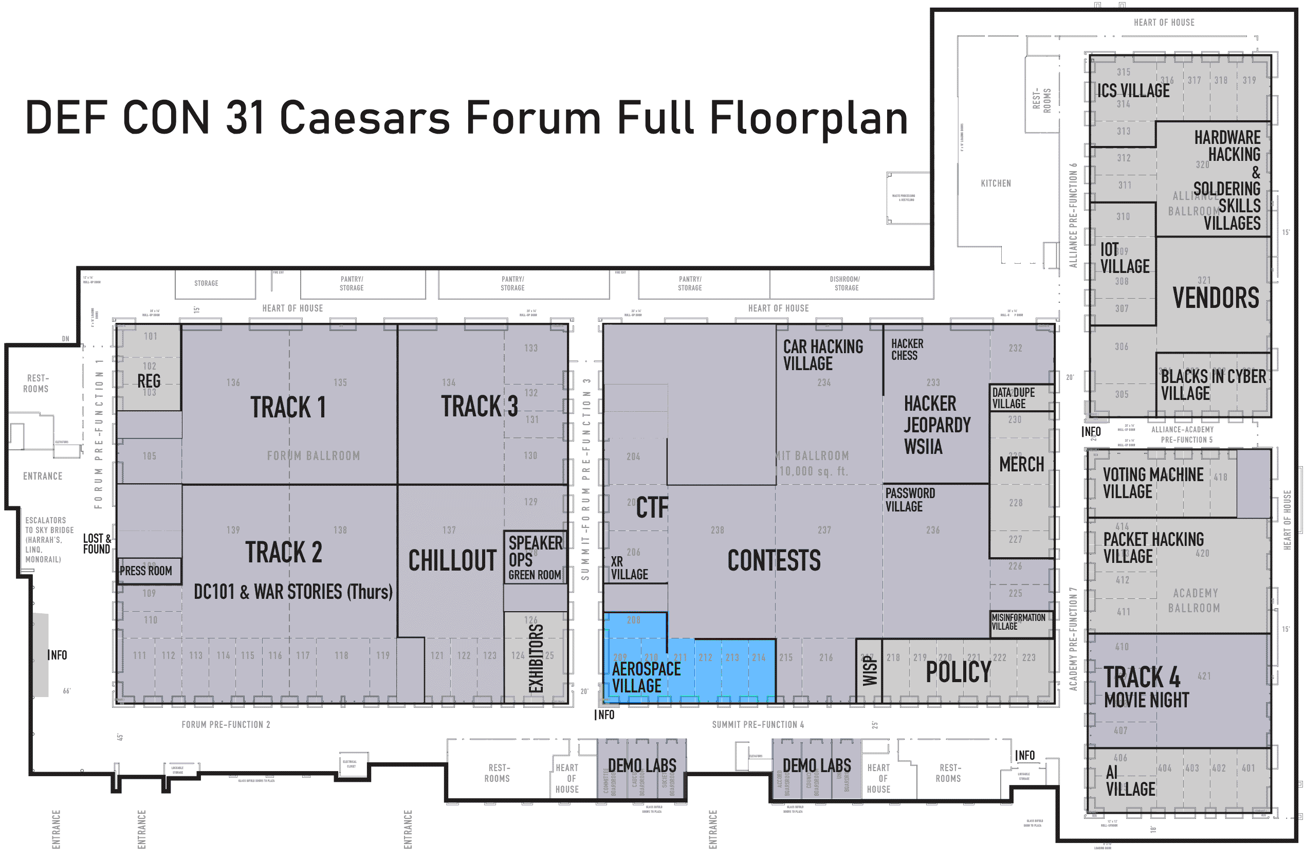


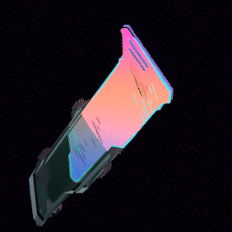
When
  On sale before and after Hack-a-Sat 4 Capture the Flag competition each day
    Before 10 AM: Friday 11th & Saturday 12th
    After 8 PM: Friday 11th & Saturday 12th
    Before noon: Sunday 13th
    After 1:30 PM: Sunday 13th
Where
  DEFCON31, Caesars Forum, Aerospace Village
  Look for "Space Bits R Us" team members wearing this badge
    Or carrying this satchel
Cost
  $20 each
  Over 10 designs to choose from!
    Lights, buttons, puzzles, games, excitement!
  Fits into the official conference badge!

Slide 42
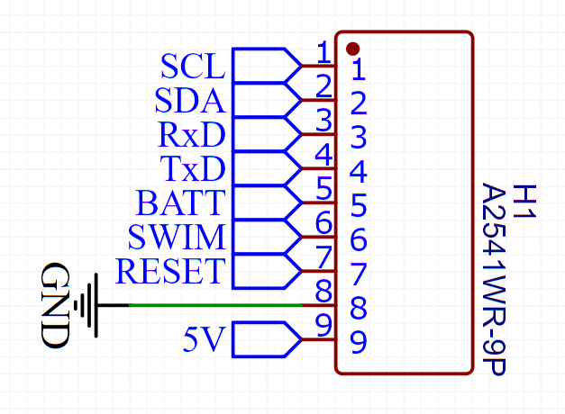
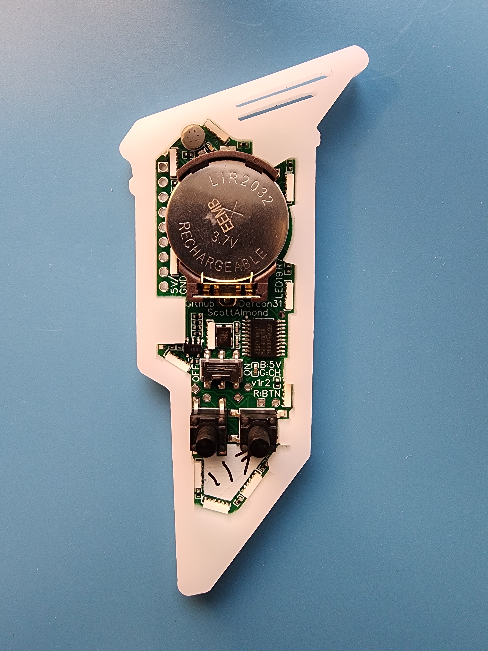
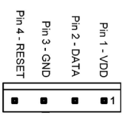
Programming
NOT grounded
ON
Connect to
external 3.3V
IF battery has
been removed

Slide 43
Terminal Access
57600 baud
TX
RX
GND
ON

