Slide 1
Boris
GDB Debug Adapter Protocol Prototype

Slide 2
DAP Architecture
Client
Debug Adapter
Debugger
GUI
GDB Server
GDB
GUI
GDB Server

Slide 3

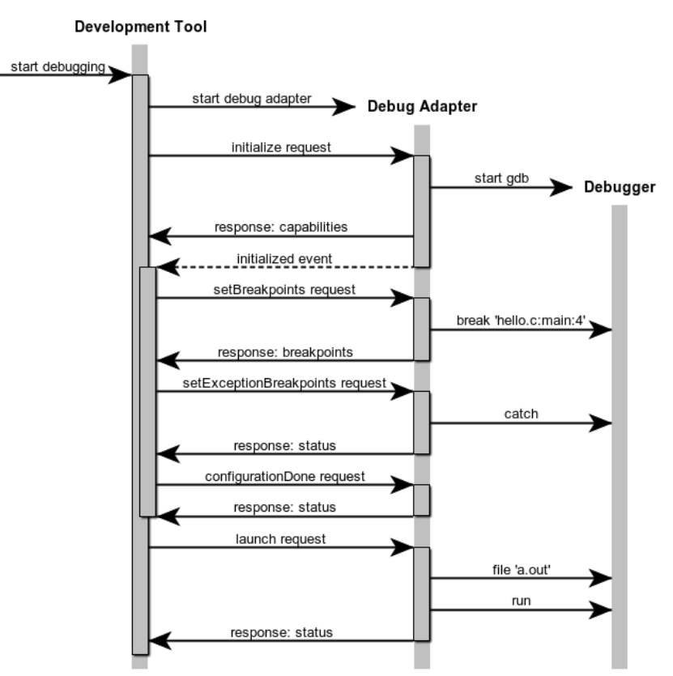
GDB Debug Adapter In Action

Slide 4

Demo Time

Slide 5
Implementation
GDB Debug Server
Loosely based on Eclipse CDT debugger (GDB MI)
Leverages Eclipse LSP4J
Don’t be afraid! It’s not tied to the Eclipse IDE, just a project in Eclipse namespace
Java binding used for communication between client and server (JSON)
GDB Debug Client
Loosely based on Eclipse CDT IDE (debug model and GUI)
Swing

Slide 6
What’s Next?
¡Párate! - we pray to the NetBeans gods now
Put a ring on it - sanction GDB debug server project
With intention of replacing NetBeans debugger one day
#winning - prototype other components
C/C++ editor - Language Server Protocol
TCF DAP
VCS - Git, Perforce

Slide 7
Takeaway
Part part-time, outside of working hours
~75 commits over 2 months
Let’s say an average of 2 hours/commit = 150 hours ≈ 4 weeks
Used open source projects as guidance and inspiration
If a single schmuck was able to put this together, imagine what a team of professionals could do!

