Slide 1
Boris
GDB Debug Adapter Protocol Prototype

Slide 2
Debugger Architecture
Client
Debug Adapter
Debugger
GUI
GDB Debug Server
GDB

Slide 3
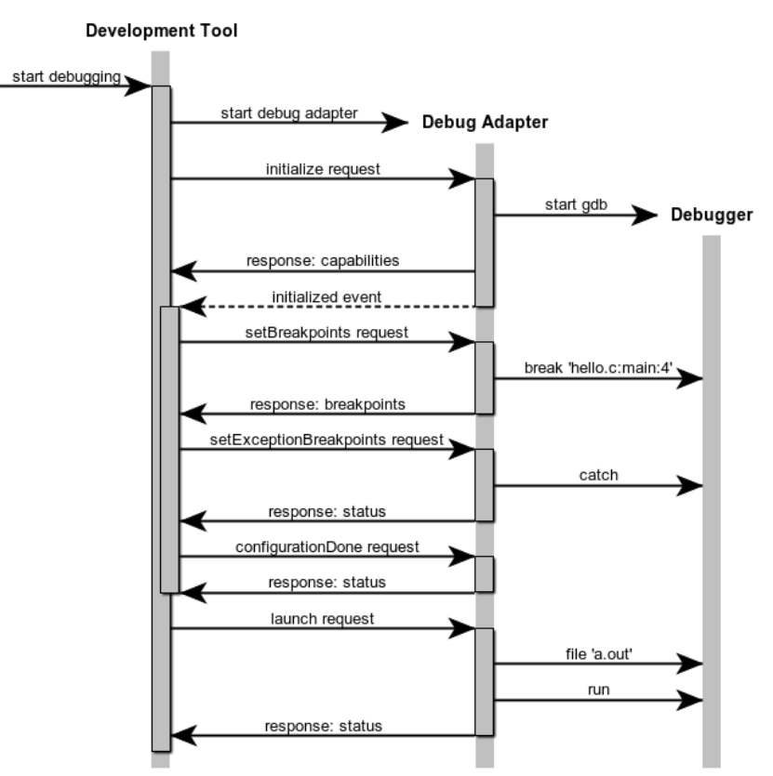
GDB Debug Adapter

Slide 4

Demo Time

