Slide 1
Project Round 2!

Slide 2

Happy Baby Says It Best…

Slide 3
Your Challenge

Slide 4
IT’S TIME TO….
SHAKE N BAKE

Slide 5
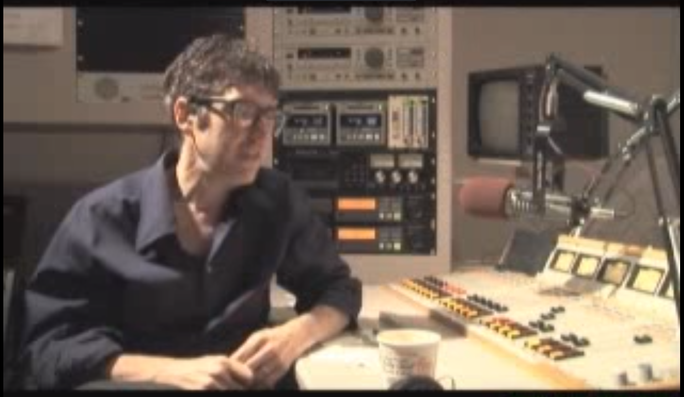
Ira Glass – On “Taste”
https://www.youtube.com/watch?v=X2wLP0izeJE

Slide 6
Your Challenge
At this point, you all have real skills.
It’s time to show it.

Slide 7
Your Challenge
Like seriously.
Be ambitious.

Slide 8
Teams

Slide 9
Group Teams
Create your own team
3 to 4 per team, 5 with approval from your instructor
If you don’t have a team please let us know and we’ll add you to a team

Slide 10
Project Task
To build a great project!

Slide 11
Coding Requirements
Must use a Node and Express Web Server
Must be backed by a MySQL Database with a Sequelize ORM
Must have both GET and POST routes for retrieving and adding new data
Must be deployed using Heroku (with Data)
Must utilize at least one new library, package, or technology that we haven’t discussed
Must have a polished frontend / UI
Must have folder structure that meets MVC Paradigm
Must meet good quality coding standards (indentation, scoping, naming)
Must protect API keys in node with environment variables

Slide 12
Coding – Nice To Haves
Utilize Handlebars for Server-Side Templating
Incorporate Authentication (JSON Web Tokens, Sessions, Etc.)
Use an existing public dataset to power the database (API’s etc)
Create a migration strategy for sharing data across team members e.g. a seed/schema.sql file.

Slide 13
Presentation Requirement
You will also be responsible for preparing a 10 minute presentation.
This will be a formal presentation.
One in which you explain in detail:
Your overall application’s concept
The motivation for its development
Your design process
The technologies you used (and briefly how they work)
A demonstration of its functionality
Directions for future development
Treat the presentation seriously!
Talking intelligently about tech > doing tech sometimes.

Slide 14
Metrics

Slide 15
Metrics
Concept
Design
Functionality
Collaboration
Presentation

Slide 16
What we need from your team by the end of the day
Your group members and team name (if you have one)
Your teams project proposal
Summary
Tech stack (libraries used)
High-level User Stories
Who’s doing what
Initial wireframes (if you have them ready)

Slide 17
Questions

