Slide 1
A Data-Driven
Game Object System
GDC 2002
Scott Bilas
Gas Powered Games

Slide 2
Introduction
Me
  Scott Bilas, scott@gaspowered.com
  Background
You
  System architect types
  Tired of fighting with statically typed systems for game code
The Test Subject
  Dungeon Siege
  >7300 unique object types (i.e. can be placed in the editor)
  >100000 objects placed in our two maps
  Continuous world means anything can load at any time
Notes:
I implemented the system I’m about to describe about a year and a half ago. As with most things in a game engine, it ended up getting used in many ways I never imagined. This talk is about the problem I was trying to solve, what I did, why you should care, and how it all turned out.

Slide 3
Cell Phones?
Notes:
Oh wait, before I forget, please put away annoying little electronic beeping things that play TV theme songs and all that…

Slide 4
Definitions
Data-Driven
  Meaning: “No engineer required”
  Engineers are slow
  Causes designers to hack around missing functionality
  Goal: remove C/C++ from game
  Line between engine and content is always moving
Notes:
First let’s look closer at the title I chose for this talk and get some terminology out of the way.
Data-Driven
This can mean many things, but for me it means that you don’t need to involve an engineer when you want to change something. Engineers are really slow and it often seems like they take forever to get anything done. This of course drives designers and artists crazy. A non-data-driven system would have the names of animations to run for a monster hard-coded into the C++ files, requiring an engineer’s time and a new build to change. A data-driven system would store all of this in a data file somewhere and you could even write a tool to keep it updated.
When I wrote the above, I realized that I was thinking in 1995 terms. Today we’ve gone much further than that, to the point that the code doesn’t even know what a monster is, and the only reason it knows to run animations is because some AI script with its own agenda is sending a request to do so. In many modern game engines you can make radical changes to the system without ever speaking to an engineer. This permits rapid prototyping and is a wonderful thing, if managed properly. The line between engine and content is always moving, maybe one day we’ll engineer ourselves out of existence.

Slide 5
Definitions (Cont.)
Game Object (Go)
  Piece of logical interactive content
  Perform tasks like rendering, path finding, path following, speaking, animating, persisting
  Examples are trees, bushes, monsters, levers, waypoint markers, doors, heroes, inventory items
  Many are “pure logic”, never see them (triggers, elevator movers, camera sequences)
  Every game has these in some form
Notes:
Game Object
A Game Object or what we at GPG call a ‘Go’ is a piece of logical interactive content that the player can do something with. The line is blurred of course depending on the engine. In Dungeon Siege, some examples of Go’s are trees, bushes, monsters, levers, waypoint markers, and doors. The heroes and each item in their inventory (like swords, rings, armor, and the inevitable potions) are Go’s. Many Go’s you never see, such as triggers, elevator movers, sound emitters, etc.
Go’s are self-contained logic that can perform many tasks, or you might say they have many abilities. They might render themselves, find paths, follow paths, think for a bit, say something, ready and shoot an arrow (which is itself a Go), or self-destruct, spawning an effect on the way out. There’s nothing special about Go’s, every game has something like this, of course, but each game does it differently.

Slide 6
Definitions (Cont.)
Game Object System
  Constructs and manages Go’s
  Maps ID’s to object pointers
  Routes messages
  Build from many things, but for this talk
    GoDb: Go database
    ContentDb: Static content database
  Every game has this in some form
Notes:
The Game Object System is simply the system that constructs and manages Go’s for the game. It’s responsible for mapping ID’s to object pointers, creating and destroying Go’s, managing external requests to use Go’s, and routing messages. In Dungeon Siege this is built from a lot of systems, but for the purposes of this talk we’ll be covering the GoDb (Go database) and the ContentDb (static content database).
Games today have crazy amounts of content, and I’m not talking about movies, which are easy (i.e. each movie is a single piece of content, no problem!). And it’s only getting worse (or better, depending on if you’re a glass-is-half-full type of person).
So let’s get into the main topic here. Say you’re an engineer set out to create a new Game Object System from scratch, and you’re going to “do it right the first time”. You talk to your designer and say “what kind of content are we going to have in this game?” They respond with “oh lots of stuff, trees, and birds, and bushes, and keys and locks and …<trailing off>” and your eyes glaze over as you start thinking of fancy C++ ways to solve the problem. The object oriented programming sages tell you to try to determine Is-A relationships and abstract functionality and all that other fun stuff. You go to the book store and buy a C++ book just to be sure, and it tells you to fire up your $5000 UML editor with one of the classic examples (next slide):

Slide 7
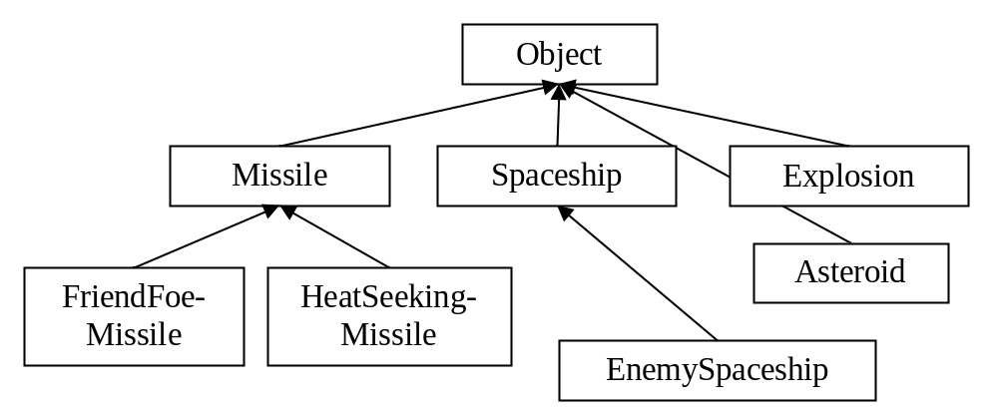
Example Class Tree
Vintage
Notes:
Here we have all our game types specified as classes in a nice hierarchy. I had to keep this diagram simple to fit on this slide but imagine all the fun virtual functions you’d see here, like DrawSelf(), Think(), and HandleMessage().

Slide 8
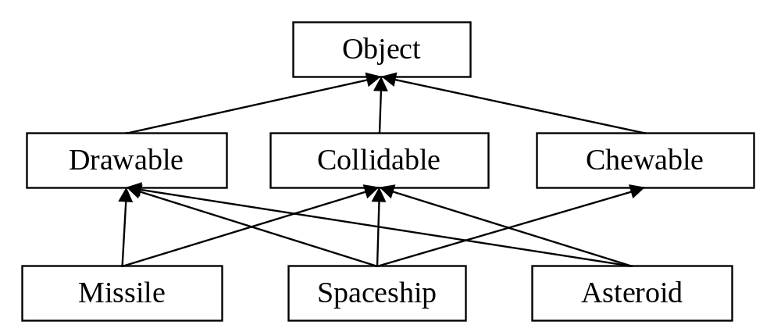
Example Class Tree
Newfangled
Notes:
Fancier books recommend something like this.
Here, we try to decompose functionality along capability lines. Each “mixin” class adds functionality, for example the “chewable” class would add knowledge of how a space monster would be able to chew up the object (maybe play some effects, add info to the leaderboard, etc.). Again, no space on the slide, but expect that there would be hooks (pure virtual functions) like OnDraw(), OnGetBoundingBox(), and whatever else.

Slide 9
It Won’t Work
There are hundreds of ways to decompose the Go system problem into classes
  They are all wrong
  They don’t start out wrong, of course…
Games constantly change
  Designer makes decisions independently of engineering type structures
  They will ask for things that cut right across engineering concerns
Notes:
There are probably hundreds of ways you could decompose your systems and come up with a set of classes (I just showed a couple simple ones), and eventually, all of them are wrong. This isn’t to say that they won’t work, but games are constantly changing, constantly invalidating your carefully planned designs. How many post-mortems have you read about designs that were too ambitious, or massive changes mid-stream, or when marketing demanded some silly thing, or something needed to get added because somebody thought it might make the game more competitive...
So you hand off your new Game Object System and go work on other things. Then one day your designer says that they want a new type of “alien” asteroid that acts just like a heat seeking missile, except it’s still an asteroid. Or they want to get rid of this whole spaceship concept and go underwater instead. Or they want those trees to sway back and forth in the wind…

Slide 10
Just Give In To Change
Requirements get fuzzier the closer your code gets to the content
Will end up regularly refactoring
Do not resist, will cause worse problems!
However: C++ does not support this very well!!
Notes:
The closer your code gets to that line between engine and content, the fuzzier the requirements and the more likely that your work will regularly need to get refactored. You could resist change like this, but that will just result in designers hacking around things, creating even worse problems. Suffice it to say that it’s just easier to try to handle this change as a fact of normal game development. And how does that change get handled? In software engineering we learn to take the things that vary and abstract them. In other words, find the parts of the system that are likely to change and make them flexible. Traditional wisdom says to do this through Is-A relationships via the class tree. Unfortunately, the class tree resists change.

Slide 11
C++: Not Flexible Enough
Code has a tendency to “harden”
  Resists change over time
  Rearranging class tree requires lots of work
Needing to change it causes engineering frustration, which leads to…
  Class merging/hoisting (fights clean OOP)
  Virtual override madness
  Increased complexity  increasing resistance
  Doc rot, editor out of sync
Notes:
This can go wrong a number of ways, and all of them are caused by programmer frustration. Here are a few:
Class merging (sometimes called hoisting)
Over time, many of these little classes end up getting merged into larger monolithic classes. It’s just easier to have little bools inside the base class that say “turn this feature on”. Many times the bools are “turn this feature off”, because you figure out that 90% of your derived classes are duplicating the same code, and it’s easier to just hoist the functionality out of them and into the base, then let it be configured with a bool. Sure you could create a new derived class that contains that functionality, but we’ve got an n-dimensional array of features here, one for each type, and there’s no way to turn it all into a nice tree. The model you choose to follow for your hierarchy design will end up being a prison. So to deal with this, you’ll probably end up turning that n-dimensional array into a list of configuration variables that sit in the base. And this isn’t necessarily a bad thing, though it usually is. Might as well have a single class with a pile of configuration variables and a bunch of switch statements, right?
Virtual override madness
The point of deriving is to specialize behavior. When you have derivatives of derivatives, you end up with potential ordering problems in your virtual function calls. A particular class overrides an OnDraw() method. It knows that it must draw its new stuff after the base class’s stuff, so it calls the base version first, then itself. A new derivative of this class wants to draw itself in between the base and its base. This is impossible, so you end up .
Increasing resistance to change
The more complex the system gets, the more paranoid people get about adding new things to it. If it’s a flat hierarchy, no big deal, just copy paste something else and adapt it. But it will have depth to it, and so when your junior guy wants to add some new gizmo to support a feature he’s working on, he freaks out! Where can it be inserted without messing everything up? Which virtual functions must you call and when and how? Most likely what they’ll do is add some more bools and put an if/else to stick in their new feature. Eventually you run into distributed state management problems, nasty.
Doc rot
It’s hard enough to get programmers to document their own code properly, much less tell the rest of the team how to use it. In your data-driven system, somewhere there is some kind of loader function – code that maps data from the resource store onto runtime objects. The names of the fields it reads in, their types, the allowable ranges, etc. are known as the “schema” of the game objects. Well since this schema is hard-coded into your C++ app, it’s up to the programmer to carefully document all of this separately, and keep it up to date as it changes. Just like the type problem, with code this close to the content, something this dynamic is going to take resources that probably aren’t there, and so documentation for the schema will end up limited or be subject to “doc rot”, and become more and more incorrect over time. This of course drives your scripters crazy.
Editor out of sync
This is a similar problem to doc rot. Whatever tool you have built to place objects in a level needs to know the game schema in order to know what values it can let the designers change.

Slide 12
Reexamine The Problem
This is a database
  (a very well understood problem)
  “The data is important, nothing else matters”
…and we’re hard coding it every time
To meet changing design needs, can’t just data-drive the object properties, must data-drive structure (schema) of the objects
Notes:
Let’s step back a bit and look at what we’re working on here. It’s a database. Why are we spending all this time, constructing classes and hierarchies and managing cpp files and h files and #include nightmares and forward declarations and ordering dependencies on virtual functions and slow compile times and custom archive functions and all of this mess, when all we’re really doing is hard-coding a database? Sure our game is data-driven in that we’re reading in property values and such from disk in order to initialize our game objects, but in order to cope with the ever-changing needs of the game, the structure of the objects themselves is what must be data-driven now. Let’s take the type structure, the hierarchy, and put it into data.
So if we’re moving type definition out of the engine and into data, what should all of this look like? And now we’re getting to the real point of this talk. The easiest way for me to describe this is to just talk about the system I implemented for Dungeon Siege – first implementation, then usage (next slide).

Slide 13
Solution: Component System
Each component is a self-contained piece of game logic
Assemble components into Go’s to build complete objects
Specification for assembly driven by data
Lay out data in a C++-style specialization tree to promote reuse and reduce memory usage
Include and enforce an external schema
Notes:
Here’s a quick overview of the implementation. It’s a simple component system, where each component encapsulates a chunk of game logic, and the data specifies how to assemble these components into Go’s and what values they should be initialized with. If you don’t like the word “component”, try “plugin” instead, same thing.
For example, the [placement] component tracks the Go’s location in the world, the [body] component is responsible for animation-related tasks, the [mind] component handles sensors and performing jobs, and the [inventory] component manages equipment and inventory items. These components are sort of like the mixin classes I mentioned earlier.

Slide 14
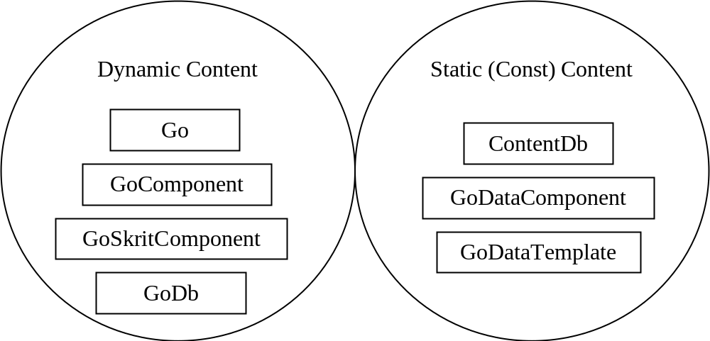
Two-Part Implementation
Notes:
There are two separate sets of classes involved here. One is for the static content and represents the schema and prototypes in the database. The other is for dynamic content and makes up the game objects for the session. I’ll be covering these two families of classes next.

Slide 15
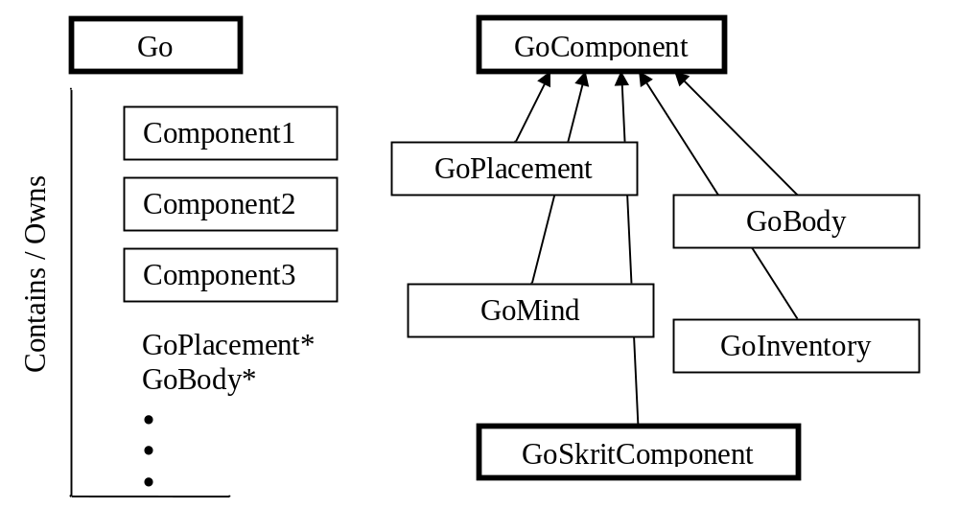
Dynamic Content Layout
Notes:
Let’s look at the dynamic content first, which includes the Go’s and components. I put thicker borders on the key classes in here. I also didn’t show the GoDb because it’s just a container for Go’s.
A Go is just a class that contains a list of components. You can query for a component by name, and it will return a GoComponent* that you can cast to the real type. Components are unique within a Go, meaning that there can only be one of each kind. This is limitation I specifically added to keep the system simple but I plan to remove it for the next game as it turns out we needed to permit arrays and nesting in some cases. For performance, the most commonly used components get a cached pointer so we don’t have to look them up each time (there are Get() functions for each of those, like GetBody(), GetInventory(), etc.). The Go class does not have derivatives. Nearly all logic is done in the components so the Go does little more than component management, maintain the parent/child tree, and a few other random things. The game runs almost completely on the logic built into the Go components.
GoComponent is our other main dynamic content class, and it’s an abstract base class. It does little more than provide the common interface through which the system components communicate. It’s filled with event handling methods meant to be overridden by derivatives, such as HandleMessage, CommitCreation, LinkParent, and Xfer (for persistence) and a few helpers. Most systems in the game that don’t care about game code deal with components through virtual methods at the GoComponent level.

Slide 16
Extension: Skrit
(DS Scripting Language)
Obvious requirement:
build components out of skrit
Leave high performance components in C++
Permits extremely fast prototyping
  No rebuilds required
  Don’t even have to restart game (reload on the fly)
Schema is internal
Notes:
When I was designing this system it became immediately obvious that we wanted to build components out of Skrit (Skrit is just the name of my scripting language). High performance components that are used everywhere should be written in optimized C++ code, and everything else would be Skrit. Why do it like this? I wanted prototyping new ideas to be as simple as creating a new Skrit file and plugging it into the data somewhere. And because it’s my compiler rather than Visual C++ I could do it all on the fly without having to restart the game (much less get a new build from an overworked engineer!).

Slide 17
Extension: Skrit (Cont.)
Simple implementation (assuming you already have event-driven scripting language ready)
  GoSkritComponent derivative owns a skrit
  Override all virtuals and pass as events to skrit
Game and editor don’t know/care difference between C++ and skrit components
  (Neither do the designers)
Notes:
In practice this was pretty simple to implement. Just create a custom derivative of GoComponent called GoSkritComponent that owns a Skrit object, overrides all those virtual functions, and passes them along as events to the Skrit. For all practical purposes, the game and the editor don’t know the difference between a C++ component and a Skrit component. And certainly none of the designers really had any idea either. They just see a property sheet in the editor.
It worked out pretty well. We ended up with about 21 components that we thought needed to be written in C++ (show next slide…)

Slide 18
21 C++ Components
actor, aspect, attack, body, common, conversation, defend, edit, fader, follower, gizmo, gold, gui, inventory, magic, mind, party, physics, placement, potion, store
Notes:
(Mention a few of these).
And the rest, nearly 150 of them… (show next slide)

Slide 19
148 Skrit components
base_chest, cmd_actor_stats, cmd_ai_dojob, cmd_animation_command, cmd_auto_save, cmd_camera_command, cmd_camera_move, cmd_camera_waypoint, cmd_delete_object, cmd_dumb_guy, cmd_enter_nis, cmd_inv_changer, cmd_leave_nis, cmd_party, cmd_party_wrangler, cmd_report_gameplay_screen_player, cmd_selection_toggle, cmd_send_world_message, cmd_steam_puzzle, cmd_texture, dev_console, dev_path_point, door_basic, elevator_2s_1c_1n, elevator_2s_1c_1n_act_deact, elevator_2s_1c_2n, elevator_2s_2c_1n, elevator_2s_2c_2n, elevator_2s_3c_1n, elevator_2s_4c_2n, elevator_3s_1c_1n, elevator_3s_2c_1n, elevator_hidden_stairwell, elevator_hidden_stairwell_act_deact, elevator_instant_1c, elevator_instant_4s_1c, fireball_emitter, fire_emitter, fire_emitter_act, generic_emitter, generic_emitter_act, glow_emitter, glow_emitter_act, go_emitter, particle_emitter, particle_emitter_act, sound_emitter, sound_emitter_act, spark_emitter, animate_object, camera_quake, camera_stomp, decal_fade, effect_manager, effect_manager_server, gom_effects, guts_manager, light_colorwave, light_enable, light_flicker, light_flicker_lightweight, nodal_tex_anim, nodal_tex_swap, tsd_manager, water_effects, generator_advanced_a2, generator_auto_object_exploding, generator_basic, generator_breakable, generator_cage, generator_dumb_guy, generator_in_object, generator_object_exploding, generator_object_pcontent, generator_random, activate_chapter, alignment_switcher, attach_robo, breaking_object, check_bool, check_level, check_quest, chipper, clone_preloader, enchantment_manager, experience_award, fountain, freeze_manager, generic_accumtrigger, generic_objblock, hidden_reveal, interface_fade, msg_switch, object_selection_toggle, on_client, play_chapter_sound, point_snapper, position_sync, respawn_shrine, screen_report, self_destruct, set_bool, tip, vis_toggle, locked, on_off_lever, gremal_reward, spell, spell_area_effect, spell_balance, spell_body_bomb, spell_chain_attack, spell_charm, spell_damage_volume, spell_deathrain, spell_death_explosion, spell_default, spell_fire, spell_freak, spell_freeze, spell_instant_hit, spell_launch, spell_lightning, spell_mass_control, spell_mass_enchant, spell_multiple_hit, spell_penalty, spell_polymorph, spell_reactive_armor, spell_resurrect, spell_return_summoned, spell_status_effect, spell_summon, spell_summon_multiple, spell_summon_random, spell_switch_alignment, spell_transmute, spell_turret, test_marker, test_timer, trapped, trp_explosion, trp_firetrap, trp_launch, trp_lightning, trp_particle, trp_trackball, minigun_magic
Notes:
…ended up in Skrit. (“You probably can’t see these well, but…” and mention a few of them).
Looking back, we probably should have done even fewer in C++, but our content engineer didn’t come on board until we had already built a number of things in C++ so we just left most of them. We did end up converting a few C++ systems, such as our spellcasting, to use this Skrit component system though because it was so much easier.

Slide 20
Alert! Before Moving On
Generic datastore required to continue
  INI file, config file, XML store, RIFF, all the same
  Permits generic data retrieval/storage
  DS has “gas”, think “INI with nesting + goodies^2”
Not difficult to roll your own
  Many books/articles on this
  Probably need one for other parts of the game anyway (i.e. you’ll find uses for it no problem)

Slide 21
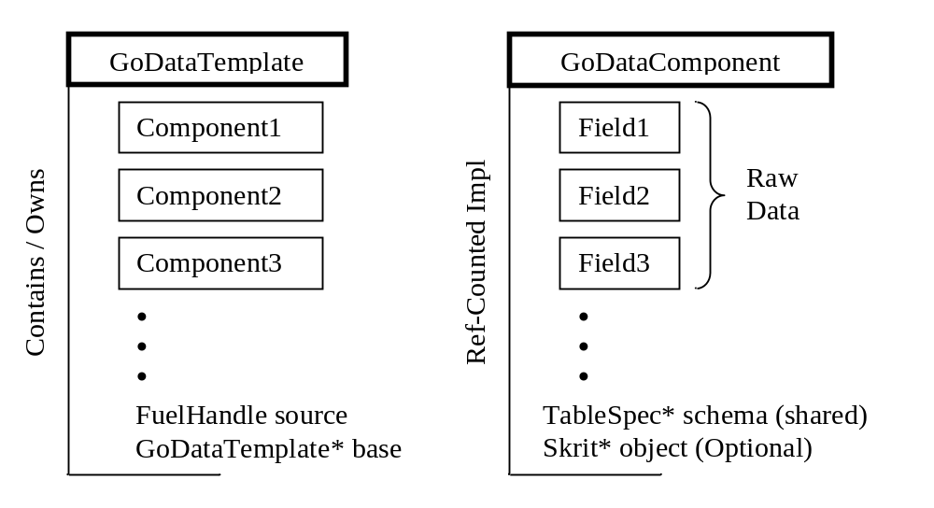
Static Content Layout (Code)
Notes:
(Template is a ‘pattern’ in the conventional meaning, not the C++ meaning.)
There is a 1:1 correspondence between a Go and its GoDataTemplate, and a Go’s components and the GoDataTemplate’s GoDataComponents. And within the GoDataComponents, the fields map 1:1 with the GoComponent public properties.

Slide 22
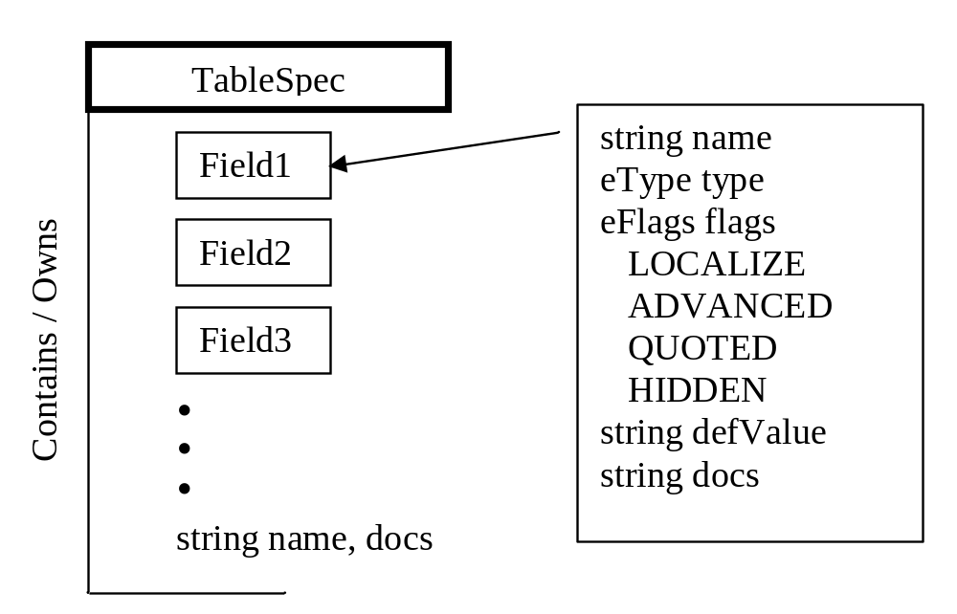
Schema Layout (Code)

Slide 23
Compile ContentDb
Part 1: Build Schema
Process components.gas (C++ table specs)
  Build table specs directly from .gas spec
Recursively scan components base directory for all skrit components
  Compile each skrit
  Build table specs from metadata in
…now we’ve got the schema constructed.

Slide 24
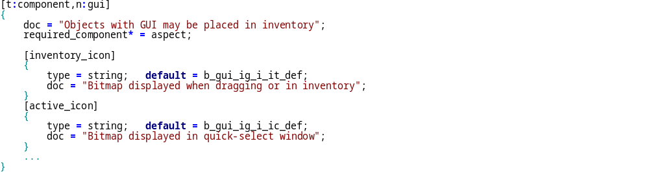
C++ Component Schema (Data)
Notes:
Talk about how it’s important to have a public schema like this.

Slide 25
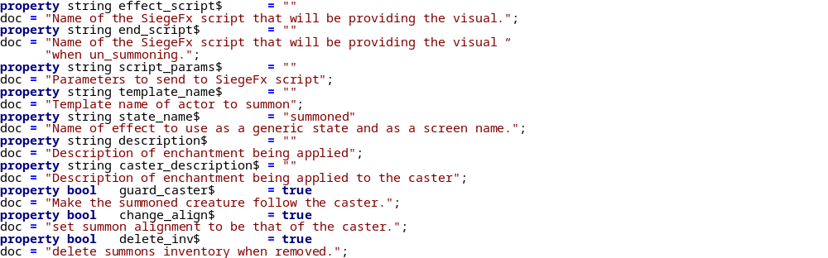
Skrit Component Schema (Data)
(Concept adapted from UnrealScript)

Slide 26
Compile ContentDb
Part 2: Build Templates
(This is just prep work)
Recursively scan .gas template tree
  Note: doesn’t need to be a physical tree
Open data handles to each template
Keep track of root nodes, build specialization tree

Slide 27
Template Forest (Data)
Root Templates
Specialization Tree
actor
actor_good
interactive
actor_evil
non_interactive
actor_custom
trap
actor_ambient
base_chicken
emitter
command
elevator
generator
chicken_red
chicken_grey
ui
chicken_white

Slide 28
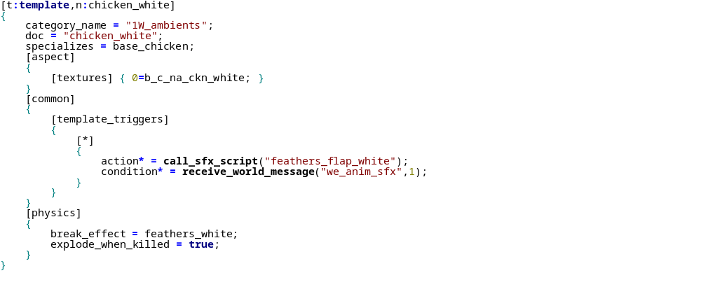
Template
Specification
(Data)
Notes:
Implicit in this template is the other components that are inherited from the base template. There are many that you don’t see here like physics (yes, chickens can simulate) and actor.

Slide 29
Compile ContentDb
Part 3: Compile Templates
Recursively compile templates root-down
Add data components on demand
Read in values, override base template fields
This is all similar to C++ base-first member initialization in ctors.

Slide 30
Compile ContentDb
Special notes
We want a flat tree for performance reasons
  Depends on how frequently you construct objects and how fast your data override system is
  Also permits special const-read optimization that can eliminate memory usage and CPU for variables that are never changed
Copy data components on write to avoid unnecessary memory usage
If have many templates, will need to JIT compile leaf templates to save memory

Slide 31
Editor Integration
This is almost trivial
Editor should have a property sheet type thing
  This is a one-entry view into the db
  Map types and names onto fields using schema
  Can un-override easily by querying template
  Be sure to add a column or tooltip for docs!

Slide 32
Editor Integration (Cont.)
For DS all editing support done through a special “GoEdit” component
  Transforms data between game object and editor
  Supports cheap rollback (undo) by double buffering
  Does not exist in game, only needed in editor
  Automates saving all game object instances – just compare vs. the const data and write out if different
Not recommended: permitting forced overrides of duplicate data

Slide 33
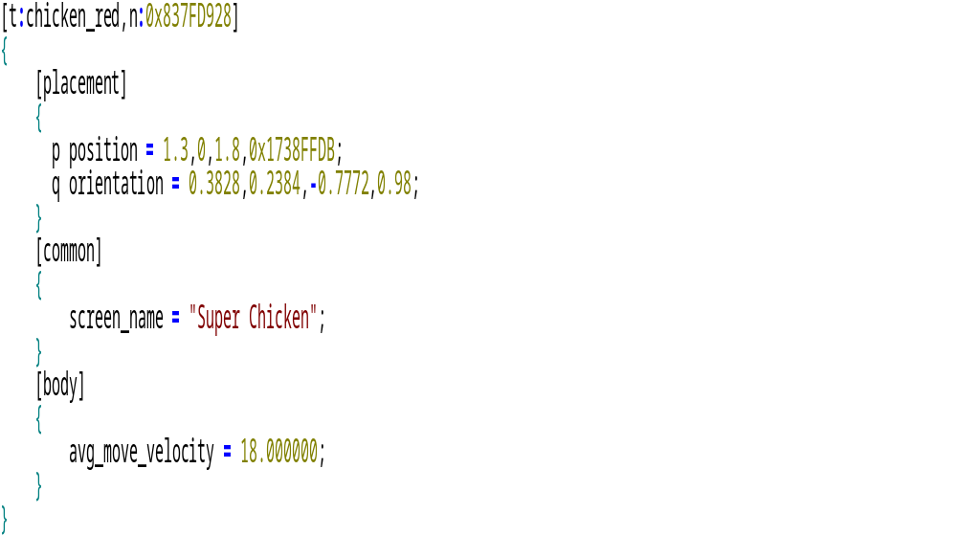
Instance Specification (Data)

Slide 34
Loading Objects
In DS, objects are referenced by content ID
Look up instance block to get template to use
Instantiate Go by that template
  For each block in instance, create a new data component
  Specialize that data component from base in template
  Finally iterate through GoComponents and xfer in data to set initial values

Slide 35
New C++ Components
Can be done with little regard for other components (just add it)
Derive from GoComponent only
  Specializing an existing class just asking for trouble
Add new block to C++ components schema (DOC IT)
Use a factory method
  Simple LUT mapping name  ‘new GoJooky’
Wait a second, wouldn’t it be better to write using the scripting language? (Probably…)

Slide 36
New Skrit Components
Same as C++, just stick it in there
Everything should be autodetect here
Extend the scripting language with metadata
  Pass it straight through to schema query
  Can implement flags, docs, and custom game features like “server only” components etc.

Slide 37
Managing the Template Tree
Can be maintained by nearly anyone once it’s set up
Should have multiple roots for broad types
Try to avoid data duplication
Reserve one branch for test templates
  Mark it dev-only (so is excluded for retail build)
  Prefix with test_ or dev_ to avoid namespace pollution
  DS ended up with 150 or so
Notes:
Recommendation: have a special part of the tree (make it compile out in retail builds) that is just for test objects. They’ll pollute the global namespace so prefix the names with something like test_ or dev_. Then you can let people work in that branch of the tree doing whatever they like for testing purposes without worrying about it screwing up the main game. DS ended up with nearly 150 of these ‘cause whatever, they’re just for testing…

Slide 38
Advantages I Forgot To Mention
Direct and automatic editor support
Designers can construct their own types to place in the editor (careful, monitor this!)
By only saving out modified data in instances, can make global changes easily by modifying templates
Reorganizing the template tree is easy
If embed a sub-tree for designers to build custom views into the database

Slide 39
Some Pitfalls
C++ components prone to becoming intertwined
  Operations can end up being order-dependent, though this is more easily controlled
  Nothing here is unique to components
It’s a little too easy to add templates, perhaps
  DS has >7300 of them, many auto-generated
  System was designed for <100
  Need to keep close eye on template complexity to avoid memory/CPU hog (i.e. unnecessary components or wacky specialization)
“With power comes responsibility”

Slide 40
Future
Schema extensible
Add flags and constraints that editor can use
  Auto-detect when can use color chooser or slider or listbox or whatever
Add defaults computed from script

Slide 41
Contact Info
Scott Bilas
scott@gaspowered.com
http://www.drizzle.com/~scottb/gdc
Web site WILL SOON contain this presentation in PowerPoint and IE HTML formats.
Notes:
A paper is not available, unfortunately shipping Dungeon Siege took up all my time. ☹

