Slide 1
Tkinter
“The little engine that could.”

Slide 2
Disclaimer
This presentation covers Tkinter and Tkk for Python 3

Slide 3
Categories of Python Graphical Packages
Text Based
Tkinter
Plotting Based
matplotlib
Game based
pygame

Slide 4
Additional Python Gui Packages
Kivy. Kivy is an OpenGL ES 2 accelerated framework for the creation of new user interfaces.
PyGame
PyQT. PyQT is one of the favoured cross-platform Python bindings implementing the Qt library for the Qt (owned by Nokia) application development framework.
Tkinter
WxPython
PyGUI
PySide
https://wiki.python.org/moin/GuiProgramming
https://techsore.com/best-python-gui/

Slide 5
Tkinter Installation
No pip, no brew, no ./configure, no make, no install, no coda
Tkinter is (sort of) built into Python
Managed by Active State
You still need to import it as if it were an external package
from tkinter import *
from tkinter.ttk import * # for tkinter themes

Slide 6
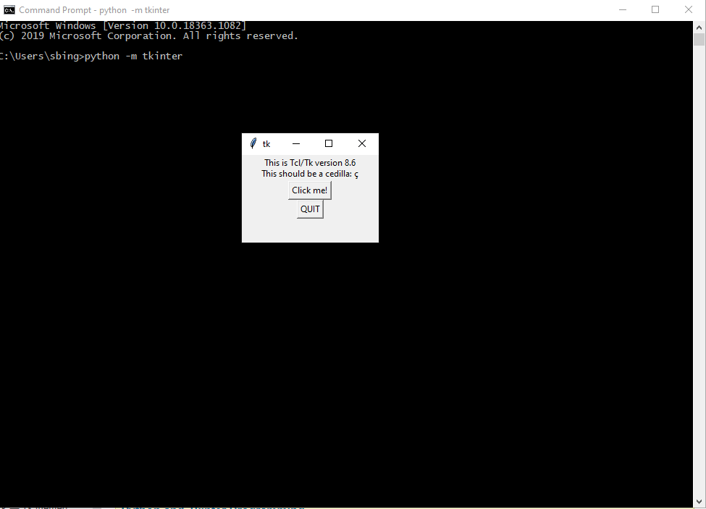
Verify Tkinter
python –m tkinter

Slide 7
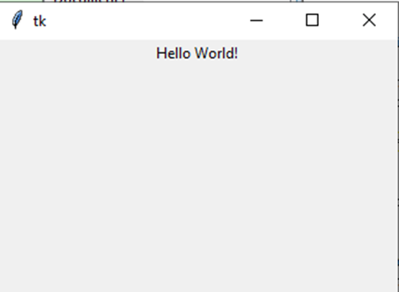
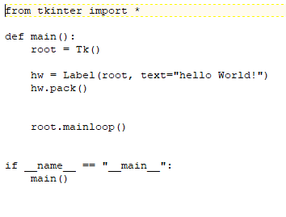
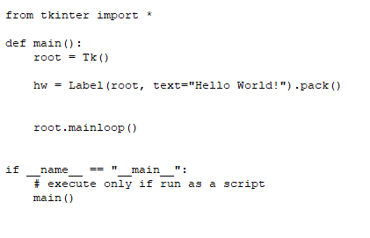
Hello World pack()

Slide 8
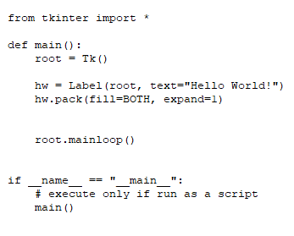
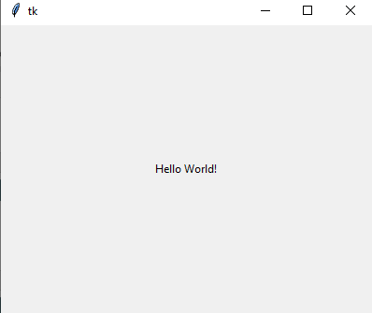
Hello World pack() Attributes

Slide 9
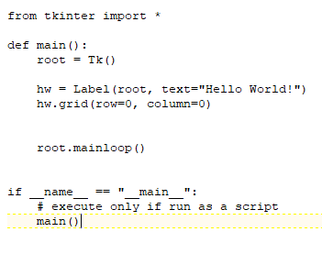
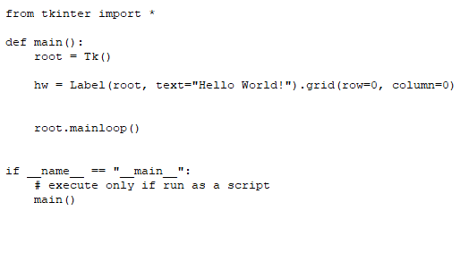

Hello World grid()

Slide 10
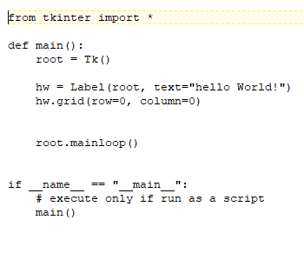
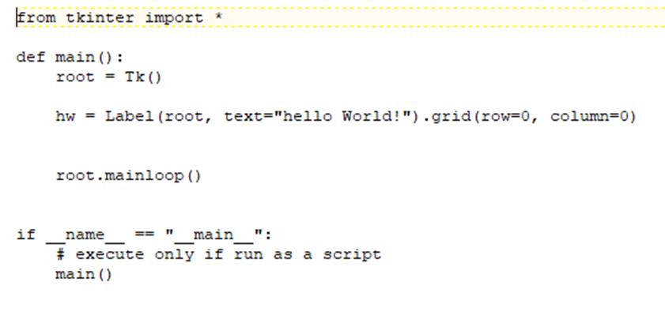
Hello World grid()

Slide 11
Tkinter Layout Managers Geometry Management
Pack (like Java Swing FlowLayout)
Put a widget inside a frame (or any other container widget), and have it fill the entire frame
Place a number of widgets on top of each other
Place a number of widgets side by side
Grid (like Java Swing GridLayout)
Screen set up in a row/column grid
More Flexible
Place – position based
You cannot mix layout managers
Exception – widgets inside a Frame or LabelFrame

Slide 12
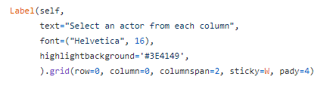
Placing widgets on the Screen
Define the widgets and its attributes first
Defines it in memory
Attach it to a layout manager
Places it on the screen

Slide 13
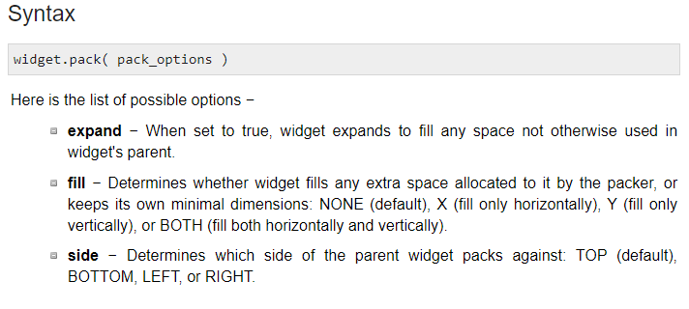
Pack Attributes
https://www.tutorialspoint.com/python/tk_pack.htm

Slide 14
Grid Attributes
Syntax
widget.grid( grid_options )
Here is the list of possible options −
column − The column to put widget in; default 0 (leftmost column).
columnspan − How many columns widgetoccupies; default 1.
ipadx, ipady − How many pixels to pad widget, horizontally and vertically, inside widget's borders.
padx, pady − How many pixels to pad widget, horizontally and vertically, outside v's borders.
row − The row to put widget in; default the first row that is still empty.
rowspan − How many rowswidget occupies; default 1.
sticky − What to do if the cell is larger than widget. By default, with sticky='', widget is centered in its cell. sticky may be the string concatenation of zero or more of N, E, S, W, NE, NW, SE, and SW, compass directions indicating the sides and corners of the cell to which widget sticks.

Slide 15
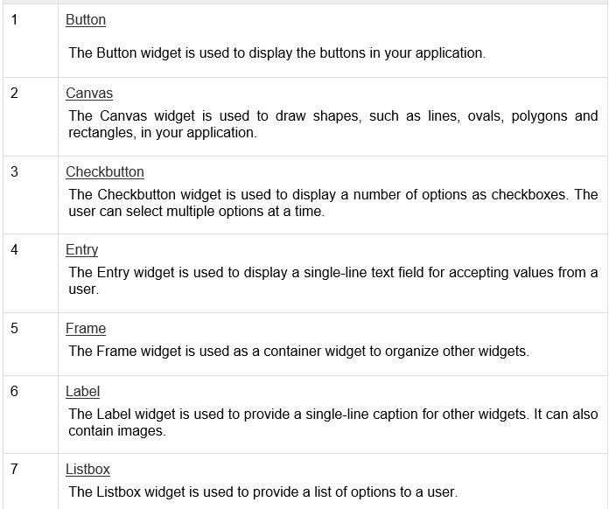
The Widgets

Slide 16
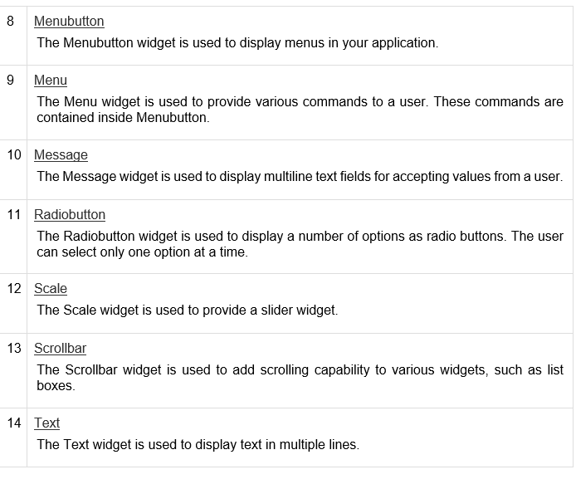
The Widgets

Slide 17
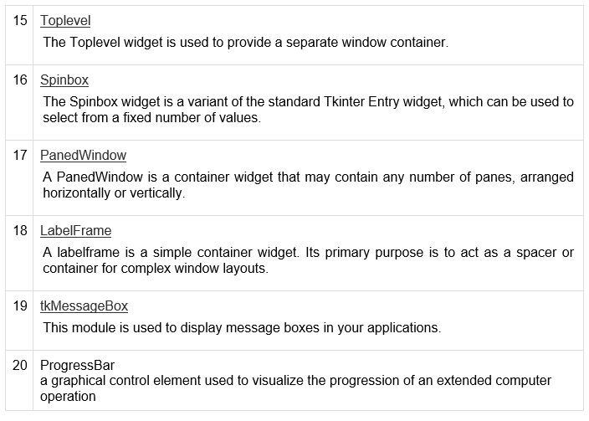
The Widgets

Slide 18
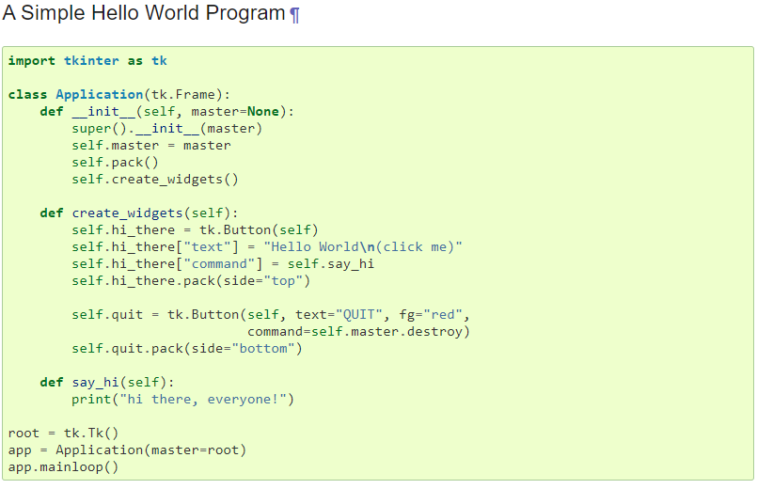
Tkinter as a Class
https://docs.python.org/3/library/tkinter.html#a-simple-hello-world-program

Slide 19
References and Tutorials
https://www.tutorialspoint.com/python3/python_gui_programming.htm
https://docs.python.org/3/library/tkinter.html#a-simple-hello-world-program

Slide 20
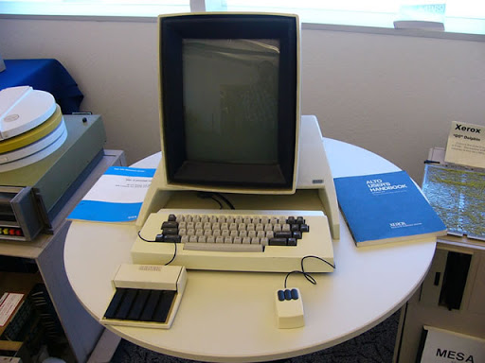
Questions Comments?

