Slide 1
Tkinter
“The little engine that could.”

Slide 2
Disclaimer
This presentation covers Tkinter and Tkk for Python 3

Slide 3
What is Tkinter?
Tkinter is a built-in python package that allows for the creation of a Python Graphical User Interface(GUI)
It is the antithesis of command level application development
Tkinter is the most popular python graphical User interface package

Slide 4
Additional Python Gui Packages
Kivy. Kivy is an OpenGL ES 2 accelerated framework for the creation of new user interfaces.
PyGame
PyQT. PyQT is one of the favoured cross-platform Python bindings implementing the Qt library for the Qt (owned by Nokia) application development framework.
Tkinter
WxPython
PyGUI
PySide
https://wiki.python.org/moin/GuiProgramming
https://techsore.com/best-python-gui/

Slide 5
Categories of Python Graphical Packages
Text Based
Tkinter
Plotting Based
matplotlib
Game based
Pygame
Multi-Platform Windows Unix Linux MacOS

Slide 6
Tkinter Identity Crisis
Tkinter is known by many names:
Tcl (pronounced as tickle)
Tk
Tcl/Tk
Tkinter
Tkk

Slide 7
Tkinter Installation
No pip, no brew, no ./configure, no make, no install, no coda
Tkinter is (sort of) built into Python
Managed by Active State
You can optionally install it to update or get the latest version
Verifying the installation
>>> import tkinter
>>> tkinter._test
You still need to import it as if it were an external package
from tkinter import *
from tkinter.tkk import * # for tkinter themes

Slide 8
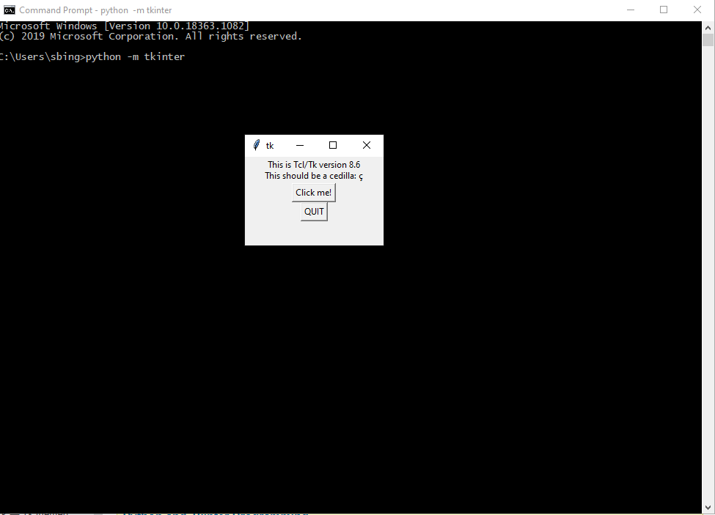
Verify Tkinter
python –m tkinter

Slide 9
Tkinter Processing Model
Import Packages
Create Root Window
Add Screen Widgets
Enter Main Loop

Slide 10
Tkinter Layout Managers Geometry Management
Pack (like Java Swing FlowLayout)
Put a widget inside a frame (or any other container widget), and have it fill the entire frame
Place a number of widgets on top of each other
Place a number of widgets side by side
Grid (like Java Swing GridLayout)
Screen set up in a row/column grid
More Flexible
Place – Absolute
place(x=20, y=20)
Most flexible
You cannot mix layout managers
Exception – widgets inside a Frame or LableFrame

Slide 11
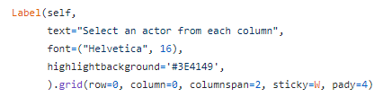
Placing widgets on the Screen
Define the widgets and its attributes first
Defines it in memory
Attach it to a layout manager
Places it on the screen

Slide 12
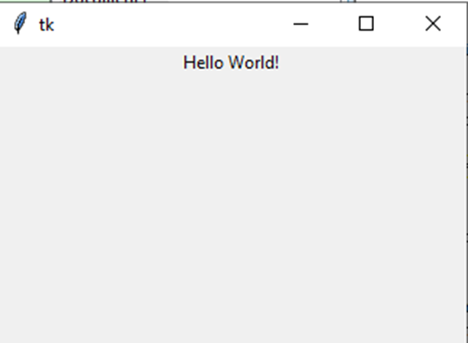
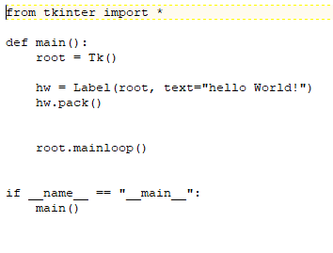
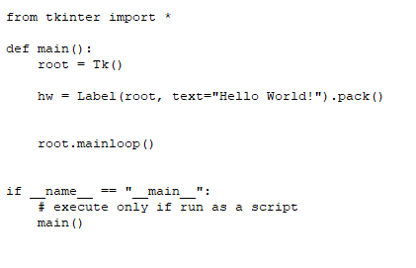
Hello World pack()

Slide 13
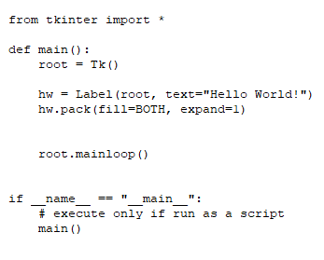
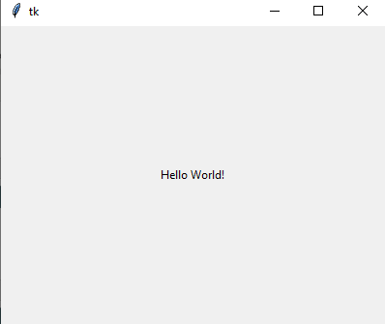
Hello World pack() Attributes

Slide 14
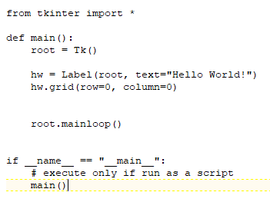
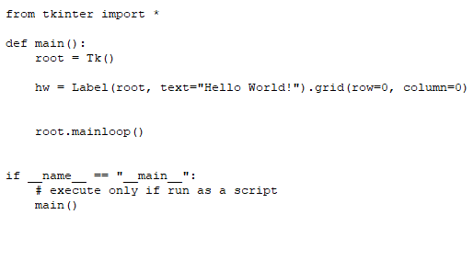

Hello World grid()

Slide 15
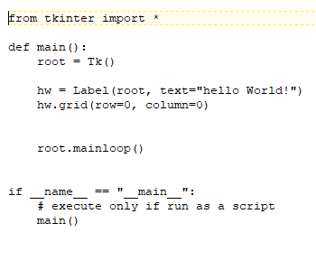
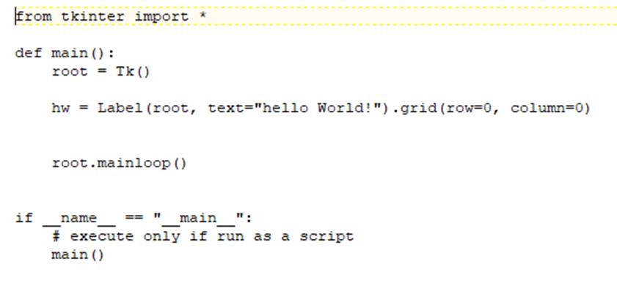
Hello World grid()

Slide 16
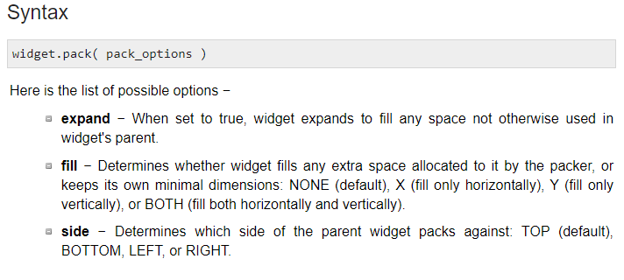
Pack Attributes
https://www.tutorialspoint.com/python/tk_pack.htm

Slide 17
Grid Attributes
Syntax
widget.grid( grid_options )
Here is the list of possible options −
column − The column to put widget in; default 0 (leftmost column).
columnspan − How many columns widgetoccupies; default 1.
ipadx, ipady − How many pixels to pad widget, horizontally and vertically, inside widget's borders.
padx, pady − How many pixels to pad widget, horizontally and vertically, outside v's borders.
row − The row to put widget in; default the first row that is still empty.
rowspan − How many rowswidget occupies; default 1.
sticky − What to do if the cell is larger than widget. By default, with sticky='', widget is centered in its cell. sticky may be the string concatenation of zero or more of N, E, S, W, NE, NW, SE, and SW, compass directions indicating the sides and corners of the cell to which widget sticks.

Slide 18
Two Classes of widgets
Classic
Tkk
Updated widgets
New widgets – Trees, ComboBoxes, Tabbed Notebooks, and more…
from tkinter import *
from tkinter.tkk import *

Slide 19
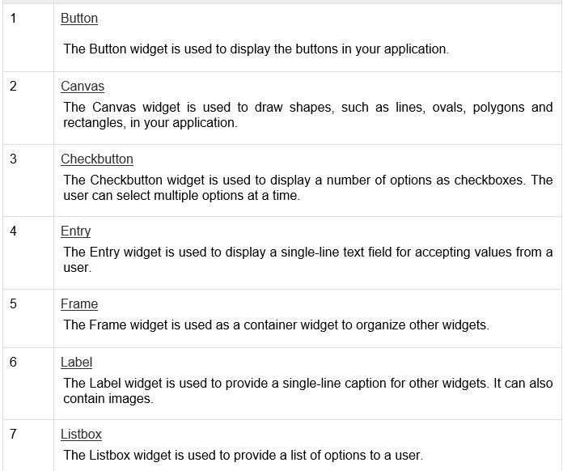
The Widgets

Slide 20
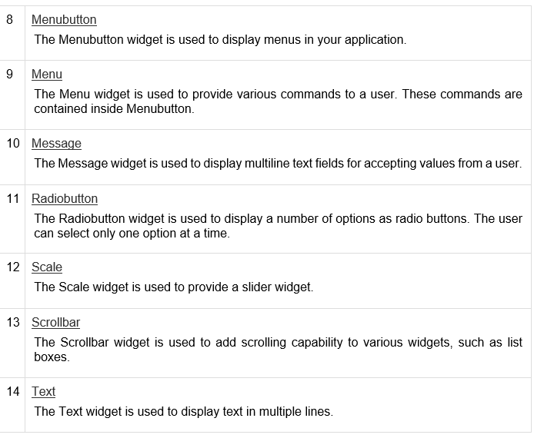
The Widgets

Slide 21
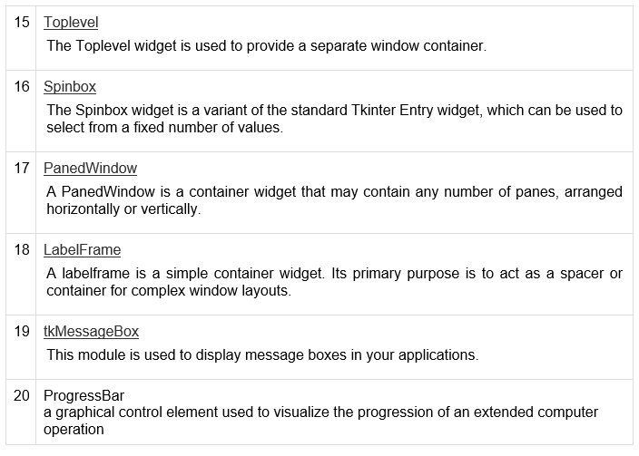
The Widgets

Slide 22
Tkk widgets
Combobox
Spinbox
Tabbed Notebook
Progressbar
Separator
Sizegrip
Treeview
Styles & Themes
http://tktable.sourceforge.net/tile/tile-tcl2004.pdf
https://docs.python.org/3/library/tkinter.ttk.html

Slide 23
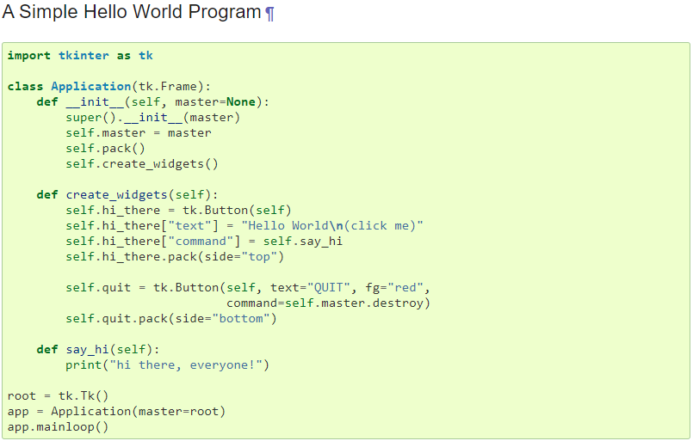
Tkinter as a Class
https://docs.python.org/3/library/tkinter.html#a-simple-hello-world-program

Slide 24
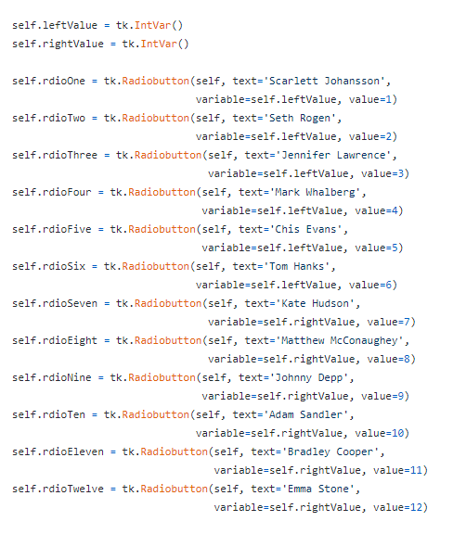
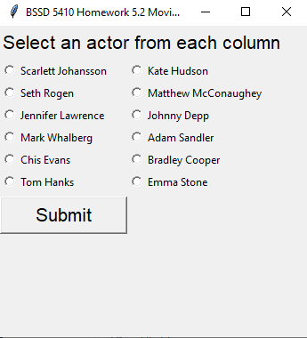
Var Classes
IntVar
StringVar
BooleanVar
FloatVar
DoubleVar

Slide 25
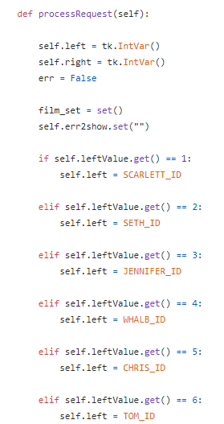
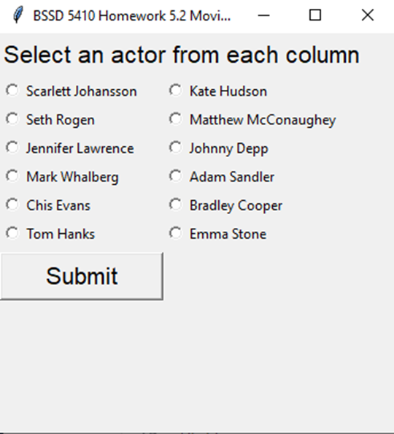
How to Respond to a Widget

Slide 26
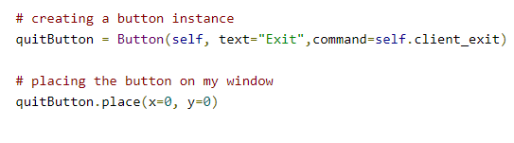
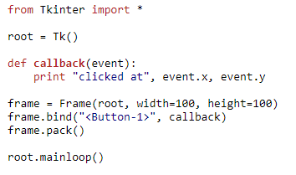
Event Handling
https://effbot.org/tkinterbook/tkinter-events-and-bindings.htm

Slide 27
Event Handling
KeyPress : Activated when a keyboard button has been pressed, the Key event can also be used for this. KeyRelease : Activated when a keyboard button is released. Button : Activated when a mouse button has been clicked. ButtonRelease : Activated when a mouse button has been released. Motion : Activated when the mouse cursor moves across the designated widget. Enter : Activated when the mouse cursor enters the designated widget. Leave : Activated when the mouse cursor leaves the designated widget. MouseWheel : Activated when the mouse wheel is scrolled. FocusIn : Activated when the designated widget gains focus through user input such as the mouse clicking on it. FocusOut : Activated when the designated widget loses focus. Configure : Activated when the designated widget's configurations have changes such as its width being adjusted by the user or its border being adjusted.
https://pythonprogramming.net/tkinter-tutorial-python-3-event-handling/

Slide 28
References and Tutorials
https://www.tutorialspoint.com/python3/python_gui_programming.htm
https://docs.python.org/3/library/tkinter.html#a-simple-hello-world-program
https://docs.python.org/3/library/tkinter.ttk.html

Slide 29
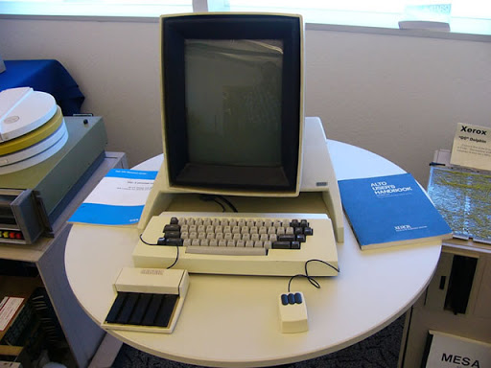
Questions Comments?

