Slide 1
Tkinter
“The little engine that could.”

Slide 2
Disclaimer
This presentation covers Tkinter and Tkk for Python 3

Slide 3
Tkinter Installation
No pip, no brew, no ./configure, no make, no install, no coda
Tkinter is (sort of) built into Python
Managed by Active State
You still need to import it as if it were an external package
from tkinter import *
from tkinter.ttk import * # for tkinter themes

Slide 4
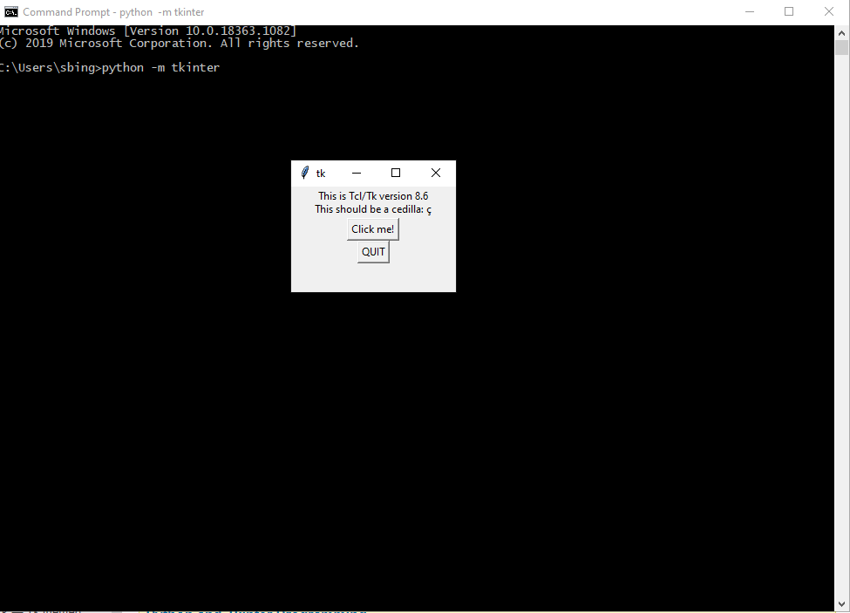
Verify Tkinter
python –m tkinter

Slide 5
Tkinter Layout Managers
Pack
Put a widget inside a frame (or any other container widget), and have it fill the entire frame
Place a number of widgets on top of each other
Place a number of widgets side by side
Grid
Screen set up in a row/column grid
More Flexible

Slide 6
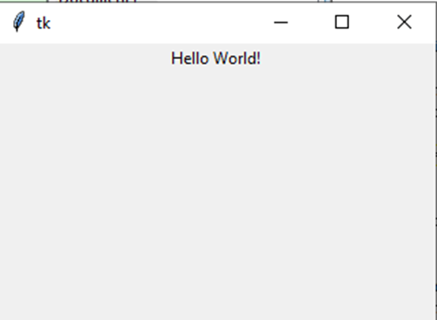
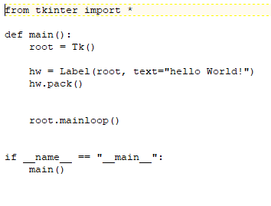
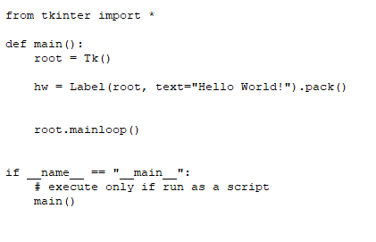
Hello World pack()

Slide 7
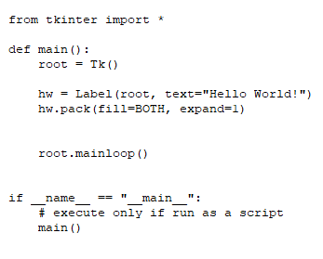
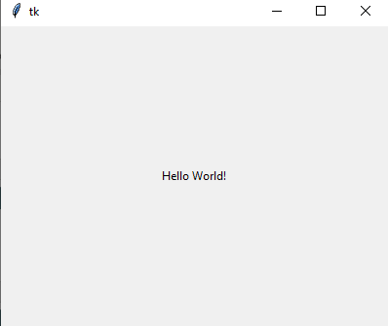
Hello World pack() Attributes

Slide 8
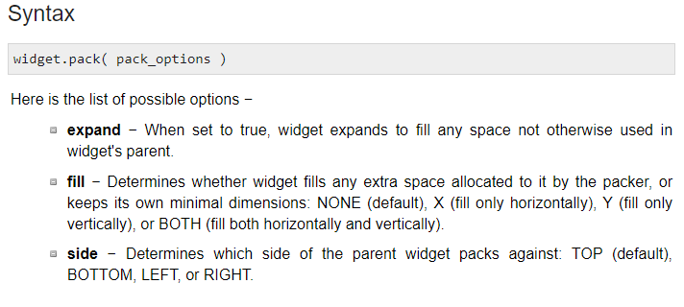
Pack Attributes
https://www.tutorialspoint.com/python/tk_pack.htm

Slide 9
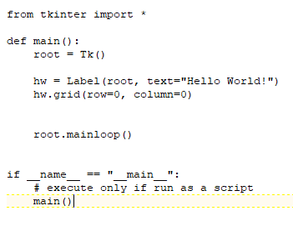
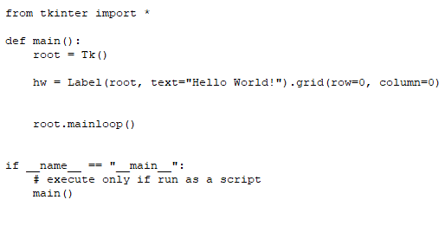

Hello World grid()

Slide 10
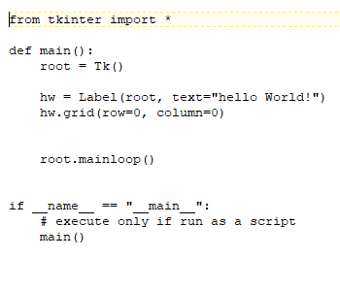
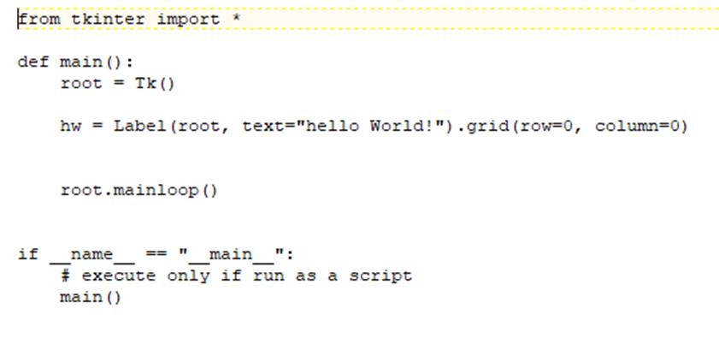
Hello World grid()

Slide 11
Grid Attributes
Syntax
widget.grid( grid_options )
Here is the list of possible options −
column − The column to put widget in; default 0 (leftmost column).
columnspan − How many columns widgetoccupies; default 1.
ipadx, ipady − How many pixels to pad widget, horizontally and vertically, inside widget's borders.
padx, pady − How many pixels to pad widget, horizontally and vertically, outside v's borders.
row − The row to put widget in; default the first row that is still empty.
rowspan − How many rowswidget occupies; default 1.
sticky − What to do if the cell is larger than widget. By default, with sticky='', widget is centered in its cell. sticky may be the string concatenation of zero or more of N, E, S, W, NE, NW, SE, and SW, compass directions indicating the sides and corners of the cell to which widget sticks.

Slide 12
label1.grid(sticky=E)
label2.grid(sticky=E)
entry1.grid(row=0, column=1)
entry2.grid(row=1, column=1)
checkbutton.grid(columnspan=2, sticky=W)
image.grid(row=0, column=2, columnspan=2, rowspan=2,
sticky=W+E+N+S, padx=5, pady=5)
button1.grid(row=2, column=2)
button2.grid(row=2, column=3)

Slide 13
Additional Python Gui Packages
Kivy. Kivy is an OpenGL ES 2 accelerated framework for the creation of new user interfaces.
PyGame
PyQT. PyQT is one of the favoured cross-platform Python bindings implementing the Qt library for the Qt (owned by Nokia) application development framework.
Tkinter
WxPython
PyGUI
PySide
https://wiki.python.org/moin/GuiProgramming

