Slide 1
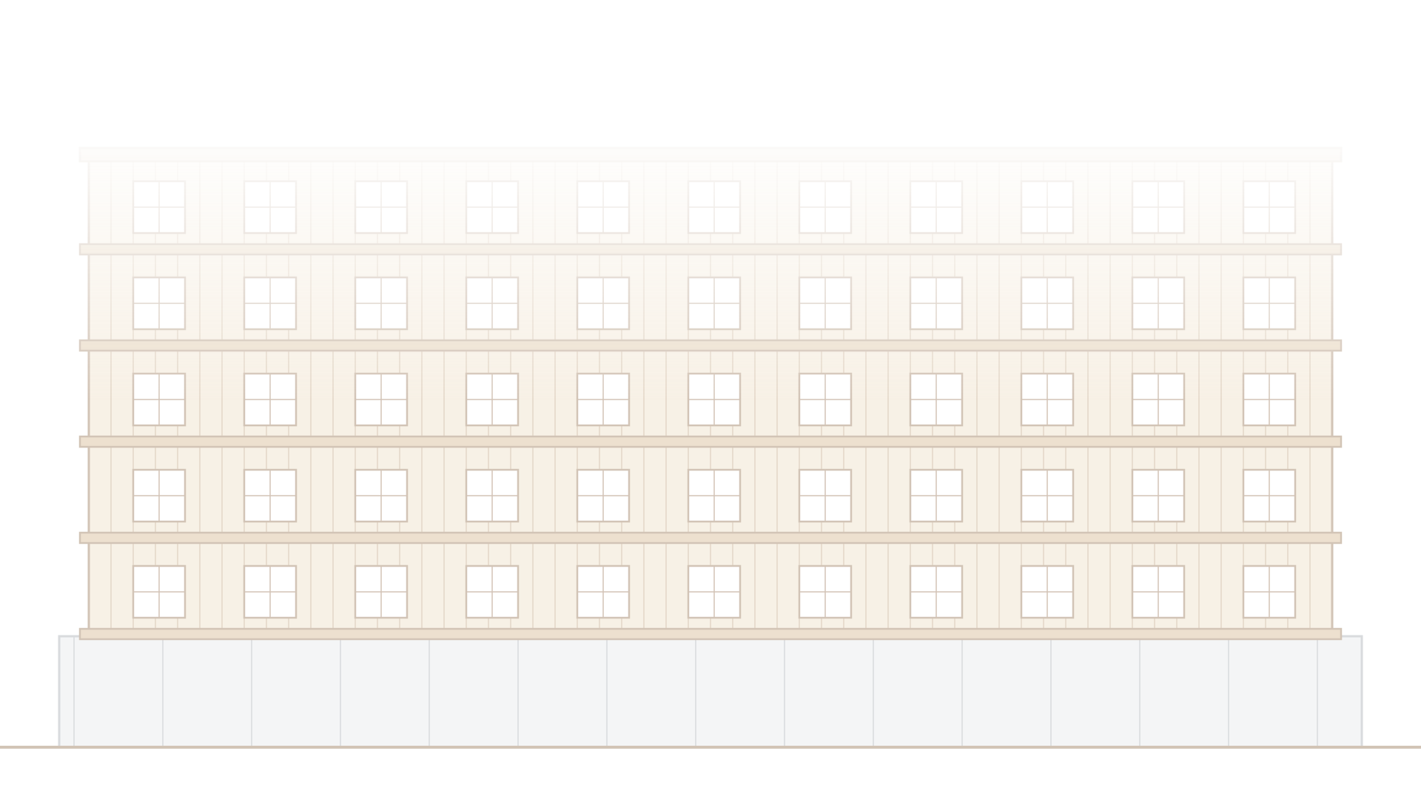
BigBuild: Light Frame Wood Shear Walls
An explainable shear-wall design tool for the NCSEA Big Build Hackathon

Slide 2

The project
Engineers designing multi-story multifamily buildings often work through shear-wall stacks with hand calculations and spreadsheets.
We want to explore a Python app that makes those calculations visible, checks individual components, and shows how design assumptions affect the results.
Prototype only: results need validation against selected references and engineering review before project use.

Slide 3
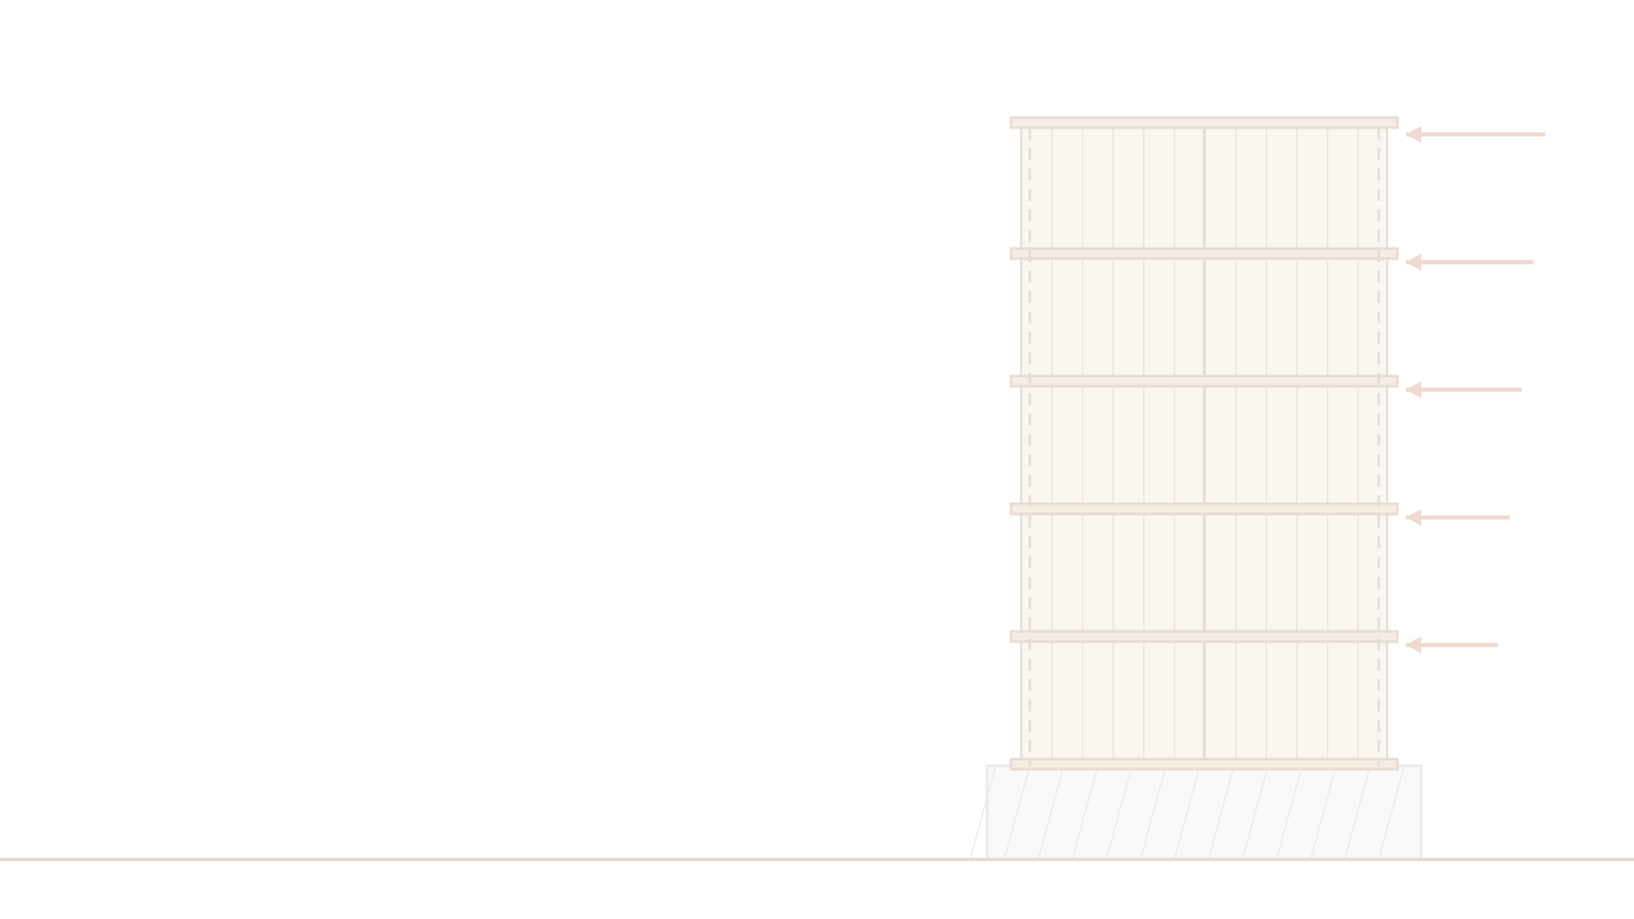
Hackathon goal
A Python prototype for one five-story stack of vertically aligned, solid wood structural panel (WSP) shear walls without openings
Start from applied seismic story loads
Show component-by-component checks and calculated story drift
Make every result traceable: inputs, units, assumptions, intermediate results, and reference citations
Components: sheathing, boundary studs/posts in compression and tension, hold-downs or continuous tie-downs, and stack connections

Slide 4
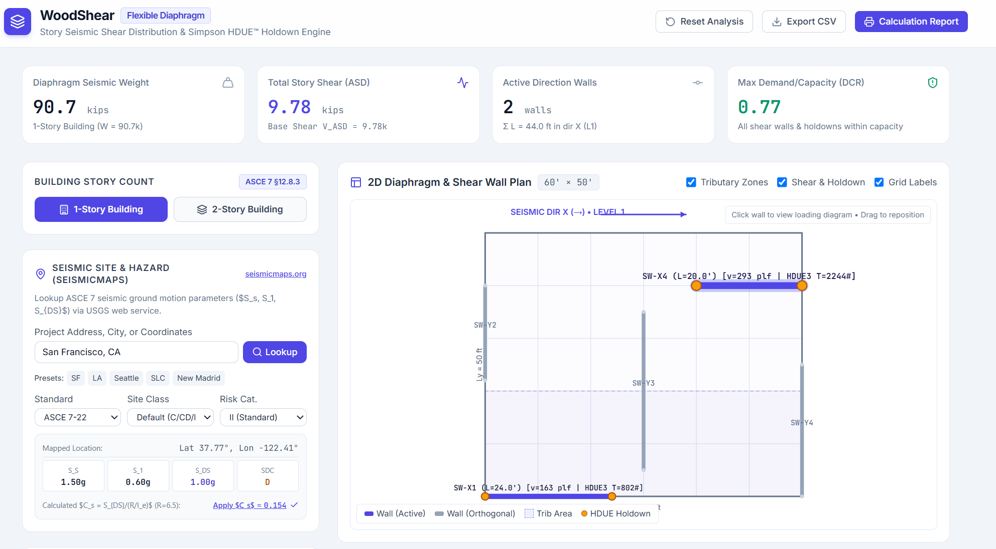
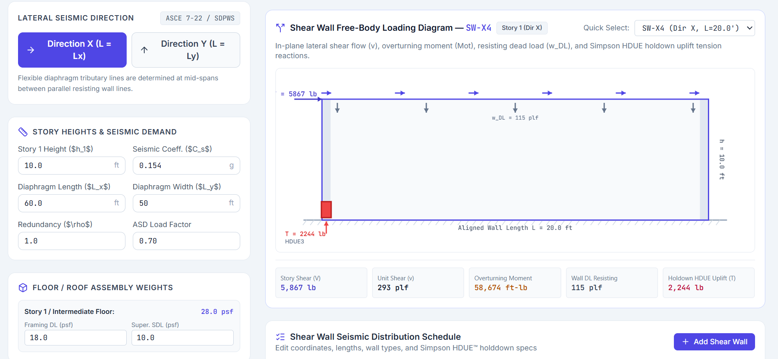
Interactive Shear Wall Design
Free-body diagram with story inputs and results
Plan view with tributary zones and holdowns

Slide 5
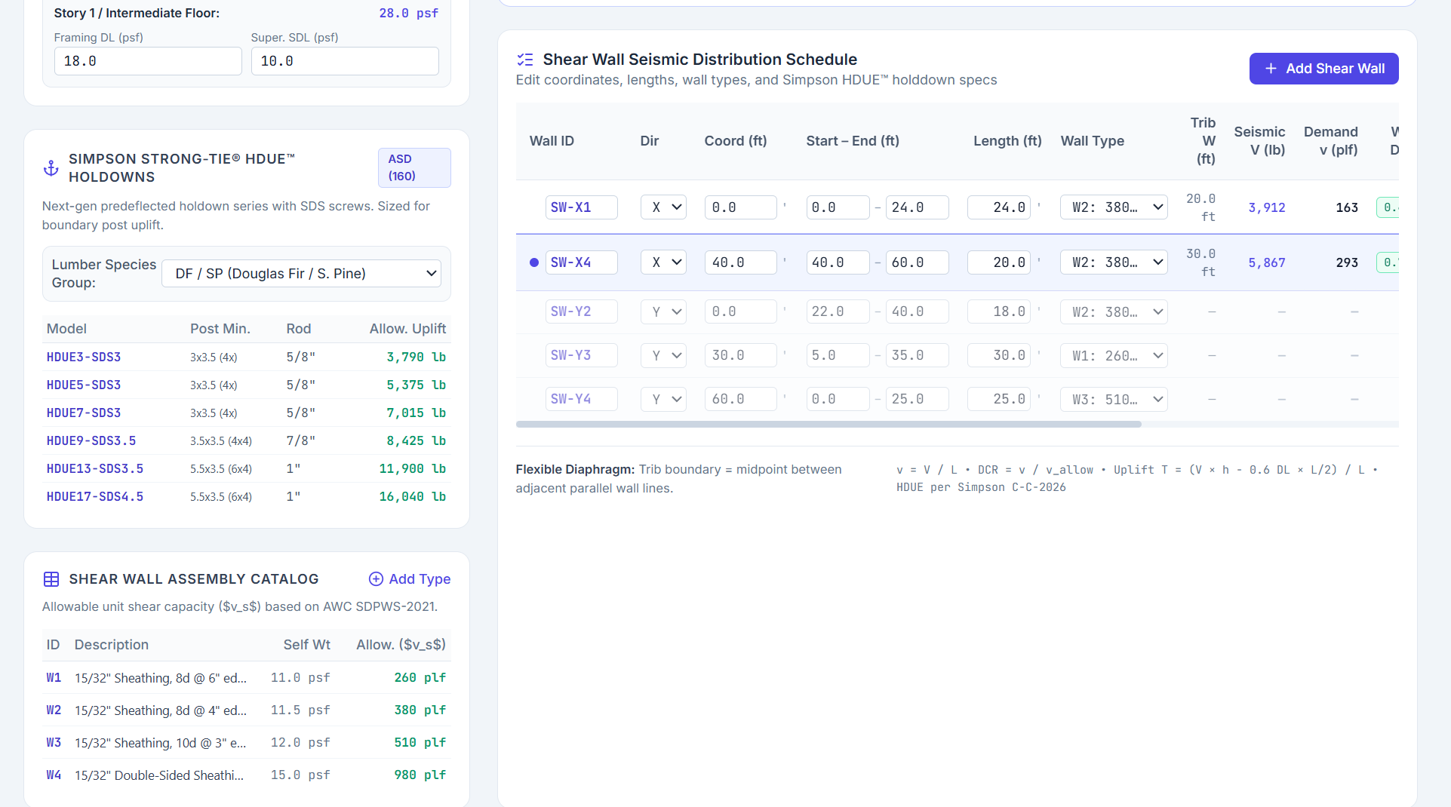
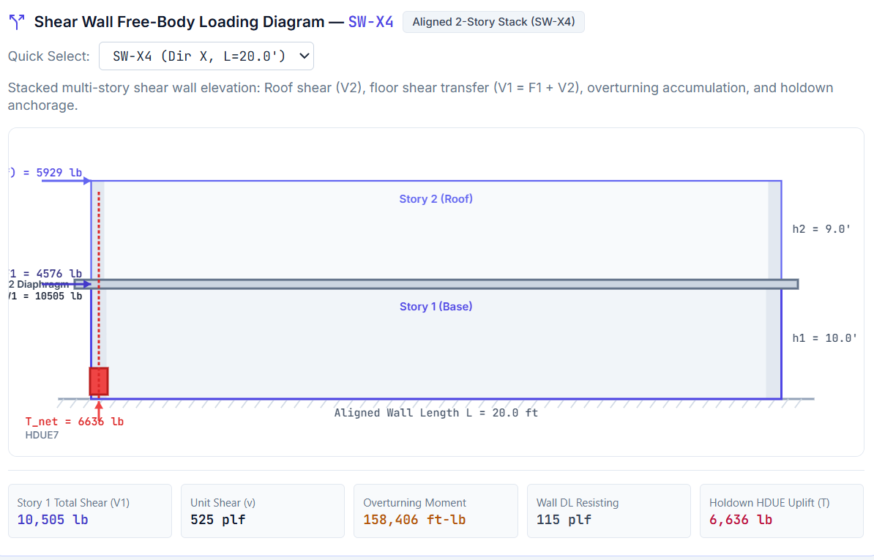
Interactive Shear Wall Design, continued
Wall schedule, holdown table and assembly catalog
Aligned two-story stack with accumulated overturning

Slide 6

Engineering basis
Standards: IBC 2024, SDPWS 2021, NDS 2024, ASCE 7-22; CBC is out of scope
Edition differences between a worked example and this basis are recorded, never silently treated as equivalent
OpenSeesPy is an installed candidate engine; it does not supply wood design provisions
Decided at the event: wall idealization, load conventions, boundary conditions, drift treatment, component checks, and acceptance tolerances

Slide 7
Reference examples
WoodWorks five-story light-frame wood structure over podium (2nd ed., Nov 2025): §3.3 shear wall design and §3.4 drift are the candidate benchmark starting point
WoodWorks cantilever wood diaphragm (updated May 2026): wall stiffness, rigid diaphragm force distribution, and drift context; not a five-story benchmark
Both PDFs are in the repo with the owner's confirmation of distribution permission
Licensed standards stay outside the repository

Slide 8
How the repository is organized
src/analysis/ structural model and response calculations
src/design/ component checks and reported calculation steps
src/ui/ user interface; Streamlit is available
tests/ engineering benchmarks and regression tests
references/public/ documents with confirmed redistribution permission
tools/ generic environment verification
No application code or engineering benchmark exists yet; it is built at the event

Slide 9


Team
Scott Breneman
Dago DeLaRosa
Project owner
Samantha Joyce
Alex Bonnar
Vince LaCoste
Sam Martin

Slide 10
Team, continued
Aidan Anderson
Hamid Khodadadi
Garret Mills
Miles Bennet

Slide 11



Project Links
BigBuild-LFW-Shearwalls
GitHub repository
github.com/scottbreneman/BigBuild-LFW-Shearwalls

