Slide 1
Multi-Region Expansion Strategy – “Blockchain Solutions Inc.”
Scott Buckel – SRE Case Study 5/20/2025

Slide 2
Problem Summary
All infrastructure is located in a single region, eu-west-1
Active and dormant service pairs, but failover is manual and error-prone
All infrastructure is managed via a single terraform repository
Terraform apply is executed manually by engineers, often times without any peer review
Increases risk of errors and configuration drift
There is minimal deployment automation

Slide 3
Objectives of Expansion
Ensure services are globally available
Support disaster recovery and failover
Enable scalable and consistent infrastructure across multiple regions
Improve automation, observability, and most importantly - reliability

Slide 4
High Level Architecture (text version)
Multiple AWS regions: eu-west-1 and adding us-east-1 for now
Route 53 latency-based routing between regional ALBs
Stateless services – active/active
EKS clusters in both regions running stateless services
Microservice with DynamoDB (global table) backend to coordinate if region is active
Stateful services – active/passive
Microservice with DynamoDB (global table) backend to coordinate which region should be active for the stateful service
Terraform workspaces to manage multi-region consistency
Monitoring via Datadog
Anti-affinity enabled for all service to enforce pod distribution across availability zones

Slide 5
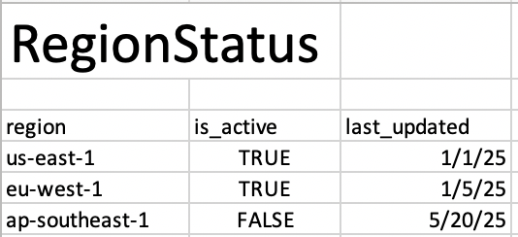
region-status microservice (stateless)
Stateless services
Simple on/off switch for each stateless service in a region-agnostic format. Ideal for services in active/active mode but can also help with coordinating deployments. This can be used to shut down an entire region for both stateless and stateful services.
Table Name:
RegionStatus
Attributes:
region
is_active
last_updated
Healthcheck Endpoint
GET /status/:region

Slide 6
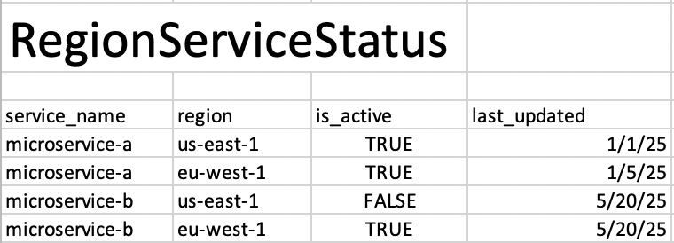
region-status microservice (stateful)
Stateful services:
Tracks per-region status for individual services that are active/passive
Table Name:
RegionServiceStatus
Attributes:
service_name
region
is_active
last_updated
Healthcheck Endpoint:
GET /status/:service/:region
Healthcheck would also check the microservices healthcheck (eg: http://servicename:8080/actuator/health)
Bonus: A service can be active in multiple regions if desired and not in others

Slide 7
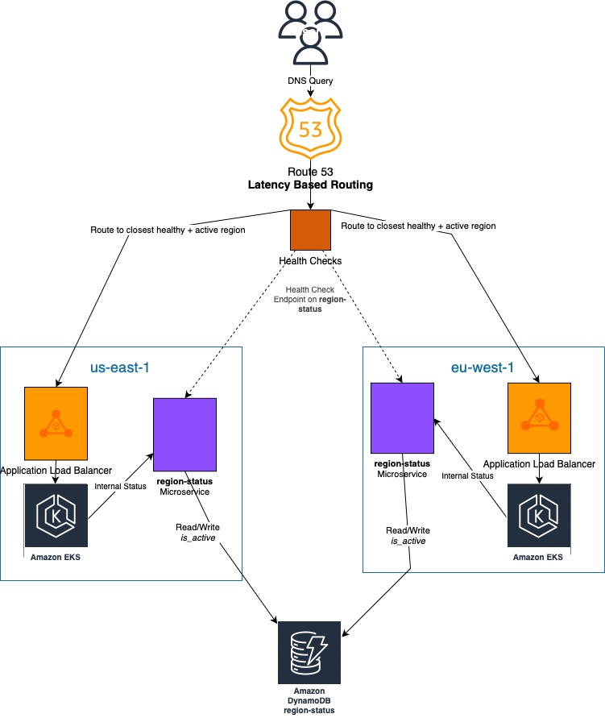
Multi Region
Architecture
(inside of eks)
(inside of eks)

Slide 8
Stateless Services Architecture
Deployed to all regions, in active/active mode
Route53 Latency based routing will route traffic to the closest healthy region
Kubernetes HPA, cluster-autoscaler for load spikes

Slide 9
Stateful Services Architecture
Optionally deployed to all regions
We always have the option to deploy service and keep service scaled down to 0 pods – this should give us faster reaction time in case of disaster
Route53 Latency based routing will route traffic to the closest healthy region
Kubernetes HPA, cluster-autoscaler for regional load spikes
More research is needed: how do we stay in sync when a failover will need to happen? How important are these services? Do they need to stay in sync 24/7, or can there be a few minutes of downtime.

Slide 10
Deployment Process
Repository changes
Individual AWS services will each have their own git repositories
tfe-eks for eks
tfe-storage for s3 buckets and databases (DynamoDB)
tfe-route53 for Route53 Setup
Changes require peer approvals
Terraform changes
Terraform Enterprise self-hosted
Developers can no longer run `terraform apply` locally
Multiple terraform workspaces and .tfvars files for the unique environment
Adopt GitOps
No manual CI/CD scripts to build deploy services. Services are built upon merge to release branch.
CD stages for dev->staging->prod with manual gates and quality checks in between. This supports gradual deployments.
Centralize Helm Management
Shared standard helm charts across services
Post deployment checks
Datadog for monitoring

Slide 11
Disaster Recovery
If an entire region or microservice is down:
Healthcheck would fail, automatically moving traffic to the healthy region.
If Stateful services only have one region configured (this will be the most likely scenario when a stateful service goes down):
We update RegionServiceStatus table to move the traffic to the new region
If entire region or microservice is misconfigured:
Update DynamoDB record in RegionStatus/RegionServiceStatus table to take entire region offline
Estimated time to resolve: 5 minutes (limited by TTL of the Route53 Record)
Monitoring:
A Lambda could automatically trigger adjusting the active region for a passive service, including syncing the data if necessary

Slide 12
Observability and Monitoring
Leverage Datadog for logging, monitoring, and observability, including APM
It can tell us if one region is acting much slower than another region
It can tell us if a new version of a service has higher response times, error rates, or resource usage. In the past I’ve actually seen this save money in the long run
We can correlate logs with stack traces when things go wrong
SLO/SLI/SLA
Datadog will help us define and monitor these metrics – potential options are latency, error rates, availability, etc. For example: 99.99% availability, 200ms latency for 95% of requests
Different regions could have different SLO’s (in developing countries, requests could take longer?)

Slide 13
Tradeoffs
COST
Spinning up a new active/active region doubles the cost of EKS
Datadog monitoring and alerting is great, but comes with cost
Explanation to management: “Increase in cost is justified by the significant improvement in reliability, DR capabilities, and global user experience which directly impacts business continuity”
COMPLEXITY
Managing the new infrastructure is much more complicated than managing one cluster
Adding a new microservice to maintain
SPEED
These changes could initially slow down developer velocity, as a tradeoff for reliability and consistency
Developers won’t be able to `terraform apply` or `helm install` or `helm upgrade` anymore. This will be handled in CI/CD Pipelines.
Eventually, with robust documentation, clear guidelines, automation for common deployment patterns, new developers will be able to dive right in.

Slide 14
Timeline and Roadmap
Phase 1
Terraform changes for Infrastructure – TFE, separate repositories, workspaces
CI/CD change for Services, including a centralized helm management
In parallel, devs will build region-status microservice
Phase 2
Deploy Route53 and point it to ALB->K8s
Deploy DynamoDB
Deploy second cluster, deploy microservices to it
Phase 3
Update Route53 to point to both regions with region-status as the healthcheck

Slide 15
Questions?
From me:
How will stateful services stay in sync? It wasn’t mentioned. I’m not sure what stateful services will be.
Will stateful<-->stateless services need to communicate?

