Slide 1
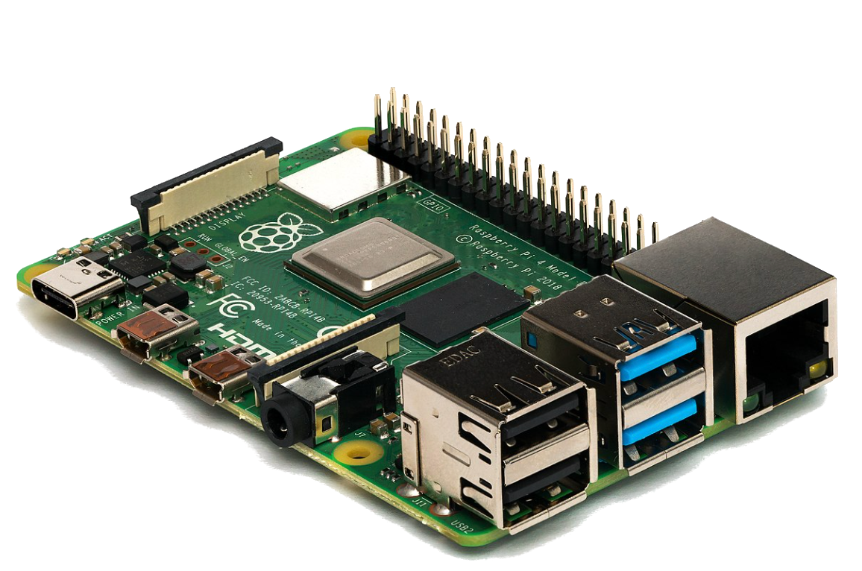

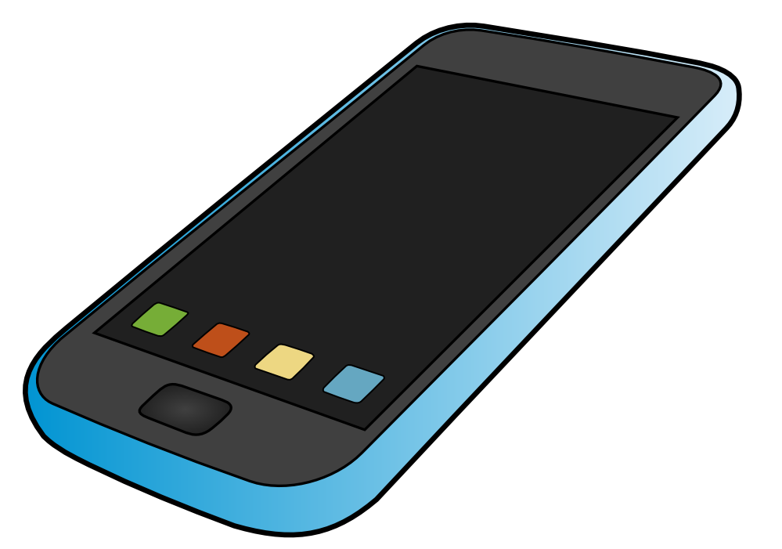
Boat network components using Pistol DDS
Compass
(pistol DDS)
Rudder Control
(pistol DDS)
Autopilot
(pistol DDS)
AIS
(pistol DDS)
Rudder Position
(pistol DDS)
Console
(pistol DDS)
Console
(pistol DDS)

